Slide 1
Toward a theory of timing effects in self-organizing sentence processing
Garrett Smith & Whitney Tabor
<Uconn, IGERT, IBACS, & Haskins logos>
Notes:
Today, talk about a new self-organizing framework for human sentence processing from which we can derive predictions about processing times for comp. and prod.
Transition: The traditional approach to sentence processing is that the mind takes a string of words and tries to provide a structural/syntactic analysis that affords semantic interpretation

Slide 2
NComp
Det
Subj
PObj
Det
The
coach
smiled
at
the
player
Notes:
In many theories, it is assumed symbolic grammar supervises parsing process (start intro’ing words)
As go along, new dependencies/structures are intro'd according to what is possible given the symb. gramm.
Parser posits only gramm. Structs.
This is plausible for simple, grammatical sentences this sentence, but not all sentences are as simple and easy-to-process as this one
(for tricky-to-process or less-than-perfectly grammatical ones, there is evidence that people sometimes entertain ungramm.)

Slide 3
Grammaticality & processing
Grammatical: The coach smiled at the player
Ungrammatical: *At smiled coach player the the
Ungrammatical but interpretable: ?The coach smile at player
Tricky to process:
The coach smiled at the player tossed the frisbee
The horse raced past the barn fell
Symbolic theories → all and only the grammatical strings in a language, struggle with intermediate cases (Rizzi XXXX)
Notes:
Word sequences with a clear grammatical structure are not the only ones we encounter
(Next bullet): and others ungrammatical (next) and some interpretable but not so great
Others are grammatical but hard to process
Transition: traditional approaches to language processing assume the mind has to find a grammatical structure that fits with the words it encounters

Slide 4
A challenge for grammar-supervised theories
The coach smiled at the player (who was) tossed the frisbee
The coach smiled at the player (who was) thrown the frisbee
…the player tossed… is locally coherent, but should be ruled out in this context because prepositions can’t take whole clauses as complements
Tabor et al. (2004) observed slowed processing at tossed but not at thrown, suggesting people are entertaining the ungrammatical parse
Grammar-supervised theories struggle because they cannot entertain ungrammatical structures
Notes:
Seems to require entertaining ungramm. structures (Konieczny 2005)

Slide 5
NComp
PObj
Det
RelCl
…smiled
at
the
player
thrown
NComp
PObj
Det
RelCl
…smiled
at
the
player
tossed
Notes:
Visually step through parsing process under grammar-controlled theory, e.g., surprisal but with dep. grammar
Show how it works for simple sentence
Explain that proc. cost comes from having to make big changes to your beliefs about sent. struct.

Slide 6
Self-organized sentence processing (SOSP)
Instead of assigning symbolic structures, we use a gradient dynamical system to build structures via optimization of local constraints
This general approach is not new (Kempen & Vosse, 1989; Smith, Franck, & Tabor, 2018; Stevenson, 1994; Tabor & Hutchins, 2004; Vosse & Kempen, 2000, 2009; van der Velde & de Kamps, 2006)
Many previous studies fail to account for how long it takes to process a structure, one of the main sources of psycholinguistic data
Our framework provides a simple way of building a dynamical parser that incorporates ungrammatical structures and allows us to make timing predictions
Notes:
So, what does this look like?

Slide 7
Parsing via hill-climbing
Peaks correspond to structures
Harmony (degree of well-formedness/feature match) given by height of peak
Dynamics drive the system uphill to maximize harmony based on local constraints between words
Notes:
We build a high-dimensional landscape where the peaks correspond to well-formed and ill-formed structures (blue dots).
The height of a peak corresponds to how well-formed it is, i.e., how well all of the features in the structure mesh.
Processing consists of turning lexical features, placing the system away from a structure
The system’s dynamics then drive up, trying to maximize the harmony of the structure it builds
Transition: local constraints between what?

Slide 8
Notes:
Highlight: feature vectors, fact that all possible interactions are entertained
Only rule out links within a treelet and circular link patterns
Treelets compete with each other to form multi-word structures according to degree of feature match
Transition: visual/intuitive, now I’ll quickly go through the equations to show how we can derive processing time predictions

Slide 9
Goal
Self-organizing theories can account for local coherence effects by allowing the system to entertain the ungrammatical parse
Prev. SOSP models acct. for lots of important parse-formation phenomena, but few results on timing
Our goal: sent. proc. framework that incorporates ungrammatical states (integrated w/ well-motivated theory of ungrammaticality) and from which we can derive both parse-formation rates and timing predictions

Slide 10
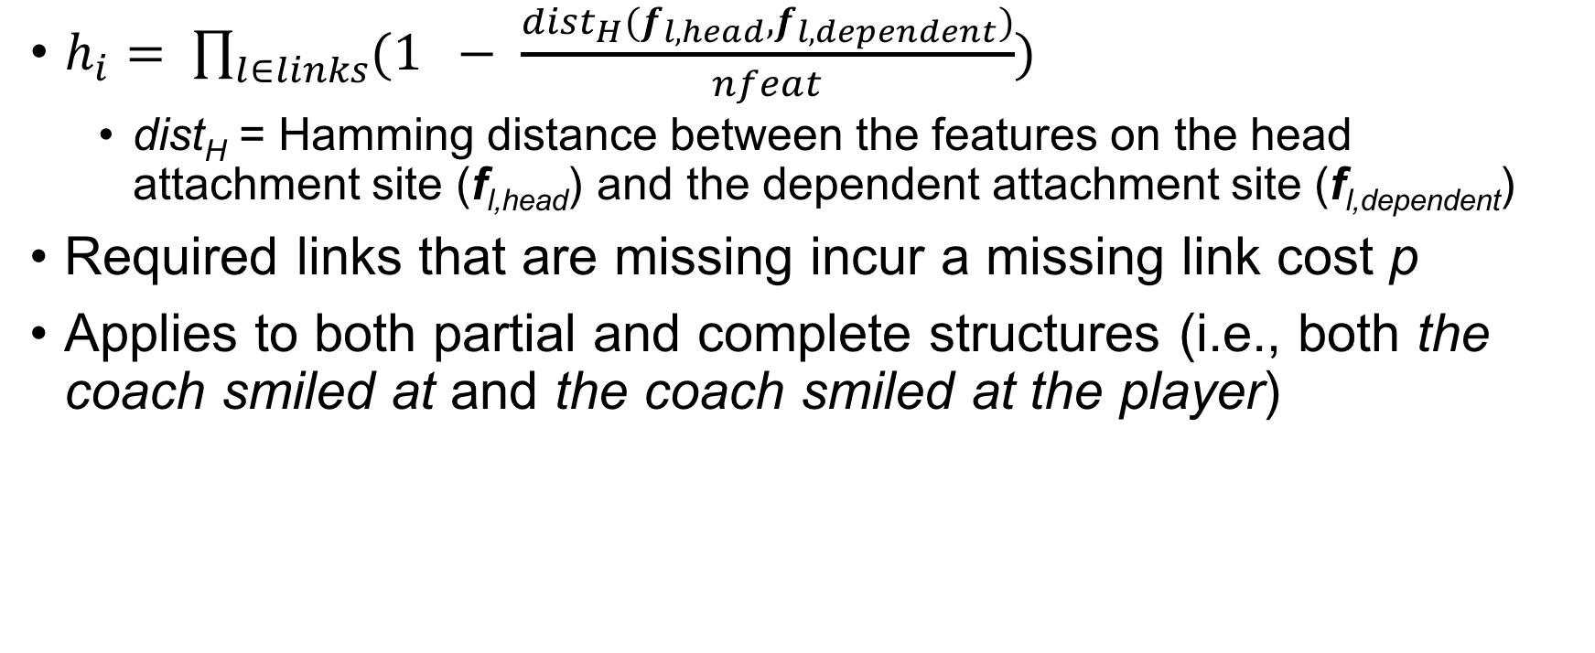
Feature match: local harmony
$h_{i}= \prod_{l∈links}{(1 − \frac{dist_{H}(f_{l, head}, f_{l,dependent})}{nfeat})}$
dist_{H} = Hamming distance between the features on the head attachment site (f_{l,head}) and the dependent attachment site (f_{l,dependent})
Required links that are missing incur a missing link cost p
Applies to both partial and complete structures (i.e., both the coach smiled at and the coach smiled at the player)
Notes:
This is a measure of how well the features match between linked attachment sites
Provides graded approach to grammaticality, improving on purely symbolic accounts

Slide 11
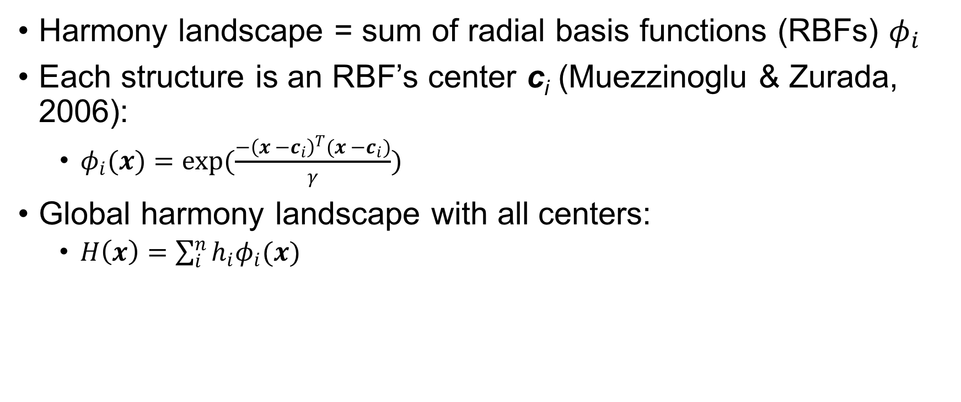
Harmony landscape
Harmony landscape = sum of radial basis functions (RBFs) $φ_{i}$
Each structure is an RBF’s center c_{i} (Muezzinoglu & Zurada, 2006):
$φ_{i}(x)=exp(\frac{−{\left(x −c_{i}\right)}^{T}(x −c_{i})}{γ})$
Global harmony landscape with all centers:
$H\left(x\right)=\sum_{i}^{n}{h_{i}φ_{i}(x)}$
Notes:
Note superficial similarity to multivariate normal distribution: we could have chosen other equations; these are just convenient.

Slide 12
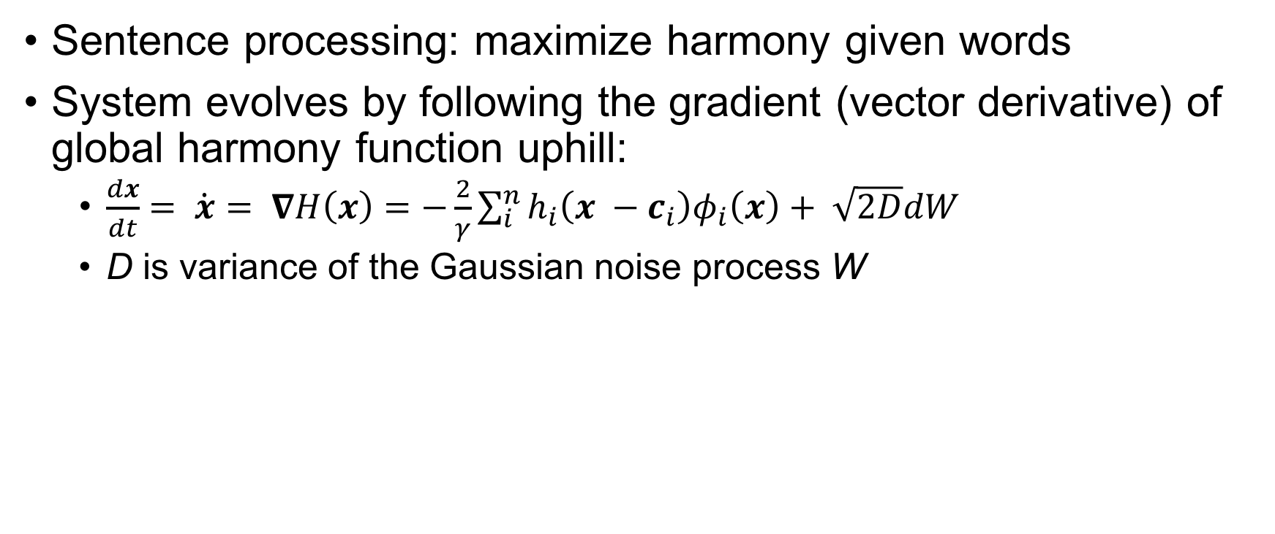
Dynamics
Sentence processing: maximize harmony given words
System evolves by following the gradient (vector derivative) of global harmony function uphill:
$\frac{dx}{dt}= \dot{x}= ∇H\left(x\right)=−\frac{2}{γ}\sum_{i}^{n}{h_{i}\left(x −c_{i}\right)φ_{i}\left(x\right)}+ \sqrt{2D}dW$
D is variance of the Gaussian noise process W

Slide 13
Dynamics II
Harmony maxima of H are attractors of the dynamics, points to which the system returns after a small perturbation (Strogatz, 1994; Smith, 2018)
Given some initial condition, the system will settle toward a harmony maximum (modulo the effects of the noise)
In the implementation, the system settles until it is within some distance tol of an attractor

Slide 14
Processing
Reading/producing a word turns on its features, displacing the system away from an attractor
Noisy dynamics drive uphill until close enough to an attractor
Then, next word is processed
Notes:
Reading or producing a word turns on its features at a particular point in the sentence
This initial condition is not close to an attractor, so the harmony is low
The noisy dynamics push the system uphill to make a more well-formed structure
Once the system is within tol of an attractor, the next word is produced or read

Slide 15

Processing times: Individual trials
Near the i-th (partial) structure, the pull of other structures is small
Thus, the dynamics are approximately $\dot{x}≈−\frac{2h_{i}}{γ}\left(x −c_{i}\right)φ_{i}(x)$
Settling time proportional to attractor’s local harmony h_{i}

Slide 16
Processing times: Many trials
Over many trials, the system will choose different attractors due to the noise
In general, the attractors will have different harmonies, so the average processing time will be the average of processing times to each attractor weighted by how often that attractor is chosen

Slide 17
Processing times: the whole picture
The time to build a structure is proportional to its harmony
Average processing time is weighted average of settling times to different attractors
Final effect on times: soft deflection
Trajectories get bowed toward high-harmony structures, even if the system eventually settles on some other attractor
<FIGURE?>

Slide 18
Applying the model to local coherence
Simplifying assumptions:
System has already read The coach smiled at the player tossed/thrown
Now it has to settle on a structure (which link forms)
Most relevant structures (and the only two attractors): attach player as subject of tossed/thrown or attach tossed/thrown as modifier of player
Notes:
Add in blurb about first published model of LC? Prob. in conclusion/discussion

Slide 19
Back to local coherence
NComp
Subj
PObj
Det
RelCl
…smiled
at
the
player
thrown
NComp
Subj
PObj
Det
RelCl
…smiled
at
the
player
tossed
Notes:
Simplifying assumptions in model: already ready up to player
Just need to decide on structure
Two options: either player → participle or participle → player

Slide 20
Results
Processing times
Tossed condition: M = 159.073, SD = 27.692
Thrown condition: M = 149.794, SD = 24.698
Parse distributions
Tossed condition: 14% of runs → locally coherent parse
Thrown condition: < 1% of runs → locally coherent parse
Parameters in extra slides
Notes:
Fig. shows state space w/ noiseless traj.; note soft deflection for tossed
First published model of local coherence effects
Somehow quickly discuss how we might account for the interaction…

Slide 21
Discussion
In SOSP-TH, local coherence effects arise because a relatively good but still ill-formed competitor slows processing more than a very bad competitor (the former is built more often, driving average processing times up)
Grammar-supervised theories (e.g., Levy et al. 2009) can explain the Tabor et al. (2004) effects by assuming the input is noisy (the coach smiled at the player tossed… → the coach smiled and the player tossed…), however this fails for other cases of local coherence (Paape & Vasishth, 2015; see discussion in Kukona et al., 2014)
Notes:
Results from a single set of params; what does the rest of para. space look like?

Slide 22
Exploring parameter space
For low- and very high-harmony competitors, processing times are fast
Determined by proportion of runs settling to the lower-harmony parse
Local coherence effects as long as 0 <= h_{1,thrown} < h_{1,tossed} < 0.8
Notes:
Plotted are means from 100 runs/point
Similar pattern holds while simultaneously manipulating gamma
Transistion: but what if h₁ is > 0.8? We argue that this is relevant to another tricky sent. proc. effect, the ambiguity advantage

Slide 23
The ambiguity advantage
The son of the driver with the mustache was pretty cool read faster than the car of the driver with the mustache and the driver of the car with the mustache (Traxler et al., 1998)
→ Ambiguous sometimes faster than unambiguous
A challenge for competition-based models like SOSP-TH
But SOSP-TH’s nonlinear relationship between processing times and competitor strength might offer an explanation
Notes:
Walk through examples carefully

Slide 24
Conclusion
SOSP-TH offers a transparent relationship between parse harmony and processing times (in contrast to previous self-organizing models)
It makes ungrammatical structures attractors, allowing them to handle phenomena that grammar-controlled theories struggle with (local coherence, agreement attraction, and encoding interference effects; see extra slides)
This work provides a flexible framework for further theoretical (e.g., mean first passage time analyses; Gardiner, 1985) and empirical (ambiguity advantage, garden path effects)

Slide 25
Extra slides

Slide 26
Params for local coherence simulations
Discretization time step = 0.01
Noise magnitude D = 0.001
Gamma = 0.25
Local harmony of grammatical structure h₀ = 1.0
Local harmony of locally coherent structure h₁ = 0.8 (tossed), h₁ = 0.5 (thrown)
2000 runs initiated from (0, 0)

Slide 27
Simple agreement attraction in production
The key to the cabinets are… (Bock & Miller, 1991; a.o.)
More attraction from plural attractors than singular ones (i.e., more errors for the key to the cabinets than the keys to the cabinet)
SOSP-TH model w/ 3 dimensions (N1 number, N2 number, V number)
Local harmonies of all attractors determined using best possible attachments w/ frequency-derived differences between sg./pl. attractors (Haskell et al., 2010)
Model replicated typical human results

Slide 28
Number agreement with pseudopartitives
A box of oranges…
A stack of sandwiches…
A lot of newspapers…
Many clocks…
is/are selection task (Smith et al., 2018) → increasing rates of plurals
Semantic feature hierarchy on N1 → SOSP-TH replication

Slide 29
Processing times under encoding interference
Barker et al. (2001): increased agreement attraction for canoe by kayaks than canoe by cabins → encoding interference
Smith (2018): SOSP-TH model predicted slower self-paced reading times at the verb for kayaks over cabins
Boat-related nouns → expectations about boat features on verb, giving kayaks a feature match advantage over cabins
This contrasts with an extension to the cue-based retrieval parsing of ACT-R (Lewis & Vasishth, 2005), extended with spreading activation under encoding similarity (van Maanen et al., 2012)
Self-paced reading results clearly favor SOSP-TH

Slide 30
References

