Slide 1
Toward a theory of timing effects in self-organizing sentence processing Garrett Smith & Whitney Tabor
Notes:
DON’T TALK SO MUCH
Today, talk about a new self-organizing framework for human sentence processing.
This framework is motivated by empirical processing time effects (called local coherence effects) that suggest that people sometimes entertain ungrammatical structures as they try to arrive at the meaning of a sequence of words
The mathematical framework we develop to accommodate these ungramm. structs. succeeds in reproducing those processing timing effects in local coherence and unexpectedly (but happily) suggests an approach to another timing effect called the ambiguity advantage
(Transition: Our approach contrasts with the traditional approach to sentence processing where the mind takes a string of words and tries to provide a structural/syntactic analysis that affords semantic interpretation)

Slide 2
Overview
Accounting for sentence processing data requires a theory that allows the mind to entertain imperfect structures
Implementing this idea led to a model that makes transparent predictions about reading times both for the phenomenon it was designed to account for and a seemingly unrelated effect
Notes:
Today present new model of sentence processing, i.e., modeling how the mind goes for a string of words to a representation of the syntactic relations between them
I’ll first discuss existing evidence that a good theory of sent. proc. requires that the mind be able to entertain imperfect structures
Then, I’ll show that our implementation of this idea leads to a transparent way of making timing predictions
To our surprise, in exploring the model, we found that it also extends to another attested points

Slide 3
NComp
Det
Subj
PObj
Det
The
coach
smiled
at
the
player
Notes:
In many theories of sentence processing, it is assumed symbolic grammar supervises parsing process
Symbolic grammars specify which strings (all and only) belong to a language
Under traditional theories of sentence processing, In on-line language processing, new dependencies/structures are intro'd according to what is possible given the symb. gramm.
And, since the parser is constrained by the symbolic grammar, it posits only gramm. Structs., as these are the only structures available at all.
This is plausible for simple, grammatical sentences this sentence, but not all sentences are as simple and easy-to-process as this one. But some evidence suggests that people are, in fact, entertaining structures outside of what symbolic grammars allow

Slide 4
A challenge for grammar-supervised theories
Tabor et al. (2004):
The coach smiled at the player (who was) thrown the frisbee
The coach smiled at the player (who was) tossed the frisbee
…the player tossed… is locally coherent but globally incoherent because at can’t take a whole clause as a complement
Tossed slower than thrown → competition between grammatical and ungrammatical parses for tossed but not thrown
Grammar-supervised theories struggle because they cannot entertain ungrammatical structures
Notes:
Intro meaning w/ thrown
Note that tossed is different
Explain self-paced reading
For grammar-surpervised theories, the only parses that exist are the strictly grammatical, so it can’t predict a difference between tossed/thrown
Transition: Findings such as these motivate a theory of processing that includes ungrammatical states

Slide 5
Self-organized sentence processing (SOSP)
Lexically anchored treelets
All words are interact with all other words → ungrammatical structures possible!
Competition based on feature match
Many previous SOSP models fail to account for processing times (e.g., Vosse & Kempen, 2000)
Notes:
Treelets are small chunks of syntactic structure with feats. of the word and its expected dependents
Treelets compete with each other to form multi-word structures according to degree of feature match
This general approach is not new; prev. cover which parses form, but fail at proc. times, one of the main sources of psycholinguistic data
Transition: Now there are a lot of complicated interactions going on, but using the tools of dynamical systems theory, we can simplify the picture, keeping the ungrammatical states and simultaneously making processing time predictions

Slide 6
Grammatical structure: [1, 0]
Locally coherent structure: [0, 1]
Notes:
Map feature/link configurations to points in a high-dim vector space
Here, we only show two dimensions b/c its easy to visualize and it’s what we used for the simulations

Slide 7
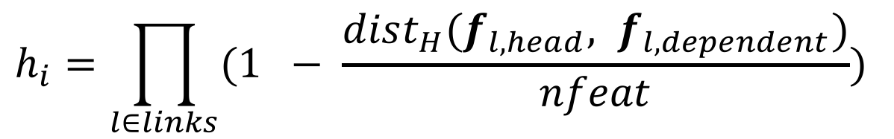
$$h_{i}=\prod_{l∈links}{(1 − \frac{dist_{H}(f_{l, head}, f_{l,dependent})}{nfeat})}$$
Notes:
Each structure is associated with a local harmony value h_i
Higher harmony = better feature match = more grammatical
Gives graded notion of grammaticality

Slide 8
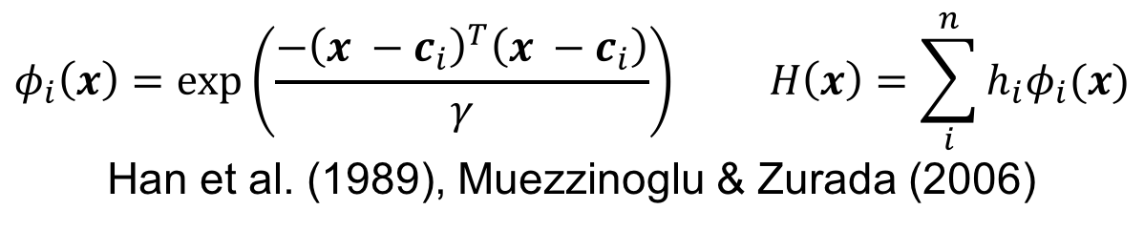
$$φ_{i}\left(x\right)=exp\left(\frac{−{\left(x −c_{i}\right)}^{T}\left(x −c_{i}\right)}{γ}\right) H\left(x\right)=\sum_{i}^{n}{h_{i}φ_{i}(x)}$$
Han et al. (1989), Muezzinoglu & Zurada (2006)
Notes:
Create harmony surface, interpolating harmony between peaks using radial basis fns.

Slide 9
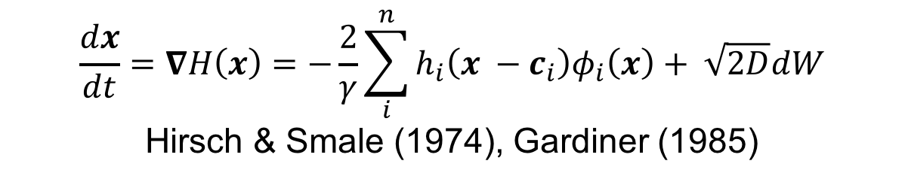
$$\frac{dx}{dt}=∇H\left(x\right)=−\frac{2}{γ}\sum_{i}^{n}{h_{i}\left(x −c_{i}\right)φ_{i}\left(x\right)}+ \sqrt{2D}dW$$
Hirsch & Smale (1974), Gardiner (1985)
Notes:
Dynamics are given by gradient (vec. deriv.) of global harmony fn.
Makes this a grad. dyn. sys., which has as its attractors the harmony peaks
Define ‘attractor’
The dynamics are really simple: like a ball on a hillside, but in reverse: the system is driven noisily uphill (green traj.) as it tries to build a well-formed structure

Slide 10
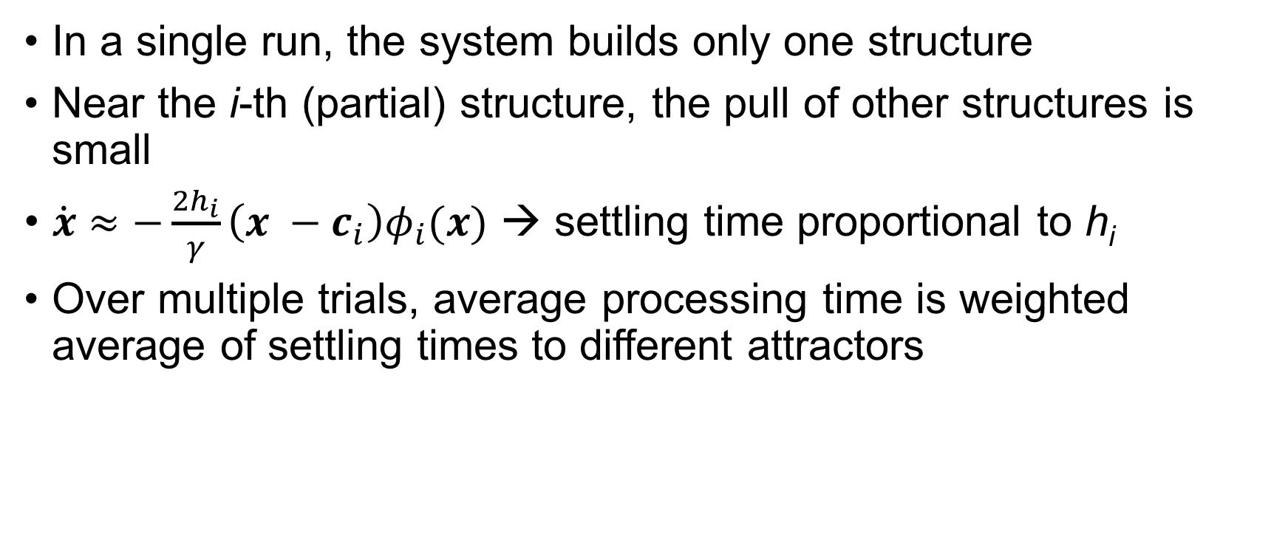
Predicting processing times
In a single run, the system builds only one structure
Near the i-th (partial) structure, the pull of other structures is small
$\dot{x}≈−\frac{2h_{i}}{γ}\left(x −c_{i}\right)φ_{i}(x)$ → settling time proportional to h_{i}
Over multiple trials, average processing time is weighted average of settling times to different attractors
Notes:
In general, the attractors will have different harmonies, so the average processing time will be the average of processing times to each attractor weighted by how often that attractor is chosen
Final effect on times: soft deflection
Trajectories get bowed toward high-harmony structures, even if the system eventually settles on some other attractor

Slide 11
NComp
Subj
PObj
Det
RelCl
…smiled
at
the
player
thrown
NComp
Subj
PObj
Det
RelCl
…smiled
at
the
player
tossed
Notes:
So, how does this work for LC?
Simplifying assumptions in model: already ready up to player
Just need to decide on structure
Most relevant structures (and the only two attractors): attach player as subject of tossed/thrown or attach tossed/thrown as modifier of player

Slide 12
Notes:
Processing times
Tossed condition: M = 159.073, SD = 27.692
Thrown condition: M = 149.794, SD = 24.698
Parse distributions
Tossed condition: 14% of runs → locally coherent parse
Thrown condition: < 1% of runs → locally coherent parse
First published model of local coherence effects
Params in extra slides
Somehow quickly discuss how we might account for the interaction…

Slide 13
Discussion
Local coherence effects for tossed result from competition between a high-harmony competitor and a grammatical parse
Low-harmony competitor also exists for thrown, but it’s almost never chosen
The grammar-supervised noisy channel (e.g., Levy, 2008) can explain some local coherence effects
Assuming the input is noisy (the coach smiled at the player tossed… → the coach smiled and the player tossed…)
Fails for other cases of local coherence (Paape & Vasishth, 2015; see discussion in Kukona et al., 2014)
Notes:
In SOSP-TH, local coherence effects arise because a relatively good but still ill-formed competitor slows processing more than a very bad competitor (the former is built more often, driving average processing times up)
Transition: Results from a single set of params; what does the rest of para. space look like?

Slide 14
The ambiguity advantage
Ambiguous sometimes faster than unambiguous (Traxer et al., 1998)
The son of the driver with the mustache was pretty cool
The car of the driver with the mustache… and
The driver of the car with the mustache…
A challenge for competition-based models (van Gompel et al., 2000), e.g., ours
faster than
Notes:
But SOSP-TH’s nonlinear relationship between processing times and competitor strength might offer an explanation
AA seems to rule out comp. Can SOSP-TH handle?

Slide 15
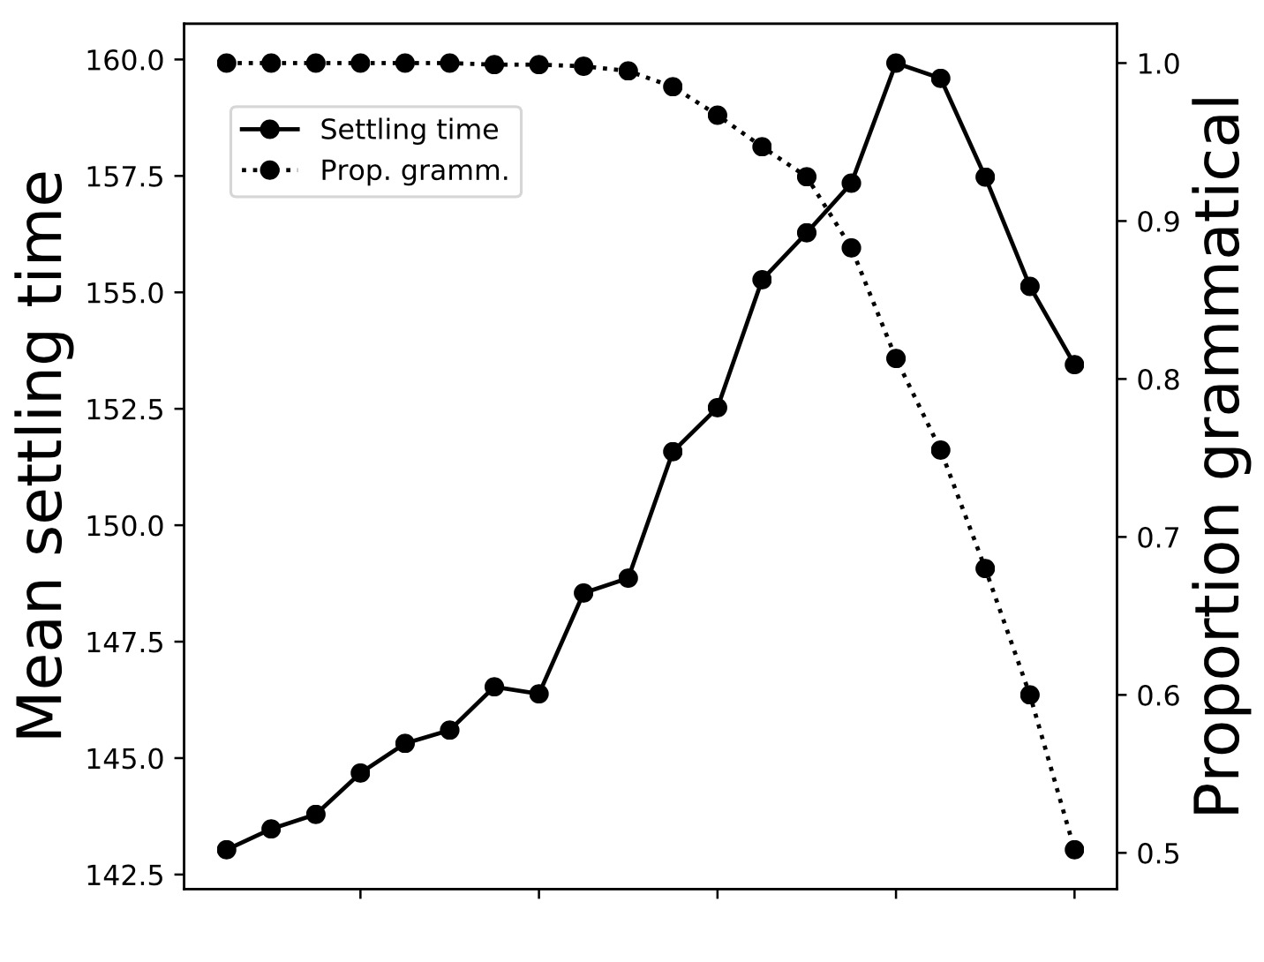
Processing times and competitor strength
Grammatical h₀ = 1 held constant
Competitor h₁ varied 0 to 1
Local coherence effects for 0 <= h_{1,thrown} < h_{1,tossed} < 0.8
Approx. equal competitors faster than high- vs. medium-harmony competition →Ambiguity Advantage
car-driver
son-driver
tossed
thrown
Notes:
Data from sims., def. “settling time”
Choosing the low harmony parse slows processing proportional to how often it’s chosen
Plotted are means from 100 runs/point
Similar pattern holds while simultaneously manipulating gamma
Transition: Unexpected unification of effects makes the framework especially promising for future explorations.

Slide 16
Conclusion
In order to account for local coherence effects, a theory of sentence processing should include ungrammatical parses
Designing such a model led to a mathematical formalism that transparently predicts processing times for local coherence effects and extends to the ambiguity advantage
Notes:
Making it a promising approach for future work in sentence processing
Flip to acknowledgements briefly and then back

Slide 17
Acknowledgements
Lab: Katherine Alfred, Hannah Brassard, Pyeong Whan Cho, Julia Calise, Mason Cumimings, Zackary Ekves, Alana Fitts, Olivia Harold, Georgia Havens, Brendan Innes, Michelle Izydorczak, Emily Kaplan, Milod Kazerounian, William Keating, Anuenue Kukona, Corinne LaPorte-Cauley, Thomas Martella, Tatyana Marugg, Brennan McDonough, Elise Noccioli, Jeremy Oliver, Bo Powers, Christopher Richard, Russell Richie, Jake Shaker, Devon Shirk, Lauren Silverio, Garret Smith, Sarah Tunewicz, Emily Szkudlarek, Panat Taranat, Peter Tiley, Aaron Votre, Dongshuo Wu, Alexander Zheng
NSF PAC 1059662, University of Connecticut
NIH P01 HD 001194 to Haskins Laboratories
University of Connecticut Neurobiology of Language Program (funded under NSF DGE-114439)
Any opinions, findings, and conclusions or recommendations expressed in this material are those of the author(s) and do not necessarily reflect the views of the National Science Foundation.

Slide 18
Params for local coherence simulations
Discretization time step = 0.01
Noise magnitude D = 0.001
Gamma = 0.25
Local harmony of grammatical structure h₀ = 1.0
Local harmony of locally coherent structure h₁ = 0.8 (tossed), h₁ = 0.5 (thrown)
2000 runs initiated from (0, 0)

Slide 19
Simple agreement attraction in production
The key to the cabinets are… (Bock & Miller, 1991; a.o.)
More attraction from plural attractors than singular ones (i.e., more errors for the key to the cabinets than the keys to the cabinet)
SOSP-TH model w/ 3 dimensions (N1 number, N2 number, V number)
Local harmonies of all attractors determined using best possible attachments w/ frequency-derived differences between sg./pl. attractors (Haskell et al., 2010)
Model replicated typical human results

Slide 20
Number agreement with pseudopartitives
A box of oranges…
A stack of sandwiches…
A lot of newspapers…
Many clocks…
is/are selection task → increasing rates of plurals (Smith et al., 2018)
Semantic feature hierarchy on N1 → SOSP-TH replication

Slide 21
Processing times under encoding interference
Barker et al. (2001): increased agreement attraction for canoe by kayaks than canoe by cabins → encoding interference
Smith (2018): SOSP-TH model predicted slower self-paced reading times at the verb for kayaks over cabins
Boat-related nouns → expectations about boat features on verb, giving kayaks a feature match advantage over cabins
This contrasts with an extension to the cue-based retrieval parsing of ACT-R (Lewis & Vasishth, 2005), extended with spreading activation under encoding similarity (van Maanen et al., 2012)
Self-paced reading results clearly favor SOSP-TH

Slide 22
References
Barker et al. (2001)
van Gompel et al. (2000).
Smith, Franck, & Tabor. (2018)
Smith (2018)
Han et al. 1989
Hirsch & Smale (1974)
Levy (2008)
Lewis & Vasishth(2005)
Muezzinoglu & Zurada (2006)

Slide 23
References
Paape & Vasishth (2015).
Tabor, Galantucci, & Richards. (2004).
Traxler et al. (1998)
Gardiner (1985)
Bock & Miller (1991)
Haskell et al. (2010)
van Maanen et al. (2012)
Vosse & Kempen (2000)

Slide 24
References

