Slide 1
Probability and Statistics: A Primer for Beginners and Pre-Beginners
The Journey Begins: Probability Theory
Part One: Of Axioms and Algebras
Primary reference: Casella-Berger 2nd Edition

Slide 2
In the beginning, there was…
Ω
(the sample space)
ALL POSSIBLE OUTCOMES!
And in it were…
(of an experiment)
…déjà vu?

Slide 3
But maybe some of those outcomes were more likely than others?
If you rolled a die with these six faces 100 times…
…you might expect a different outcome than you’d get from one with these six faces.
So maybe probability could be interpreted in terms of the frequency of occurrence of certain outcomes of an experiment?

Slide 4
Maybe, but some “experiments” can’t be repeated.
How many times can you repeat an election?
So maybe interpretation of probability is more subjective?

Slide 5
Doesn’t matter, it’s math, baby!
We don’t need no stinking context when we got cold, hard axioms!
For now, we don’t need to interpret probabilities, we just gotta make sure they follow the rules.

Slide 6
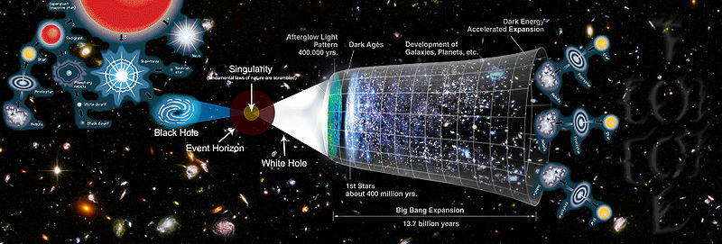
Doesn’t matter, it’s math, baby!
But before we can talk about the axioms of probability, first we need to talk about parallel universes.
(nah just sigma algebras)
Notes:
Image source: https://commons.wikimedia.org/wiki/File:Multiverse.jpg

Slide 7
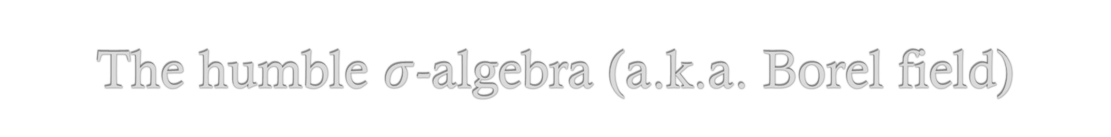

The humble $σ$-algebra (a.k.a. Borel field)
First, it gets a fancy letter: $ℬ$
Second, it’s a term for a collection of subsets of our sample space Ω that has special properties!

Slide 8


The special rules of our humble Borel field
a. $∅∈ℬ$ : It ain’t a Borel field unless the empty set is an element!
b. For any set $A$, if $A∈ℬ$, then $A^{C}∈ℬ$. Remember, $A^{C}$ is the complement of A! This property is known as being closed under complementation!
c. If sets $A_{1},A_{2},A_{3}, …∈ℬ$, then
$\bigcup_{i=1}^{∞}{A_{i}}$ $∈ℬ$
This property is known as being closed under countable unions!

Slide 9

Simple enough, but we can stretch them a bit!
a. $∅∈ℬ$
So the empty set is in $ℬ$. Big deal, right? $∅$ is a subset of every set.
But, $∅=Ω^{c}$, and rule b. said $ℬ$ had to be closed under complementation! So now $Ω$ is always in $ℬ$, too!

Slide 10

The special rules of our humble Borel field
c. If sets $A_{1},A_{2},A_{3}, …∈ℬ$, then
$\bigcup_{i=1}^{∞}{A_{i}}$ $∈ℬ$
Oh boy, things get tricky for a bit. By rule b. (closed under complementation), ${\left(\bigcup_{i=1}^{∞}{A_{i}}\right)}^{C}∈ℬ$ too! Plus, $A_{1}^{C},A_{2}^{C},A_{3}^{C}, …∈ℬ$. Applying rule c. once more means $\bigcup_{i=1}^{∞}{A_{i}^{C}}$ $∈ℬ$, and a final application of rule b. means ${\left(\bigcup_{i=1}^{∞}{A_{i}^{C}}\right)}^{C}$ $∈ℬ$!
(is the room spinning, or just my head?!)

Slide 11

It gets worse before it gets better…
Remember DeMorgan’s Law? It states that for any sets $A_{1}$ and $A_{2}$, ($A_{1}$∪$A_{2}$)^{C}= $A_{1}^{C}∩$ $A_{2}^{C}$.
Well, that law can be shown to prove that
${\left(\bigcup_{i=1}^{∞}{A_{i}^{C}}\right)}^{C}=\bigcap_{i=1}^{∞}{A_{i}}$, so now the intersection of all those sets is by definition an element of $ℬ$.

Slide 12

Taking stock of everything in the Borel field:
$∅∈ℬ$
$Ω∈ℬ$
If sets $A_{1},A_{2},A_{3}, …∈ℬ$,
$\bigcup_{i=1}^{∞}{A_{i}}$ $∈ℬ$
${\left(\bigcup_{i=1}^{∞}{A_{i}}\right)}^{C}∈ℬ$
$A_{1}^{C},A_{2}^{C},A_{3}^{C}, …∈ℬ$
$\bigcup_{i=1}^{∞}{A_{i}^{C}}$ $∈ℬ$
${\left(\bigcup_{i=1}^{∞}{A_{i}^{C}}\right)}^{C}=\bigcap_{i=1}^{∞}{A_{i}}$ $∈ℬ$

Slide 13

What does this all mean? Maybe not much…
For all of that misery, we’re only interested in the smallest Borel field that contains all the open sets of $Ω$. If the elements of $Ω$ are finite or at least countable, then this is just all the subsets of Ω, including Ω itself.

Slide 14

What does this all mean? Maybe not much…
Ok, so let’s define a little sample space again, and figure out which sets go into our Borel field.
Ω = {x, y, z}
$∅$
{x, y, z}
{x}
{y}
{z}
{x, y}
{x, z}
{y, z}

Slide 15
What if Ω is uncountable?
…you don’t want to know.

Slide 16
I didn’t come here to learn about no stinking Borel fields! I want to learn the axioms of probability!
And so you shall, my friend! For now, I shall unveil to you Kolmogorov’s axioms of probability, though only to whet your appetite for the decadent mathematical pleasures yet to come!
Now for the moment you’ve been waiting for, here they are!

Slide 17

Axioms of Probability
P($A$) ≥ 0 for all $A∈ℬ$
P(Ω) = 1
If sets $A_{1},A_{2},A_{3}, …∈ℬ$ are pairwise disjoint, then P($\bigcup_{i=1}^{∞}{A_{i}}$) = $\sum_{i=1}^{∞}{P(A_{i}})$
(okay bye)

