Slide 1
Probability and Statistics: A Primer for Beginners and Pre-Beginners
The Journey Begins: Probability Theory
Part Six: Learning to Count (pt.2)
Primary reference: Casella-Berger 2nd Edition

Slide 2

Counting ever higher
When we last left off, we were considering a scenario where a lottery player picks four from nine possible numbers:
We found that if the order of the picks was important, and they were picked without replacing them, then the number of possible lottery tickets was
$n_{1}∗n_{2}∗n_{3}∗n_{4}=9∗8∗7∗6=3,024$ possible tickets
1
2
3
4
5
6
7
8
9

Slide 3

Counting ever higher
A quick note here on an operation called “factorial”(!):
$$n!=n∗\left(n−1\right)∗\left(n−2\right)∗…∗2∗1$$
So $9∗8∗7∗6=\frac{9∗8∗7∗6∗5∗4∗3∗2∗1}{5∗4∗3∗2∗1}=\frac{9!}{5!}$
So if we’re picking r items from n possibilities without replacement, and order is important, the job can be done in
$$\frac{n∗\left(n−1\right)∗\left(n−2\right)∗…∗2∗1}{\left(n−r\right)∗\left(n−r−1\right)∗…∗2∗1}=\frac{n!}{(n−r)!}$$

Slide 4
But what if the order doesn’t matter?
Good question, hypothetical reader! If the order doesn’t matter, then counting using the previous method won’t work. Let’s take a smaller example using three balls instead of nine where we need to choose two without replacement:
If order mattered, we could pick (1,2), (1,3), (2,1), (2,3), (3,1), or (3,2), for six possibilities. But if order doesn’t matter, then (1,2) and (2,1) are equivalent. Thus, three of these six possibilities are redundant, and we only have three possible picks.
1
2
3

Slide 5


Sounds like it’ll get complicated.
Don’t worry, there’s an intuitive way to think about this: For any 2 balls you pick, you can pick them in two possible orders. For example:
So just take the total number of ordered permutations for your initial pick (in this example, six), and divide by the total number of ordered permutations for the items you’ve picked (in this case, 2):
$$\frac{3!}{2!}=\frac{6}{2}=3$$
1
2
2
1

Slide 6

Can we expand this example?
Definitely: Let’s go back to the nine-ball lottery. Now, you must pick four numbers without replacing them, but the order in which you pick them doesn’t matter (e.g. 1-2-3-4 is the same as 2-4-3-1)
We’ve established the number of picks when order is important to be:
$$\frac{n!}{(n−r)!}=\frac{9!}{(9−4)!}=\frac{9!}{5!}$$
1
2
3
4
5
6
7
8
9

Slide 7

Can we expand this?
But now, those four numbers we pick can be in any order and still be a winner. How many ways can we pick a given group of four numbers? Using the fundamental theorem of counting:
$$n_{1}∗n_{2}∗n_{3}∗n_{4}=4∗3∗2∗1=4!$$
So we need to divide the number of ordered possibilities in the initial pick (4 from 9) by the number of ways we can pick them (4!):
$$\frac{\left(\frac{9!}{5!}\right)}{4!}=\frac{9!}{5!4!}$$

Slide 8

Looks like there might be a formula here.
Right you are! If we say we’re picking r=4 numbers from n=9 possibilities without replacement, we know that if order is important, the number of possible picks is:
$$\frac{n!}{(n−r)!}=\frac{9!}{(9−4)!}=\frac{9!}{5!}$$
So if order is not important, we simply divide this formula by the number of possible ordered sets of a given pick, r!=4!:
$\frac{n!}{\left(n−r\right)!r!}=\frac{9!}{\left(9−4\right)!4!}=\frac{9!}{5!4!}=$126 possible picks

Slide 9

LEVEL UP!
You’re ready to learn some new notation! The formula on the previous slide calculates the number of possible combinations and can be represented like this:
$$\frac{n!}{\left(n−r\right)!r!}=\left({n \atop r}\right)=\left({9 \atop 4}\right)=\frac{9!}{\left(9−4\right)!4!}$$

Slide 10
Hey, this all seems pretty easy!
Well, I’ve got some bad news for you: Now we’re picking numbers with replacement but where order is not important (e.g. we could pick 1-1-1-2, but it would be the same as 1-2-1-1), and that, my friend, is not so fun. ☹ Once again, we’re picking r = 4 from n=9:
If we start trying to count the balls themselves, this’ll get complicated in a hurry. Instead, let’s try a different way of looking at the problem.
1
2
3
4
5
6
7
8
9

Slide 11
How should we approach this, then?
Instead of picking the balls, let’s pretend we have four identical tokens, and each of the balls is a bin in which we place a token. For example, if we pick 2-3-4-3 (or equivalently, 3-3-2-4, for example), we mark it like this:
Still, this doesn’t quite help us as much as we might like. Let’s add one more element to this graphic to help us gain a new perspective.
1
2
3
4
5
6
7
8
9

Slide 12
How should we approach this, then?
Now that we’re treating the balls as “bins” into which we can place our tokens, we don’t really need to see the balls at all. Rather, we can simply look at the separations between them:
1
2
3
4
5
6
7
8
9

Slide 13
What good does that do?
We’ve transformed this into a collection of 12 objects: four tokens, and the eight separations between our nine “bins”. (So n+r-1 objects)
Now we just need to order these n+r-1 objects. If every object was unique, that would give us 12! orders. But remember two things:
The order of the tokens doesn’t matter.
The order of the separators doesn’t matter.

Slide 14

How do we handle the redundant token and separator orders?
Same as before: We divide by the number of equivalent orders! Remember, the eight identical separators could be arranged in 8! ways, and the four identical tokens could be arranged in 4! ways. So the number of possible picks with replacement where order doesn’t matter is:
$$\frac{12!}{8!4!}=495$$

Slide 15

Are we gonna generalize this one too?
Of course! Let’s remember that we picked r=4 from n=9 and then work backwards from our final result:
$$495=\frac{12!}{8!4!}=\frac{(9+4−1)!}{(12−4)!4!}=\frac{(n+r−1)!}{(n+r−1−r)!r!}=\left({n+r−1 \atop r}\right)$$
Now we’ve learned the final counting scenario: Choosing r from n with replacement and where order is not important.

Slide 16
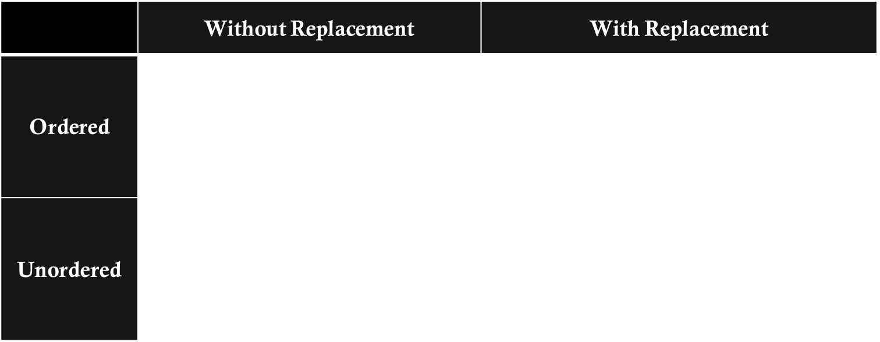
Counting Reference Table For picking r items from a collection of n items
 | Without Replacement | With Replacement
Ordered | $$\frac{n!}{r!}$$ | $$n^{r}$$
Unordered | $$\frac{n!}{r!\left(n−r\right)!}=\left({n \atop r}\right)$$ | $$\frac{(n+r−1)!}{(n+r−1)!\left(r\right)!}=\left({n+r−1 \atop r}\right)$$

