Slide 1
Probability and Statistics: A Primer for Beginners and Pre-Beginners
Coding
Prologue: Obtaining R
Primary reference: Casella-Berger 2nd Edition

Slide 2
What is R?
It’s a programming language. A free one!
And it’s open-source! That means anyone can read the code that was used to build it.
And that means lots of people have added lots of stuff to it, so it can do just about anything (in statistics) you want!

Slide 3
Why do we need a programming language for this stuff?
Because, coins and dice are only gonna get us so far! (mostly me, I can’t draw that well)
It’s gonna let us make graphs, and do simulations, and other things that are gonna make this stuff clearer, especially for people who haven’t taken a lot of math and might not get it any other way.
Plus I already added a “Coding” page to the website so it’s too late to turn back now!
H
T

Slide 4
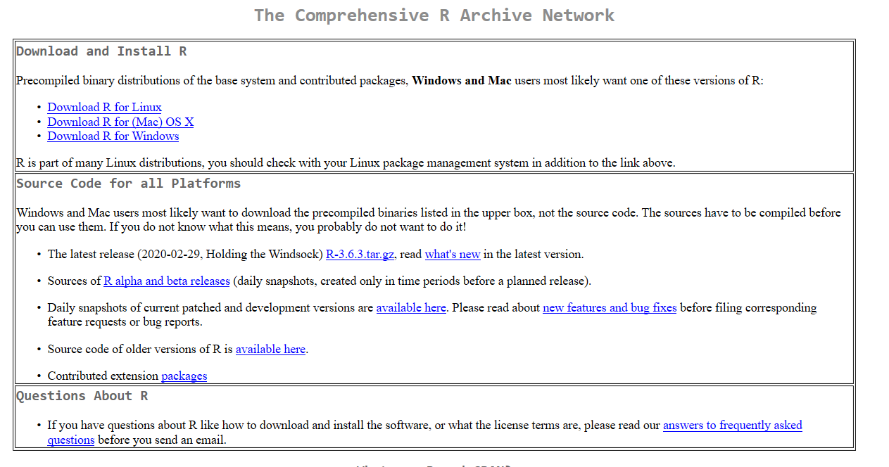
Where do I get R?
Go here: https://cran.mtu.edu/
Choose one. Install it.

Slide 5
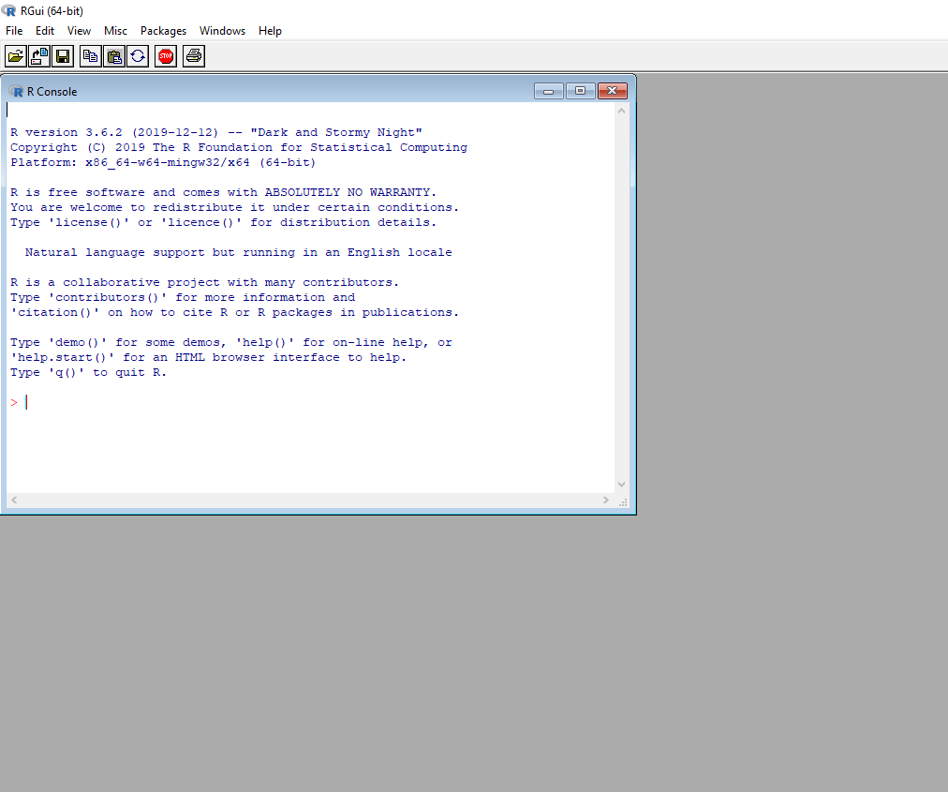
Got it. What’s next?
Open it:
Now close it, and never open it again.

Slide 6
What? Why?
You saw that thing. It’s hideous, like something out of 1997.
We’re gonna get something better: A really good IDE (integrated development environment).
We’re going line-by-line through a lot of this early stuff, so we’re gonna get a program that’ll let us see everything changing step-by-step. And it’s also free!

Slide 7
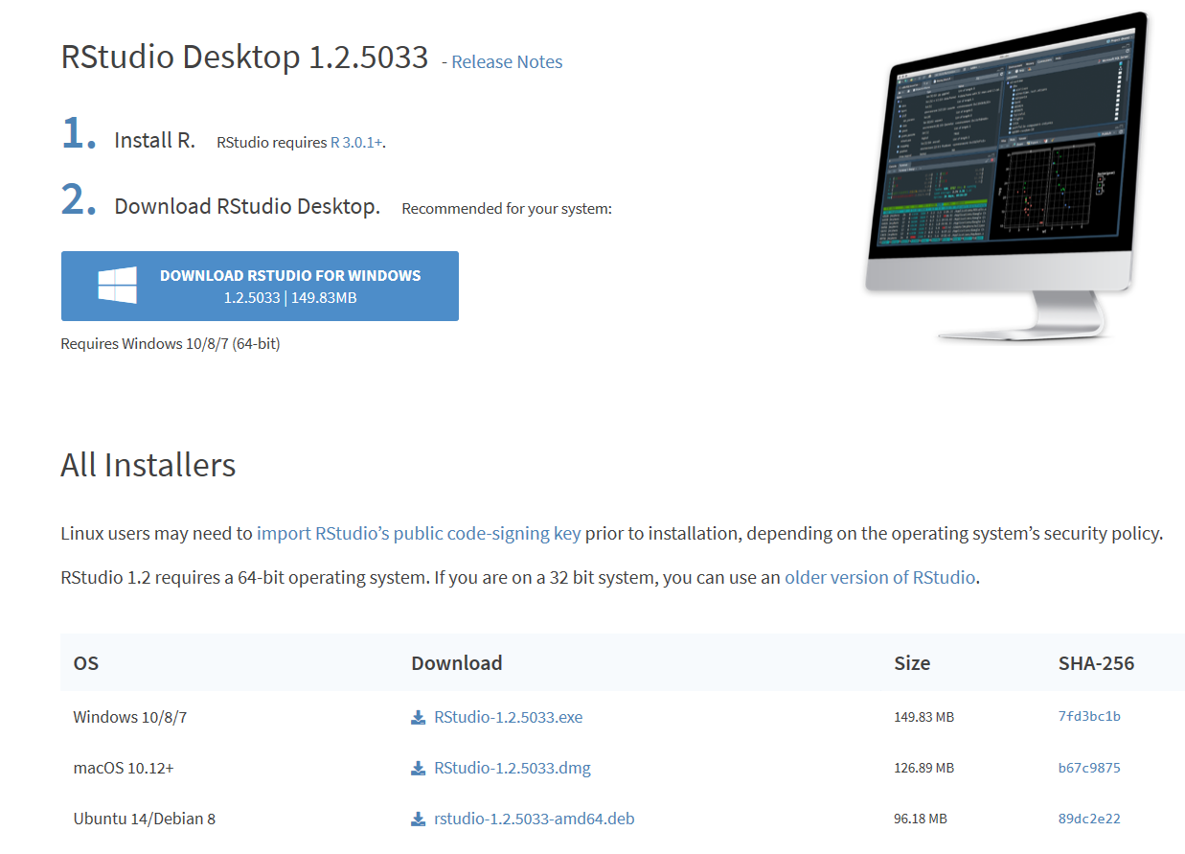
What is it? Where do I get it?
It’s called RStudio. Go here: https://rstudio.com/products/rstudio/download/#download
Install here.
Or down here if you need to.

Slide 8
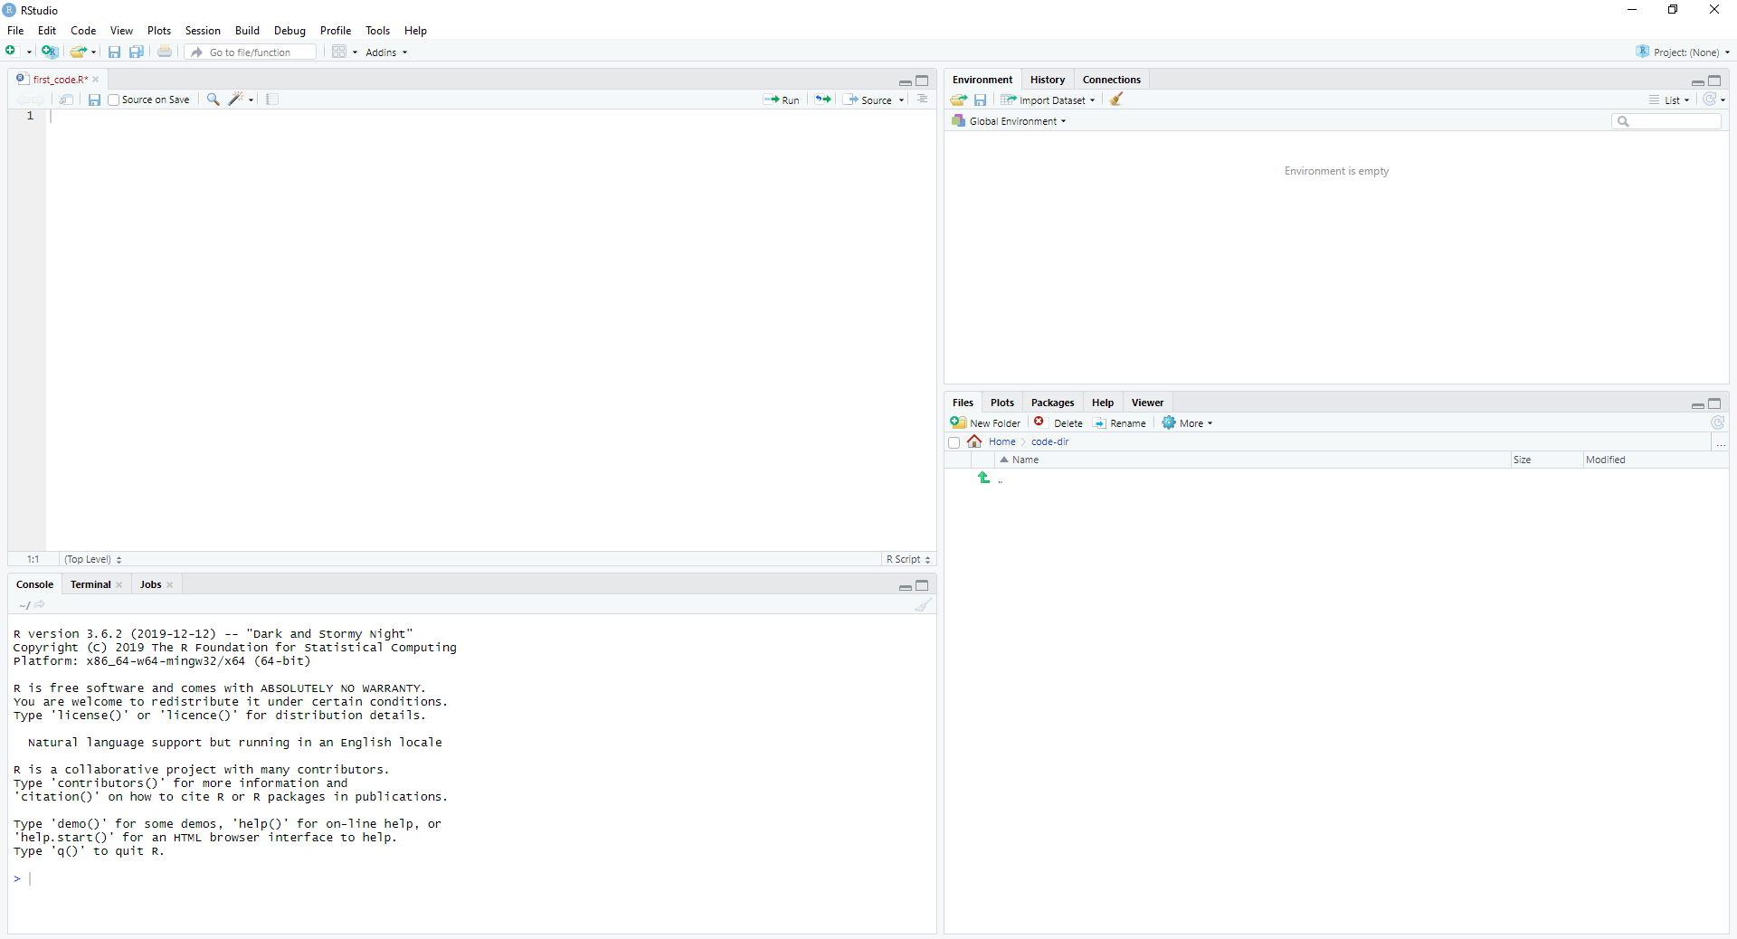
What’s all this?
This’ll show you all kinds of info, especially a little summary of what your data looks like.
Here’s where you’ll write code!
This’ll show you different kinds of output, and help you keep track of your files, and let you access help documentation.
This is the console. It’ll tell you what your code’s doing, and if it’s got an error when you run it.

Slide 9
Neat, can I write some code now?
Sure, just let me find a cool font to type the code in…
#All right here we go! I’ll type the code in this font.
#You can copy this whole code block into that upper left window if you want.
#<-This # symbol tells R you’re writing a comment.
#R ignores comments. They’re intended for people to read to understand your code.
#So remember to write them!
When the code’s in, just press Ctrl+A to highlight it all and press Ctrl+Enter to run your code!

Slide 10
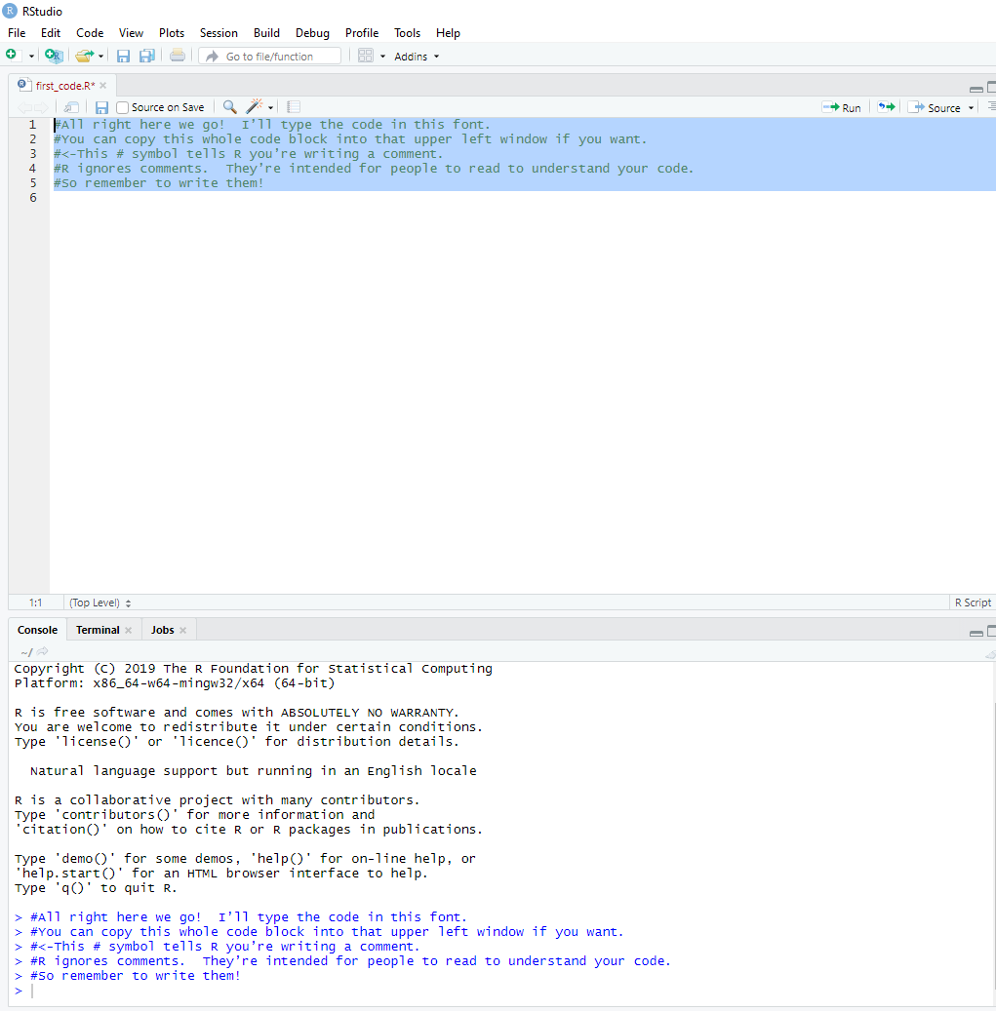
You copied. You highlighted. You executed.
When you’re done, it’ll look something like this:
Also, you can press Ctrl+S to save the code you wrote! I saved mine as first_code.R. ☺
Hey, it printed your comments to the console!

Slide 11
Hey, that just copied those comments. I want to write some real code!
All right, fine. Meet me back in the code block.
#We’re gonna use the print() function. Think of functions as instructions.
#They look simple to us, but there’s more going on behind the scenes.
#They let us do complex things quickly and simply. So let’s try one:
print(“Hello World!”)
When the code’s pasted in, highlight the lines you just wrote and press Ctrl+Enter to run your code.

Slide 12
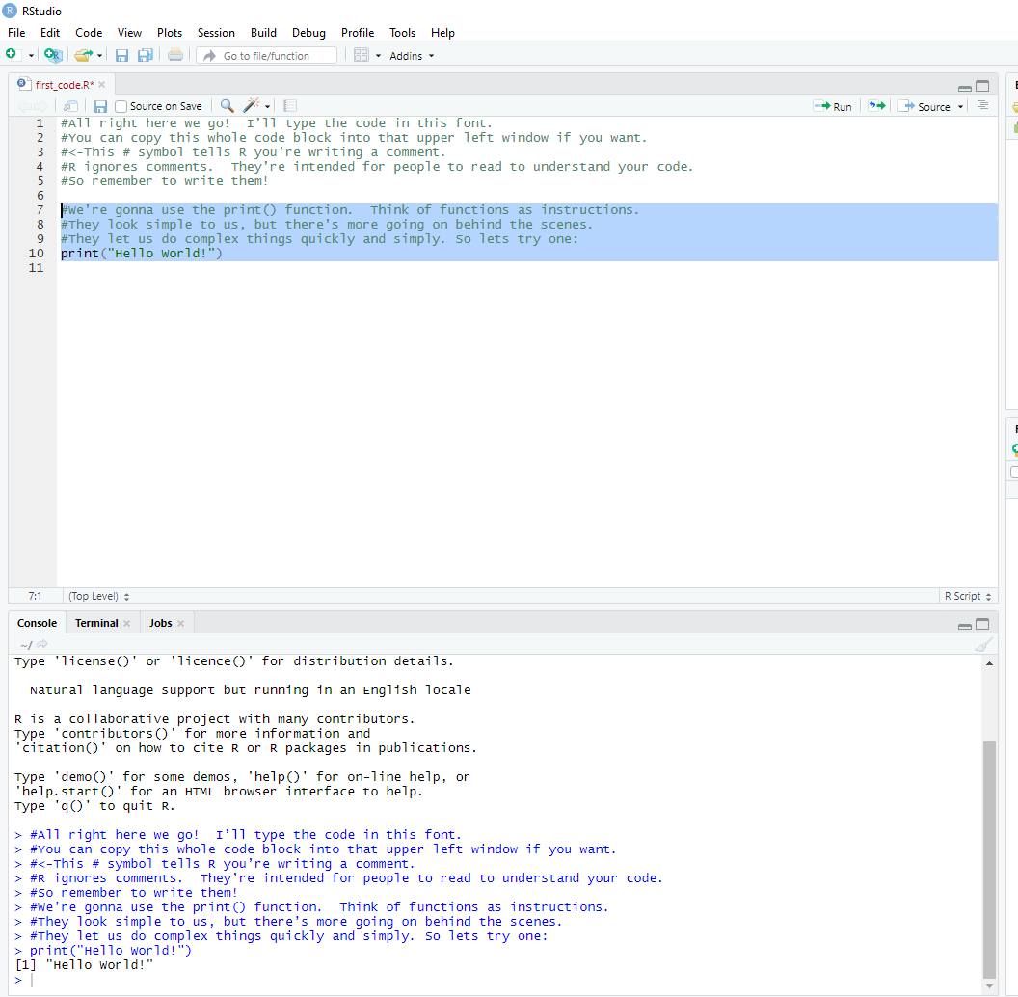
Now you’re just running part of your code.
Now you’re a real programmer!
How’s that for coding?

