Slide 1
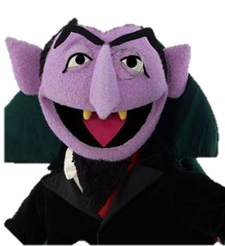
Probability and Statistics: A Primer for Beginners and Pre-Beginners
The Journey Begins: Probability Theory
Part Five: Learning to Count (pt.1)
Primary reference: Casella-Berger 2nd Edition

Slide 2
…but I know how to count.
Do you, though? Let’s try something, then. See those nine balls below? Say you need to choose four of them for a lottery, and the ticket has to get all four numbers right in the same order they were picked to win.
1
2
3
4
5
6
7
8
9
How many different lottery tickets can there be?

Slide 3
Hmm…
1-2-3-4
1-2-3-5
1-2-3-6
1-2-3-7
1-2-3-8
1-2-3-9
1-2-4-3
1-2-4-5
1-2-4-6
1-2-4-7
1-2-4-8
1-2-4-9
…

Slide 4
All right, stop! This’ll take forever.
It sure will! And just imagine if I’d used the 44-number lottery from Casella and Berger’s example! But we can think about this a little differently.
We’re choosing from these nine balls without replacing them, right?
So for our first pick, there are nine possibilities:

Slide 5
Yeah, ok.
Then, no matter what that number was, there are 8 balls left.
So, for each of the 9 possible first choices, there are 8 possible second choices. So there are 9*8 possible permutations for the first two numbers. And after the second pick, there are 7 balls left:

Slide 6
…so, 9*8*7 possible permutations for the first three choices?
Now you’re getting it! And that leaves 6 possible final choices.
So how many possible lottery tickets? 9*8*7*6 = 3,024
Choosing that lottery ticket consisted of four tasks (each number to pick). The first task could be done 9 ways, the second could be done 8 ways, the third could be done 7 ways, and the fourth could be done 6 ways…

Slide 7
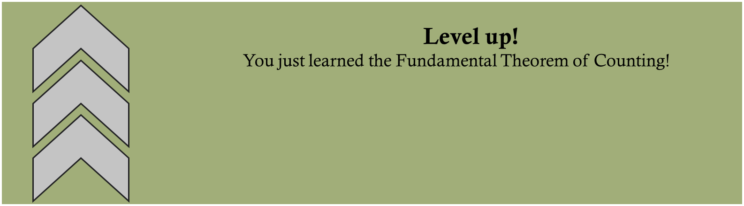

I sense a theorem coming on…
How perceptive of you!
If a job consists of k tasks, and the ith task can be done n_{i} ways, then the total number of ways to complete the task is
$n_{1}∗n_{2}∗n_{3}∗…∗n_{k}$

Slide 8
Neat. So we’re done, then?
No! ☺
Say that first lottery was hemorrhaging money, so the organizers changed the rules: Now, after being picked, the ball gets put back and could be picked again! We still have nine choices for the first number:
But then, things change…

Slide 9
Right, we’ve still got nine choices for the second number.
Exactly:
Same goes for the third number:
And the fourth:

Slide 10

Can we still use the theorem?
We sure can!
Our “job” still consists of 4 tasks, but now each of those tasks can be done in nine ways, giving us
$n_{1}∗n_{2}∗n_{3}∗n_{4}=9∗9∗9∗9=9^{4}=6,561$ possible tickets

