Slide 1
Battleship
Introduction to Programming Final Project
Aravind Rajagopalan, David Rosenberg, and Garrett Yoon

Slide 2
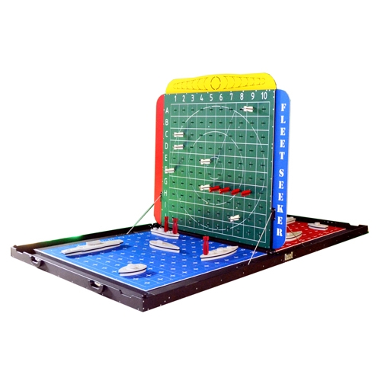
The Game
1-player mode
2-player mode
8x8 grid, with 4 ships to place
Loop until one player has sunk all the other player’s ships
Notes:
Traditionally a strategy guessing game for two players. It is played on ruled grids (paper or board) on which each player's fleet of ships (including battleships) are marked. The locations of the fleets are concealed from the other player. Players alternate turns calling "shots" at the other player's ships, and the objective of the game is to destroy the opposing player's fleet.
We would like to make a 2-player version of the game Battleship where the user will play against an AI opponent. The player and AI will take turns guessing “shots” to destroy the opposing player’s fleet. The game will be played on a simple 8x8 grid, with (up to?) 4 ships for each player. The ship locations will be generated by player input, while the locations of the AI’s ships will be generated randomly. Ships cannot overlap and may only be laid vertically or horizontally. The player will be notified of whether a player's guess “hits” a ship or not, with the player’s board or tracking grid being updated. When a ship is destroyed, the player will be notified of which ship was destroyed. Repeat steps until the game is lost/won.
Modular, we handled the board and types of ships using a list, and created functions that select game mode, place ships, get user input, make moves, and check for sinks. We specifically created a function to print blank boards to keep the game blind when a player is guessing coordinates.
At each step, there are checks to ensure that users enter valid input. There are also exit conditions that allow the user to exit in the middle of gameplay if they choose. We also thought it would be fun to include a timer (we used the sleep function from the time module) that simulates delay when firing a shot.

Slide 3
The “Weak” AI
Makes more intelligent guesses around the last-guessed area to increase chance of hits
Keeps track of previous guesses (1-move memory)
Hit
Randomly selects adjacent move
Randomly makes a move within entire board
Miss
Notes:
We also would like to implement weak AI into the program, where if the computer recognizes a hit, it will make subsequent guesses around that area until a ship is sunk. If the AI component becomes too complicated to construct over the 2 weeks that we have to work on the project we will convert to a 2-player human vs. human game. The game will end when one player’s ships have all been eliminated.

