Slide 1


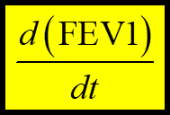

1
Choose
Features
Non
-numeric
Numeric
Microbial
data
FEV1, Age
Sex, Genotype
OTUs, diversity
Clinical data
2
Regression with
Features
4
Rank
Feature
strength
for predicting
Classifiers
with F-scores from
support vector machine (SVM):
3
Choose
Classifiers
F-score (
,
) = ____
F-score (
,
) = ____
NTM disease
M. avium/abscessus

