Slide 1
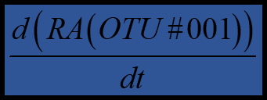
1
Choose
Features
Train support vector machine (SVM) model to predict
5
OTUs
Genera
All mothur eco. measures
Classifiers
A
Choose training/test samples
B
Train SVM model
2
Regression with
Features
C
Cross-validation with test set
( Done when Accuracy > 0.8)
4
Select best
Features
3
Choose
Classifiers
(F-score > 0.3)
NTM disease
M. avium/abscessus
F-score (
) = #(0-1)

Slide 2
All mothur eco. measures

Slide 3


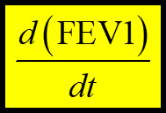

1
Choose
Features
Non
-numeric
Numeric
Microbial
data
FEV1, Age
Sex, Genotype
OTUs, diversity
Clinical data
OUTDATED
2
Regression with
Features
4
Rank
Feature
strength
for predicting
Classifiers
with F-scores from
support vector machine (SVM):
3
Choose
Classifiers
F-score (
,
) = ____
F-score (
,
) = ____
NTM disease
M. avium/abscessus

