Slide 1


Final Engagement
Attack, Defense & Analysis of a Vulnerable Network

Slide 2

Table of Contents
Network Topology
Critical Vulnerabilities
Exploits Used
Methods Used to Avoid Detection

Slide 3




Network Topology
Network 192.168.1.0/24
Network:
Address Range:
192.168.1.0/24
Netmask:
255.255.255.0
Gateway:
10.0.0.1
Microsoft Windows 10 Pro
192.168.1.1
Machines
IPv4:192.168.1.1
OS: Windows
Hostname:
ML-RefVm-684427
IPv4:192.168.1.90
OS: Kali Linux
Hostname:
Kali
IPv4:192.168.1.100
OS: Linux / Elastic Stack
Hostname:
ELK Stack
IPv4:192.168.1.105
OS: Ubuntu
Hostname:
Capstone
IPv4:192.168.1.110
OS: Linux
Hostname:
Target 1
IPv4:192.168.1.115
OS: Linux
Hostname:
Target 2
Elk Stack
192.168.1.100
Target 2
192.168.1.115
Capstone VM
192.168.1.105
Target 1
192.168.1.110
Kali Linux VM
192.168.1.90

Slide 4

Critical Vulnerabilities

Slide 5
Critical Vulnerabilities: Target 1
Vulnerability | Description | Impact
Sensitive Data Exposure via dirsearch & wpscan | I was able to use dirsearch a tool like gobuster and dirbuster that allows attackers or users to find hidden directories using common wordlists and extensions. Once going onto the Web Server I was able to figure out that it was a WordPress site I then ran a wpscan in order to possibly find more vulnerabilities on the webserver along with possible users. | When I ran a dirsearch to help enumerate the site I didn’t get anything concrete but allowed me to get a bit more familiar with the system. After that I ran a wpscan and was able to find 2 users that were on the server named Steven and Michael, which gave me everything I needed to continue to gain a shell or whatever needed to continue the engagement.
Weak Passwords | Common / Weak passwords are all over the place allowing attackers to use a dictionary attack, brute force attack or even guess the password to accounts leading to one of the easiest ways to get hacked and information to be stolen. | Due to weak passwords I was able to easily SSH onto the Target1 Machine by guessing Michael's password leading me to gain a shell and gain persistent access.
Python Sudo Capabilities | The user steven had sudo privileges that allowed him to use python as sudo which is a big security risk in the system. This allows for possible escalation or use or malicious python scripts in order to further exploit the system. | I was able to use this sudo capability to run a python command that escalated my privilege to a root user. This allowed to me to have full root access to the system.

Slide 6

Exploits Used

Slide 7
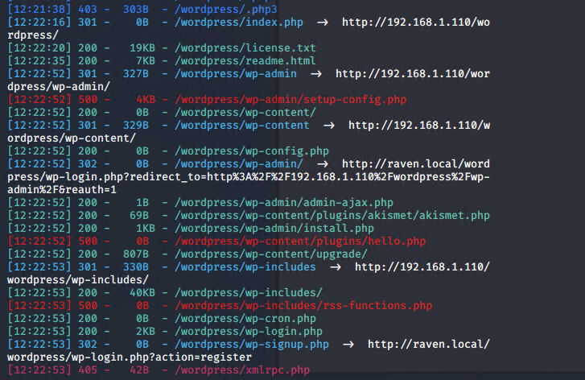
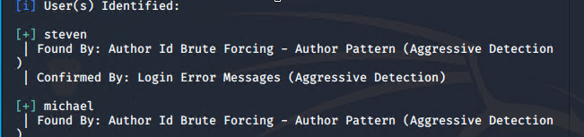
Target 1 Exploitation: Sensitive Data Exposure
I found a vulnerability in the webservers Sensitive Data and used dirsearch, a directory traversal tool that shows attackers possible “hidden” folders and topology of the system.
I also used wpscan another tool used to help me find users that were on the system.
These tools granted me a user shell from the user Michael and to find the flags.
DIRSEARCH
WPSCAN

Slide 8
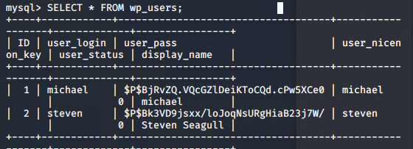
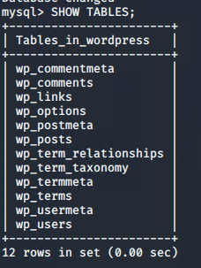
Target 1 Exploitation: Weak Passwords
Weak passwords were found all over the system, Michael’s password was easily guessable leading me to gain a user shell for Michael
After gaining the shell I was then able to keep digging and found a wp-config.php file which contained the database, username and password for the root user of the db
This clearly is a big security flaw because I was able to maintain persistence because I had passwords to both Michael and the Root SQL db.
This also allowed me to traverse through the whole mySQL database and gain whatever information I wanted like the posts, users, options and comments.
Along with having passwords to the DB and user Michael when digging around the wp_users table inside of the DB I found hashes for both users Michael and Steven which was out in the open with no security or protection.
I was then able to crack these hashes using john a password cracking tool and got Stevens password.

Slide 9
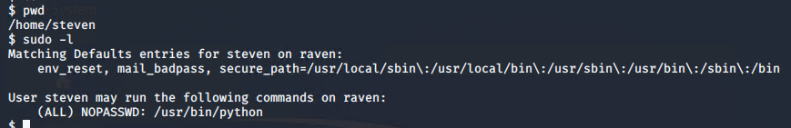

Target 1 Exploitation: Sudo Capabilities
Once I had access to the Steven user I was then in the Post-Exploitation phase and was looking for what else I could do.
I then ran sudo –l to look for what type of sudo privileges Steven had and was able to find that he was able to use python with no limitations
This was a huge security flaw in my eyes and I used this to my advantage and looked for a simple python shell which I found via GTFObins.
This gave me full unrestricted python shell that had me as a root user and had full control of the system.

Slide 10

Avoiding Detection

Slide 11
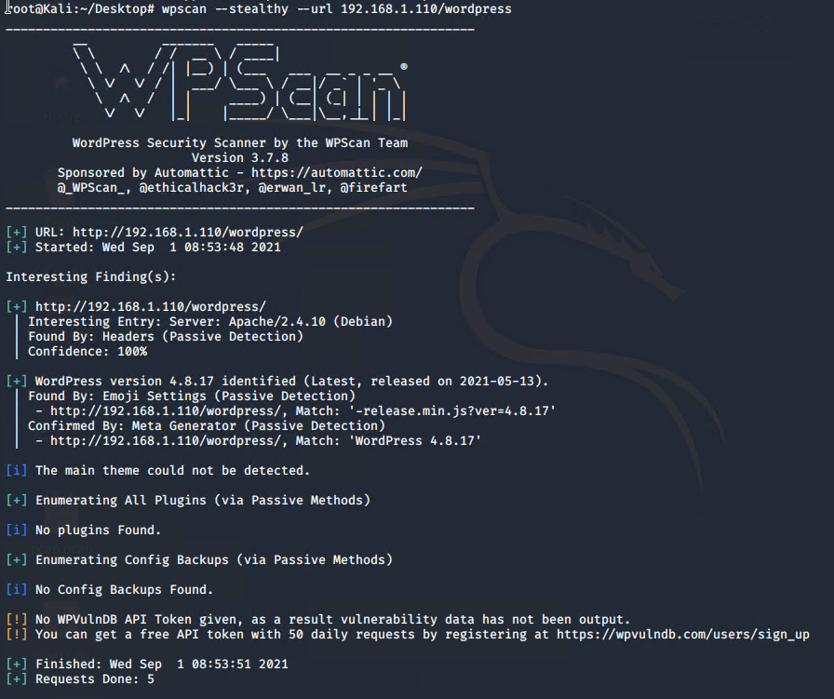
Stealth Exploitation of Sensitive Data Exposure
Monitoring Overview
Which alerts detect this exploit?
Excessive HTTP errors due to the aggressive enumeration of the users on wpscan
Which metrics do they measure?
It measures if there are tons of error codes which would indicate a brute force attack
Which thresholds do they fire at?
Due to the mass amounts of attempts it doesn’t matter the threshold if there is a alert on the system it will trigger it
Mitigating Detection
How can you execute the same exploit without triggering the alert
For dirsearch there is a –quiet-mode that is a option that you can use under specifically dirsearch that may lead to a quiet scan and less detection
Much like dirsearch, wpscan has a passive scan that would most likely be a lot safer and wouldn’t be aggressive and be as fast. It also has a –stealthy option that makes all the scans perform passively
Are there alternative exploits that may perform better?
Possibly, depends on preference but wpscan is a must due to it being a WordPress site

Slide 12
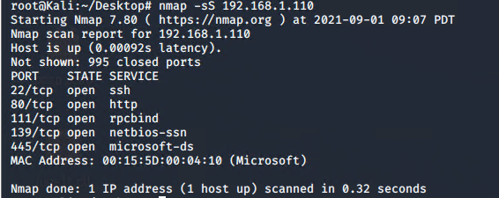
Stealth Exploitation of Nmap
Monitoring Overview
Which alerts detect this exploit?
Excessive HTTP errors and HTTP request due to the aggressive scan I did with -A
Which metrics do they measure?
It measures if there are tons of error codes which would indicate a brute force attack along with if http requests have a large amount of packets
Which thresholds do they fire at?
Due to the mass amounts of attempts and aggressive scans it triggered easily
Mitigating Detection
How can you execute the same exploit without triggering the alert
Nmap has several different methods due to how it can manipulate the 3 way handshake with a Stealthy Syn Scan:
-sS
Are there alternative exploits that may perform better?
There aren’t many alternative options for nmap due to its usability and how easy it is to have on a system

