Slide 1
DK-Protocol Implementation
By Lee Davis
Garrett Koller

Slide 2
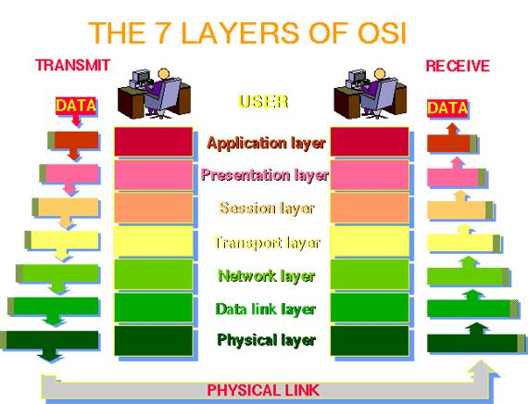
OSI Model

Slide 3
Goal
To implement a transport layer protocol.
Protocol will have
  Sliding Window Protocol
  Checksums
  Basic encryption scheme
Will connect two actual nodes in point to point link.

Slide 4
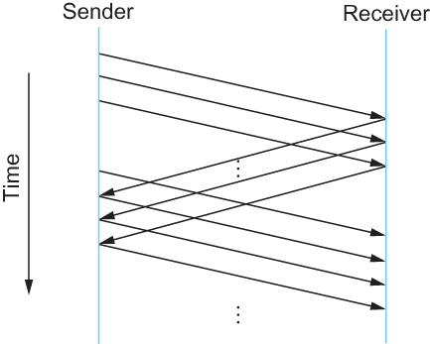
Sliding Window Protocol

Slide 5
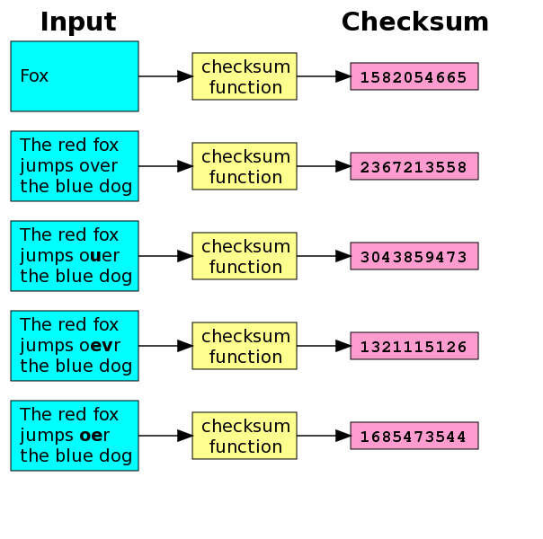
Checksums

Slide 6
Encryption Schemes
MD5
  Example of MD5:
  MD5("The quick brown fox jumps over the lazy dog.") = e4d909c290d0fb1ca068ffaddf22cbd0
RSA
  Symmetric Encryption scheme

Slide 7
Resources
Sami Rollins' skeleton code for transport layer protocol.
  http://www.mtholyoke.edu/courses/srollins/cs325-f03/web/assignments/proj2.html
Comupter Networks by Larry Petersen and Bruce Davie
  Contains example code for Sliding Window.

