Slide 1
Classifying Observations from the Sloan Digital Sky Survey with Machine Learning
Garrett DuCharme
Jan. 22, 2020

Slide 2
Outline
Motivation
Data Overview
Methodology
Results

Slide 3

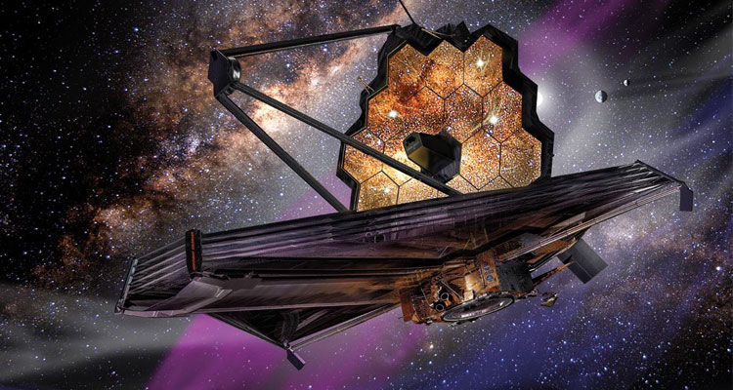
Motivation
The Sloan Digital Sky Survey (SDSS) is the most comprehensive map of the universe ever made
The ability to classify currently available data helps us with future astronomical ventures (James Webb Space Telescope)
Machine learning does this quickly and accurately

Slide 4
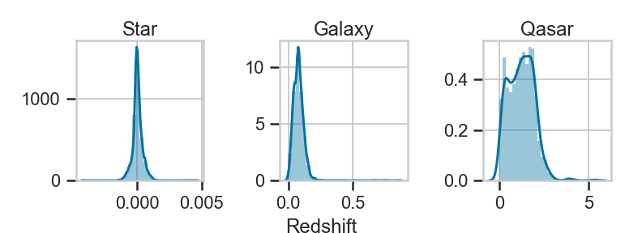
Data Overview
10,000 observations with 17 features
3 Classes; 4152 Stars, 4998 Galaxies, 850 Qasars
Features such as redshift, light intensity (ultraviolet to near-infrared), location in the sky

Slide 5
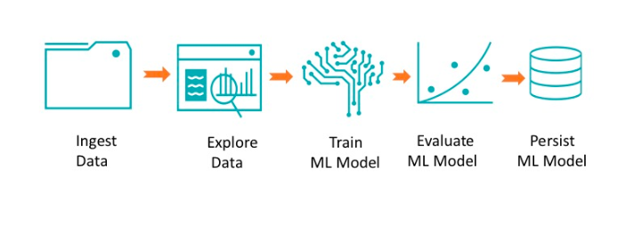
Methodology
17 ⟶ 9 features
6 different models trained and evaluated
Performance is evaluated based on accuracy and precision (F1 score)

Slide 6
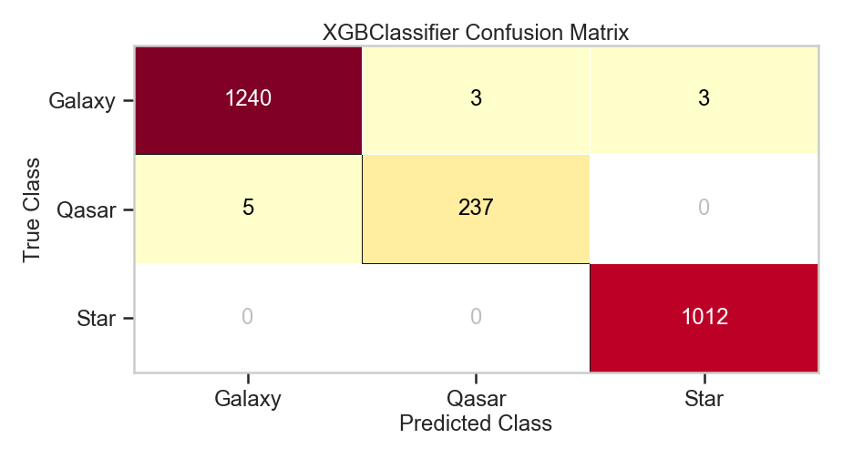
Results
State of the art “ensemble” methods perform the best
F1 scores: 0.99 for galaxies, 0.98 for qasars, 1.00 for stars

Slide 7
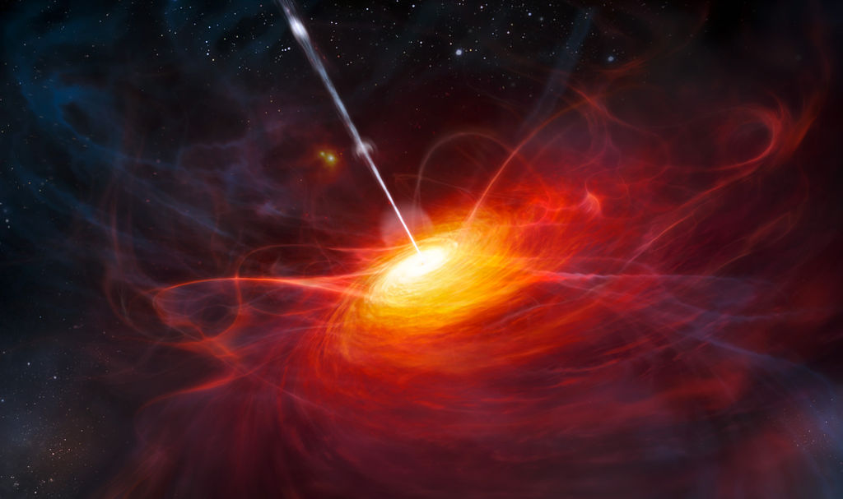
Questions?

Slide 8
Technical Details
ugriz spectra was reduced using PCA with 3 principal components
80/20 train/test splits
XGBoost performs the best overall
100 estimators. Tuning does not improve performance
Not much better than random forest
Class balancing does not improve model performance

