Slide 1
Forecasting Concentrations of Air Pollutants on the Southeast Side of Chicago
Garrett DuCharme
Feb. 13, 2020

Slide 2
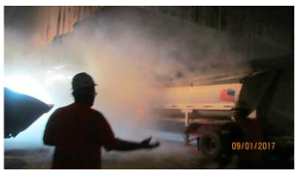
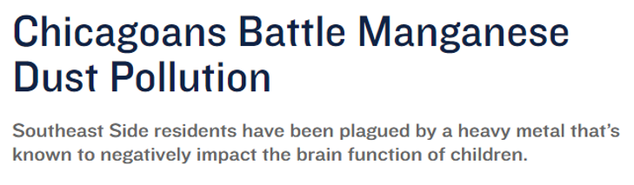
Problem Statement
How can we predict future concentrations of air pollutants based on past concentrations and meteorological data?

Slide 3
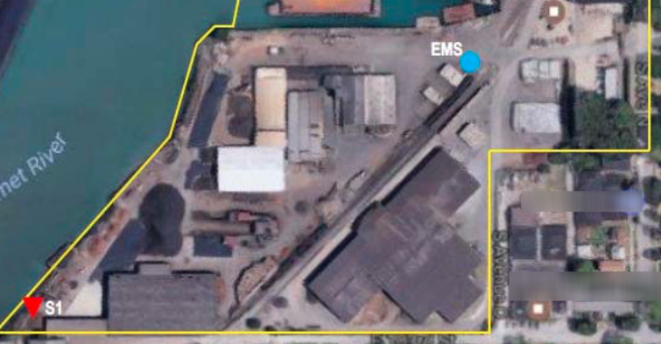
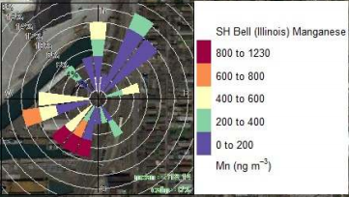
Data Collection
: Pollution
Hourly Measurements from Mar. 2017 – Nov. 2019
: Meteorological

Slide 4
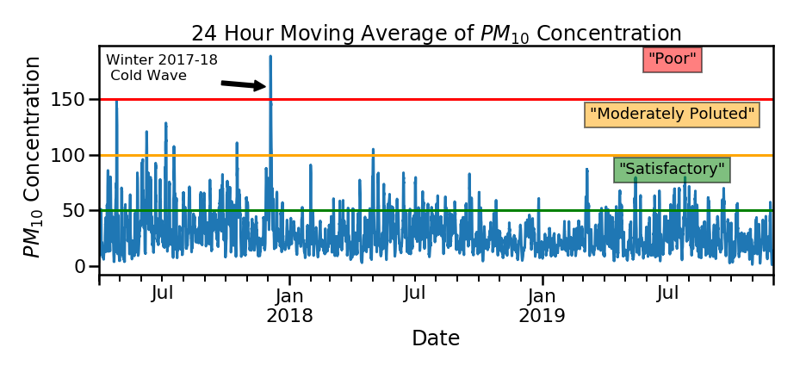
Analytics

Slide 5
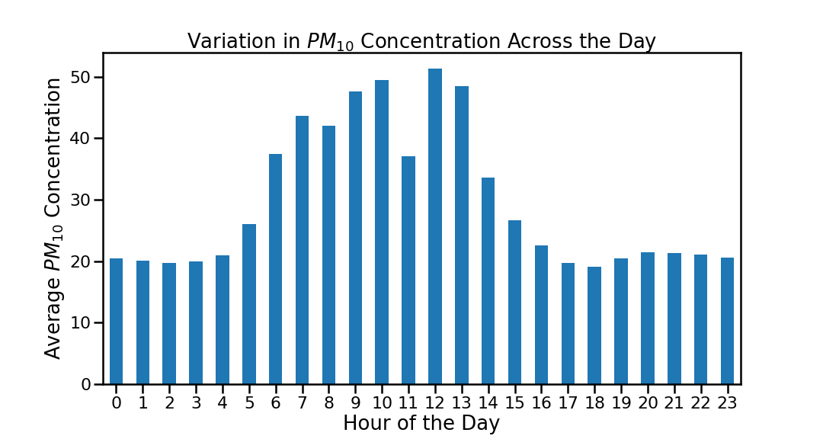
Analytics (Cont.)

Slide 6
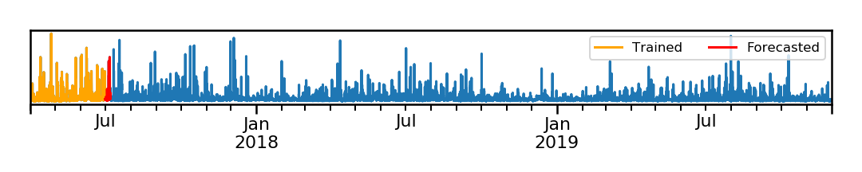
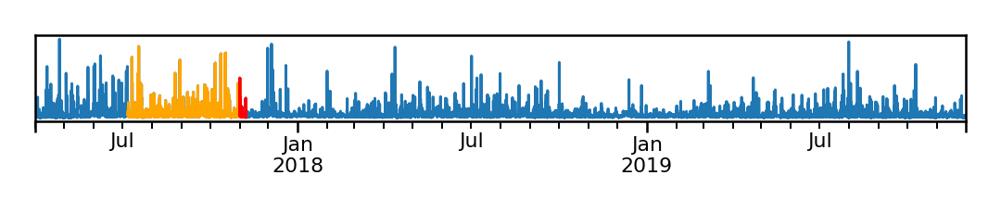
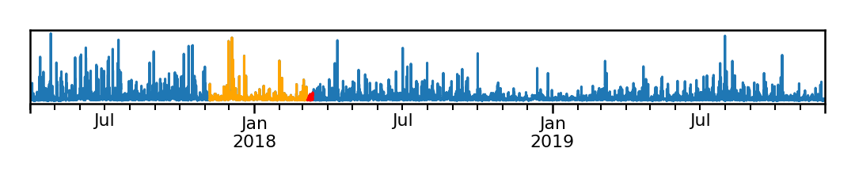
Modelling Techniques

Slide 7
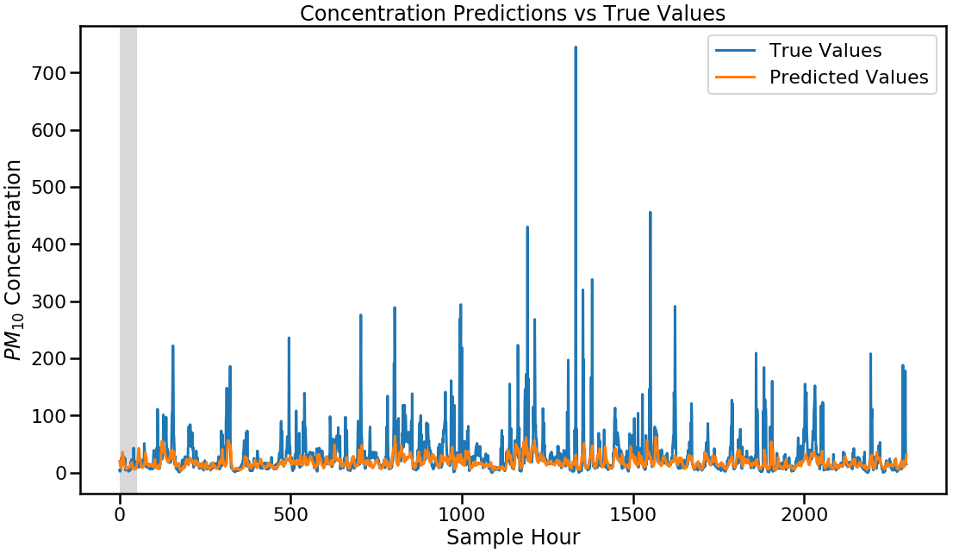
Results

Slide 8
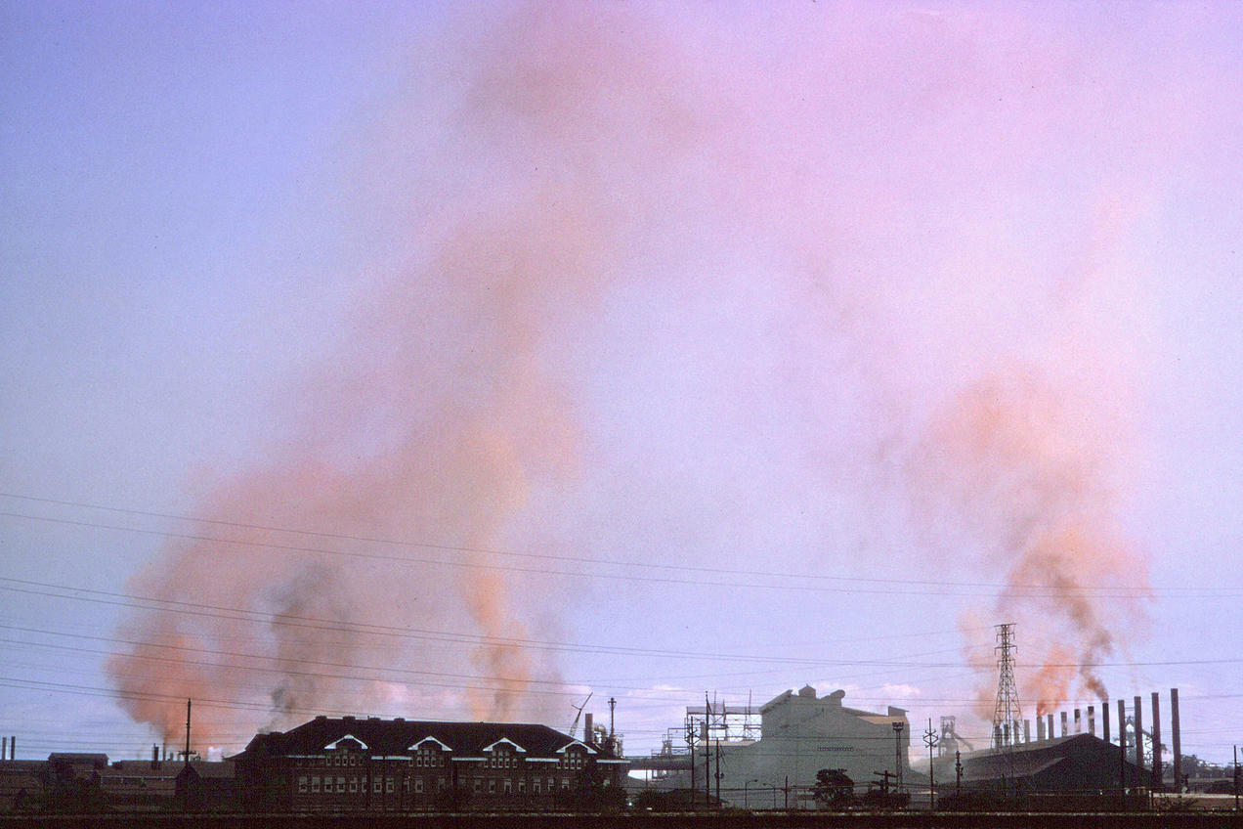
Thank you! Questions?

