Slide 1
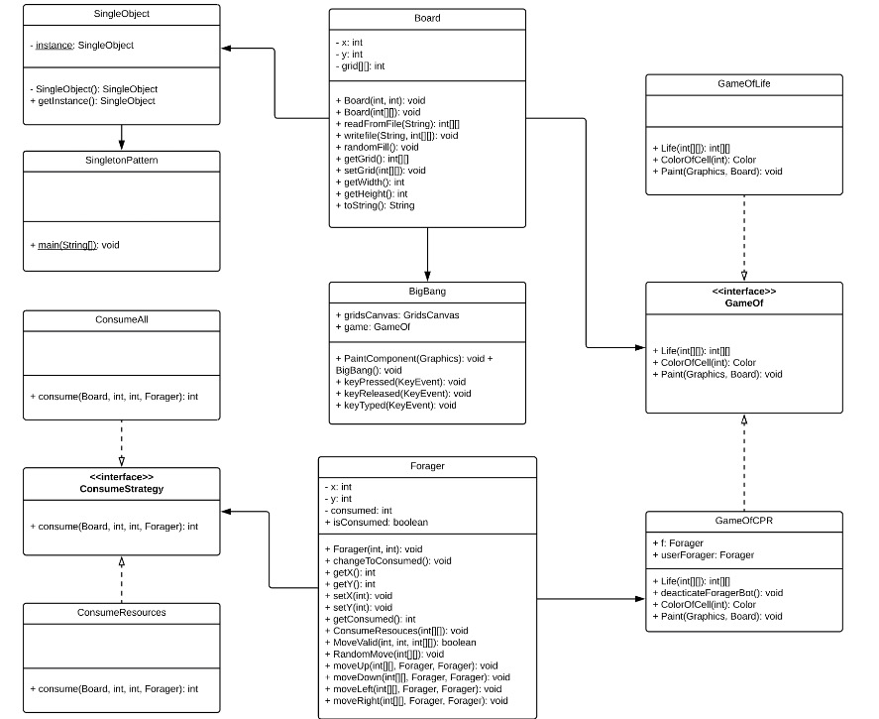
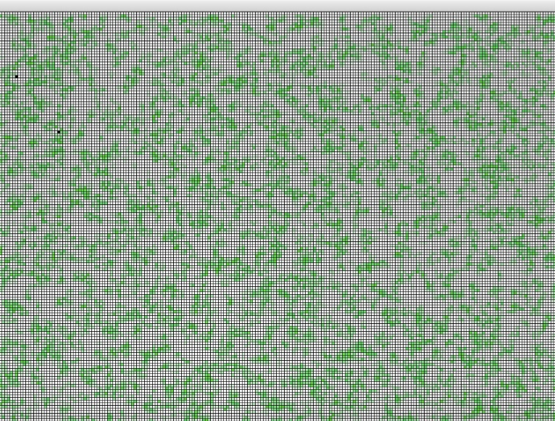
Game Of Life
Strategy Pattern
The strategy design pattern is implemented in Consume Strategy.
This design pattern helped the forager to know which consume algorithm to run to consume other foragers and resources. It solved this problem of having multiple things to consume because the strategy pattern allows the program to select different algorithms at run time.
The Game of Life was invented in 1970 by the British mathematician John Horton Conway. It is the best-known example of a cellular automaton which is any system in which rules are applied to cells and their neighbors in a regular grid.
How It Works In Our Project
In Game of Life, we implement a simulation for the resource growth to be used in a CPR model, the cell growth will depends on the number of neighbor cells instead of the simple check of alive or dead. By this way, the cell growth will be much more accurate and simple.
Common Resource Pool (CPR) is a type of good that is self replenishing but can be expended if all the resources are consumed. In our model we have Foragers who will consume the resources and compete for their share of resources.
Singleton Pattern
If a system only needs one instance of a class, and that instance needs to be accessible in many different parts of a system, you control both instantiation and access by making that class a singleton.
The singleton pattern in our project is implemented for making sure one user can only initialize one Client, because we have to prevent one user control multiple foragers.
MVC Pattern
View displays the cell’s move and changes between alive and dead
Controller controls the requirement of cell to be alive and dead
Model represents the cell and grid canvas and will be updated if the data changes
CSCI-C322
Object-Oriented Software Method
Professor: Mitja Hmeljak
Benefits
the model is decoupled from the view, it allows a great flexibility to implement the model using code reusability and modularity. The inner working of the model can be changed any time without any effect on the view as long as the output remains the same. Parallel development process for model and view!
Zhongyu Yang : zy7@iu.edu
Mengyuan Li: li504@iu.edu
Garret Memmer: gtmemmer@iu.edu
Zhibo Sun: zhibsun@iu.edu

