Slide 1
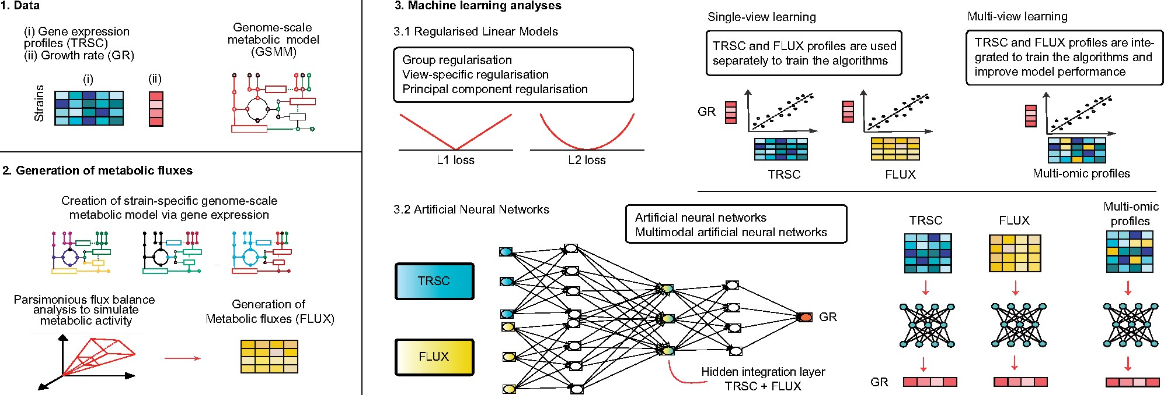

Fig. 1. Pipeline adopted in this study. From 1143 S. cerevisiae strains, the gene expression was used as a starting ...
Notes:
Fig. 1. Pipeline adopted in this study. From 1143 S. cerevisiae strains, the gene expression was used as a starting point (Kemmeren et al., 2014). A GSMM was then used (panel 1) to generate strain-specific GSMM models. From these GSMMs, metabolic fluxes were generated via pFBA (panel 2, see Section 2.2). The machinelearning methods were applied in two different settings: single-view and multiview regression. In the former case, transcriptomics and fluxomics data were used separately as input for RLMs and ANN, while in the latter the two omics were integrated to let the two classes of methods leverage the different information of both sources (panel 3)
Unless provided in the caption above, the following copyright applies to the content of this slide: © The Author(s) 2021. Published by Oxford University Press. All rights reserved. For permissions, please e-mail: journals.permissions@oup.comThis article is published and distributed under the terms of the Oxford University Press, Standard Journals Publication Model (https://academic.oup.com/journals/pages/open_access/funder_policies/chorus/standard_publication_model)

