Slide 1
Using pyGSTi to Generate Probabilities
End state: For drifting noise at a given frequency, determine the amplitude of the probability vs. time function for that frequency.
The challenge of doing this with pyGSTi:
pyGSTi doesn’t explicitly associate a probability amplitude with each frequency/power.
It just takes the frequencies with powers above their threshold and puts those back into the inverse transform (IDCT).
This generates a set of probability vs time values, but not an explicit function relating an amplitude to each frequency.
By manually choosing the frequencies and powers to inverse transform, I can find the probability oscillation for each individual frequency.

Slide 2
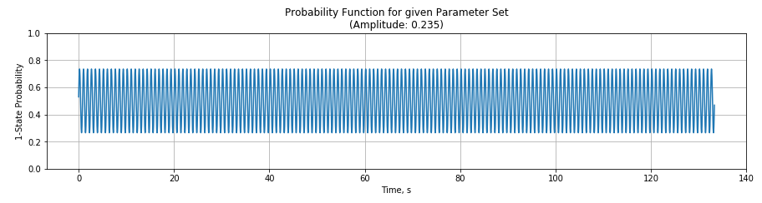
Example: Simulation with 1.2 Hz Noise
This is the probability vs. time function used to generate the 8000 data points.

Slide 3
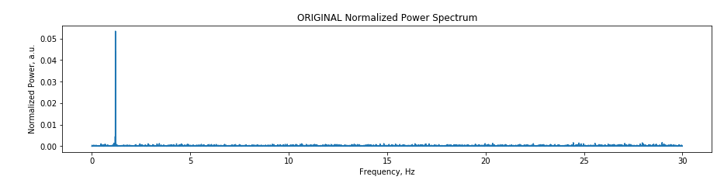
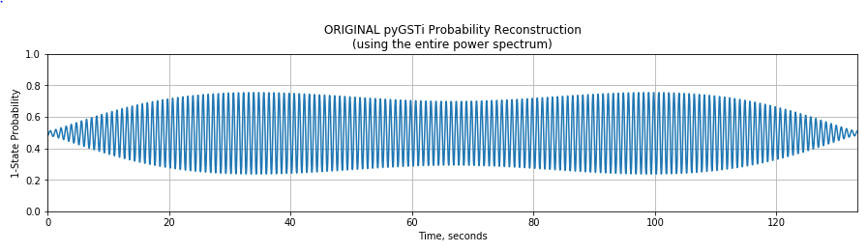
Comparison, part 1: pyGSTi results
This is the power spectrum and resultant probability reconstruction that pyGSTi generated by itself.
I didn’t change the power spectrum going back into the IDCT at all
(I normalized the power spectrum shown here however.)
The probability function should be a simple 1.2 Hz sine curve.
The max probability is just slightly greater than the input value.

Slide 4
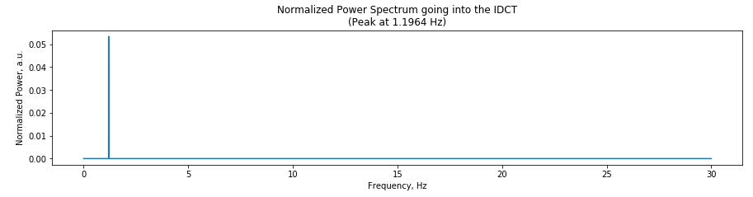
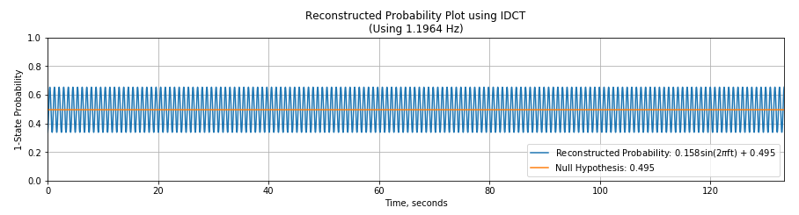
Comparison, part 2: My edits to pyGSTi
In this case, I set the power to zero for all frequencies except for the one closest to 1.2 Hz.
The amplitude is much less than the input amplitude. However, it is clearly a 1.2 Hz sine curve.
The “null hypothesis” line is just the average of the simulated data points.

Slide 5
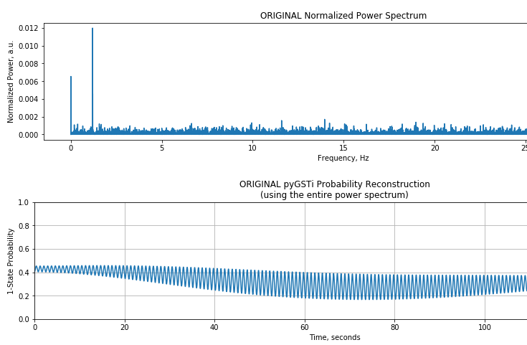
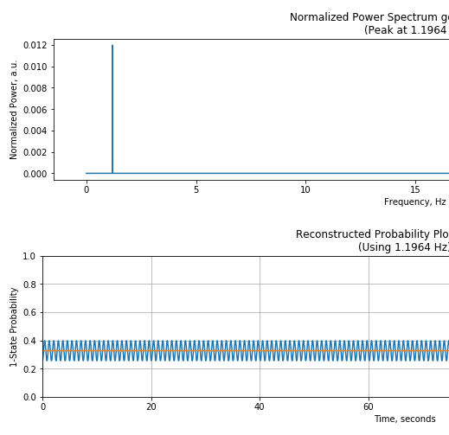
Adding low-frequency components: 0.001 and 0.004 Hz
Cropped images of pyGSTi original results on the left, and my modifications on the right

Slide 6
Next steps
I’ll try adding in other frequencies within a range of the central frequency. Those may add amplitude to the probability function without messing with the sinusoidal shape too much.
Even after changing the size of the input probability amplitude, the trend seems to be that pyGSTi’s maximum probability will overestimate, while my single-frequency version consistently underestimates.
pyGSTi’s reconstructed probability gets rather ugly when there are multiple significant frequencies that are far apart. Selectively choosing the frequencies to inverse transform becomes more effective in those cases.
How well does this work for experimental data?

