Slide 1
Interpreting Power
End state: Convert a power at a frequency of interest to a change in 1-state probability per second (i.e. Ramsey oscillation graph)
My approach to doing so:
Using simulations, relate the per-gate overrotation angle amplitude of a drift frequency to the amplitude of the 1-state probability oscillation.
Using simulations, keeping all other factors constant, vary the per-gate overrotation amplitude over many trials, and record the normalized power of a peak of interest for each trial.
Convert the per-gate overrotation amplitude to a 1-state probability amplitude, and plot the 1-state probability amplitude and the normalized peak power together.
Find a function that relates both 1-state probability amplitude and normalized peak power.
For both experimental data and other simulations, use that function to find the 1-state probability of a normalized power spectrum peak.

Slide 2
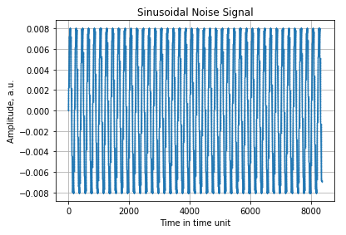
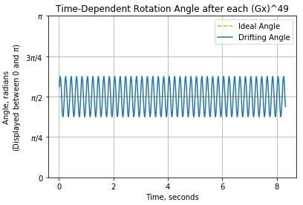
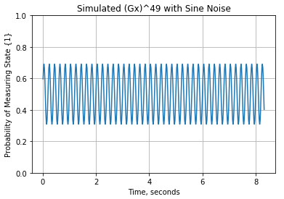

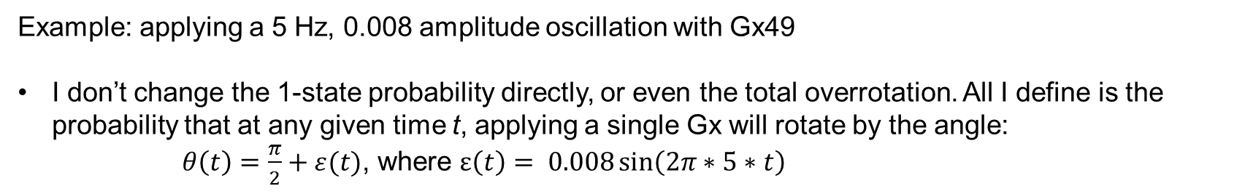

1. Relating per-gate overrotation angle to 1-state probability
Example: applying a 5 Hz, 0.008 amplitude oscillation with Gx49
I don’t change the 1-state probability directly, or even the total overrotation. All I define is the probability that at any given time t, applying a single Gx will rotate by the angle:
$θ\left(t\right)=\frac{π}{2}+ε(t)$, where $ε\left(t\right)= 0.008\sin\left(2π∗5∗t\right)$
1-state probability after 49 Gx gates
$$ε\left(t\right)$$
$θ\left(t\right)$ x 49 (49 Gx gates)

Slide 3
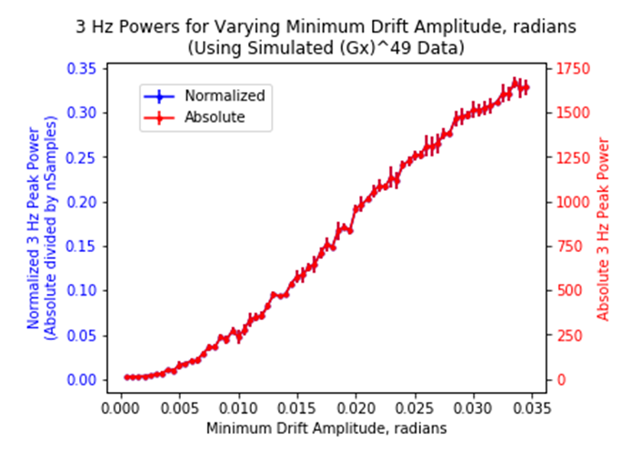
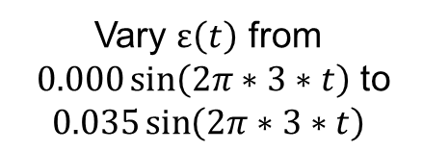
2. Vary the overrotation angle amplitude over multiple trials
***Normalized spectrum = absolute spectrum divided by the number of samples, so that all power values are between 0 and 1 (total normalized power sums to 1)
Vary $ε\left(t\right)$ from
$0.000\sin\left(2π∗3∗t\right)$ to
$$0.035\sin\left(2π∗3∗t\right)$$

Slide 4
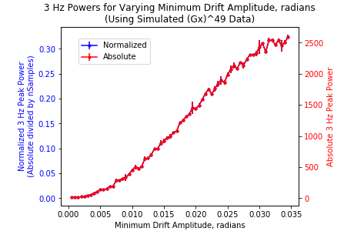
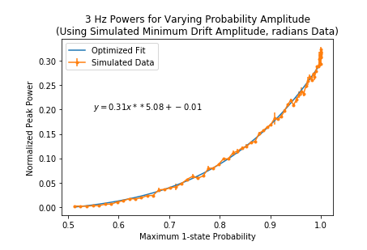
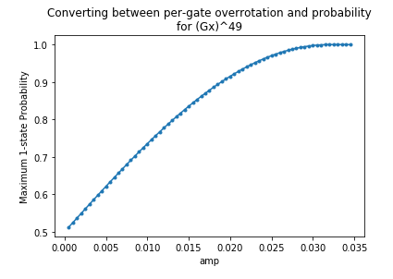
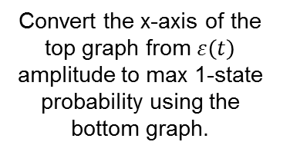
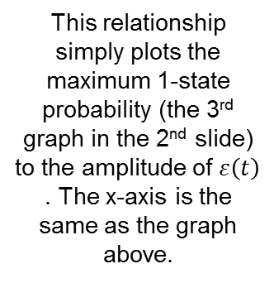
3. Convert the per-gate overrotation amplitude to a 1-state probability amplitude, and relate that to normalized peak power.
Convert the x-axis of the top graph from $ε\left(t\right)$ amplitude to max 1-state probability using the bottom graph.
This relationship simply plots the maximum 1-state probability (the 3rd graph in the 2nd slide) to the amplitude of $ε\left(t\right)$ . The x-axis is the same as the graph above.
There’s a pretty clear relationship between maximum 1-state probability and normalized peak power. This is important because 1-state probability is ultimately what we see in the lab when we do experiments.

Slide 5
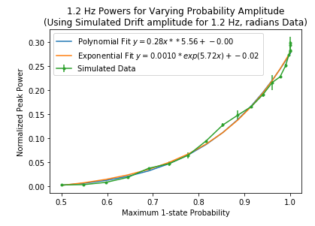
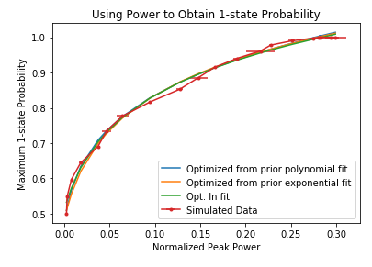
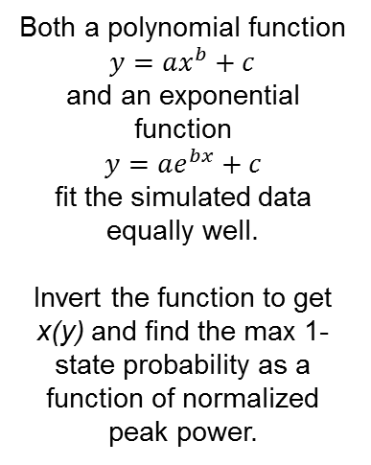
4. Relate 1-state probability amplitude and normalized peak power.
I tried different ranges of amplitudes and frequencies, and the following relationship held for almost all of the cases (± 3 on the last digit of fitted parameters). However, when the maximum 1-state probability exceeds 1 (i.e. the 1-state probability vs. time plot for a single frequency no longer looks like a simple sine curve), this relationship breaks down. Although simulation data may exceed p = 1, experimental data is NOT likely to do so. We’ll probably see the 1-state probability going haywire in LabView before we run in through drift.
Both a polynomial function
$y=ax^{b}+c$
and an exponential function
$y=ae^{bx}+c$
fit the simulated data equally well.
Invert the function to get x(y) and find the max 1-state probability as a function of normalized peak power.

Slide 6
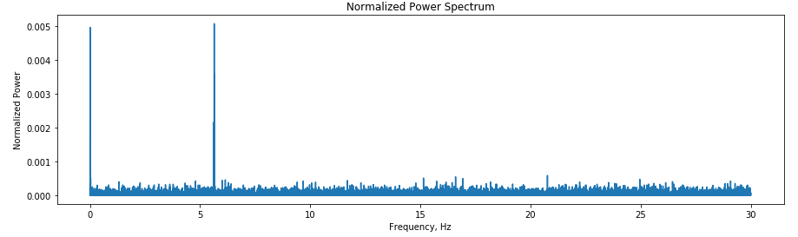
5. For experimental data, find the maximum 1-state probability of a selected frequency peak.
Recall: from 20AUG, we used Gx^11 and modulated amplitude at ~5.5 Hz by ~5% by dithering noise eater setpoint. It used 28000 samples.
The normalized power spectrum for the experiment is shown below.
The peak frequencies are 5.64 Hz (power = 0.0051) and 0.010 Hz (power = 0.0050)

Slide 7
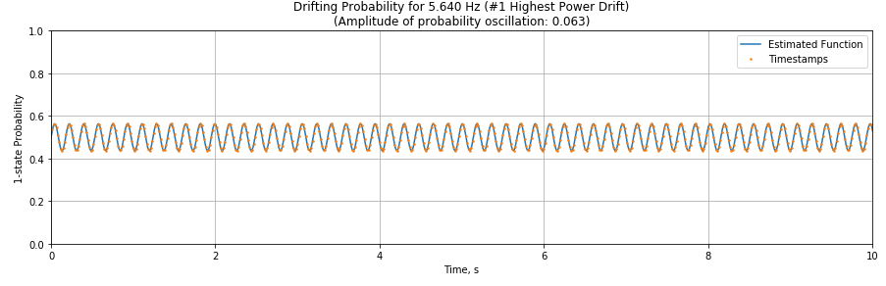
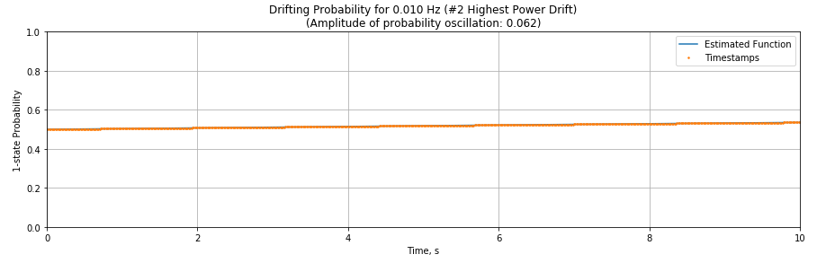


5, continued.
Using the optimized parameters from the exponential fit between 1-state probability and normalized power, the 1-state probabilities for 5.640 and 0.010 Hz are plotted below.
$$p=0.5+0.063\sin{(2π∗5.64t)}$$
$$p=0.5+0.062\sin{(2π∗0.01t)}$$

Slide 8
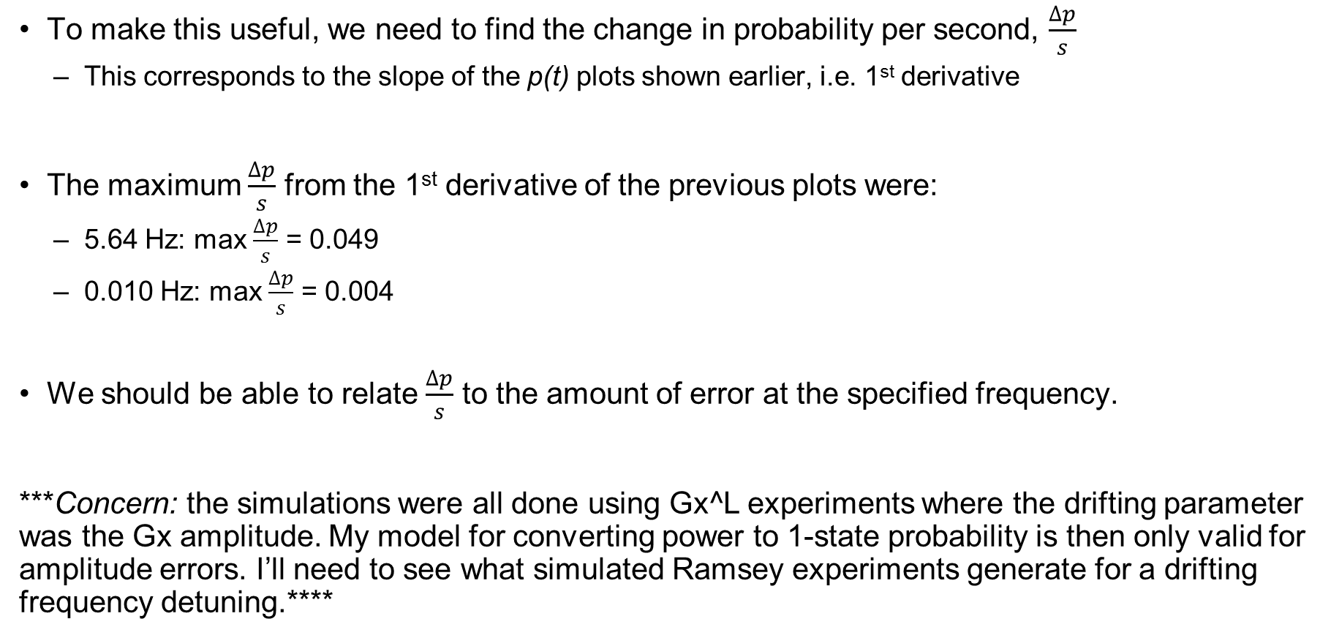
5., continued.
To make this useful, we need to find the change in probability per second, $\frac{∆p}{s}$
This corresponds to the slope of the p(t) plots shown earlier, i.e. 1st derivative
The maximum $\frac{∆p}{s}$ from the 1st derivative of the previous plots were:
5.64 Hz: max $\frac{∆p}{s}$ = 0.049
0.010 Hz: max $\frac{∆p}{s}$ = 0.004
We should be able to relate $\frac{∆p}{s}$ to the amount of error at the specified frequency.
***Concern: the simulations were all done using Gx^L experiments where the drifting parameter was the Gx amplitude. My model for converting power to 1-state probability is then only valid for amplitude errors. I’ll need to see what simulated Ramsey experiments generate for a drifting frequency detuning.****

Slide 9
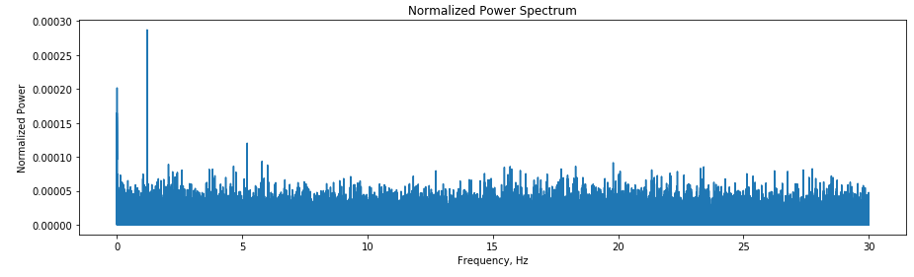
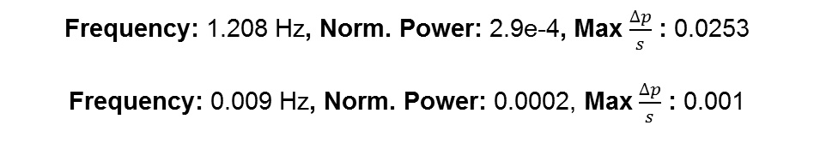
More experimental data, using Ramsey experiments
Gx(32Gi)Gy: 2018_08_27_1627_08_DRIFT
Frequency: 1.208 Hz, Norm. Power: 2.9e-4, Max $\frac{∆p}{s}$ : 0.0253
Frequency: 0.009 Hz, Norm. Power: 0.0002, Max $\frac{∆p}{s}$ : 0.001

Slide 10
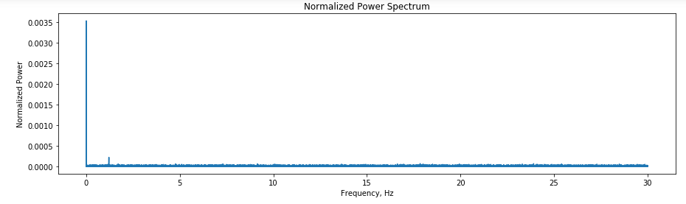
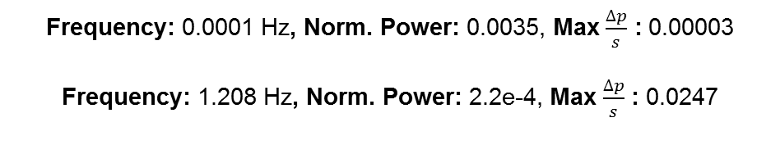
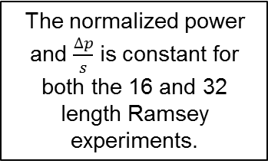
More experimental data, using Ramsey experiments
Gx(16Gi)Gy : 2018_08_27_1354_31_DRIFT
Frequency: 0.0001 Hz, Norm. Power: 0.0035, Max $\frac{∆p}{s}$ : 0.00003
Frequency: 1.208 Hz, Norm. Power: 2.2e-4, Max $\frac{∆p}{s}$ : 0.0247
The normalized power and $\frac{∆p}{s}$ is constant for both the 16 and 32 length Ramsey experiments.

Slide 11
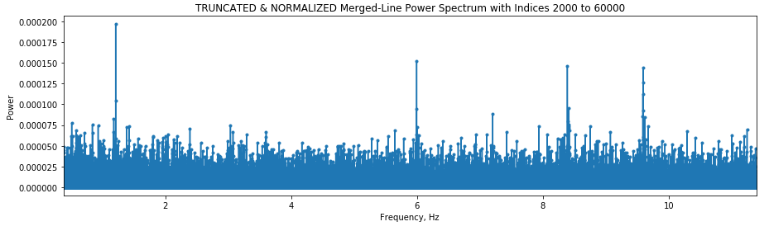
Older experimental data
79 Gx49: 08_21_1614_28
Frequency: 1.210 Hz, Norm. Power: 2e-4, Max $\frac{∆p}{s}$ : 0.0247

Slide 12
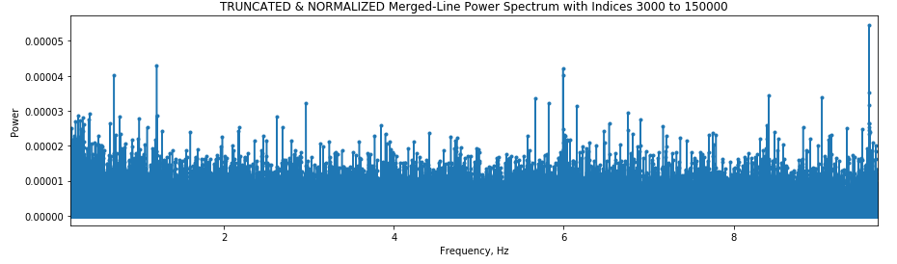
Other older experimental data
232 Gx49: 2018_08_22_1214_32
Frequency: 1.209, Norm. Power: 4e-5, Max $\frac{∆p}{s}$ : 0.0233

