Slide 1
Chapter 1 C++ Basics Review
Reading: Sections 1.4 and 1.5

Slide 2
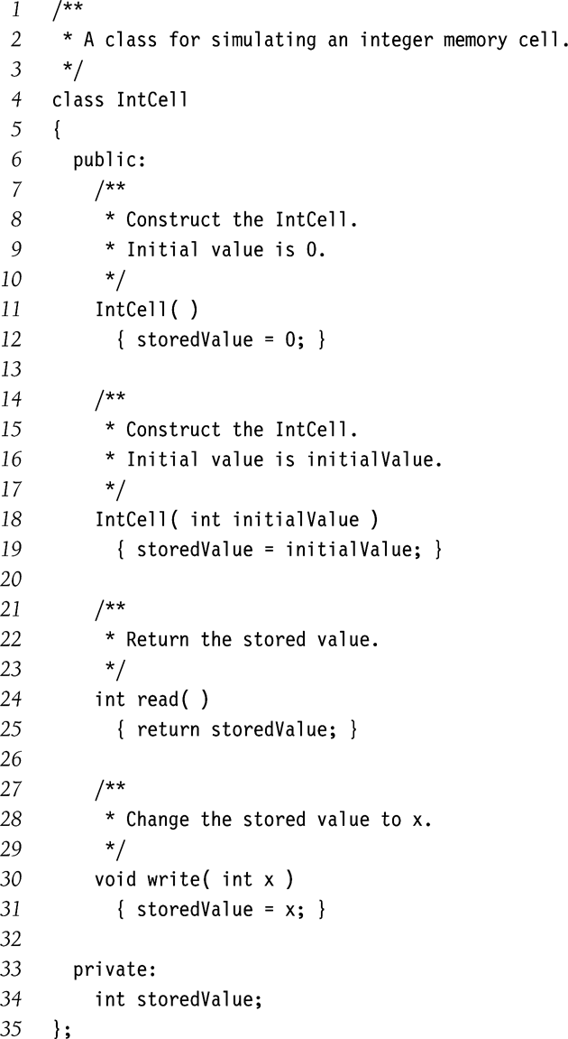
Classes
Defines abstract characteristics of a type of things
Thing’s characteristics (attributes, properties)
That it can do (behaviors or methods)
Properties and methods called members
Members can be
Data/variables
Functions/Methods
Object
An instance of class
Information Hiding Labels
public
private
protected
Constructors
We have two in this example
Why?

Slide 3
Additional Syntax and Accessors
Default parameters
Parameter to constructor is optional
Initializer list
Init data members directly in the constructor
Explicit constructor
Avoids automatic type conversion (and resulting bugs)
The following not allowed
IntCell obj;
obj = 37;
Constant member functions
Examines, but does not change the object state
Also called ‘accessor’
Non-const functions are called ‘mutators’
/**
* A class for simulating an integer memory cell.
*/
class IntCell
{
public:
explicit IntCell( int initialValue = 0 )
: storedValue{ initialValue } { }
int read( ) const
{ return storedValue; }
void write( int x )
{ storedValue = x; }
private:
int storedValue;
};

Slide 4
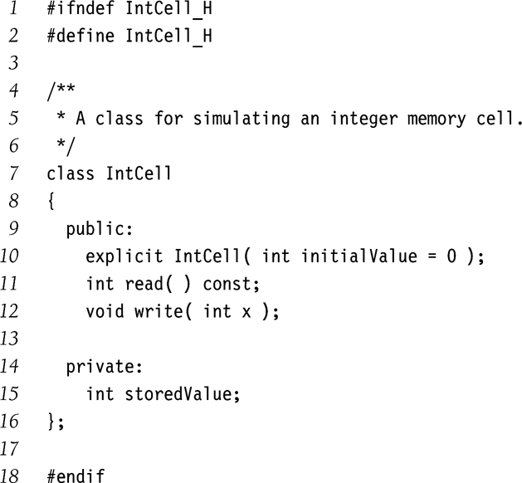
Interface Vs. Implementation
Interface typically defined in .h files
#include in .cpp file
Also referred to as declaration
Preprocessor commands
Guards against multiple inclusion of .h files
Interface

Slide 5
Interface Vs. Implementation (contd.)
Implementation
Scope-resolution operator
The :: symbol
To identify the class corresponding to each function
Remember
Function signatures must match in both interface and implementation
Default parameters are specified only in the interface
#include "IntCell.h"
/**
* Construct the IntCell with initialValue
*/
IntCell::IntCell( int initialValue ) : storedValue{ initialValue }
{
}
/**
* Return the stored value.
*/
int IntCell::read( ) const
{
return storedValue;
}
/**
* Store x.
*/
void IntCell::write( int x )
{
storedValue = x;
}

Slide 6
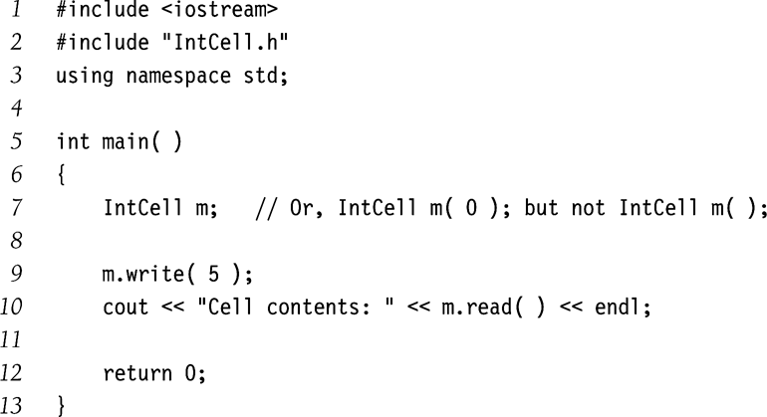
main() function
Objects are declared just like primitive data types.
Legal Declarations
IntCell obj1; // zero parameter constructor
IntCell obj2(12); // one parameter constructor, in classic C++
Illegal declarations
IntCell obj3 = 37; // explicit constructor used
IntCell obj4(); // function declaration
New style supported in C++11
IntCell obj5{12}
IntCell Obj6{}
main() function

Slide 7
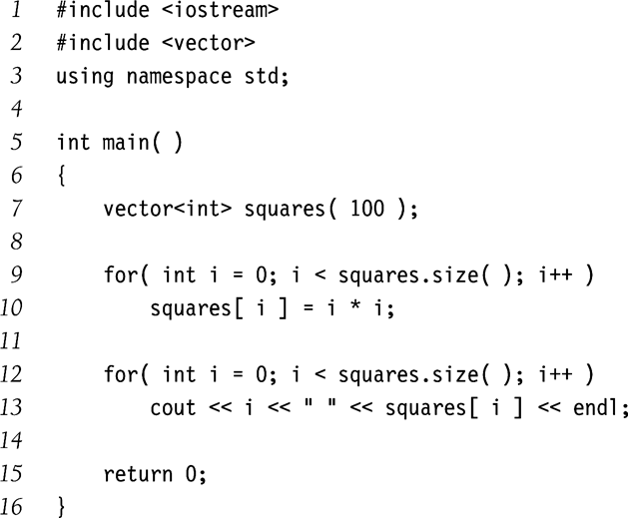
vector and string in C++ STL
Replace built-in C++ arrays and strings, respectively
Built-in arrays/string do not act as proper C++ objects
Standard vector class
Gives a size() function
Can be assigned using =
Standard string class
Compared with ==, <, etc.
Can be assigned using =
Gives length() function
Avoid C++ built-in arrays and strings
Instead, use vector and string classes
Exception: code optimized for speed

Slide 8
New Features in C++11
Initialization of vectors using {}
vector<int> vec1 = {10, 20, 30};
vector<int> vec2{10, 20, 30};
How about
vector<int> vec3(12); //specifying size of vector
vector<int>vec4{12}; // value initialization
Curly braces are for value initialization
Range-based for loop
Keyword auto
You do not need to specify the type
auto i = 20;
auto itr = vec1.begin();
Auto may not be used in some cases
int sum = 0;
for (int x : squares) {
sum += x;
}

Slide 9
Pointers
Pointer variable
Stores the address of another object/data in memory.
Declaration
* before the variable name indicates a pointer declaration
Pointers are uninitialized at declaration time.
Reading uninitialized pointer values results in bugs.
Address-of operator &
&obj gives the address where obj is stored.
int a;
int *b = &a;
int main( )
{
IntCell *m;
m = new IntCell{ 0 };
m->write( 5 );
cout << "Cell contents: " << m->read( ) << endl;
delete m;
return 0;
}
a
b
5
1001
1001

Slide 10
Pointers (contd)
Dynamic object creation
Using the new keyword
Garbage collection
Objects allocated using new must be explicitly deleted.
Otherwise your program will have memory leaks
There’s no automatic GC in C++.
Accessing members of an object
Use the -> operator
int main( )
{
IntCell *m;
m = new IntCell{ 0 };
m->write( 5 );
cout << "Cell contents: " << m->read( ) << endl;
delete m;
return 0;
}

Slide 11
Reference Variables
Synonyms of objects they reference
Reference are not pointers
E.g.
string x = findMax(a);
string & y = x;
cout << y << endl;
Avoid the cost of copying
Can be used for
Parameter passing
Local variables
Also used for referencing objects with complex expression
E.g. list<T> & whichList = theLists[ hash(x, theLists.size()) ];
Range-based for loop
x
y
whatever string
for (auto & x : squares) {
++x;
}

Slide 12
Lvalue, Rvalue, and References (C++11)
Lvalue
Associated with non-temporary object
string str = “hello”;
string & str1 = str;
Rvalue
Associated with temporary object that will be destroyed soon
string && str2 = “hello”;
For the new move syntax in C++11
Rvalues can be moved (we do not need the value anyway)
Lvalues can only be copied
What if you want to change a Lvalue into Rvalue
Std::move(str)

Slide 13
A Motivating Example
vector<int> vector_sum(const vector<int> & v1, const vector<int>& v2) {
// assuming v1 and v2 have the same size
vector<int> v(v1.size()); // temporary vector
for (auto i = 0; I != v1.size(); ++i) {
v[i] = v1[i] + v2[i];
}
return v;
}
vector<int> a, b;
….
vector<int> c = vector_sum(a, b); // copied to c

Slide 14
Parameter Passing
double avg( const vector<int> & arr, int n, bool & errorFlag);
Call by value
Copies the value of parameter being passed.
Called function can modify the parameter, but cannot alter the original variable.
What happens if the parameter is a large object?
Call by reference
Used when the function needs to change the value of original argument
Technically, it is call by lvalue reference
Call by constant reference
Typically used when
Should not be changed by the function
parameter is a large object
Using call-by-value would result in large copying overhead.

Slide 15
New Feature in C++11
Call by rvalue reference
Move rvalue instead of copy
Which is normally much more efficient
string randomItem(const vector<string> & arr); // lvalue
string randomItem(vector<string> && arr); //rvalue
vector<string> v{“hello”, “world”};
cout << randomItem(v) << endl; // lvalue
cout << randomItem({“hello”, “world”}) << end; // rvalue

Slide 16
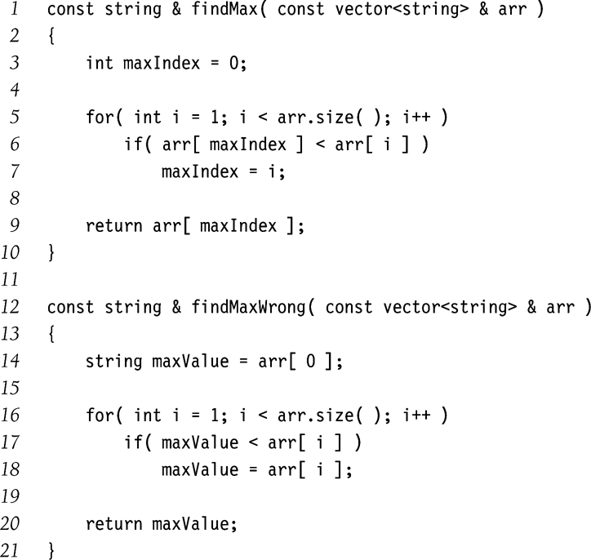
Return Passing
Return by value
Makes a copy of the variable returned
Return by reference
Return reference of the variable returned
Return by constant reference
Return the reference of the variable returned
Return value cannot be modified by caller.
For the last two techniques
Lifetime of returned value should extend beyond the function called
Note also that return by value can be very efficient in C++11
Correct
Incorrect
Why??

Slide 17
Big Five in C++
Five special functions provided in all C++ classes
Destructor
Copy constructor
Move constructor // since C++11
Copy assignment operator=
Move assignment operator= // since C++11
Similarly, a default constructor will be provided by compiler, if no any constructor explicitly defined
This is rare, you normally provide at least a constructor

Slide 18
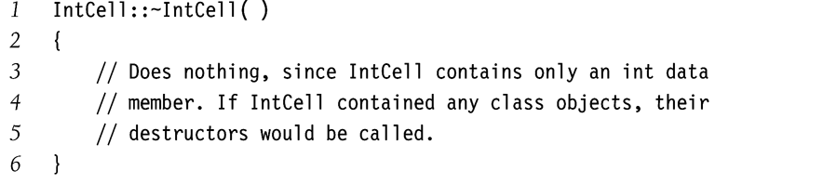
Destructor
Called whenever
Object goes out of scope
delete called
Frees up resource allocated for the object

Slide 19
Copy and move constructor
Initializes a new object to another of its own type
Copy constructor if existing one is lvalue
Move constructor if existing one is rvalue
Invoked during
Declaration
IntCell B = C;
Intcell B {C};
Call by value, and return by value
But not in
IntCell B;
B = C; (assignment operator)
Function signatures
IntCell(const IntCell &rhs);
IntCell(IntCell && rhs);

Slide 20
copy and move operator=
Assignment operator
Called when both LHS and RHS objects have been created
Copy assignment if RHS is lvalue
Move assignment if RHS is ravlue
Function signatures
IntCell & operator=(const IntCell &rhs);
IntCell & operator=(IntCell && rhs);

Slide 21
Problem with defaults
Usually don’t work when data member is a pointer type.
What is the output of f() in the adjacent example?
In this example, default operator= and copy constructor copy the pointer instead of the value (pointee)
If a class contains pointers as member variables, and you want two copies of objects pointed at
Write your own big fives
class IntCell
{
public:
explicit IntCell( int initialValue = 0 )
{ storedValue = new int{ initialValue }; }
int read( ) const
{ return *storedValue; }
void write( int x )
{ *storedValue = x; }
private:
int *storedValue;
};
int f( )
{
IntCell a{ 2 };
IntCell b = a;
IntCell c;
c = b;
a.write( 4 );
cout << a.read( ) << endl << b.read( ) << endl << c.read( ) << endl;
return 0;
}

Slide 22
IntCell with Big Five
class IntCell
{
public:
explicit IntCell( int initialValue = 0 )
{ storedValue = new int{ initialValue }; }
~IntCell( ) // destructor
{ delete storedValue; }
IntCell( const IntCell & rhs ) // copy constructor
{ storedValue = new int{ *rhs.storedValue }; }
IntCell( IntCell && rhs ) : storedValue{ rhs.storedValue } // move constructor
{ rhs.storedValue = nullptr; }
IntCell & operator= ( const IntCell & rhs ) // copy assignment
{
if( this != & rhs )
*storedValue = *rhs.storedValue;
return *this;
}
IntCell & operator= ( IntCell && rhs ) // move assignment
{
std::swap( storedValue, rhs.storedValue );
return *this;
}
int read( ) const
{ return *storedValue; }
void write( int x )
{ *storedValue = x; }
private:
int *storedValue;
};

Slide 23
Exercise
Identify the difference between
Shallow copy, and
Deep copy
For next class
Read Section 1.6

Slide 24
Base Class and Derived Class
Constructor
Instantiating an object of derived class begins a chain of constructor calls
Derived class constructor first calls base class constructor before performing its own tasks
Base class constructor can be either implicitly or explicitly invoked by the derived class constructor
Explicit invocation via “base-class initializer syntax”
Explicit invocation normally involves passing some parameters
Destructor
Destroying an object of derived class begins a chain of destructor calls
In the reverse order of constructor execution
Destructor of derived class performs its own tasks first, before calling the base class destructor
Called implicitly

Slide 25
Example
#include <iostream>
using namespace std;
class my_base_class {
public:
my_base_class(int initial_value = 0) : x(initial_value) {
cout << "Inside base class constructor" << endl;
cout << "x == " << x << endl;
}
~my_base_class() {
cout << "Inside base class destructor" << endl;
}
int get_x() const {
return x;
}
private:
int x;
};
class my_derived_class : public my_base_class {
public:
my_derived_class(int initial_x_value = 0, int initial_y_value = 0)
: my_base_class(initial_x_value), y(initial_y_value) {
cout << "Inside derived class constructor" << endl;
cout << "x == " << get_x() << endl;
cout << "y == " << y << endl;
}
~my_derived_class() {
cout << "Inside derived class destructor" << endl;
}
private:
int y;
};
Explicitly calling base class constructor

Slide 26
Example (Cont’d)
int main() {
my_derived_class mdc1;
my_derived_class mdc2(2, 4);
return(0);
}
Inside base class constructor
x == 0
Inside derived class constructor
x == 0
y == 0
Inside base class constructor
x == 2
Inside derived class constructor
x == 2
y == 4
Inside derived class destructor
Inside base class destructor
Inside derived class destructor
Inside base class destructor
see r1/base_derived.cpp

