Slide 1
Chapter 1 C++ Templates
Readings: Sections 1.6 and 1.7

Slide 2
Templates
Type-independent patterns that can work with multiple data types.
Generic programming
Code reusable
Function Templates
These define logic behind the algorithms that work for multiple data types.
Class Templates
These define generic class patterns into which specific data types can be plugged in to produce new classes.

Slide 3
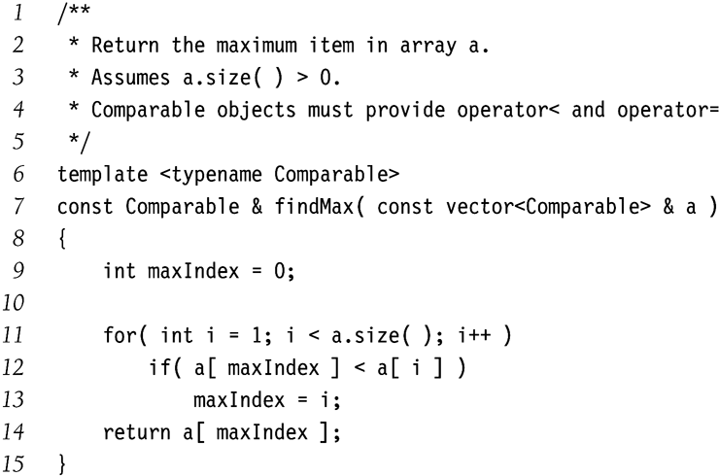
Function Templates Example
Generic function to find a maximum value in a given vector
If argument is a vector<int> type, then compiler generates a corresponding function
where Comparable is replaced by int type.
Similarly for vector<double>, vector<string> etc.
Assumption in this example:
Operator < is defined in the Comparable.
Hence assumptions made by the template must be clearly stated.
template <class Comparable>

Slide 4
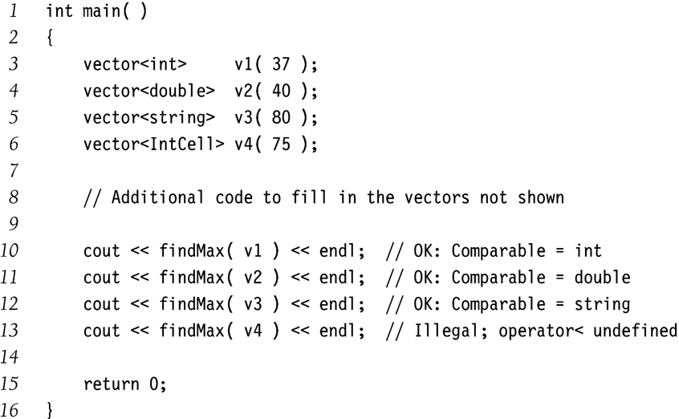
Function Templates Usage
Each call to findMax() on a different data type forces the compiler to generate a different function using the template.
Compiler will complain about findMax(v4)
because IntCell class does not defined operator<

Slide 5
An example
class Square
{
public:
explicit Square( double s = 0.0 ) : side{ s }
{ }
double getSide( ) const
{ return side; }
double getArea( ) const
{ return side * side; }
double getPerimeter( ) const
{ return 4 * side; }
void print( ostream & out = cout ) const
{ out << "(square " << getSide( ) << ")"; }
bool operator< ( const Square & rhs ) const
{ return getSide( ) < rhs.getSide( ); }
private:
double side;
};
// Define an output operator for Square
ostream & operator<< ( ostream & out, const Square & rhs )
{
rhs.print( out );
return out;
}
Operator Overloading
Comparison operator<
Defines the meaning of operator< for Employee class.
Output operator<<
Define a global nonclass function operator<< that calls print(…)
Define a public member function
print( ostream & out)

Slide 6
Function Objects
template <typename Object, typename Comparator>
const Object & findMax( const vector<Object> & arr, Comparator cmp )
{
int maxIndex = 0;
for( int i = 1; i < arr.size( ); ++i )
if( cmp.isLessThan( arr[ maxIndex ], arr[ i ] ) )
maxIndex = i;
return arr[ maxIndex ];
}
class CaseInsensitiveCompare
{
public:
bool isLessThan( const string & lhs, const string & rhs ) const
{ return strcasecmp( lhs.c_str( ), rhs.c_str( ) ) < 0; }
};
int main( )
{
vector<string> arr = { "ZEBRA", "alligator", "crocodile" };
cout << findMax( arr, CaseInsensitiveCompare{ } ) << endl;
return 0;
}
Objects whose primary purpose is to define a function
Here findMax accepts a Comparator parameter as a function object.
Comparator assumed to define the isLessThan(…) function.
There is a more formal way to define function objects in C++ (next slide).

Slide 7
Function objects in C++ style
template <typename Object, typename Comparator>
const Object & findMax( const vector<Object> & arr,
Comparator isLessThan )
{
int maxIndex = 0;
for( int i = 1; i < arr.size( ); ++i )
if( isLessThan( arr[ maxIndex ], arr[ i ] ) )
maxIndex = i;
return arr[ maxIndex ];
}
const Object & findMax( const vector<Object> & arr )
{
return findMax( arr, less<Object>{ } );
}
class CaseInsensitiveCompare
{
public:
bool operator( )( const string & lhs, const string & rhs ) const
{ return strcasecmp( lhs.c_str( ), rhs.c_str( ) ) < 0; }
};
int main( )
{
vector<string> arr = { "ZEBRA", "alligator", "crocodile" };
cout << findMax( arr, CaseInsensitiveCompare{ } ) << endl;
cout << findMax( arr ) << endl;
return 0;
}
Using operator overloading
Define operator () for CaseInsensitiveCompare class
Instead of cmp.operator()(x,y)
we can use cmp(x,y)
Case-sensitive comparison can also be performed using STL function object less<Object>(...)

Slide 8
Class Template Example
MemoryCell template can be used for any type Object.
Assumptions
Object has a zero parameter constructor
Object has a copy constructor
Copy-assignment operator
Convention
Class templates declaration and implementation usually combined in a single file.
It is not easy to separate them in independent files due to complex c++ syntax.
This is different from the convention of separating class interface and implementation in different files.
/**
* A class for simulating a memory cell.
*/
template <typename Object>
class MemoryCell
{
public:
explicit MemoryCell( const Object & initialValue = Object{ } )
: storedValue{ initialValue } { }
const Object & read( ) const
{ return storedValue; }
void write( const Object & x )
{ storedValue = x; }
private:
Object storedValue;
};

Slide 9
Another Way (Implementation outside of declaration)
template <typename T>
class MemoryCell {
public:
explicit MemoryCell(const T& initialVale = T{});
const T& read() const;
void write(const T& x);
private:
T storedValue;
};
template <typename T>
MemoryCell<T>::MemoryCell(const T& initialValue): storedValue{initialValue} {}
template <typename T>
const T& MemoryCell<T>::read() const {
return storedValue;
}
template <typename T>
void MemoryCell<T>::write(const T& x) {
storedValue = x;
}

Slide 10
Class Template Usage Example
MemoryCell can be used to store both primitive and class types.
Remember
MemoryCell is not a class.
It’s a class template.
MemoryCell<int>, MemoryCell<string> etc are classes.
int main( )
{
MemoryCell<int> m1;
MemoryCell<string> m2{ "hello" };
m1.write( 37 );
m2.write( m2.read( ) + " world" );
cout << m1.read( ) << endl << m2.read( ) << endl;
return 0;
}

Slide 11
Matrices
#include <vector>
using namespace std;
template <typename Object>
class matrix
{
public:
matrix( int rows, int cols ) : array( rows )
{
for( auto & thisRow : array )
thisRow.resize( cols );
}
matrix( const vector<vector<Object>> & v ) : array{ v }
{ }
matrix( vector<vector<Object>> && v ) : array{ std::move( v ) }
{ }
const vector<Object> & operator[]( int row ) const
{ return array[ row ]; }
vector<Object> & operator[]( int row )
{ return array[ row ]; }
int numrows( ) const
{ return array.size( ); }
int numcols( ) const
{ return numrows( ) ? array[ 0 ].size( ) : 0; }
private:
vector<vector<Object>> array; // C++11
// vector<vector<Object> > array; // prior to c++11
};
C++ library does not provide a matrix class
Constructor
Creates rows number of zero-sized vectors
Resizes each vector to col elements
Two types of [] operators
One for LHS that returns by reference
Another for RHS that returns by constant reference
So we have two very identical functions
What makes their signatures different?

Slide 12
Reading Assignment
2.1, 2.2, 2.3, 2.4.1, 2.4.2, 2.4.3

