Slide 1
Chapter 2 Algorithm Analysis
Reading: Chapter 2

Slide 2
Complexity Analysis
Measures efficiency (time and memory) of algorithms and programs
Can be used for the following
Compare different algorithms
See how time varies with size of the input
Operation count
Count the number of operations that we expect to take the most time
Asymptotic analysis
See how fast time increases as the input size approaches infinity
2
Notes:
2

Slide 3
Operation Count Examples
Example 1
for(i=0; i<n; i++)
cout << A[i] << endl;
Example 2
template <class T>
bool IsSorted(T *A, int n)
{
bool sorted = true;
for(int i=0; i<n-1; i++)
if(A[i] > A[i+1])
sorted = false;
return sorted;
}
Number of outputs = n
Number of comparisons = n - 1
3
Notes:
3

Slide 4
Scaling Analysis
How much will time increase in example 1, if n is doubled?
t(2n)/t(n) = 2n/n = 2
Time will double
If time t(n) = 2n² for some algorithm, then how much will time increase if the input size is doubled?
t(2n)/t(n) = 2 (2n)² / (2n ²) = 4n ² / n ² = 4
4
Notes:
4

Slide 5
Comparing Algorithms
Assume that algorithm 1 takes time t₁(n) = 100n+n² and algorithm 2 takes time t₂(n) = 10n²
If an application typically has n < 10, then which algorithms is faster?
If an application typically has n > 100, then which algorithms is faster?
Assume algorithms with the following times
Algorithm 1: insert - n, delete - log n, lookup - 1
Algorithm 2: insert - log n, delete - n, lookup - log n
Which algorithm is faster if an application has many inserts but few deletes and lookups?
5
Notes:
5

Slide 6
Asymptotic Complexity Analysis
Compares growth rate of two functions
T = f(n) (estimated run time)
Variables: non-negative integers
For example, size of input data
Values: non-negative real numbers
For example, running time of an algorithm
Dependent on
Eventual (asymptotic) behavior
Independent of
constant multipliers
and lower-order effects
Metrics
“Big O” Notation: O()
“Big Omega” Notation: ()
“Big Theta” Notation: ()

Slide 7
Big “O” Notation
f(n) =O(g(n))
If and only if
there exist two positive constants c > 0 and n₀ > 0,
such that f(n) < cg(n) for all n >= n₀
iff ∃ c, n₀ > 0 | 0 < f(n) < cg(n) ∀ n >= n₀
cg(n)
f(n)
f(n) is asymptotically
upper bounded by g(n)
n₀

Slide 8
Big “Omega” Notation
f(n) = Ω(g(n))
iff ∃ c, n₀ > 0 | 0 < cg(n) < f(n) ∀ n >= n₀
f(n)
cg(n)
f(n) is asymptotically
lower bounded by g(n)
n₀

Slide 9
Big “Theta” Notation
f(n) = Θ(g(n))
iff ∃ c₁, c₂, n₀ > 0 | 0 < c₁g(n) < f(n) < c₂g(n) ∀ n >= n₀
c₂g(n)
f(n)
f(n) has the
same long-term
rate of
growth as g(n)
c₁g(n)
n₀

Slide 10
Example
f(n) = 3n² + 17
Ω(1), Ω(n), Ω(n²) ➔lower bounds
O(n²), O(n³), … ➔ upper bounds
Θ(n²) ➔ exact bound

Slide 11
Analogous to Real Numbers
f(n) = O(g(n)) (a < b)
f(n) = Ω(g(n)) (a > b)
f(n) = Θ(g(n)) (a = b)
The above analogy is not quite accurate, but its convenient to think of function complexity in these terms.

Slide 12
Transitivity
f(n) = O(g(n)) (a < b)
f(n) = Ω(g(n)) (a > b)
f(n) = Θ(g(n)) (a = b)
If f(n) = O(g(n)) and g(n) = O(h(n))
Then f(n) = O(h(n))
If f(n) = Ω(g(n)) and g(n) = Ω(h(n))
Then f(n) = Ω(h(n))
If f(n) = Θ(g(n)) and g(n) = Θ(h(n))
Then f(n) = Θ(h(n))
And many other properties

Slide 13
Arithmetic Properties
Additive property
If e(n) = O(g(n)) and f(n) = O(h(n))
Then e(n) + f(n) = O(g(n) + h(n))
Less formally: O(g(n)+h(n)) = max(O(g(n)), O(h(n))
Multiplicative property
If e(n) = O(g(n)) and f(n) = O(h(n))
Then e(n) * f(n) = O(g(n) * h(n))

Slide 14
Some Rules of Thumb
If f(n) is a polynomial of degree k
Then f(N) = Θ (N^{k})
log^{k}N = O(N) for any constant k
Logarithms grow very slowly compared to even linear growth

Slide 15
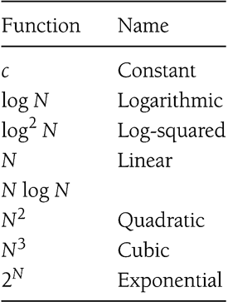
Typical Growth Rates

Slide 16
Exercise
f(N) = N logN and g(N) = N^{1.5}
Which one grows faster??
Note that g(N) = N^{1.5} = N*N^{0.5}
Hence, between f(N) and g(N), we only need to compare growth rate of logN and N^{0.5}
Equivalently, we can compare growth rate of log²N with N
Now, refer to the result on the previous slide to figure out whether f(N) or g(N) grows faster!

Slide 17
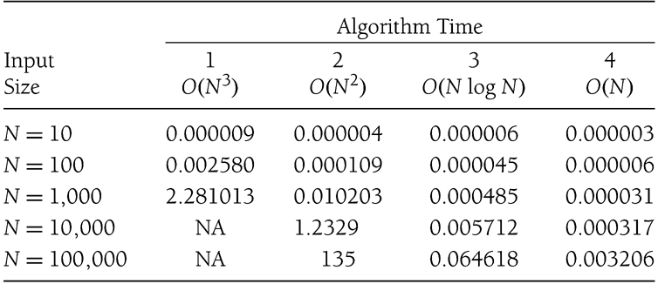
Maximum Subsequence Sum Problem
Given a sequence of integers A₁, A₂, …, A_{N}
Find the maximum subsequence (A_{i} + A _{i+1} + … + A _{k}), where 1 < i < N
For example
for: –2, 11, -4, 13, -5, -2
The answer is 20: (11, -4, 13)
Many algorithms of differing complexity can be found
Example run times from some computer illustrated below

Slide 18
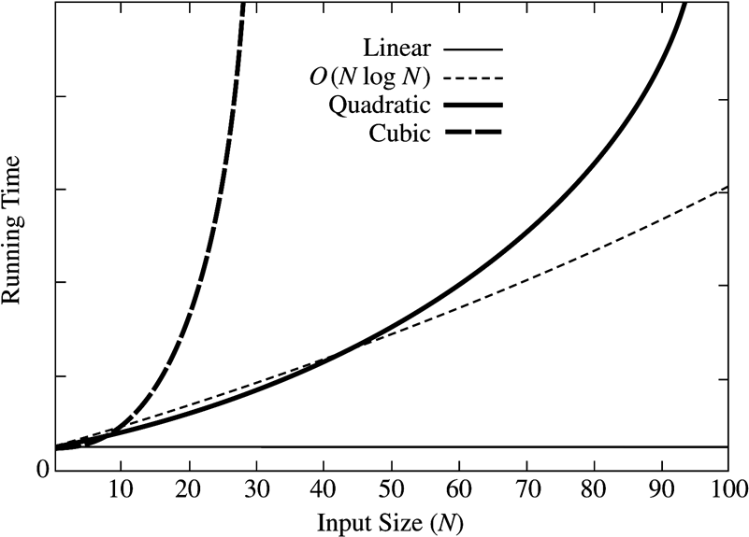
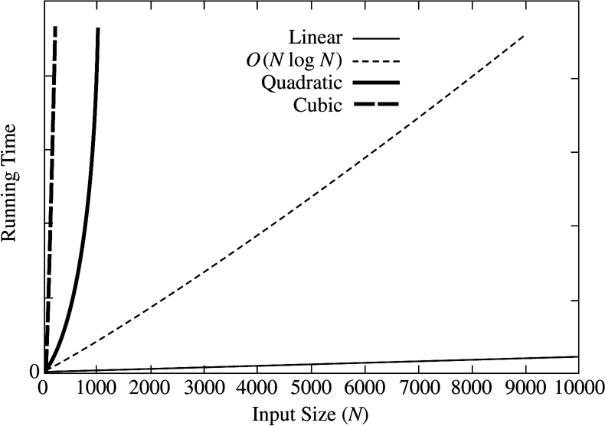
How Complexity Affects Running Times
18
Notes:
18

Slide 19
Complexity Analysis
Steps
Find n = size of input
Find atomic activities to count
Primitive operations such as +, -, *, /.
Assumed to finish within one unit of time
Find f(n) = the number of atomic activities done by an input size of n
Complexity of an algorithm = complexity of f(n)

Slide 20
Running Time Calculations - Loops
for (j = 0; j < n; ++j) {
// 3 atomics
}
Number of atomic operations
Each iteration has 3 atomic operations, so 3n
Cost of the iteration itself
One initialization assignment
n increment (of j)
n comparisons (between j and n)
Complexity = Θ(3n) = Θ(n)

Slide 21
Loops with Break
for (j = 0; j < n; ++j) {
// 3 atomics
if (condition) break;
}
Upper bound = O(4n) = O(n)
Lower bound = Ω(4) = Ω(1)
Complexity = O(n)
Why don’t we have a Θ(…) notation here?

Slide 22
Sequential Search
Given an unsorted vector a, find the location of element X.
for (size_t i = 0; i < a.size(); i++) {
if (a[i] == X) return true;
}
return false;
Input size: n = a.size()
Complexity = O(n)

Slide 23
If-then-else Statement
if(condition)
i = 0;
else
for ( j = 0; j < n; j++)
a[j] = j;
Complexity = ??
= O(1) + max ( O(1), O(N))
= O(1) + O(N)
= O(N)

Slide 24
Consecutive Statements
Add the complexity of consecutive statements
Complexity = Θ(3n + 5n) = Θ(n)
for (j = 0; j < n; ++j) {
// 3 atomics
}
for (j = 0; j < n; ++j) {
// 5 atomics
}

Slide 25
Nested Loop Statements
Analyze such statements inside out
for (j = 0; j < n; ++j) {
// 2 atomics
for (k = 0; k < n; ++k) {
// 3 atomics
}
}
Complexity = Θ((2 + 3n)n) = Θ(n²)

Slide 26
Recursion
long factorial( int n )
{
if( n <= 1 )
return 1;
else
return n * factorial( n - 1 );
}
long fib( int n )
{
if ( n <= 1)
return 1;
else
return fib( n – 1 ) + fib( n – 2 );
}
We need to determine how many times a recursive function is called
This is really a
simple loop
disguised as recursion
Complexity = O(n)
Fibonacci Series:
Terrible way to
Implement recursion
Complexity = ((3/2)^{N} )
That’s Exponential !!

Slide 27
Logarithms in Running Time
General rule:
If constant time is required to merely reduce the problem by a constant amount, the algorithm is O(N).
An algorithm is O(logN) if it takes constant O(1) time to cut the problem size by a fraction (usually ½N).
Binary search
Euclid’s Algorithm
Exponentiation

Slide 28
Binary Search
Given a sorted vector a, find the location of element X
int binary_search(const vector<int> & a, int X)
{
unsigned int low = 0, high = a.size()-1;
while (low <= high) {
int mid = (low + high) / 2;
if (a[mid] < X)
low = mid + 1;
else if( a[mid] > X )
high = mid - 1;
else
return mid;
}
return NOT_FOUND;
}
Input size: n = a.size()
Complexity = O( k iterations x (1 comparison+1 assignment) per loop)
= O(log(n))

Slide 29
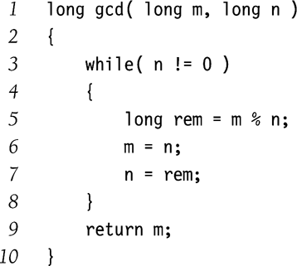
Euclid’s Algorithm
Find the greatest common divisor (gcd) between m and n
Given M > N
For example
M = 50, N = 15
Remainders
5, 0
So gcd(50, 15) = 5
Complexity = O(logN)
Exercise:
Why is it O(logN) ?
If M > N, then (M mod N) < M/2

Slide 30
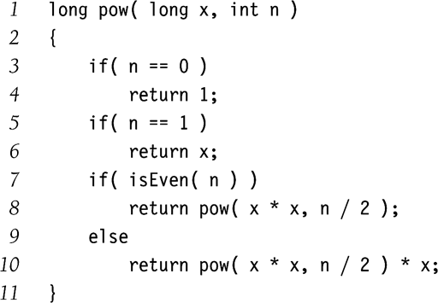
Exponentiation
Calculate x^{n}
Example:
x¹¹ = x⁵ * x⁵ * x
x⁵ = x² * x² * x
x² = x * x
Complexity = O( logN )
Why didn’t we implement the recursion as follows?
pow(x,n/2)*pow(x,n/2)*x

