Slide 1
List ADT: Linked lists
Reading: Sections 3.2, 3.3, 3.5

Slide 2
Lists in Everyday Life
Shopping list
To-do list
Dave Letterman’s top 10 list
List stored as a vector
What if you want to insert or delete an item?
How many elements you need to move?

Slide 3
List Wish List
Efficiently insert an element
Efficiently remove an element
Remove all items
Assignment operator
Comparison operators
Constructors/destructors
Generic class
Convenient way to iterate through the list

Slide 4
Singly Linked List
ListElement
next
next
next
next
null
null
prev
front
back?
Time complexities for push_front, push_back, pop_front, pop_back?
4
Notes:
4

Slide 5
Abstract view of List and Iterator
Doubly-linked list
ListElement
next
next
next
next
null
null
prev
prev
prev
prev
front
I1
back
Iterator

Slide 6
List Public Interface
Constructors and big-five
Copy/move constructor, copy/move assignment operator, destructor
List();
List(const List &rhs);
List(List &&rhs);
List & operator=(const List &rhs);
List & operator=(List && rhs);
~List();
Read-only accessor functions
int size() const;
bool empty() const;

Slide 7
List Public Interface (cont’d)
Accessing values on the list
Object & front();
Object & back();
and their constant versions.
Locating places on the list using iterators
Both regular and constant versions
iterator begin();
const_iterator begin() const;
iterator end();
const_iterator end() const;

Slide 8
List Public Interface (cont’d)
List manipulation functions
int push_front(const Object & x);
int push_back(const Object & x);
int pop_front();
int pop_back();
iterator insert(iterator & itr, const Object & x);
iterator erase( iterator itr);
iterator erase( iterator start, iterator end );
void clear();
// and move versions, where it is applicable

Slide 9
List Complexity Requirements
O(1) Runtime complexity
Default constructor
Move constructor
Move assignment operator=
push_front(t), push_back(t), insert(I, t)
pop_front(), pop_back(), erase(I)
begin(), end();
front(), back();
empty();

Slide 10
List Complexity Requirements (2)
O(N) Runtime complexity
Copy Constructor
Copy assignment operator=
Destructor
clear()
erase(SI,EI)

Slide 11
List Iterator Public Interface
Read-only operators
bool operator== (const iterator & rhs) const;
bool operator!= (const iterator & rhs) const;
Object & operator* ( ) const;
// return a reference to current value
Write operators
iterator & operator++ ( ); // prefix
iterator operator++ ( int ); // postfix
iterator& operator-- ( ); // prefix
iterator operator-- ( int ); // postfix
O(1) requirement for space and time

Slide 12
Using List
List<string> Cities;
Cities.push_front(“Tallahassee”);
“Tallahassee”
Cities.push_back(“Gainesville”);
“Tallahassee”, “Gainesville”
Cities.push_front(“Jacksonville”);
“Jacksonville”, “Tallahassee”, “Gainesville”
Cities.push_back(“Miami”);
“Jacksonville”, “Tallahassee”, “Gainesville”, “Miami”
List<string>::iterator I;
for (I = Cities.begin(); I != Cities.end(); ++I) {
// print list with <<
}
// C++11
for (auto I = Cities.begin(); I != Cities.end(); ++I) {
…
}
for (const auto & city : Cities) {
…
}

Slide 13
List Insertion
Insert “Orlando” before “Miami”
// sequential search
for (auto I = Cities.begin(); I != Cities.end(); ++I) {
if (“Miami” == *I) {
break;
}
}
// insert the new string
Cities.insert(I, “Orlando”);
“Jacksonville”, “Tallahassee”, “Gainesville”, “Orlando”, “Miami”
// what happens if “Miami” is not on the list?

Slide 14
Remove all copies of an item from List
Remove all elements with value “Orlando”
List<string>::iterator I = Cities.begin();
// auto I = Cities.begin(); // c++11
while( I != Cities.end()) {
if (“Orlando” == *I) {
I = Cities.erase(I);
} else {
I++;
}
}

Slide 15
List and List Iterator
Conceptual relationship
Iterator I1
begin current end
List: A, B, C, D, E, F
begin current end
Iterator I2

Slide 16
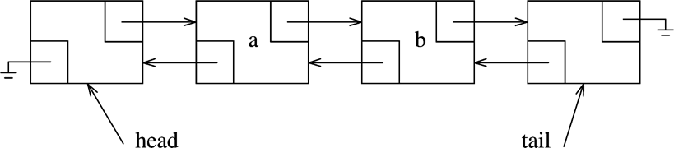
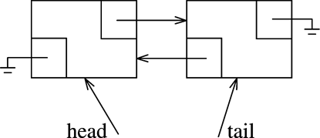
List Implementation
A Doubly Linked List With Header and Tail Nodes as Markers
An Empty List

Slide 17
Nodes in a list
Node
Data Value
Pointers to the previous and next element
Defined within the List class, with limited scope
data
prev
next
data
prev
next
data
prev
next
No need for contiguous memory allocation

Slide 18
List Class (Part 1)
template <typename Object>
class List
{
private:
struct Node
{
Object data;
Node *prev;
Node *next;
Node( const Object & d = Object{ }, Node * p = nullptr, Node * n = nullptr )
: data{ d }, prev{ p }, next{ n } { }
Node( Object && d, Node * p = nullptr, Node * n = nullptr )
: data{ std::move( d ) }, prev{ p }, next{ n } { }
};

Slide 19
List Class (Part 2)
public:
class const_iterator
{
public:
const_iterator( ) : current{ nullptr } // Public constructor for const_iterator.
{ }
const Object & operator* ( ) const
{ return retrieve( ); }
const_iterator & operator++ ( ) // prefix
{
current = current->next;
return *this;
}
const_iterator operator++ ( int ) // postfix
{
const_iterator old = *this;
++( *this );
return old;
}

Slide 20
List Class (Part 3)
const_iterator & operator-- ( )
{
current = current->prev;
return *this;
}
const_iterator operator-- ( int )
{
const_iterator old = *this;
--( *this );
return old;
}
bool operator== ( const const_iterator & rhs ) const
{ return current == rhs.current; }
bool operator!= ( const const_iterator & rhs ) const
{ return !( *this == rhs ); }
protected:
Node *current;
Object & retrieve( ) const
{ return current->data; }
const_iterator( Node *p ) : current{ p }
{ }
friend class List<Object>;
};

Slide 21
List Class (Part 4)
class iterator : public const_iterator
{
public:
iterator( ) { }
Object & operator* ( )
{ return const_iterator::retrieve( ); }
const Object & operator* ( ) const
{ return const_iterator::operator*( ); }
iterator & operator++ ( )
{
this->current = this->current->next;
return *this;
}
iterator operator++ ( int )
{
iterator old = *this;
++( *this );
return old;
}
Why do we
override the
parent’s *
implementation?
Why do we
override the
parent’s ++
implementation?

Slide 22
List Class (Part 5)
iterator & operator-- ( )
{
this->current = this->current->prev;
return *this;
}
iterator operator-- ( int )
{
iterator old = *this;
--( *this );
return old;
}
protected:
iterator( Node *p ) : const_iterator{ p }
{ }
friend class List<Object>;
};

Slide 23
List Class (Part 6)
public:
List( )
{ init( ); }
~List( )
{
clear( );
delete head;
delete tail;
}
List( const List & rhs ) // copy constructor
{
init( );
for( auto & x : rhs )
push_back( x );
}
List & operator= ( const List & rhs ) // copy assignment operator=
{
List copy = rhs;
std::swap( *this, copy );
return *this;
}

Slide 24
List Class (Part 7)
List( List && rhs ) // move constructor
: theSize{ rhs.theSize }, head{ rhs.head }, tail{ rhs.tail }
{
rhs.theSize = 0;
rhs.head = nullptr;
rhs.tail = nullptr;
}
List & operator= ( List && rhs ) // move assignment operator=
{
std::swap( theSize, rhs.theSize );
std::swap( head, rhs.head );
std::swap( tail, rhs.tail );
return *this;
}
iterator begin( )
{ return iterator( head->next ); }
const_iterator begin( ) const
{ return const_iterator( head->next ); }

Slide 25
List Class (Part 8)
iterator end( )
{ return iterator( tail ); }
const_iterator end( ) const
{ return const_iterator( tail ); }
int size( ) const
{ return theSize; }
bool empty( ) const
{ return size( ) == 0; }
void clear( )
{
while( !empty( ) )
pop_front( );
}
Object & front( )
{ return *begin( ); }
const Object & front( ) const
{ return *begin( ); }

Slide 26
List Class (Part 9)
Object & back( )
{ return *--end( ); }
const Object & back( ) const
{ return *--end( ); }
void push_front( const Object & x ) // copy
{ insert( begin( ), x ); }
void push_back( const Object & x ) // copy
{ insert( end( ), x ); }
void push_front( Object && x ) // move
{ insert( begin( ), std::move( x ) ); }
void push_back( Object && x ) // move
{ insert( end( ), std::move( x ) ); }
void pop_front( )
{ erase( begin( ) ); }
void pop_back( )
{ erase( --end( ) ); }

Slide 27
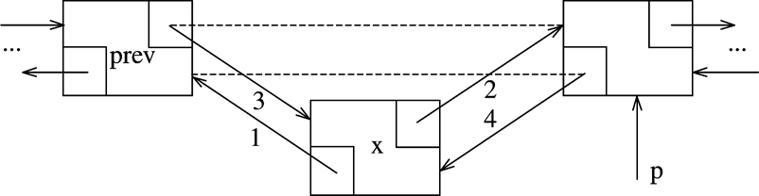
List Class (Part 10)
iterator insert( iterator itr, const Object & x )
{
Node *p = itr.current;
++theSize;
return iterator( p->prev = p->prev->next = new Node{ x, p->prev, p } );
}
iterator insert( iterator itr, Object && x )
{
Node *p = itr.current;
++theSize;
return iterator( p->prev = p->prev->next = new Node{ std::move( x ), p->prev, p } );
}

Slide 28
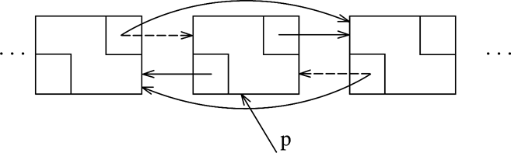
List Class (Part 10)
iterator erase( iterator itr )
{
Node *p = itr.current;
iterator retVal( p->next );
p->prev->next = p->next;
p->next->prev = p->prev;
delete p;
--theSize;
return retVal;
}
iterator erase( iterator from, iterator to )
{
for( iterator itr = from; itr != to; )
itr = erase( itr );
return to;
}

Slide 29
List Class (Part 11)
private:
int theSize;
Node *head;
Node *tail;
void init( )
{
theSize = 0;
head = new Node;
tail = new Node;
head->next = tail;
tail->prev = head;
}
};

Slide 30
Reading assignment
Sections 3.6 and 3.7
A problem to consider
Assuming that we do not maintain theSize member variable, how do we determine the number of elements in a list using a recursive function?

