Slide 1
Trees : Part 1
Reading: Section 4.1
Theory and Terminology
Preorder, Postorder and Levelorder Traversals

Slide 2
Theory and Terminology
Definition: A tree is a connected graph with no cycles
Consequences:
Between any two vertices, there is exactly one unique path

Slide 3
A Tree?
9
10
11
12
5
6
7
8
2
3
4
1

Slide 4
A Tree? Nope
9
10
11
12
5
6
7
8
2
3
4
1

Slide 5
A Tree?
9
10
11
12
5
6
7
8
2
3
4
1

Slide 6
A Tree? Yup
9
10
11
12
5
6
7
8
2
3
4
1

Slide 7
Theory and Terminology
Definition: A rooted tree is a graph G such that:
G is connected
G has no cycles
G has exactly one vertex called the root of the tree
Consequences
A tree T can be arranged so that the root is at the top
Parent vs. child nodes and edges
Sibling nodes
Nodes of same parent nodes
Leaf nodes
Nodes without children nodes
root
1
2
3
4
5
6
7
8
9
10
11
12

Slide 8
Theory and Terminology
Path from n₁ to n_{k}
A sequence of nodes n₁, n₂, …, n_{k}, where n_{i} is parent of n_{i+1}
Descending path
Length of path
Number of edges on path
root
1
2
3
4
5
6
7
8
9
10
11
12

Slide 9
Theory and Terminology
Consequences
A unique path from the root to any vertex is a descending path
Depth of a vertex v
Length of the unique descending path from root to v
The root is at depth 0
its neighboring vertices are vertices of depth 1, and so on…
Set of all vertices of depth k is called level k of the tree
depth = 0
root
1
depth = 1
2
3
4
depth = 2
5
6
7
8
depth = 3
9
10
11
12

Slide 10
Theory and Terminology
Definitions
Height of a vertex v is the length of the longest path from v to one of its descendant leaves.
The height of a tree is the height of the root
Equal to the maximum depth of the tree
depth = 0
root
1
height = 3
depth = 1
2
3
4
height = 2
height
depth = 2
5
6
7
8
height = 1
depth = 3
9
10
11
12
height = 0

Slide 11
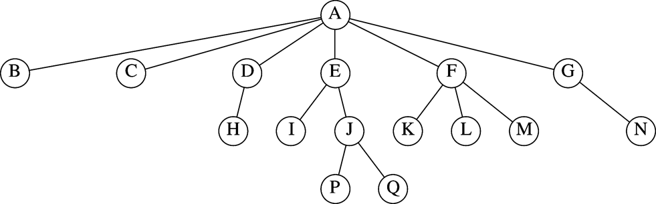
Example of rooted tree
Which are the parent nodes?
Which are the child nodes?
Which are the leaves?
What is the height and depth of the tree?
What is the height and depth of node E? Node F?

Slide 12
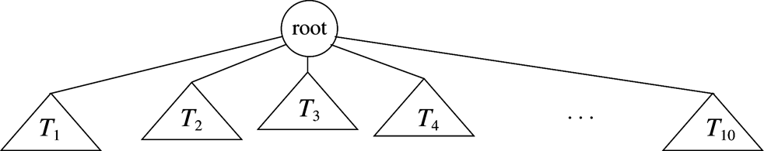
Rooted Tree: Recursive definition
A graph with N nodes and N-1 edges
Graph has
one root r
Zero or more non-empty sub-trees, each of whose root is connected to r by an edge.
Every node except the root has one parent

Slide 13
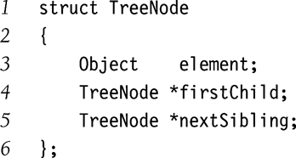
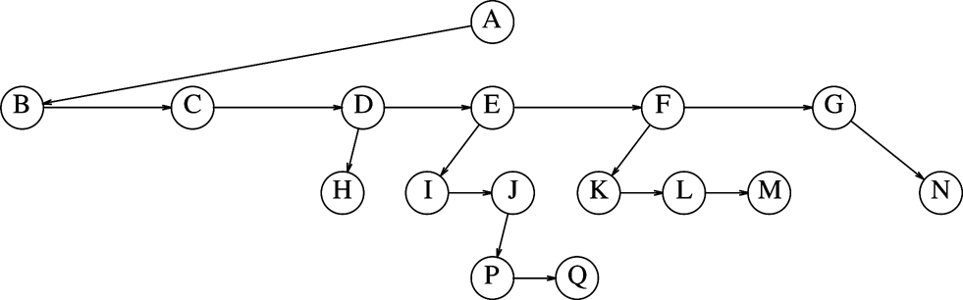
A simple Tree Implementation
Each node points to
Its first child
Its next sibling
Back to its parent (optional)
What could be an alternate representation?

Slide 14
Tree Traversals
Definition: A traversal is the process for “visiting” all of the vertices in a tree
Often defined recursively
Each kind corresponds to an iterator type
Iterators are implemented non-recursively
Preorder traversal
Postorder traversal
Levelorder traversal

Slide 15
Preorder Traversal
Visit vertex, then visit child vertices (recursive definition)
How to implement preorder traversal
Depth-first search
Begin at root
Visit vertex on arrival
Implementation may be recursive, stack-based, or nested loop

Slide 16
Preorder Traversal
root
1
root
1
(1)
2
3
4
(2)
2
3
4
5
6
7
8
5
6
7
8
root
1
root
1
(3)
2
3
4
2
3
4
(4)
5
6
7
8
5
6
7
8

Slide 17
Preorder Traversal
root
1
root
1
(5)
2
3
4
2
3
4
(6)
5
6
7
8
5
6
7
8
root
1
root
1
(7)
2
3
4
2
3
4
(8)
5
6
7
8
5
6
7
8

Slide 18
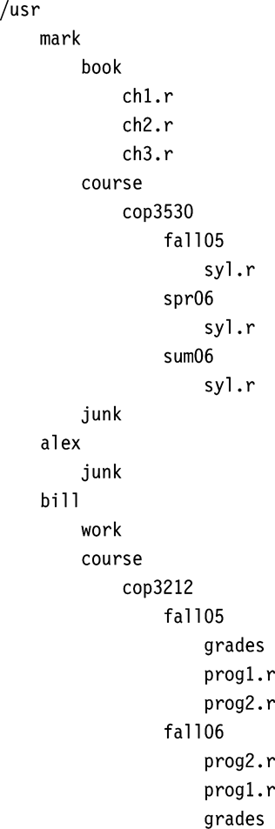
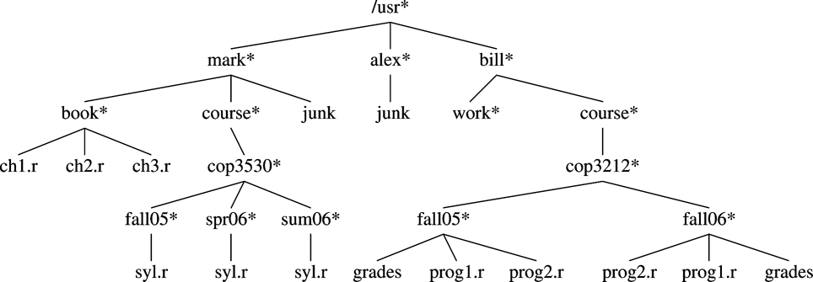
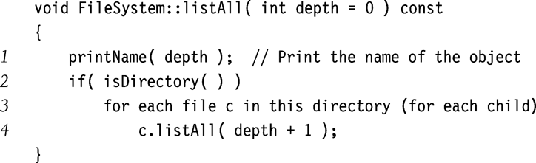
Preorder Traversal of UNIX Directory Tree

Slide 19
Postorder Traversal
Visit child vertices, then visit vertex (recursive definition)
How to implement the postorder traversal
Depth-first search
Begin at root
Visit vertex on departure
Implementation may be recursive, stack-based, or nested loop

Slide 20
Postorder Traversal
root
1
root
1
(1)
2
3
4
2
3
4
(2)
5
6
7
8
5
6
7
8
root
1
root
1
(3)
2
3
4
2
3
4
(4)
5
6
7
8
5
6
7
8

Slide 21
Postorder Traversal
root
1
root
1
(5)
2
3
4
2
3
4
(6)
5
6
7
8
5
6
7
8
root
1
root
1
(7)
2
3
4
2
3
4
(8)
5
6
7
8
5
6
7
8

Slide 22
Postorder Traversal
root
1
root
1
(9)
2
3
4
2
3
4
(10)
5
6
7
8
5
6
7
8
root
1
root
1
(11)
2
3
4
2
3
4
(12)
5
6
7
8
5
6
7
8

Slide 23
Postorder Traversal
root
1
root
1
(13)
2
3
4
2
3
4
(14)
5
6
7
8
5
6
7
8
root
1
root
1
2
3
4
2
3
4
(15)
(16)
5
6
7
8
5
6
7
8

Slide 24
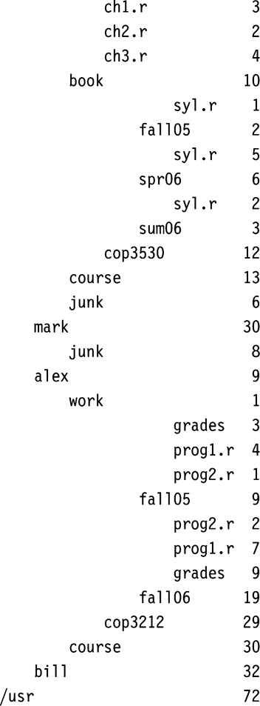

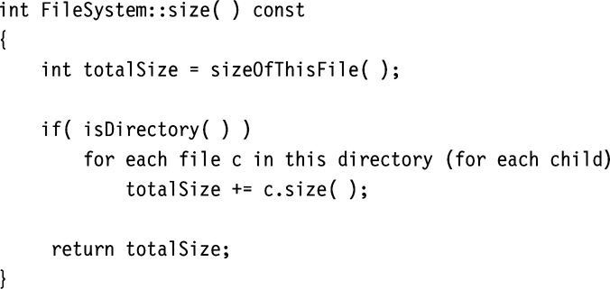
Postorder Traversal Calculating Size of Directory

Slide 25
Levelorder Traversal
Visit all vertices in level, starting with level 0 and increasing
How to implement levelorder traversal
AKA breadth-first traversal
Breadth-first search
Begin at root
Visit vertex on departure
Only practical implementation is queue-based

Slide 26
Levelorder Traversal
root
1
root
1
(1)
2
3
4
2
3
4
(2)
5
6
7
8
5
6
7
8
root
1
root
1
(3)
2
3
4
2
3
4
(4)
5
6
7
8
5
6
7
8

Slide 27
Levelorder Traversal
root
1
root
1
(5)
2
3
4
2
3
4
(6)
5
6
7
8
5
6
7
8
root
1
root
1
(7)
2
3
4
2
3
4
(8)
5
6
7
8
5
6
7
8

Slide 28
Traversal Orderings
Preorder: depth-first search (possibly stack-based), visit on arrival
Postorder: depth-first search (possibly stack-based), visit on departure
Levelorder: breadth-first search (queue-based), visit on departure

Slide 29
Reading Assignment
Sections 4.2 and 4.3

