Slide 1
Trees 2 Binary trees
Section 4.2

Slide 2
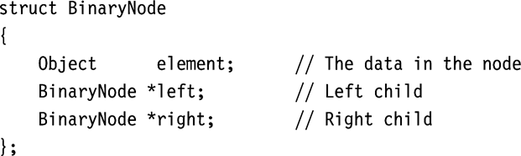
Binary Trees
Definition: A binary tree is a rooted tree in which no vertex has more than two children
Left and right child nodes
root
1
2
3
4
5
6
7

Slide 3
Complete Binary Trees
Definition: A binary tree is complete iff every layer except possibly the bottom, is fully populated with vertices. In addition, all nodes at the bottom level must occupy the leftmost spots consecutively.
root
1
root
1
2
3
2
3
4
5
6
7
4
5
6

Slide 4
Complete Binary Trees
A complete binary tree with n vertices and height H satisfies:
2^{H} < n < 2^{H + 1}
2² < 7 < 2^{2 + 1 ,} 2² < 4 < 2² ⁺ ¹
root
1
root
1
n = 7
H = 2
n = 4
H = 2
2
3
2
3
4
5
6
7
4

Slide 5
Complete Binary Trees
A complete binary tree with n vertices and height H satisfies:
2^{H} < n < 2^{H + 1}
H < log n < H + 1
H = floor(log n)

Slide 6
Complete Binary Trees
Theorem: In a complete binary tree with n vertices and height H
2^{H} < n < 2^{H + 1}

Slide 7
Complete Binary Trees
Proof:
At level k <= H-1, there are 2^{k} vertices
At level k = H, there are at least 1 node, and at most 2^{H} vertices
Total number of vertices when all levels are fully populated (maximum level k):
n = 2⁰ + 2¹ + …2^{k}
n = 1 + 2¹ + 2² +…2^{k} (Geometric Progression)
n = 1(2^{k + 1} – 1) / (2-1)
n = 2^{k + 1} - 1

Slide 8
Complete Binary Trees
n = 2^{k + 1} – 1 when all levels are fully populated (maximum level k)
Case 1: tree has maximum number of nodes when all levels are fully populated
Let k = H
n = 2^{H + 1} – 1
n < 2^{H + 1}
Case 2: tree has minimum number of nodes when there is only one node in the bottom level
Let k = H – 1 (considering the levels excluding the bottom)
n’ = 2^{H} – 1
n > n’ + 1 = 2^{H}
Combining the above two conditions we have
2^{H} < n < 2^{H + 1}

Slide 9
Vector Representation of Complete Binary Tree
Tree data
Vector elements carry data
Tree structure
Vector indices carry tree structure
Index order = levelorder
Tree structure is implicit
Uses integer arithmetic for tree navigation

Slide 10
Vector Representation of Complete Binary Tree
Tree navigation
Parent of v[k] = v[(k – 1)/2]
Left child of v[k] = v[2*k + 1]
Right child of v[k] = v[2*k + 2]
root
0
l
r
ll
lr
rl
rr

Slide 11
Vector Representation of Complete Binary Tree
Tree navigation
Parent of v[k] = v[(k – 1)/2]
Left child of v[k] = v[2*k + 1]
Right child of v[k] = v[2*k + 2]
0 | 1 | 2 | 3 | 4 | 5 | 6
0

Slide 12
Vector Representation of Complete Binary Tree
Tree navigation
Parent of v[k] = v[(k – 1)/2]
Left child of v[k] = v[2*k + 1]
Right child of v[k] = v[2*k + 2]
0 | 1 | 2 | 3 | 4 | 5 | 6
0 | l

Slide 13
Vector Representation of Complete Binary Tree
Tree navigation
Parent of v[k] = v[(k – 1)/2]
Left child of v[k] = v[2*k + 1]
Right child of v[k] = v[2*k + 2]
0 | 1 | 2 | 3 | 4 | 5 | 6
0 | l | r

Slide 14
Vector Representation of Complete Binary Tree
Tree navigation
Parent of v[k] = v[(k – 1)/2]
Left child of v[k] = v[2*k + 1]
Right child of v[k] = v[2*k + 2]
0 | 1 | 2 | 3 | 4 | 5 | 6
0 | l | r | ll

Slide 15
Vector Representation of Complete Binary Tree
Tree navigation
Parent of v[k] = v[(k – 1)/2]
Left child of v[k] = v[2*k + 1]
Right child of v[k] = v[2*k + 2]
0 | 1 | 2 | 3 | 4 | 5 | 6
0 | l | r | ll | lr

Slide 16
Vector Representation of Complete Binary Tree
Tree navigation
Parent of v[k] = v[(k – 1)/2]
Left child of v[k] = v[2*k + 1]
Right child of v[k] = v[2*k + 2]
0 | 1 | 2 | 3 | 4 | 5 | 6
0 | l | r | ll | lr | rl

Slide 17
Vector Representation of Complete Binary Tree
Tree navigation
Parent of v[k] = v[(k – 1)/2]
Left child of v[k] = v[2*k + 1]
Right child of v[k] = v[2*k + 2]
0 | 1 | 2 | 3 | 4 | 5 | 6
0 | l | r | ll | lr | rl | rr

Slide 18
Binary Tree Traversals
Inorder traversal
Definition: left child, vertex, right child (recursive)
Algorithm: depth-first search (visit between children)

Slide 19
Inorder Traversal
root
1
root
1
2
3
2
3
4
5
6
7
4
5
6
7
root
1
root
1
2
3
2
3
4
5
6
7
4
5
6
7

Slide 20
Inorder Traversal
root
1
root
1
2
3
2
3
4
5
6
7
4
5
6
7
root
1
root
1
2
3
2
3
4
5
6
7
4
5
6
7

Slide 21
Inorder Traversal
root
1
root
1
2
3
2
3
4
5
6
7
4
5
6
7
root
1
root
1
2
3
2
3
4
5
6
7
4
5
6
7

Slide 22
Inorder Traversal
root
1
root
1
2
3
2
3
4
5
6
7
4
5
6
7

Slide 23
Binary Tree Traversals
Other traversals apply to binary case:
Preorder traversal
vertex, left subtree, right subtree
Inorder traversal
left subtree, vertex, right subtree
Postorder traversal
left subtree, right subtree, vertex
Levelorder traversal
vertex, left children, right children

Slide 24
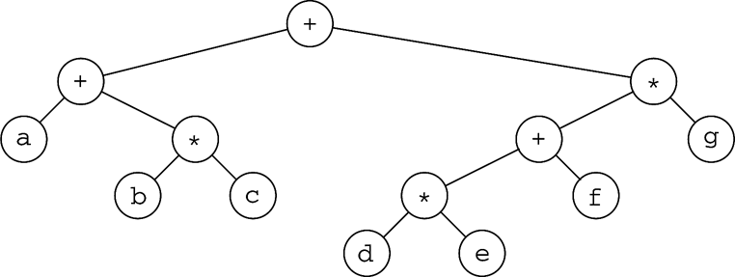
Example: Expression Tree
How do you construct an expression tree
from a postfix expression?
E.g a b + c d e + * *

Slide 25
Build Expression Tree from Postfix Expression
Let S be a stack
while not end of the postfix expression
Get next token
If (token is operand)
Create a new node with the operand
Push new node into stack S
If (token is operator)
pop corresponding operands from S
create a new node with the operator (and corresponding operands as left/right children)
push new node into stack S
end while
S.top is the final binary expression tree

Slide 26
a b + c d e + * *
a
b

Slide 27
a b + c d e + * *
+
a
b

Slide 28
a b + c d e + * *
+
c
d
e
a
b

Slide 29
a b + c d e + * *
+
c
+
a
b
d
e

Slide 30
a b + c d e + * *
+
*
a
b
c
+
d
e

Slide 31
a b + c d e + * *
*
+
*
a
b
c
+
d
e

Slide 32
Obtaining Infix Expression from Binary Expression Tree
Traversing the tree using inorder traversal
How to ensure correct precedence
Adding proper parentheses

Slide 33
Reading assignment
Section 4.3

