Slide 1
Trees 3: The Binary Search Tree
Reading: Sections 4.3 and 4.6

Slide 2
Binary Search Tree
Also known as Totally Ordered Tree
Definition: A binary tree B is called a binary search tree iff:
There is an order relation < defined for the vertices of B
For any vertex v, and any descendant u of v.left, u < v
For any vertex v, and any descendent w of v.right, v < w
root
4
2
6
1
3
5
7

Slide 3
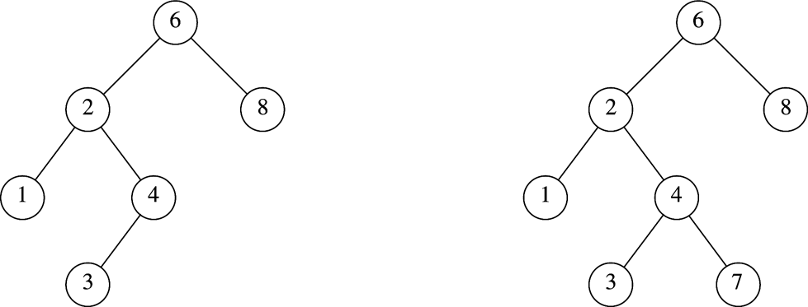
Binary Search Tree
Which one is NOT a BST?

Slide 4
Binary Search Tree
Consequences:
The smallest element in a binary search tree (BST) is the “left-most” node
The largest element in a BST is the “right-most” node
Inorder traversal of a BST encounters nodes in increasing order
root
4
2
6
1
3
5
7

Slide 5
Binary Search using BST
Assumes nodes are organized in a totally ordered binary tree
Begin at root node
Descend using comparison to make left/right decision
if (search_value < node_value) go to the left child
else if (search_value > node_value) go to the right child
else return true (success)
Until descending move is impossible
Return false (failure)

Slide 6
Binary Search using BST
Runtime <= descending path length <= depth of tree
If tree has enough branching, runtime <= O(log size)

Slide 7
BST Class Template
Template <typename Comparable>
Class BinarySearchTree {
public:
BinarySearchTree();
BinarySearchTree(const BinarySearchTree & rhs); // copy
BinarySearchTree(BinarySearchTree &&rhs); // move
~BinarySearchTree();
const Comparable & findMin() const;
const Comparable & findMax() const;
bool contains(const Comparable &x) const;
bool isEmpty() const;
void printTree(ostream & out = std::cout) const;
void makeEmpty();
void insert(const Comparable &x);
void insert(Comparable &&x); // move
void remove(const Comparable &x);
BinarySearchTree & operator=(const BinarySearchTree &rhs);
BinarySearchTree & operator=(BinarySearchTree && rhs); // move

Slide 8
BST Class Template (Cont’d)
private:
struct BinaryNode {
Comparable element;
BinaryNode *left;
BinaryNode *right;
BinaryNode(const Comparable &theElement, BinaryNode *lt, BinaryNode *rt)
: element{theElement}, left{lt}, right{rt} {}
BinaryNode(Comparable && theElement, BinaryNode *lt, BinaryNode *rt)
: element{std::move(theElement)}, left{lt}, right{rt} {}
};
BinaryNode *root;
void insert(const Comparable &x, BinaryNode * & t);
void insert(Comparable &&x, BinaryNode * &t);
void remove(const Comparable &x, BinaryNode * & t);
BinaryNode *findMin(BinaryNode *t) const;
BinaryNode *findMax(BinaryNode *t) const;
bool contains(const Comparable &x, BinaryNode *t) const;
void makeEmpty(BinaryNode * &t);
void printTree(BinaryNode *t, ostream & out) const;
BinaryNode *clone(BinaryNode *t) const;
};
Pointer passed by reference
(why?)
Internal functions
used in recursive
calls

Slide 9
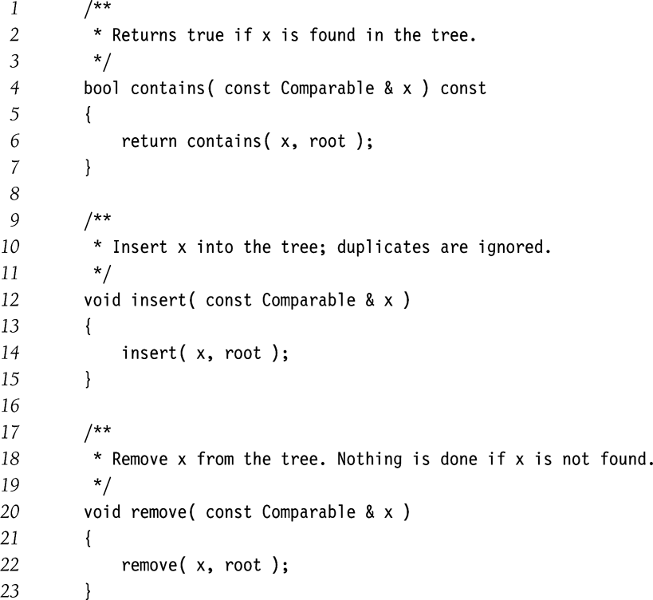
BST: Public members calling private recursive functions

Slide 10
BST: Searching for an element
/**
* Internal method to test if an item is in a subtree.
* x is item to search for.
* t is the node that roots the subtree.
*/
bool contains( const Comparable & x, BinaryNode *t ) const
{
if( t == nullptr )
return false;
else if( x < t->element )
return contains( x, t->left );
else if( t->element < x )
return contains( x, t->right );
else
return true; // Match
}

Slide 11
BST: Find the smallest element
/**
* Internal method to find the smallest item in a subtree t.
* Return node containing the smallest item.
*/
BinaryNode * findMin( BinaryNode *t ) const
{
if( t == nullptr )
return nullptr;
if( t->left == nullptr )
return t;
return findMin( t->left );
}
Tail recursion

Slide 12
BST: Find the biggest element
/**
* Internal method to find the largest item in a subtree t.
* Return node containing the largest item.
*/
BinaryNode * findMax( BinaryNode *t ) const
{
if( t != nullptr )
while( t->right != nullptr )
t = t->right;
return t;
}
Non-recursive

Slide 13
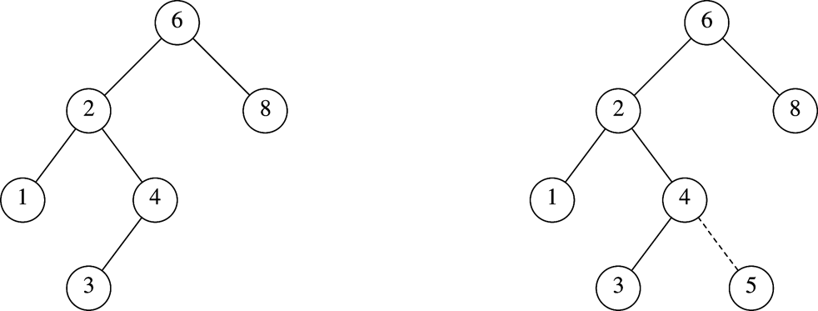
BST: Insertion (5)
Before insertion
After insertion

Slide 14
BST: Insertion (contd.)
/**
* Internal method to insert into a subtree.
* x is the item to insert.
* t is the node that roots the subtree.
* Set the new root of the subtree.
*/
void insert( const Comparable & x, BinaryNode * & t )
{
if( t == nullptr )
t = new BinaryNode{ x, nullptr, nullptr };
else if( x < t->element )
insert( x, t->left );
else if( t->element < x )
insert( x, t->right );
else
; // Duplicate; do nothing
}
How to implement the move version of insert()?
Strategy:
Traverse the tree as if searching for x with contains()
Insert when you reach a null pointer t.

Slide 15
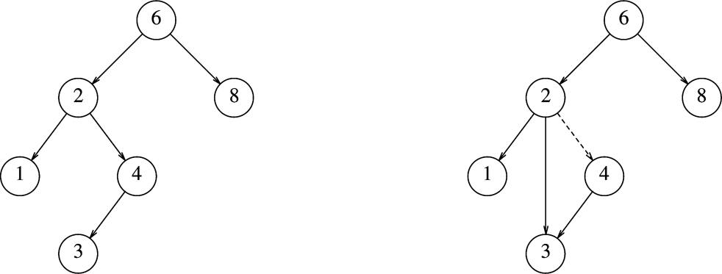
BST: Deletion
Deleting a node with one child
Before deleting (4)
After deleting (4)
Deletion Strategy: Bypass the node being deleted

Slide 16
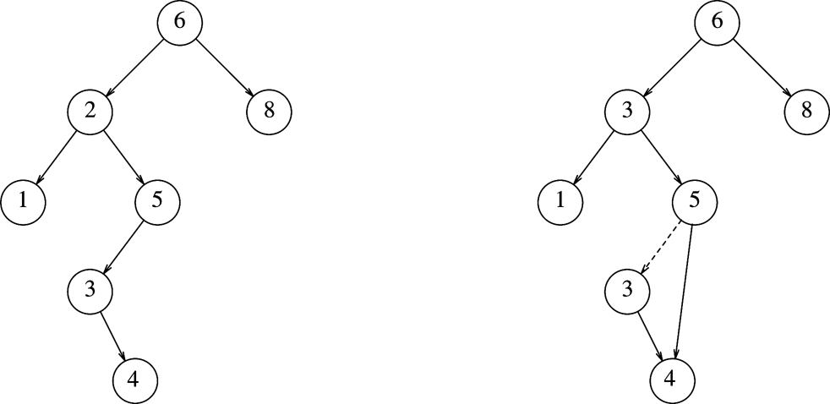
BST: Deletion (contd.)
Deleting a node with two children
Before deleting (2)
After deleting (2)
Deletion Strategy: Replace the node with
smallest node in the right subtree

Slide 17
BST: Deletion (contd.)
/**
* Internal method to remove from a subtree.
* x is the item to remove.
* t is the node that roots the subtree.
*/
void remove( const Comparable & x, BinaryNode * & t ) {
if( t == nullptr )
return; // Item not found; do nothing
if( x < t->element )
remove( x, t->left );
else if( t->element < x )
remove( x, t->right );
else if( t->left != nullptr && t->right != nullptr ) { // two children
t->element = findMin( t->right )->element;
remove( t->element, t->right );
}
else {
BinaryNode *oldNode = t;
t = ( t->left != nullptr ) ? t->left : t->right;
delete oldNode;
}
}

Slide 18
BST: Lazy Deletion
Another deletion strategy
Don’t delete!
Just mark the node as deleted.
Wastes space
But useful if deletions are rare or space is not a concern.

Slide 19
BST: Destructor
/**
* Destructor for the tree
*/
~BinarySearchTree( )
{
makeEmpty( );
}
/**
* Internal method to make subtree empty.
*/
void makeEmpty( BinaryNode * & t )
{
if( t != nullptr )
{
makeEmpty( t->left );
makeEmpty( t->right );
delete t;
}
t = nullptr;
}

Slide 20
BST: Assignment Operator
/**
* Copy constructor
*/
BinarySearchTree( const BinarySearchTree & rhs ) : root{ nullptr }
{
root = clone( rhs.root );
}
/**
* Internal method to clone subtree.
*/
BinaryNode * clone( BinaryNode *t ) const
{
if( t == nullptr )
return nullptr;
else
return new BinaryNode{ t->element, clone( t->left ), clone( t->right ) };
}

Slide 21
Tree Traversal (Inorder)
// Print the tree contents in sorted order.
void printTree( ostrem & out ) const
{
if( isEmpty( ) )
cout << "Empty tree" << endl;
else
printTree( root, out);
}
/**
* Internal method to print a subtree rooted at t in sorted order.
*/
void printTree( BinaryNode *t, ostream & out ) const
{
if( t != nullptr )
{
printTree( t->left );
out << t->element << endl;
printTree( t->right );
}
}

Slide 22
BST: Insertion Bias
Start with an empty tree.
Insert elements in sorted order
What tree do you get?
How do you fix it?

Slide 23
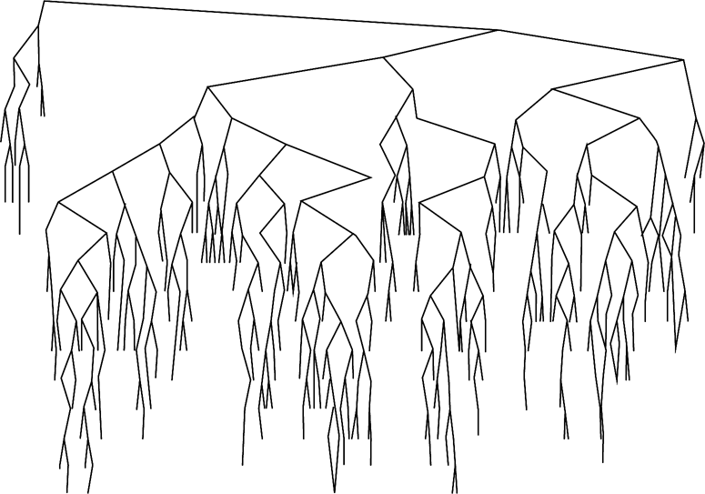
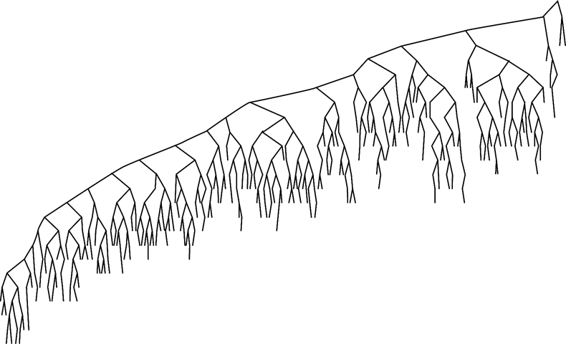
BST: Deletion Bias
After large number of alternating insertions and deletions
Why this bias? How do you fix it?

Slide 24
BST: Search using function objects
Template <typename Object, typename Comparable=less<Object>>
class BinarySearchTree {
public:
// same methods, with Object replacing Comparable
private:
BinaryNode *root;
Comparable isLessThan;
// same methods, with Object replacing Comparable
bool contains( const Comparable & x, BinaryNode *t ) const
{
if( t == nullptr )
return false;
else if( isLessThan(x, t->element ))
return contains( x, t->left );
else if( isLessThan(t->element ,x ))
return contains( x, t->right );
else
return true; // Match
}
};

Slide 25
Reading assignment
Sections 4.4, 4.7, and 4.8

