Slide 1
Trees 4: AVL Trees and B-Trees
Reading: Sections 4.4, 4.6, and 4.7

Slide 2
AVL (Adelson-Velskii and Landis) Trees
AVL tree is binary search tree with balance condition
To ensure depth of the tree is O(log(N))
And consequently, search complexity bound O(log(N))
Balance condition
For every node in tree, height of left and right subtree can differ by at most 1
How to maintain balance condition?
Rotate nodes if condition violated when inserting nodes
Assuming lazy deletion

Slide 3
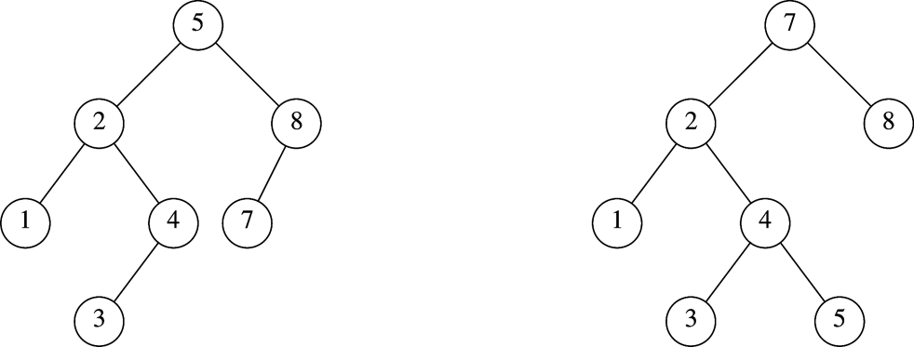
Which is an AVL Tree?

Slide 4
Balance Condition Violation
If condition violated after a node insertion
Which nodes we need to rotate?
Only nodes on path from insertion point to root may have their balance altered
If we rebalance tree at the deepest node along path
The entire tree will be rebalanced
Violation cases at node k (deepest node)
An insertion into left subtree of left child of k
An insertion into right subtree of left child of k
An insertion into left subtree of right child of k
An insertion into right subtree of right child of k
Cases 1 and 4 equivalent
Single rotation to rebalance
Cases 2 and 3 equivalent
Double rotation to rebalance

Slide 5
AVL Trees
Overhead
Extra space for maintaining height information at each node
Insertion becomes more expensive
Advantage
All tree operations except insertion in O(log(N))
In particular, the search operation is O(log(N))

Slide 6
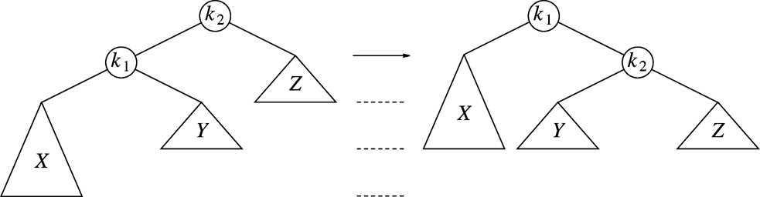
Single Rotation (Case 1)
Replace node k₂ by node k₁
Set node k₂ to be right child of node k₁
Set subtree Y to be left child of node k₂

Slide 7
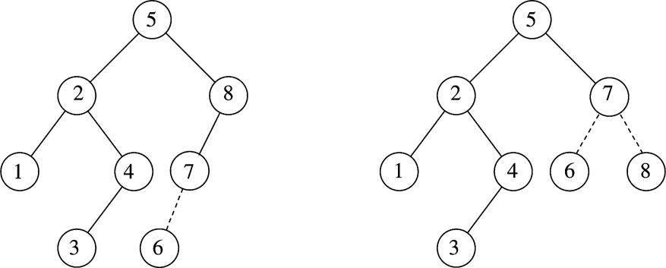
Example
After inserting 6
Balance condition at node 8 is violated

Slide 8
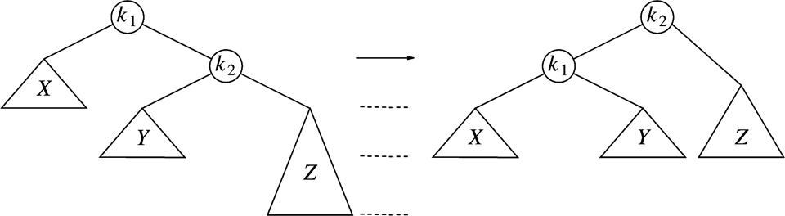
Single Rotation (Case 4)
Replace node k₁ by node k₂
Set node k₁ to be left child of node k₂
Set subtree Y to be right child of node k₁

Slide 9
Example
Inserting 3, 2, 1, and then 4 to 7 sequentially into empty AVL tree
3
2
2
1
3
1

Slide 10
Example (Cont’d)
Inserting 4
Inserting 5
2
1
3
4
2
2
1
3
4
1
4
5
3
5

Slide 11
Example (Cont’d)
Inserting 6
Inserting 7
4
2
2
5
1
4
1
3
6
3
5
6
4
4
2
6
2
5
1
3
5
7
1
3
6
7

Slide 12
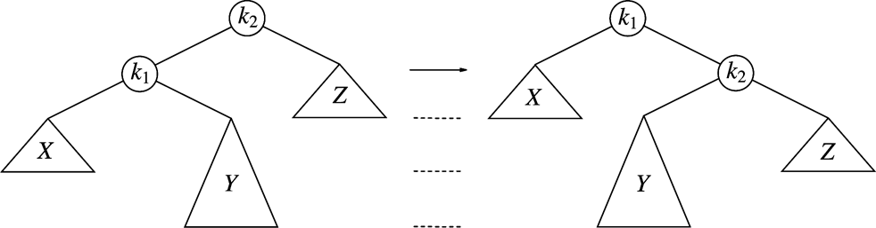
Single Rotation not Work for Other Cases
For case 2
After single rotation, k₁ still not balanced
Double rotations needed for case 2 and case 3

Slide 13
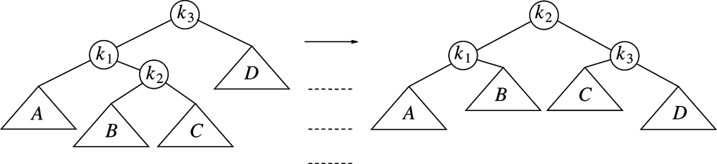
Double Rotation (Case 2)
Left-right double rotation to fix case 2
First rotate between k₁ and k₂
Then rotate between k₂ and k₃

Slide 14
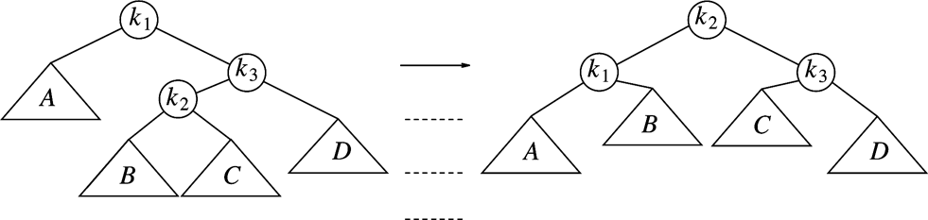
Double Rotation (Case 3)
Right-left double rotation to fix case 3
First rotate between k₂ and k₃
Then rotate between k₁ and k₂

Slide 15
Example
Continuing the previous example by inserting
16 down to 10, and then 8 and 9
Inserting 16 and 15
4
4
2
6
2
6
1
3
5
15
1
3
5
7
7
16
16
15

Slide 16
Example (Cont’d)
Inserting 14
Other cases as exercises
4
4
2
7
2
6
1
3
6
15
1
3
5
15
14
16
7
16
5
14

Slide 17
Implementation of AVL Tree
struct AvlNode
{
Comparable element;
AvlNode *left;
AvlNode *right;
int height;
AvlNode( const Comparable & ele, AvlNode *lt, AvlNode *rt, int h = 0 )
: element{ ele }, left{ lt }, right{ rt }, height{ h } { }
AvlNode( Comparable && ele, AvlNode *lt, AvlNode *rt, int h = 0 )
: element{ std::move( ele ) }, left{ lt }, right{ rt }, height{ h } { }
};
/**
* Return the height of node t or -1 if nullptr.
*/
int height( AvlNode *t ) const
{
return t == nullptr ? -1 : t->height;
}

Slide 18
Insertion into an AVL Tree
/**
* Internal method to insert into a subtree.
* x is the item to insert.
* t is the node that roots the subtree.
* Set the new root of the subtree.
*/
void insert( const Comparable & x, AvlNode * & t )
{
if( t == nullptr )
t = new AvlNode{ x, nullptr, nullptr };
else if( x < t->element )
insert( x, t->left );
else if( t->element < x )
insert( x, t->right );
balance( t );
}

Slide 19
Insertion into an AVL Tree (Cont’d)
static const int ALLOWED_IMBALANCE = 1;
// Assume t is balanced or within one of being balanced
void balance( AvlNode * & t )
{
if( t == nullptr )
return;
if( height( t->left ) - height( t->right ) > ALLOWED_IMBALANCE )
if( height( t->left->left ) >= height( t->left->right ) )
rotateWithLeftChild( t );
else
doubleWithLeftChild( t );
else
if( height( t->right ) - height( t->left ) > ALLOWED_IMBALANCE )
if( height( t->right->right ) >= height( t->right->left ) )
rotateWithRightChild( t );
else
doubleWithRightChild( t );
t->height = max( height( t->left ), height( t->right ) ) + 1;
}
Case 1
Case 2
Case 4
Case 3

Slide 20
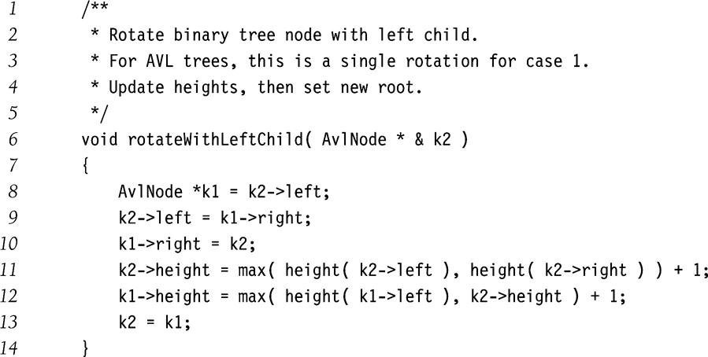
Single Rotation (Case 1)

Slide 21
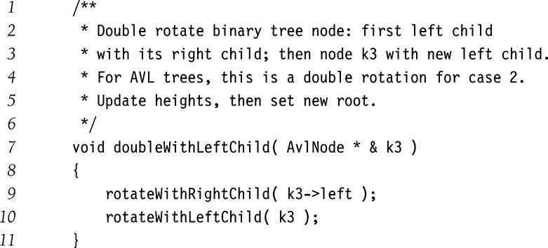
Double Rotation (Case 2)

Slide 22
B-Trees: Problem with Big `O’ notation
Big ‘O’ assumes that all operations take equal time
Suppose all data does not fit in memory
Then some part of data may be stored on hard disk.
CPU speed is in millions of instructions per second
3GHz machines
Equals roughly 3000 million instructions per seconds
Typical disk speeds about 7,200 RPM
Roughly 120 disk accesses per second
So accessing disk is incredibly expensive.
So we may be willing to do more computation to organize our data better and make fewer disk accesses.

Slide 23
Problem with binary trees
There is no guarantee that binary trees will be balanced
If stored on disk, we
have potentially O(N)
disk operations

Slide 24
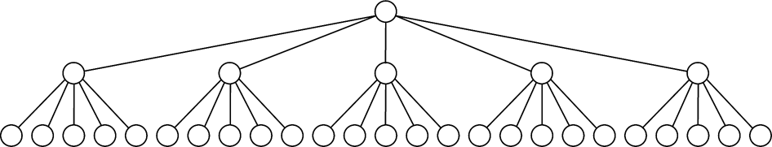
M-ary Trees
Allows up to M children for each node
Instead of max two for binary trees
A complete M-ary tree of N nodes has a depth of log_{M}N
Example of complete 5-ary tree of 31 nodes

Slide 25
M-ary search tree
Similar to binary search tree, except that
Each node has (M-1) keys to decide which of the M branches to follow.
Larger M ➔ smaller tree depth
But how to make M-ary tree balanced?

Slide 26
B-Tree (or Balanced Trees)
B-Tree is an M-ary search tree with the following balancing restrictions
Data items are stored at the leaves
Non-leaf nodes store up to M-1 keys to guide the searching
Key i represents the smallest key in subtree (i+1)
The root is either a leaf, or has between 2 to M children
All non-leaf nodes have between ceil(M/2) and M children
All leaves are at the same depth and have between ceil(L/2) and L data items, for some L.

Slide 27
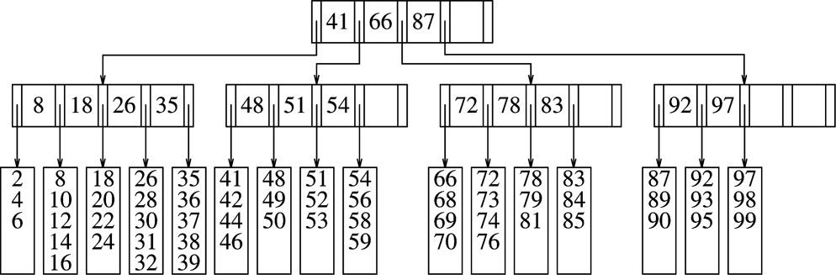
B-Tree Example
M=5, L=5

Slide 28
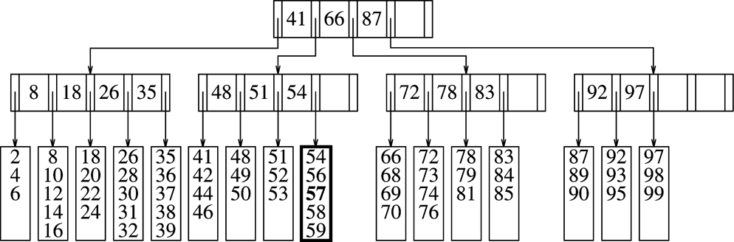
B-Tree: Inserting a value
After insertion of 57. Simply rearrange data in the correct leaf.

Slide 29
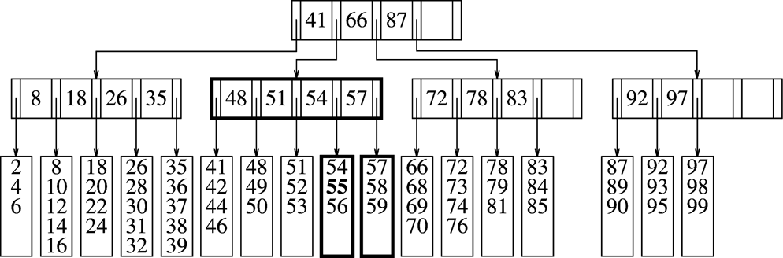
B-Tree: Inserting a value (cont’d)
Inserting 55.
Splits a full leaf into two leaves.

Slide 30
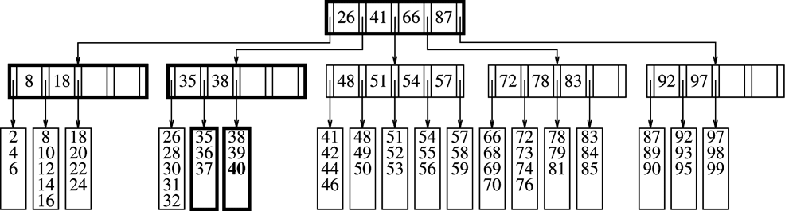
B-Tree: Inserting a value (contd)
Insertion of 40.
Splits a leaf into two leaves.
Also splits the parent node.

Slide 31
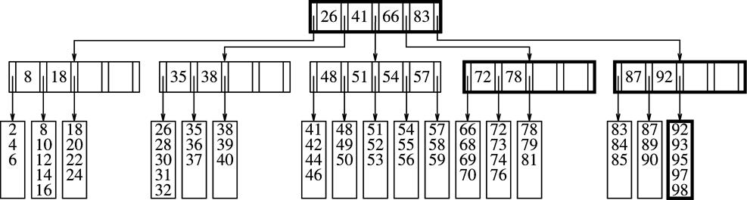
B-tree: Deletion of a value
Deletion of 99
Causes combination of two leaves into one.
Can recursively combine non-leaves

Slide 32
Questions
How does the height of the tree grow?
How does the height of the tree reduce?
How else can we handle insertion, without splitting a node?

Slide 33
Reading Assignment
Section 4.8
Chapter 5

