Slide 1
Introduction to Hashing - Hash Functions
Sections 5.1 and 5.2

Slide 2
Hashing
Data items are stored in an array of some fixed size
Hash table
Search performed using some part of the data item
key
Used for performing insertions, deletions, and finds in constant average time
Operations requiring ordering information not supported efficiently
Such as findMin, findMax

Slide 3
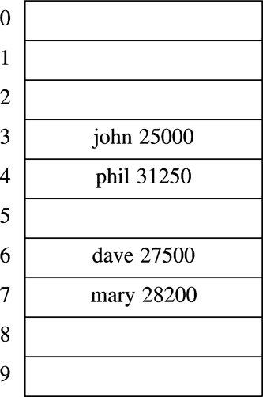
An example of hash table

Slide 4
Applications of hash tables
Comparing search efficiency of different data structures:
Vector, list: O(N)
Binary search tree: O(log(N))
Hash table: O(1)
Compilers to keep track of declared variables
Symbol tables
Mapping from name to id
Game programs to keep track of positions visited
Transposition table
On-line spelling checkers
BTW, a fast way to solve the word puzzle problem is to use hash table to maintain the valid words
Examples/r7

Slide 5
Hashing functions
Map keys to integers (which represent table indices)
Hash(Key) = Integer
Evenly distributed index values
Even if the input data is not evenly distributed
What happens if multiple keys mapped to the same integer (same position)?
Collision management (discussed in detail later)

Slide 6
Simple Hash Functions
Assumptions:
K: an unsigned 32-bit integer
M: the number of buckets (the number of entries in a hash table)
Goal:
If a bit is changed in K, all bits are equally likely to change for Hash(K)
So that items evenly distributed in hash table

Slide 7
A Simple Function
What if
Hash(K) = K % M
Where M is of any integer value
What is wrong?
Values of K may not be evenly distributed
But Hash(K) needs to be evenly distributed
Suppose
M = 10,
K = 10, 20, 30, 40
Then K % M = 0, 0, 0, 0, 0…

Slide 8
Another Simple Function
If
Hash(K) = K % P, P = prime number
Suppose
P = 11
K = 10, 20, 30, 40
K % P = 10, 9, 8, 7
More uniform distribution…
So hash tables have prime number of entries

Slide 9
Hashing a Sequence of Keys
K = {K₁, K₂, …, K_{n})
E.g., Hash(“test”) = 98157
Design Principles
Use the entire key
Use the ordering information

Slide 10
Use the Entire Key
unsigned int Hash(const string& Key) {
unsigned int hash = 0;
for (string::size_type j = 0; j != Key.size(); ++j) {
hash = hash ^ Key[j] // exclusive or
}
return hash;
}
Problem: Hash(“ab”) == Hash(“ba”)

Slide 11
Use the Ordering Information
unsigned int Hash(const string &Key) {
unsigned int hash = 0;
for (string::size_type j = 0; j != Key.size(); ++j) {
hash = hash ^ Key[j];
hash = hash * (j%32);
}
return hash;
}

Slide 12
Better Hash Function
unsigned int Hash(const string& S)
{
string::size_type i;
long unsigned int bigval = S[0];
for (i = 1; i < S.size(); ++i)
bigval = ((bigval & 65535) * 18000) // low16 * magic_number
+ (bigval >> 16) // high16
+ S[i];
bigval = ((bigval & 65535) * 18000) + (bigval >> 16);
// bigval = low16 * magic_number + high16
return bigval & 65535; // return low16
}
/* some values:
f(a) = 42064
f(b) = 60064
f(abcd) = 41195
f(bacd) = 39909
f(dcba) = 29480
f(x) = 62848
f(xx) = 44448
f(xxx) = 15118
f(xxxx) = 28081
f(xxxxx) = 45865
*/

