Slide 1
Designing Hash Tables
Sections 5.3, 5.4, 5.5, 5.6

Slide 2
Designing a Hash Table
Hash function: establishing a key with an indexed location in a hash table.
E.g. Index = hash(key) % table_size;
Resolve conflicts:
Need to handle case where multiple keys mapped to the same index.
Two representative solutions
Chaining with separate lists.
Probing open addressing

Slide 3
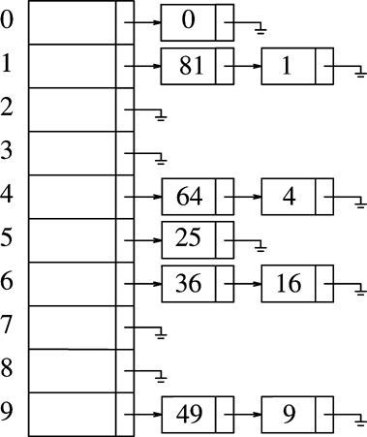
Separate Chaining
Each table entry stores a list of items
Multiple keys mapped to the same entry maintained by the list
Example
Hash(k) = k mod 10
(10 is not a prime, just for illustration)

Slide 4
Separate Chaining Implementation
template <typename HashedObj>
class HashTable
{
public:
explicit HashTable( int size = 101 ) ;
bool contains( const HashedObj & x ) const;
void makeEmpty( );
bool insert( const HashedObj & x );
bool insert( HashedObj && x);
bool remove(const HashedObj & x);
private:
vector<list<HashObj>> theList; // the array of the lists
int currentSize;
void rehash();
size_t myhash(const HashedObj & x) const;
};
Type Declaration for
Separate Chaining
Hash Table

Slide 5
HashedObj
Needs to provide
Equality operators (operator== or operator!= )
Hash function
Provided for standard types such as string and int
In C++11, function object template is used to implement hash functions, using so-called template specialization.
template <typename key>
class hash { // class template
public:
size_t operator()(const key &k) const;
};
template <>
class hash<string> { // class template specialization
public:
size_t operator() (const string & key) {
…
}
};

Slide 6
An Example Class for HashedObj
class Employee {
public:
const string & getName() const
{ return name; }
bool operator==(const Employee &rhs) const
{ return getName() == rhs.getName(); }
bool operator!=(const Employee &rhs) const
{ return !(*this == rhs); }
// additional public members not shown
private:
string name;
double salary;
int seniority;
// additional private members not shown
};
template <>
class hash<Employee> {
public:
size_t operator() (const Employee & item) {
static hash<string> hf;
return hf(item.getName());
}
};

Slide 7
Separate chaining
size_t myhash(const HashedObj &x) {
static hash<HashedObj> hf;
return hf(x) % theLists.size();
}

Slide 8
Separate Chaining (Cont’d)
void makeEmpty() {
for (auto & thisList : the Lists) {
thisList.clear();
}
}
bool contains(const HashedObj & x) const {
auto & whichList = theLists[myhash(x)];
return find(begin(whichList), end(whichList), x) != end(whichList);
}
bool remove(const HashedObj & x) {
auto & whichList = theLists[myhash(x)];
auto itr = find(begin(whichList), end(whichList), x);
if (itr == end(whichList))
return false;
whichList.erase(itr);
--currentSize;
return true;
}

Slide 9
Separate Chaining (contd.)
bool insert(const HashedObj & x) {
auto & whichList = theLists[myhash(x)];
if (find(begin(whichList), end(whichList), x) != end(whichList))
return false;
whichList.push_back(x);
// rehash, see Section 5.5
if (++currentSize > theLists.size())
rehash();
return true;
}

Slide 10
Hash Tables Without Chaining
Try to avoid buckets with separate lists
How ➔ use Probing Hash Tables
If collision occurs, try another cell in the hash table.
More formally, try cells h₀(x), h₁(x), h₂(x), h₃(x)… in succession until a free cell is found.
h_{i}(x) = hash(x) + f(i)
And f(0) = 0

Slide 11
Linear Probing
f(i)=i
Insert (assume no duplicated keys)
Index = hash(key) % table_size;
If table[index] is empty, put information (key and others) in entry table[index].
If table[index] is not empty then
Index ++; index = index % table_size;
goto 2.
Search (key)
Index = hash(key) % table_size;
If (table[index] is empty) return –1 (not found).
Else if (table[index].key == key) return index;
Index ++; index = index % table_size; goto 2.

Slide 12
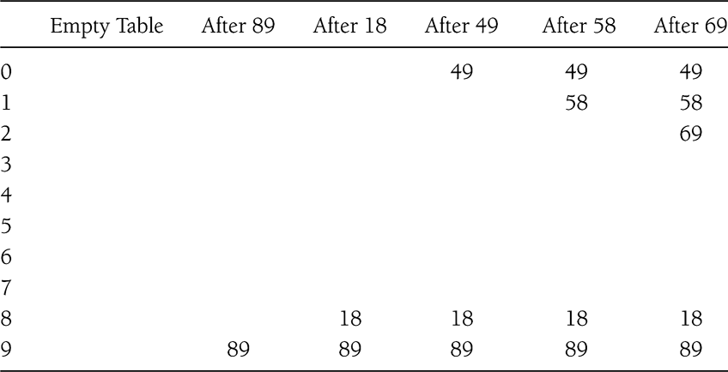
Example
Insert 89, 18, 49, 58, 69 (hash(k) = k mod 10)

Slide 13
Linear probing
Delete
Can be tricky, must maintain the consistency of the hash table.
What is the simplest deletion strategy you can think of??

Slide 14
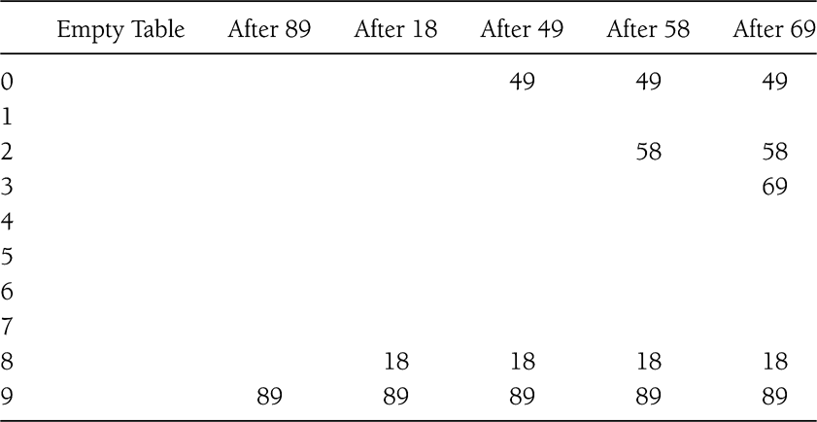
Quadratic Probing
f(i) = i²

Slide 15
Probing strategy hash table
template <typename HashedObj>
class HashTable {
public:
explicit HashTable(int size = 101);
bool contains(const HashedObj & x) const;
void makeEmpty();
bool insert(const HashedObj & x);
bool insert(HashedObj && x);
bool remove(const HashedObj & x);
enum EntryType {ACTIVE, EMPTY, DELETED};
private:
struct HashEntry {
HashedObj element;
EntryType info;
HashEntry(const HashedObj & e = HashedObj{}, EntryType I = EMPTY)
: element{e}, info{i} {}
HashEntry(HashedObj &&e, EntryType I = EMPTY)
: element{std::move(e)}, info{i} {}
};
vector<HashEntry> array;
int currentSize;
bool isActive(int currentPos) const;
int findPos(const HashedObj & x) const;
void rehash();
size_t myhash(const HashedObj & x) const;
};

Slide 16
Quadratic probing (contains())
bool contains(const HashedObj &x) const {
return isActive(findPos(x));
}
int findPos(const HashedObj & x) const {
int offset = 1;
int currentPos = myhash(x);
while (array[currentPos].info != EMPTY &&
array[currentPos].element != x) {
currentPos += offset;
offset += 2;
if (currentPos >= array.size())
currentPos -= array.size();
}
return currentPos;
}
bool isActive(int currentPos) const {
return array[currentPos].info == ACTIVE;
}

Slide 17
Quadratic probing
bool insert(const HashedObj & x) {
// insert x as active
int currentPos = findPos(x);
if (isActive(currentPos))
return false;
array[currentPos].element = x;
array[currentPos].info = ACTIVE;
// rehash; see Section 5.5
if (++currentSize > array.size() / 2)
rehash();
return true;
}
bool remove(const HashedObj & x) {
int currentPos = findPos(x);
if (! isActive(currentPos))
return false;
array[currentPos].info = DELETED;
return true;
}

Slide 18
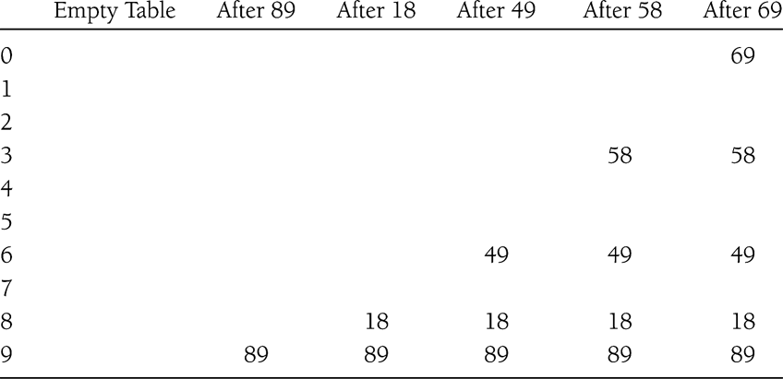
Double Hashing
f(i) = i*hash₂(x)
E.g. hash₂(x) = 7 – (x % 7)
What if hash₂(x) = 0 for some x?

Slide 19
Rehashing
Hash Table may get full
No more insertions possible
Hash table may get too full
Insertions, deletions, search take longer time
Solution: Rehash
Build another table that is twice as big and has a new hash function
Move all elements from smaller table to bigger table
Cost of Rehashing = O(N)
But happens only when table is close to full
Close to full = table is X percent full, where X is a tunable parameter

Slide 20
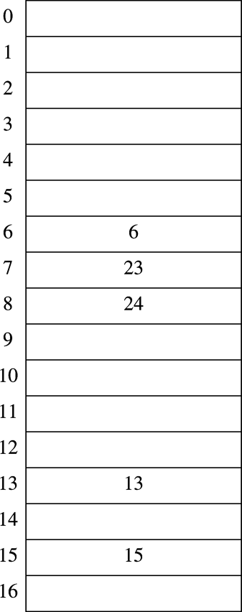
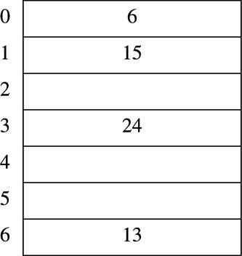
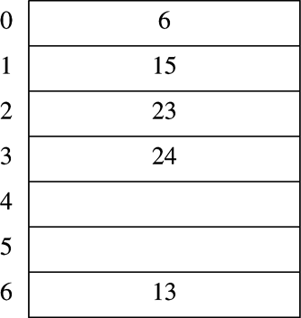
Rehashing Example
Original Hash Table
After Rehashing
After Inserting 23

Slide 21
Rehashing Implementation
/** rehashing for quadratic probing hash table */
void rehash() {
vector<HashEntry> oldArray = array;
// create new double-sized, empty table
array.resize(nextPrime(2 * oldArray.size()));
for (auto & entry : array)
entry.info = EMPTY;
// copy table over
currentSize = 0;
for (auto & entry : oldArray)
if (entry.info == ACTIVE)
insert(std::move(entry.element));
}

Slide 22
Rehashing implementation
/** rehashing for separate chaining hash table */
void rehash() {
vector<list<hashedObj>> oldLists = theLists;
// create new double-sized, empty table
theLists.resize(nextPrime(2 * theLists.size()));
for (auto & thisList: theLists)
thisList.clear();
// copy table over
currentSize = 0;
for (auto & thisList : oldLists)
for (auto & x : thisList)
insert(std::move(x));
}

Slide 23
Hash Table in C++ Library
Supported in C++11 STL
Both set and map
unordered_set (multiset)
unordered_map (multimap)
To use, include the corresponding header files
<unordered_set>
<unordered_map>
Examples
unordered_set<string> ht_str;
unordered_map<int, bool> ht_int;
Examples/r7

Slide 24
Reading assignment
Chapter 6

