Slide 1
Heapsort, Mergesort, and Quicksort
Sections 7.5 to 7.7

Slide 2
Heapsort
Build a binary minHeap of N elements
O(N) time
Then perform N deleteMin operations
log(N) time per deleteMin
Total complexity O(N log N)
However it requires an extra array to store results
In addition to the heap
To eliminate this requirement
Using heap to store sorted elements
Using maxHeap instead of minHeap

Slide 3
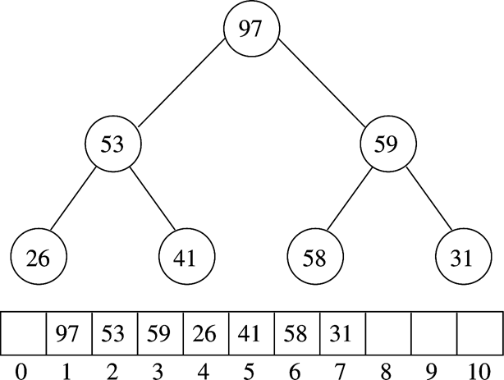
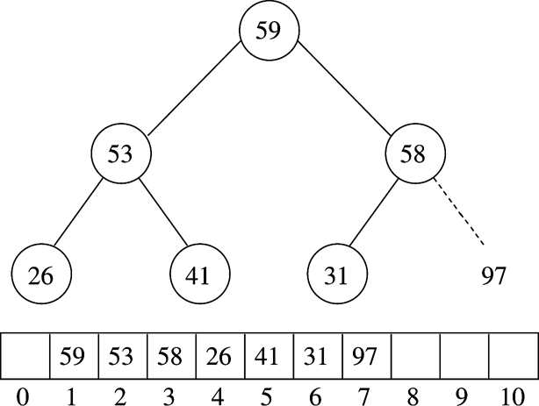
Example (MaxHeap)
After BuildHeap
After first deleteMax

Slide 4
Heapsort Implementation
// Standard heapsort.
template <typename Comparable>
void heapsort( vector<Comparable> & a )
{
// build heap
for( int i = a.size( ) / 2 - 1; i >= 0; --i )
percDown( a, i, a.size( ) );
// deleteMax
for( int j = a.size( ) - 1; j > 0; --j )
{
std::swap( a[ 0 ], a[ j ] );
percDown( a, 0, j );
}
}
/* Internal method for heapsort.
* i is the index of an item in the heap.
* Returns the index of the left child. */
inline int leftChild( int i )
{
return 2 * i + 1;
}
/**
* Internal method for heapsort that is used in
* deleteMax and buildHeap.
* i is the position from which to percolate down.
* n is the logical size of the binary heap.
*/
template <typename Comparable>
void percDown( vector<Comparable> & a, int i, int n )
{
int child;
Comparable tmp;
for( tmp = std::move( a[ i ] ); leftChild( i ) < n; i = child )
{
child = leftChild( i );
if( child != n - 1 && a[ child ] < a[ child + 1 ] )
++child;
if( tmp < a[ child ] )
a[ i ] = std::move( a[ child ] );
else
break;
}
a[ i ] = std::move( tmp );
}

Slide 5
Mergesort
Divide the N values to be sorted into two halves
Recursively sort each half using Mergesort
Base case N=1 ➔ no sorting required
Merge the two (sorted) halves
O(N) operation
Complexity??
We’ll see

Slide 6
Mergesort Implementation
// Mergesort algorithm (driver).
template <typename Comparable>
void mergeSort( vector<Comparable> & a )
{
vector<Comparable> tmpArray( a.size( ) );
mergeSort( a, tmpArray, 0, a.size( ) - 1 );
}
/**
* Internal method that makes recursive calls.
* a is an array of Comparable items.
* tmpArray is an array to place the merged result.
* left is the left-most index of the subarray.
* right is the right-most index of the subarray.
*/
template <typename Comparable>
void mergeSort( vector<Comparable> & a,
vector<Comparable> & tmpArray, int left, int right )
{
if( left < right )
{
int center = ( left + right ) / 2;
mergeSort( a, tmpArray, left, center );
mergeSort( a, tmpArray, center + 1, right );
merge( a, tmpArray, left, center + 1, right );
}
}

Slide 7
/**
* Internal method that merges two sorted halves of a subarray.
* a is an array of Comparable items.
* tmpArray is an array to place the merged result.
* leftPos is the left-most index of the subarray.
* rightPos is the index of the start of the second half.
* rightEnd is the right-most index of the subarray.
*/
template <typename Comparable>
void merge( vector<Comparable> & a, vector<Comparable> & tmpArray,
int leftPos, int rightPos, int rightEnd )
{
int leftEnd = rightPos - 1;
int tmpPos = leftPos;
int numElements = rightEnd - leftPos + 1;
// Main loop
while( leftPos <= leftEnd && rightPos <= rightEnd )
if( a[ leftPos ] <= a[ rightPos ] )
tmpArray[ tmpPos++ ] = std::move( a[ leftPos++ ] );
else
tmpArray[ tmpPos++ ] = std::move( a[ rightPos++ ] );
while( leftPos <= leftEnd ) // Copy rest of first half
tmpArray[ tmpPos++ ] = std::move( a[ leftPos++ ] );
while( rightPos <= rightEnd ) // Copy rest of right half
tmpArray[ tmpPos++ ] = std::move( a[ rightPos++ ] );
// Copy tmpArray back
for( int i = 0; i < numElements; ++i, --rightEnd )
a[ rightEnd ] = std::move( tmpArray[ rightEnd ] );
}

Slide 8
Complexity analysis
Let T(N) be the complexity when size is N
Recurrence relation
T(N) = 2T(N/2) + N
T(N) = 4T(N/4) + 2N
T(N) = 8T(N/8) + 3N
…
T(N) = 2^{k}T(N/2^{k}) + k*N
For k = log N
T(N) = N T(1) + N log N
Complexity: O(NlogN)

Slide 9
Quicksort
Fastest known sorting algorithm in practice
Caveats: not stable
Vulnerable to certain attacks
Average case complexity →O(N log N )
Worst-case complexity → O(N²)
Rarely happens, if coded correctly

Slide 10
Quicksort Outline
Divide and conquer approach
Given array S to be sorted
If size of S < 1 then done;
Pick any element v in S as the pivot
Partition S-{v} (remaining elements in S) into two groups
S1 = {all elements in S-{v} that are smaller than v}
S2 = {all elements in S-{v} that are larger than v}
Return {quicksort(S1) followed by v followed by quicksort(S2) }
Trick lies in handling the partitioning (step 3).
Picking a good pivot
Efficiently partitioning in-place

Slide 11
Quicksort example
81
43
31
57
75
13
92
65
26
0
Select pivot
81
43
31
57
75
13
65
26
0
92
partition
13
31
57
65
81
43
26
0
92
75
Recursive call
Recursive call
0
13
26
31
43
57
75
81
92
Merge
0
13
26
31
43
57
65
75
81
92

Slide 12
Picking the Pivot
How would you pick one?
Strategy 1: Pick the first element in S
Works only if input is random
What if input S is sorted, or even mostly sorted?
All the remaining elements would go into either S1 or S2!
Terrible performance!
Why worry about sorted input?
Remember → Quicksort is recursive, so sub-problems could be sorted
Plus mostly sorted input is quite frequent

Slide 13
Picking the Pivot (contd.)
Strategy 2: Pick the pivot randomly
Would usually work well, even for mostly sorted input
Unless the random number generator is not quite random!
Plus random number generation is an expensive operation

Slide 14
Picking the Pivot (contd.)
Strategy 3: Median-of-three Partitioning
Ideally, the pivot should be the median of input array S
Median = element in the middle of the sorted sequence
Would divide the input into two almost equal partitions
Unfortunately, its hard to calculate median quickly, without sorting first!
So find the approximate median
Pivot = median of the left-most, right-most and center element of the array S
Solves the problem of sorted input

Slide 15
Picking the Pivot (contd.)
Example: Median-of-three Partitioning
Let input S = {6, 1, 4, 9, 0, 3, 5, 2, 7, 8}
left=0 and S[left] = 6
right=9 and S[right] = 8
center = (left+right)/2 = 4 and S[center] = 0
Pivot
= Median of S[left], S[right], and S[center]
= median of 6, 8, and 0
= S[left] = 6

Slide 16
Partitioning Algorithm
Original input : S = {6, 1, 4, 9, 0, 3, 5, 2, 7, 8}
Get the pivot out of the way by swapping it with the last element
Have two ‘iterators’ – i and j
i starts at first element and moves forward
j starts at last element and moves backwards
8 1 4 9 0 3 5 2 7 6
pivot
8 1 4 9 0 3 5 2 7 6
i
j
pivot

Slide 17
Partitioning Algorithm (contd.)
While (i < j)
Move i to the right till we find a number greater than pivot
Move j to the left till we find a number smaller than pivot
If (i < j) swap(S[i], S[j])
(The effect is to push larger elements to the right and smaller elements to the left)
Swap the pivot with S[i]

Slide 18
Partitioning Algorithm Illustrated
i
j
pivot
8 1 4 9 0 3 5 2 7 6
Move
i
j
pivot
8 1 4 9 0 3 5 2 7 6
swap
i
j
pivot
2 1 4 9 0 3 5 8 7 6
move
i
j
pivot
2 1 4 9 0 3 5 8 7 6
swap
i
j
pivot
2 1 4 5 0 3 9 8 7 6
move
j
i
pivot
i and j
have crossed
2 1 4 5 0 3 9 8 7 6
Swap S[i]
with pivot
2 1 4 5 0 3 6 8 7 9
j
i
pivot

Slide 19
Dealing with small arrays
For small arrays (say, N ≤ 20),
Insertion sort is faster than quicksort
Quicksort is recursive
So it can spend a lot of time sorting small arrays
Hybrid algorithm:
Switch to using insertion sort when problem size is small (say for N < 20)

Slide 20
Quicksort Driver Routine
/**
* Quicksort algorithm (driver).
*/
template <typename Comparable>
void quicksort( vector<Comparable> & a )
{
quicksort( a, 0, a.size( ) - 1 );
}

Slide 21
Quicksort Pivot Selection Routine
/**
* Return median of left, center, and right.
* Order these and hide the pivot.
*/
template <typename Comparable>
const Comparable & median3( vector<Comparable> & a, int left, int right )
{
int center = ( left + right ) / 2;
if( a[ center ] < a[ left ] )
std::swap( a[ left ], a[ center ] );
if( a[ right ] < a[ left ] )
std::swap( a[ left ], a[ right ] );
if( a[ right ] < a[ center ] )
std::swap( a[ center ], a[ right ] );
// Place pivot at position right - 1
std::swap( a[ center ], a[ right - 1 ] );
return a[ right - 1 ];
}
Swap a[left], a[center]
and a[right] in-place
Pivot is in a[center] now
Swap the pivot a[center]
with a[right-1]

Slide 22
Quicksort routine
/*a is an array of Comparable items.
* left is the left-most index of the subarray. right is the right-most index of the subarray. */
template <typename Comparable>
void quicksort( vector<Comparable> & a, int left, int right )
{
if( left + 10 <= right )
{
const Comparable & pivot = median3( a, left, right ); // has a side effect
// Begin partitioning
int i = left, j = right - 1;
for( ; ; ) {
while( a[ ++i ] < pivot ) { }
while( pivot < a[ --j ] ) { }
if( i < j )
std::swap( a[ i ], a[ j ] );
else
break;
}
std::swap( a[ i ], a[ right - 1 ] ); // Restore pivot
quicksort( a, left, i - 1 ); // Sort small elements
quicksort( a, i + 1, right ); // Sort large elements
}
else // Do an insertion sort on the subarray
insertionSort( a, left, right );
}
move
swap

Slide 23
Exercise: Runtime analysis
Worst-case
Average case
Best case

Slide 24
Reading Assignment
Chapter 9 Graph Algorithms

