Slide 1

Canine Corner
MSSA Project Step 9
Garrett Snyder

Slide 2
User Stories
As a dog owner I want to be able to keep track of my dog’s information, in relation to breed average, so that I can make sure that my dog is still healthy.
As a dog owner I want a way to keep track of all my dogs vaccinations and medications so that I can make sure that I am taking them to the vet or giving them medication at the correct times.
As a dog owner I want to be able to look at dog friendly places in an area so that I know where I can take them without having to worry about it being against the rules.
As someone looking to get a dog I want to be able to see breed information so that I can get a dog that I can find a breed that is compatible with my current lifestyle and home situation.

Slide 3
Application Walkthrough
Upon opening users will have 3 options to choose from: Personal information, locations, and breed information
There will be a menu button up at the top with these options, plus a login option that will be maintained on all pages
Choosing any of the options will go to a different page based on what they chose to do
All options will be button with onClick code that will take them to the required location

Slide 4
Application Walkthrough: Personal Information Option
If the user chooses personal, they’ll be taken to a page displaying their current dog information
They will be shown name, breed, age, height, weight
There will be a button at the bottom with an onClick to take them to medical information
There will be an update button that will open a simple form for them to fill out and upon submission update their information in a database
There will be a display all button that will search the database for all their past data and display it to show how their dog has grown

Slide 5
Application Walkthrough: Medical
Upon going to this page, the user will be shown their dog’s name followed by current medications and vaccines, last administered date, and what the next date it needs to be administered
This information will be pulled from a database
There will be a button that when clicked allow the user to check which to delete and then when pressed again remove the information.
Delete will need to use check boxes next to item
There will be an add button that will bring up a form asking user for medication, last administered date, and periodicity it is needed
Upon submission it will be added to the database

Slide 6
Application Walkthrough: Locations
If this option is chosen, the user will be taken to a page asking for location and what kind of location
Upon submission of the request, they will be given locations to check out
The preferred way to do this by pulling and displaying a information from BringFido.com
If I can’t pull specific information display the webpage in the app with their search (it uses the search data in the html)
Backup to this is saving locations in a database and providing them to the user upon search
There will be a button to rate a location where the user can enter the name and rating
Ratings will be displayed upon request

Slide 7
Application Walkthrough: Breed Information
This page will be blank to begin with and have a drop down box for specific breeds, a filter section, and a search button
The filter section will have the overall stat groups (friendliness, health, grooming, etc.) and a choice of 1-5 for each and make a database search based on those choices
If a breed is chosen the statistic information will be pulled from a data base and shown to the user at the top of the screen
There where be a button with the option to show more information
When clicked either pull information from dogtime.com or link to the page and display it at the bottom

Slide 8
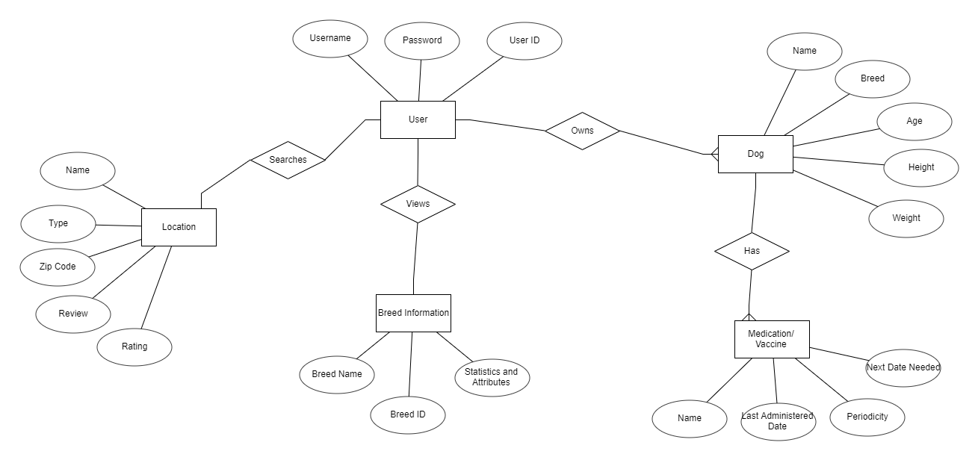
ERD

Slide 9
Personal Information Database
Personal.Table
Users Table
User ID (int) | User Name (VarChar) | Password (VarChar)
Personal Info Table
User ID (int) | Dog Name (VarChar) | Dog Breed (VarChar) | Dog Age (int) | Dog Weight (int) | Dog Height (int)
Medical Table
User ID (int) | Dog Name (VarChar) | Medication Name (VarChar) | Last Date (Date) | Periodicity (Date) | Next Date (Date)

Slide 10
Location Database
Locations.Table
Locations Table
Location Name (VarChar) | Location (zip)(int) | Type (VarChar) | Average Rating (int)
Rating and Reviews Table
Location Name (VarChar) | Rating (int) | Review (VarChar)

Slide 11
Breed Information Database
BreedInfo.Table
Overall Table
Breed ID (int) | Breed Name (VarChar) | Average Height (int) | Average Weight (int) | Average Lifespan (int) | Adaptability (int) | Friendliness (int) | Health (int) | Grooming (int) | Training (int) | Exercise (int)
Adaptability Table
Breed ID (int) | Overall (int) | Apartment (int) | Novice Owners (int) | Sensitivity (int) | Alone (int) | Hot Weather (int) | Cold Weather (int)
Friendliness Table
Breed ID (int) | Overall (int) | With Family (int) | With Kids (int) | Other Dogs (int) | Strangers (int)
Grooming Table
Breed ID (int) | Overall (int) | Shedding (int) | Drooling (int) | Easiness of Grooming (int)
Training Table
Breed ID (int) | Overall (int) | Easiness (int) | Intelligence (int) | Mouthiness (int) | Prey Drive (int) | Barking (int) | Wanderlust (int)
Exercise Table
Breed ID (int) | Overall (int) | Energy Level (int) | Intensity (int) | Exercise Need (int) | Playfulness (int)

Slide 12
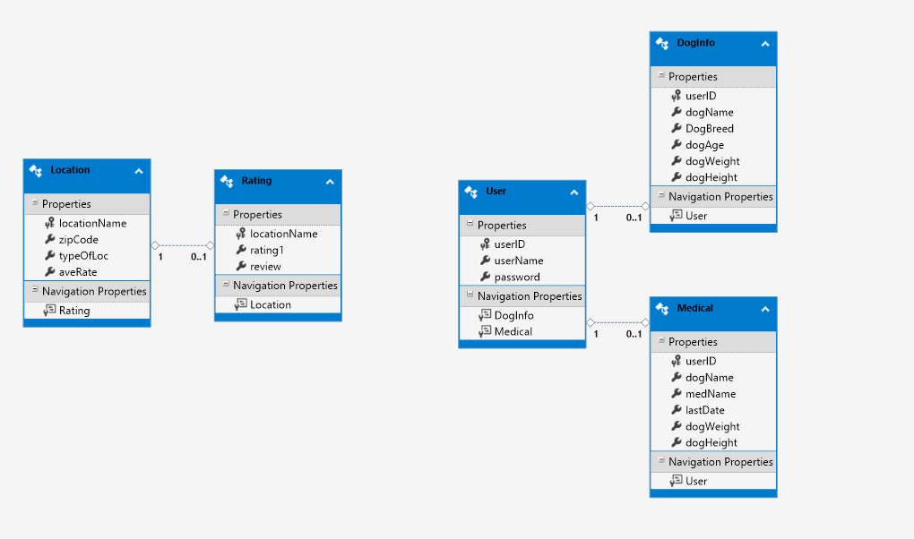
Model Class Diagram

Slide 13
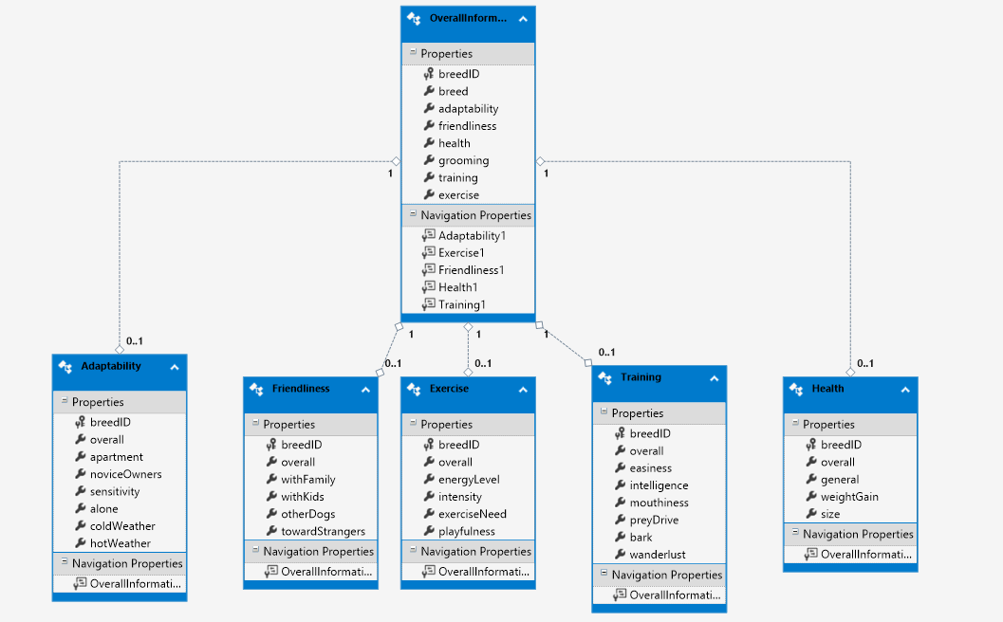
Model Class Diagram

Slide 14
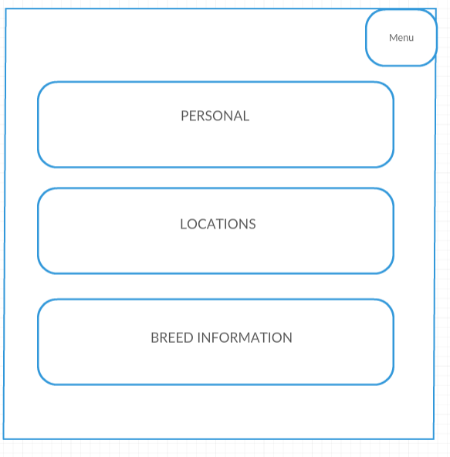
Main Page Wireframe

Slide 15
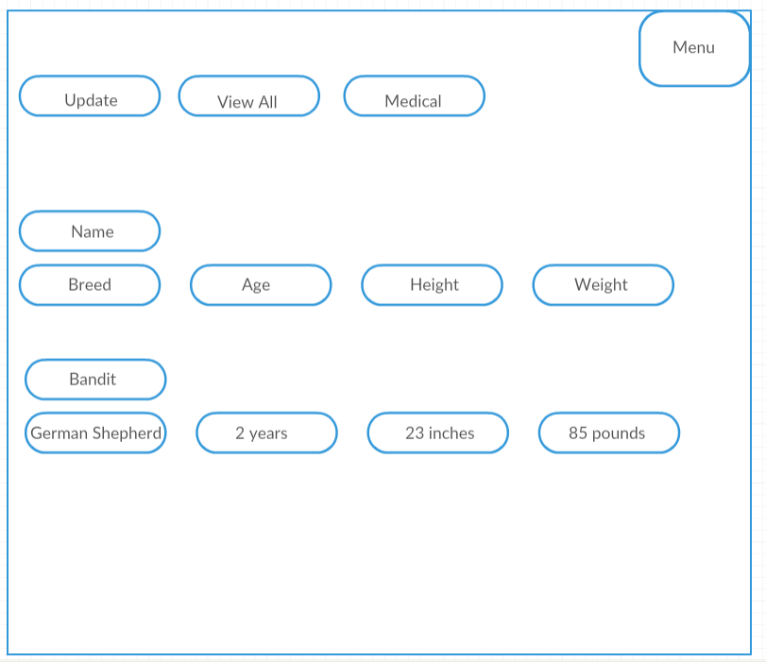
Personal Information Wireframe

Slide 16
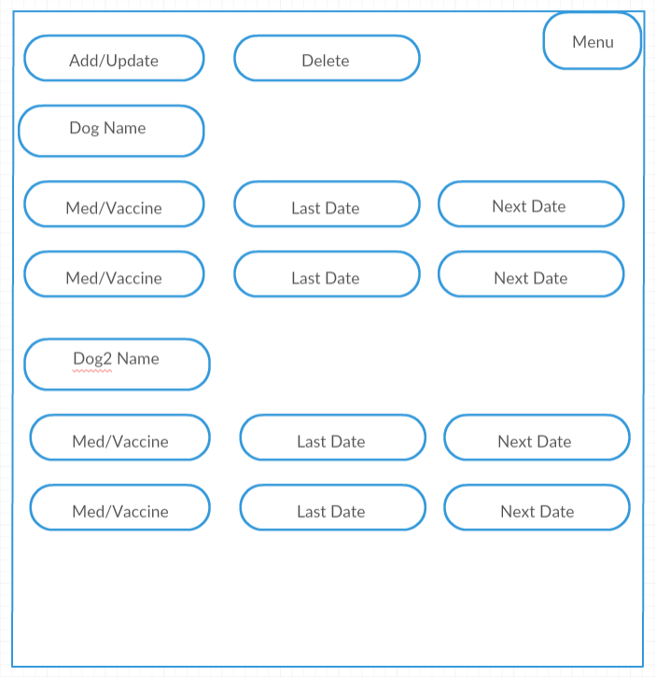
Medical Wireframe

Slide 17
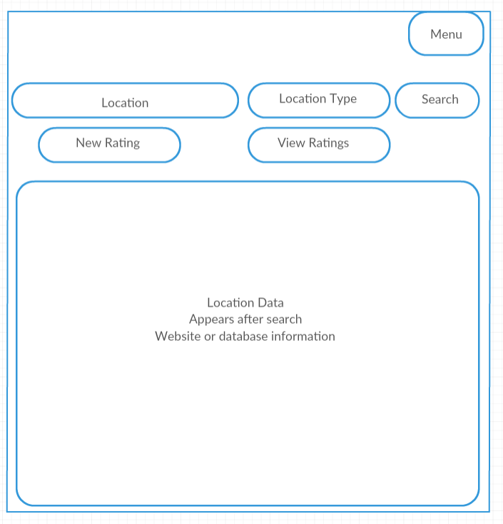
Location Wireframe

Slide 18
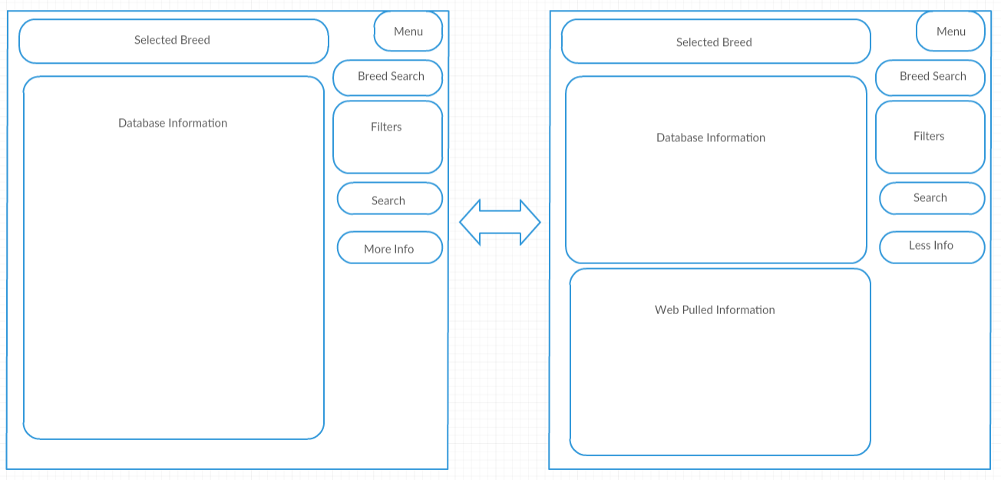
Breed Information Wireframe

Slide 19
Future Updates
Lost dog/found dog postings
Capability to contact local animal services
Database with foods dangerous to dogs and cures

