Slide 1
Linear regression
CSS2
Garrett Swan

Slide 2
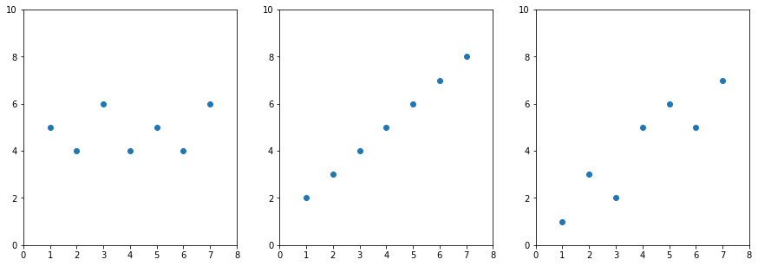
Linear regression is a method for modeling the relationship between two scalar values: the input variable x and the output variable y.
Values of X do not tell us at all about the values of Y
Values of X tell us exactly the value of Y
Values of X give us an idea of the values of y

Slide 3
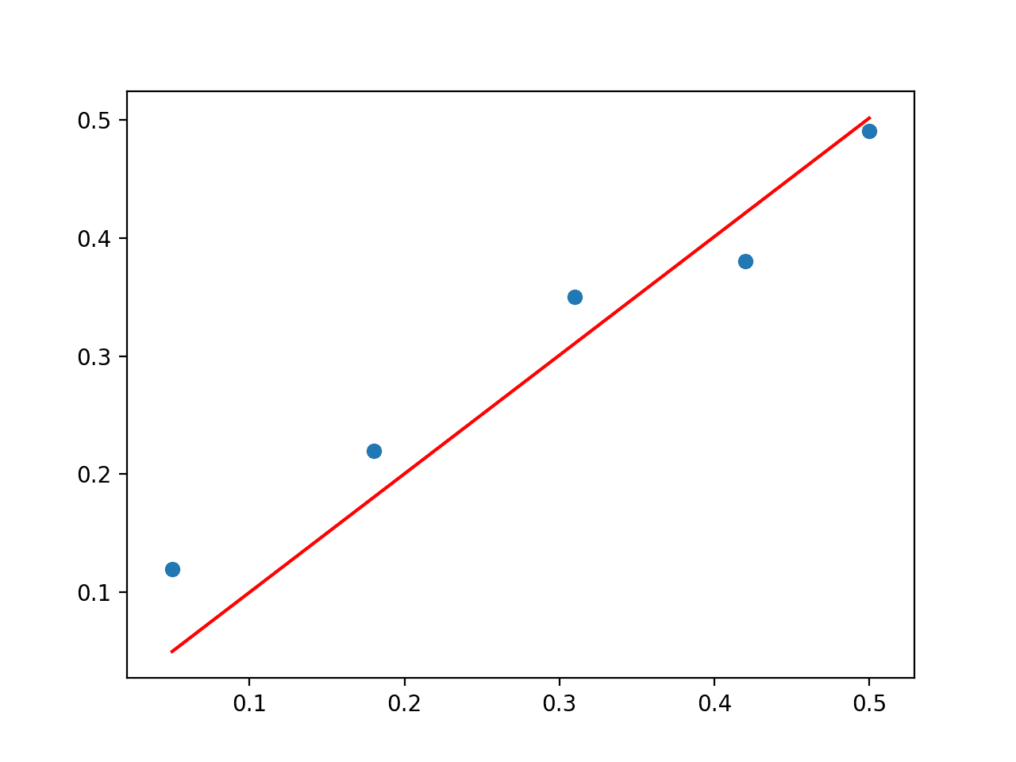
Linear regression is modeled with line, y_{i} = ß₀ + X_{i}ß_{i} + e_{i}
y = y values ß₁ = slope (or the angle of the line)
X₁ = x values ß₀ = y-intercept (i.e., y value when x = 0)
e_{i} = error
_{i} = each observation

Slide 4
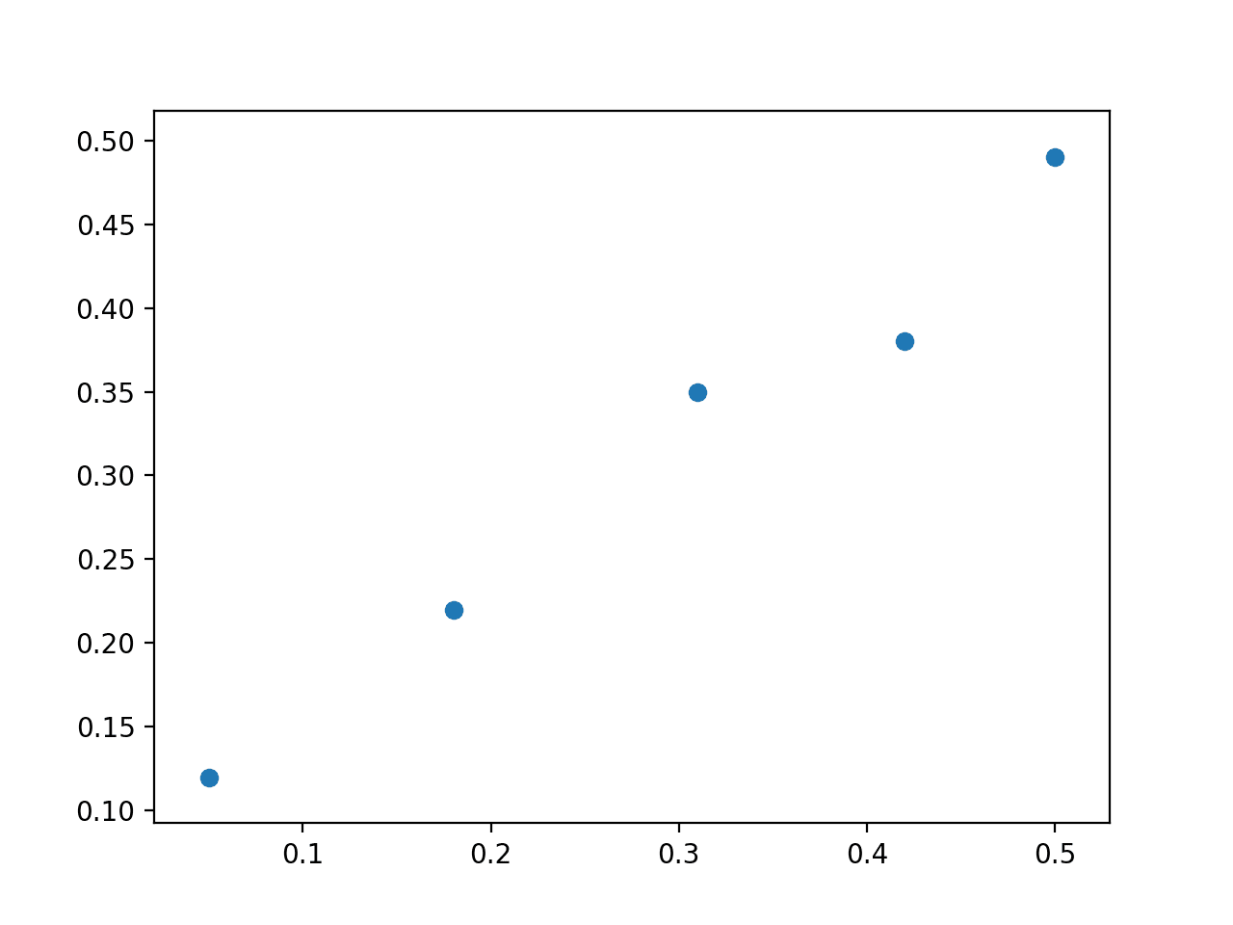
So, how do we find the line? (i.e., solve y_{i} = ß₀ + X_{i}ß_{i} + e_{i})
Ideally, we want pick ß₀ and ß_{i} that minimizes e_{i} (smaller e_{i} means that X is closer to y)

Slide 5
Lots of ways of doing that
You could basically randomly select ß₀ and ß_{i} values
You could solve the equation!
https://setosa.io/ev/ordinary-least-squares-regression/
https://towardsdatascience.com/understanding-the-ols-method-for-simple-linear-regression-e0a4e8f692cc
https://towardsdatascience.com/building-linear-regression-least-squares-with-linear-algebra-2adf071dd5dd

