Slide 1
Feature engineering – what is it?
April 21st
CSS2
Garrett Swan

Slide 2
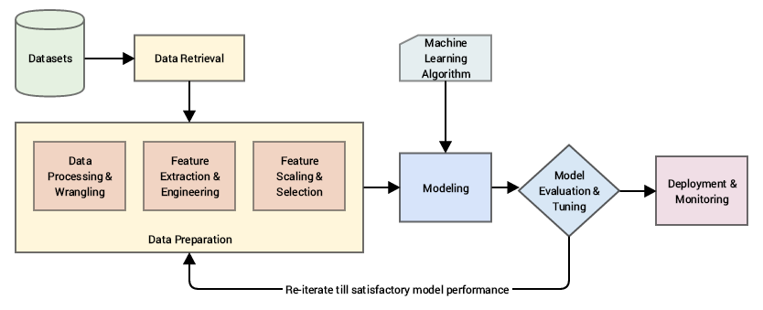
Representation of this course

Slide 3
Representation of this course
Dataframes, web scraping, loading data, fake data, processing strings, etc

Slide 4
Representation of this course
Feature engineering section

Slide 5
Representation of this course
Last half of class focuses on modeling and machine learning

Slide 6
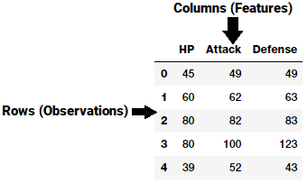
Feature engineering is the process of using domain knowledge (specific knowledge) to extract features (measurable properties) from raw data via data mining (selection, pre-processing, transformation, modeling, and evaluation)
In other words, its about intelligently selecting features so that we can our best to understand, interpret, and predict data

Slide 7
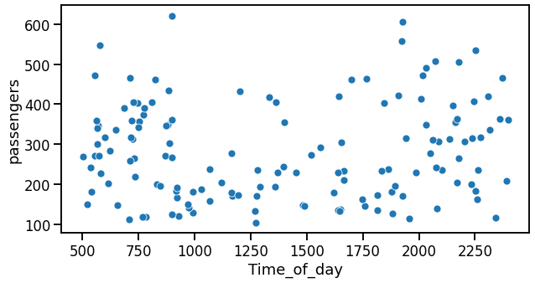
Example with no feature engineering
Imagine you have some flight data (time of day and the number of passengers)
You want to see the relationship between the two
The model that fits this data will be quite complex!

Slide 8
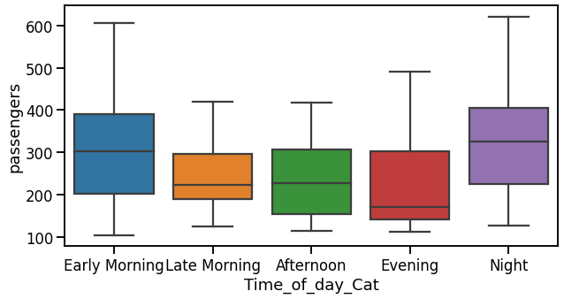
Example with feature engineering
Same dataset as before
But now, time of day is binned into different categories
For example, flights between 5am and 9am are Early Morning
Lost some precision, but much simpler to understand!
A u-shaped function!

Slide 9
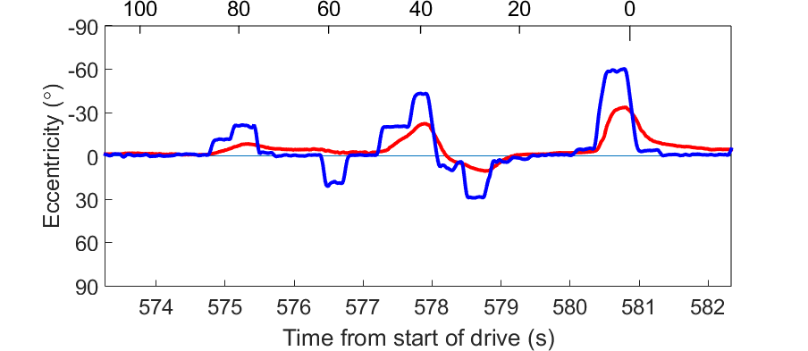
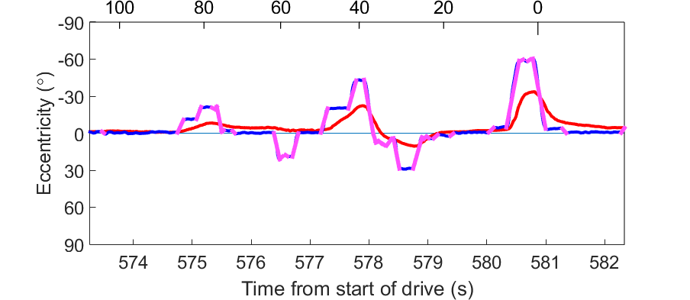
Here is another example
Eye tracking data while someone drives
Left
How do people scan left and right when driving?
600 individual gaze points
Gaze
Head
Right
Left
25 individual saccade data points
- Which are easier to analyze
Rapid eye movements = saccades
Right

Slide 10
In practice, the most common type of feature engineering that we will encounter in this course is:
Selecting features
Picking the features most relevant to your question
Removing features that aren’t relevant
Transforming/cleaning the data

Slide 11
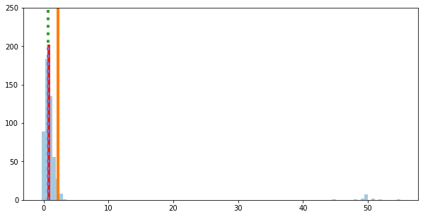
Transforming the data
Removing missing data
Typically NaNs
Removing outliers
Data points that are far from other data points
Checking for duplicate entries
Transforming categories/ranks into numerical data
Transforming numerical data
Binning data
E.g., converting continuous time into discrete bins
Mean without outliers
Mean with outliers
Median without outliers
Median with outliers

Slide 12
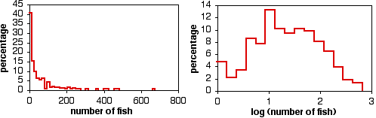
Transforming the data
Removing missing data
Typically NaNs
Removing outliers
Data points that are far from other data points
Checking for duplicate entries
Transforming categories/ranks into numerical data
Transforming numerical data
Binning data
E.g., converting continuous time into discrete bins

Slide 13
Is it normal to do feature engineering?
Of course
This is what separates good from great data scientists!
Is it normal to do all of that feature engineering?
Yes and no
In research labs, probably no
A lot of feature engineering talks place in deciding which variables from the experiment are saved
But you still may have missing data, outliers, or incorrectly inputted data
Outside of research labs, sometimes
It depends on the data!

Slide 14
For the next several lectures, we will be feature engineering a version of the mpg dataset that I have purposely messed up!
Some websites below with some more helpful discussion of feature engineering!
https://towardsdatascience.com/feature-engineering-in-python-part-i-the-most-powerful-way-of-dealing-with-data-8e2447e7c69e
https://towardsdatascience.com/understanding-feature-engineering-part-1-continuous-numeric-data-da4e47099a7b

