Slide 1
Binary classification

Slide 2
Binary Classification
Instead of a continuous target array (y), we are dealing with a target array composed of 1s and 0s
Dichotomous variable
Goal –predict whether something belongs to group 1 or group 0

Slide 3
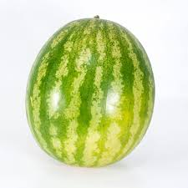


How would you differentiate between an apple or a watermelon?
Feature
Feature values
Color
Criterion

Slide 4


How would you differentiate between an apple or a watermelon?
Feature
Feature values
Color
Apple!
Criterion
Watermelon!

Slide 5
So, our model is based on color. So, let’s give our model some apples and watermelons and see how it performs
Note: If its an not an apple, then it must be a watermelon
True positive
Predicted as an apple and it is!

Slide 6
So, our model is based on color. So, let’s give our model some apples and watermelons and see how it performs
Note: If its an not an apple, then it must be a watermelon
True positive
Predicted as an apple and it is!
True negative
Predicted as not an apple, but it ain’t

Slide 7

So, our model is based on color. So, let’s give our model some apples and watermelons and see how it performs
Note: If its an not an apple, then it must be a watermelon
True positive
Predicted as an apple and it is!
False negative!
Predicted as not an apple, but it is!
True negative
Predicted as not an apple, but it ain’t

Slide 8
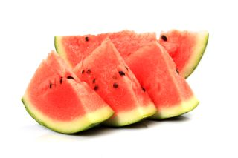
So, our model is based on color. So, let’s give our model some apples and watermelons and see how it performs
Note: If its an not an apple, then it must be a watermelon
True positive
Predicted as an apple and it is!
False positive
Predicted as an apple but it ain’t
False negative!
Predicted as not an apple, but it is!
True negative
Predicted as not an apple, but it ain’t

Slide 9
These are the only possible outcomes from binary classification
This is called our confusion matrix
Actually True
Actually false
True positive
Predicted as an apple and it is!
False positive
Predicted as an apple but it ain’t
Predicted True
Predicted False
False negative!
Predicted as not an apple, but it is!
True negative
Predicted as not an apple, but it ain’t

Slide 10
If we had to classify a 100 apples/watermelons, we may have a confusion matrix like so:
That’s pretty good! Accuracy would be:
Number correct predictions / total number of classifications = 90%
Actually True
Actually false
True positive
Predicted as an apple and it is!
False positive
Predicted as an apple but it ain’t
Predicted True
45
5
Predicted False
False negative!
Predicted as not an apple, but it is!
True negative
Predicted as not an apple, but it ain’t
5
45

Slide 11
What about this confusion matrix?
Lots of false positives! Not good!
Number correct precisions / total number of classifications = 65%
Actually True
Actually false
True positive
Predicted as an apple and it is!
False positive
Predicted as an apple but it ain’t
Predicted True
20
30
Predicted False
False negative!
Predicted as not an apple, but it is!
True negative
Predicted as not an apple, but it ain’t
5
45

Slide 12
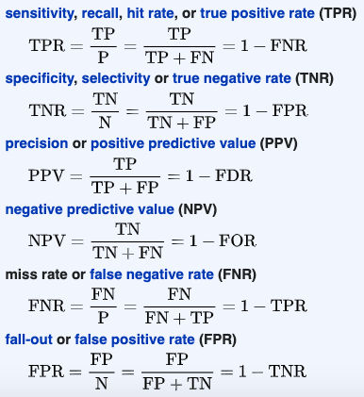
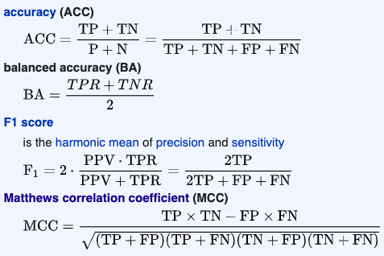
The number of True positives (TP), False positives (FP), True negatives (TN), and False negatives (FN) will be extremely helpful in determining the success of our classification

Slide 13
The number of True positives (TP), False positives (FP), True negatives (TN), and False negatives (FN) will be extremely helpful in determining the success of our classification

Slide 14
Accuracy is a commonly used metric
Train a binary classifier
Calculate the accuracy of the classifier for the testing data
But what if you are dealing with something like:
Predicting whether its your birthday or not
If my model always returned “no, it is not your birthday”
It would be 99.7% accurate!
Accuracy isn’t great for imbalanced datasets
For other discussions, check this out:
https://stats.stackexchange.com/questions/312780/why-is-accuracy-not-the-best-measure-for-assessing-classification-models

Slide 15
The number of True positives (TP), False positives (FP), True negatives (TN), and False negatives (FN) will be extremely helpful in determining the success of our classification

Slide 16
The number of True positives (TP), False positives (FP), True negatives (TN), and False negatives (FN) will be extremely helpful in determining the success of our classification
These will also be useful!

Slide 17
We will focus on the following methods for binary classification:
Decision tree classifiers

Slide 18
We will focus on the following methods for binary classification:
Decision tree classifiers
Is the color more red than green?
no
yes
Watermelon
Apple

Slide 19
We will focus on the following methods for binary classification:
Decision tree classifiers
Is the color more red than green?
no
yes
Bigger than my dog?
Bigger than my dog?
no
yes
no
yes
Apple
Watermelon
Apple
Watermelon

Slide 20
We will focus on the following methods for binary classification:
Decision tree classifiers
Is the color more red than green?
Node
no
yes
Branch
Bigger than my dog?
Bigger than my dog?
no
yes
no
yes
Leaf
Apple
Watermelon
Apple
Watermelon

Slide 21
We will focus on the following methods for binary classification:
Decision tree classifiers
Is the color more red than green?
Node
no
yes
Branch
Bigger than my dog?
Bigger than my dog?
no
yes
no
yes
Leaf
Apple
Watermelon
Apple
Watermelon

Slide 22
We will focus on the following methods for binary classification:
Decision tree classifiers
Is the color more red than green?
Node
no
yes
Branch
Bigger than my dog?
Bigger than my dog?
no
yes
no
yes
Leaf
Apple
Watermelon
Apple
Watermelon

Slide 23
We will focus on the following methods for binary classification:
Decision tree classifiers
Is the color more red than green?
no
yes
Bigger than my dog?
Bigger than my dog?
no
yes
no
yes
Apple
Watermelon
Apple
Watermelon
Simple to implement and easy to interpret and visualize
Easy to overfit!

Slide 24
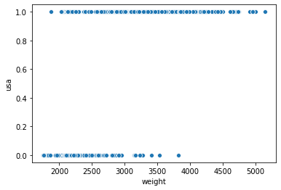
We will focus on the following methods for binary classification:
Decision tree classifiers
Logistic regression
Transformed linear regression
Logistic classification:
Y >= 0.5, USA = 1
Y < 0.5, USA = 0
Linear
Simple to implement
Not very powerful
Logistic

Slide 25
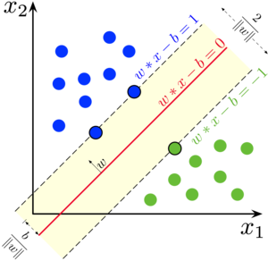
We will focus on the following methods for binary classification:
Decision tree classifiers
Logistic regression
Support vector machines
Simplest version = linear = drawing a line between categories
-Works great with multi-dimensions and when data are easily separable
-Less impact of outliers!
-Takes a long time when there are lots of data

Slide 26
Questions?
In CSS100, we will more about how these algorithms work and discuss multi-class classification

