Slide 1


LORSTransformerDRL
A Novel Deep Reinforcement Learning Framework for Intelligent Stock Trading with Chaotic Oscillators and Attention Mechanisms
Breaking Through Traditional Prediction-Decision Paradigms
Ziqian LU 2230026112
Pengyue MA 2230026119
Zihang ZENG 2230026204
Beijing Normal-Hong Kong Baptist University

Slide 2
Contents
1
Introduction & Motivation
4
Experimental Setup
Research background and problem definition
Dataset and evaluation methodology
2
Background & Related Work
5
Results & Analysis
DRL, chaos theory, and Transformers
Performance evaluation and insights
3
Methodology
6
Conclusion & Future Work
LORS mechanism and system architecture
Summary and research directions

Slide 3
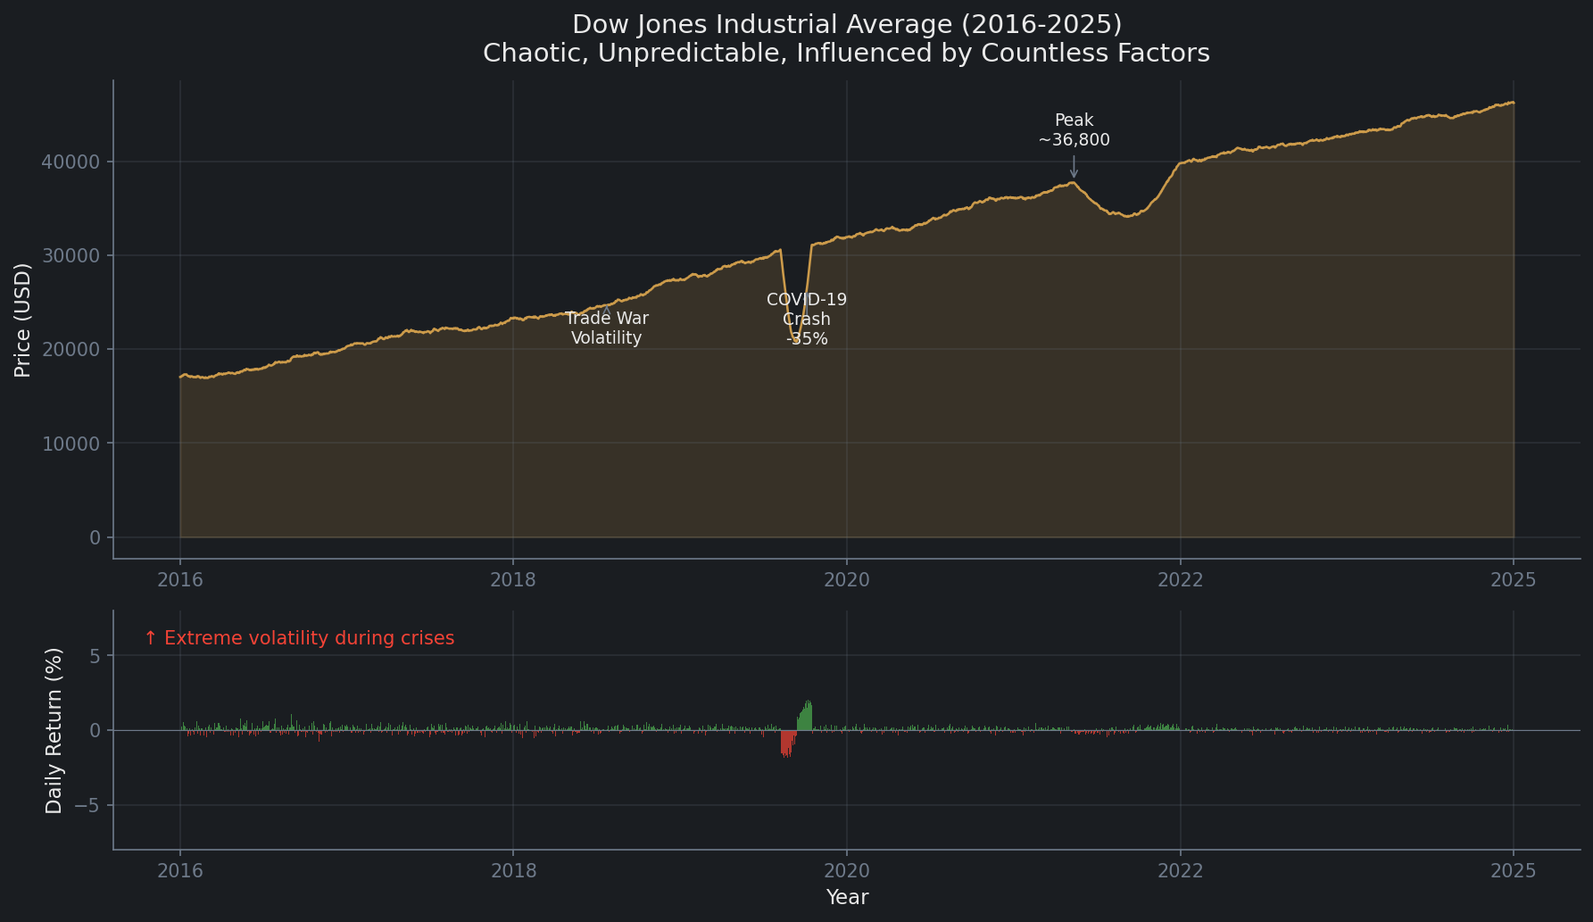
Why Stock Trading is Hard?
Understanding the challenge before introducing our solution

Slide 4
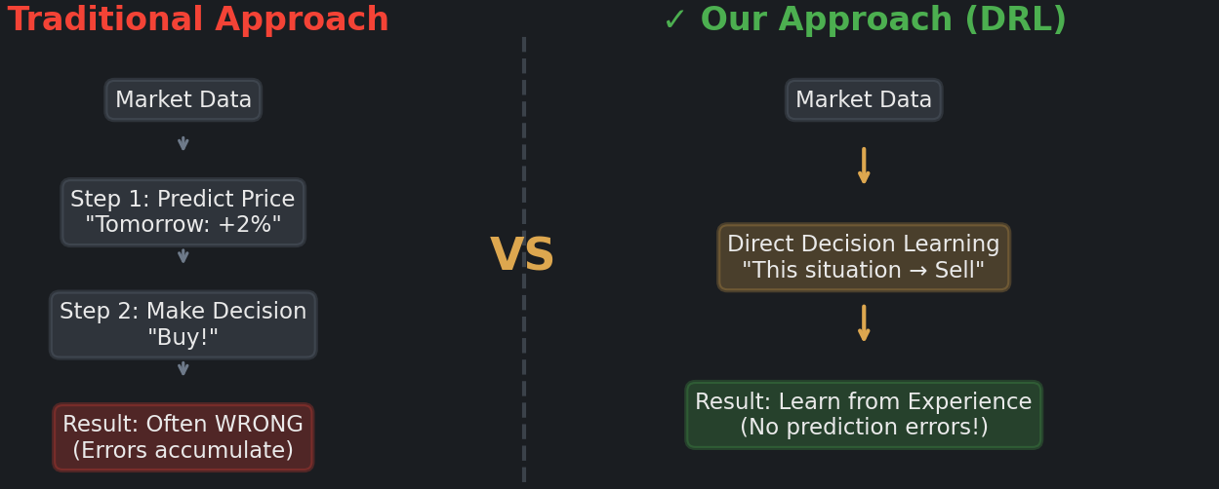
Why Stock Trading is Hard?
~ Learning to ride a bike, but we do not calculate physics, we learn by doing.

Slide 5
Research Motivation
📈
⚠️
🎯
Market Characteristics
Traditional Approach Problems
Our Goal
End-to-end decision optimization
Direct action learning
No prediction step needed
Highly non-linear dynamics
Chaotic and uncertain behavior
Complex multi-factor influences
'Predict-then-decide' paradigm
Error accumulation
Poor adaptation to changes
Traditional
VS
Our Approach
Predict → Decide → Error
Direct Decision

Slide 6
Problem Definition
Input
Output
Objective
Historical market data
(120-day window, 10 features)
Trading actions {Buy, Hold, Sell}
Maximize risk-adjusted returns (Sharpe ratio)
Key Challenges:
Our Solution:
LORS
~
Non-stationary dynamics
Chaotic Dynamics
|
Low signal-to-noise ratio
v
Transformer
$
Transaction costs and slippage
Attention
v
DRL
Policy Optimization

Slide 7
Deep Reinforcement Learning in Trading
RL Framework
Key Concepts
Agent
DQN (Mnih et al., 2015)
Q-function approximation with neural networks
Trading Strategy
Action aₜ
State sₜ
Experience Replay
(Buy/Hold/Sell)
(Market Data)
Breaks correlation between samples
Env
Target Networks
Stable training with separate target network
Market
Advantages: Direct state-to-action mapping • No prediction error accumulation • Adaptive to market changes

Slide 8
Chaos Theory in Financial Markets
Chaotic System Characteristics
Lee Oscillator
Retrograde Signaling (LORS)
🦋
Sensitive dependence on initial conditions
〰️
Discrete-time neural oscillator
🔄
Feedback from output to input
🔀
Non-linear dynamics
🔀
Controlled chaotic behavior
🧠
Enhanced temporal memory
🎲
Deterministic but unpredictable
📈
Better than sigmoid activation
⏱️
Long-term dependency capture
LORS = Lee Oscillator + Retrograde Signaling

Slide 9
Transformer Architecture
Self-Attention Mechanism
Advantages over RNN/LSTM
Attention(Q,K,V) = softmax(QKᵀ/√dₖ)V
✓
No vanishing gradient problem
✓
Long-range dependencies
Query
Key
Value
✓
Parallel computation
What to look for
What to compare
What to extract
Limitation for Financial Data
Standard attention may miss non-linear relationships → Our solution: LORS integration for chaotic market dynamics

Slide 10
Our Contributions
1
Novel LORS Integration (Pengyue MA)
First to embed Lee Oscillator Retrograde Signal into Transformer architecture.
2
End-to-End Framework (Zihang ZENG)
Direct trading decision optimization without prediction step.
3
Comprehensive Evaluation (Ziqian LU)
Rigorous anti-leakage protocol with 8 baseline comparisons.
Key Results
214.9%
0.216
100%
Cumulative Return
Sharpe Ratio (6.9×)
Outperforms Baselines

Slide 11
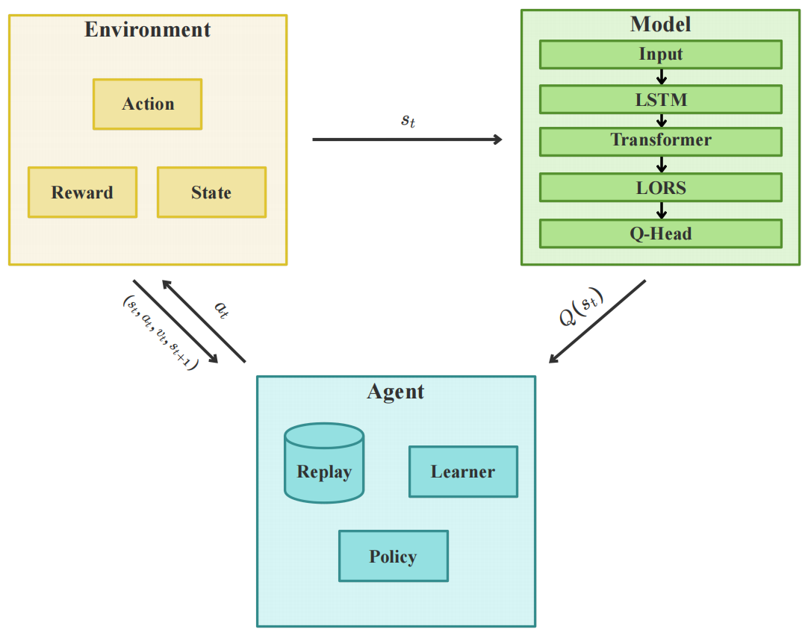
System Architecture Overview

Slide 12
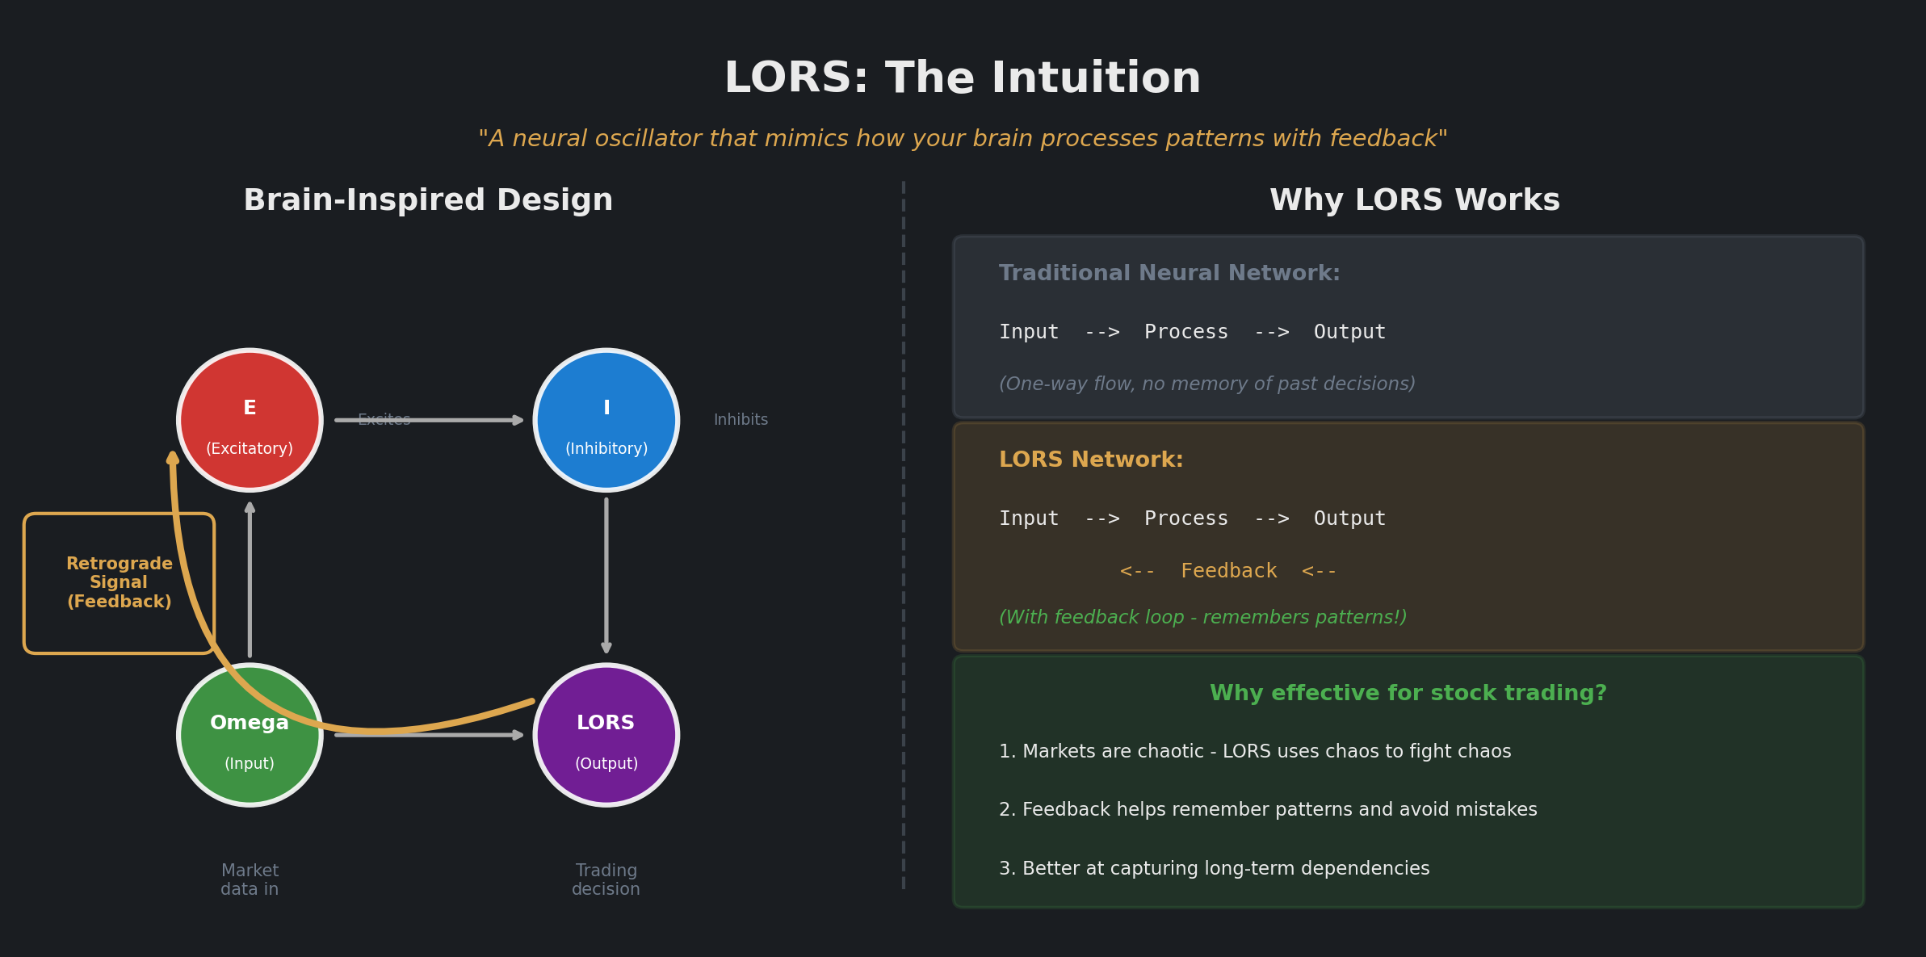

Slide 13
Trading Environment Design
Action Space
Reward Function
State Space
120-day sliding window, 10 features
↑
Buy: Use cash to purchase
rₜ = Vₜ - Vₜ₋₁
—
Hold: Maintain position
Change in portfolio value
Price Data (5): OHLCV
Technical Indicators (5): RSI, MACD, BB, Volatility
↓
Sell: Sell held shares
Normalization: MinMax scaling
Costₜ = c × |ΔNₜ| × Pₜᶜˡᵒˢᵉ
Holdings: Shares, cash
Limit: One unit per trade for risk control.
Transaction cost (c = 10 bps)

Slide 14
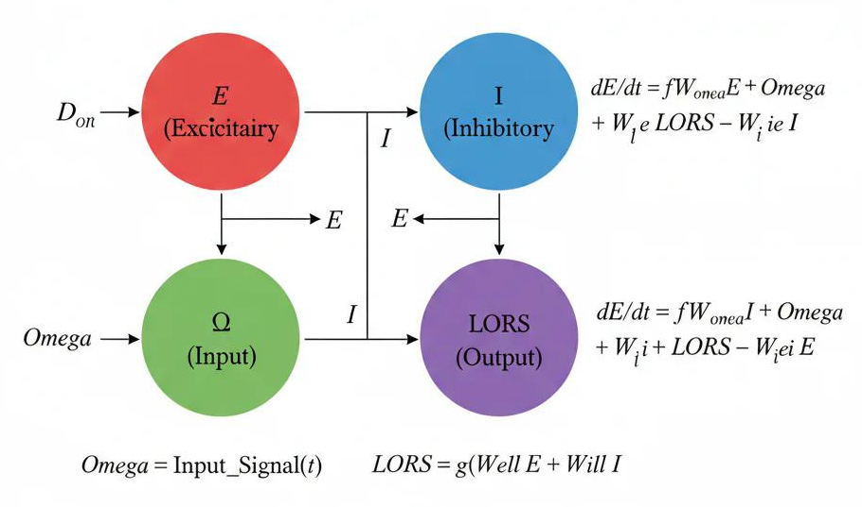
LORS Mechanism - Neurodynamics

Slide 15
LORS Bifurcation Types
Bifurcation Diagram
8 LORS Configurations
System transitions from steady state → period-doubling → chaos as μ increases.
LORS#0: Original Lee oscillator
LORS#1-7: Increasing bifurcation parameter μ
μ=0
μ=1
μ=2
μ=3
μ=4
μ=5
μ=6
μ=7
Attention-Weighted Combination
Lyapunov Exponent
LORS_combined = Σ wᵢ · LORSᵢ(Attention)
wᵢ are learned weights for adaptive selection
λ > 0 indicates chaos
Positive exponent shows sensitive dependence

Slide 16
LORSTransformerDRL Architecture
Input (120 x 10)
Key Components
v
Input Embedding + Position
Transformer Encoder (x3)
v
8 attention heads, FFN dim: 256, Dropout: 0.15
LSTM Layer
v
LORS Module
8 LORS configurations with attention-weighted combination
Transformer Encoder x3
+ LORS Module
Dual Pooling
v
Global average + max pooling for robust features
Dual Pooling + Output
v
Output Layer
3 Q-values for Buy/Hold/Sell actions
Q-values [Buy, Hold, Sell]

Slide 17
LORS Attention Mechanism
Flow Diagram
Standard vs LORS Attention
Attention Output
↓
Standard: Attention(Q,K,V)
LORS#0
LORS#1
LORS#2
...
= softmax(QKᵀ/√d)V
↓
Attention Weights
LORS: LORSAttention
↓
= LORS(softmax(QKᵀ/√d)V)
Weighted Sum
↓
Residual + LayerNorm
Benefits
Combines self-attention with chaotic dynamics • Adaptive LORS configuration selection • Enhanced non-linear pattern capture

Slide 18
DQN Algorithm
Core Update Rule
Key Techniques
Q(s,a) ← Q(s,a) + α[r + γ max_a' Q(s',a') - Q(s,a)]
Experience Replay
Buffer: 20,000, Batch: 64
Loss: L(θ) = E[(r + γ max Q(s',a';θ⁻) - Q(s,a;θ))²]
Target Network
Training Parameters
Update every 10 episodes
Learning rate:
Discount γ:
ε-Greedy Exploration
0.0001
0.99
ε: 1.0 → 0.01, Decay: 0.995
Optimizer:
Grad clip:
Adam
1.0

Slide 19
Anti-Leakage Protocol
Leakage Prevention
Chronological Data Split
✓
Scalers fit on training only, then frozen
✓
Rolling statistics use only past data
Train 60%
Val 20%
Test 20%
✓
Model selection by validation Sharpe only
Jan 2016 - May 2021
May 2021 - Mar 2023
Mar 2023 - Dec 2024
✓
Single-pass test evaluation (no refitting)
*
Cost Consistency
Transaction cost c = 10 bps, identical in training and testing.

Slide 20
Experimental Setup
Dataset
Training Config
Dow Jones Industrial Average
Features (10D)
Max Episodes
^DJI ticker symbol
100 (Early stop: 15)
Price Data (5):
Period
Open, High, Low, Close, Volume
Initial Capital
Jan 2016 - Jan 2025
Technical Indicators (5):
$1,000,000
RSI, MACD, BB_High, BB_Low, Volatility (20d)
Total
Selection
2,518 trading days
Validation Sharpe ratio

Slide 21
Baseline Models
Recurrent Networks
CNN/MLP
Transformer-based
LSTM_DQN: Basic LSTM
CNN_DQN: 1D Convolutional
Transformer_DQN: No LORS
GRU_DQN: Gated Recurrent Unit
DQN_MLP: Multi-layer Perceptron
AttentionLSTM_DQN: LSTM + Attention
Ablation Baselines
Lower Bound
ChaoticRNN_DQN: Chaos (no retrograde)
Random: Random action baseline
LORSTransformer: LORS + Transformer (no DRL)

Slide 22
Evaluation Metrics
Risk-Return Metrics (Table I)
Trading Behavior Metrics (Table II)
Cumulative Return (CR)
CR = (V_T / V_0 - 1) × 100%
Average Holding Time
Days per position
Sharpe Ratio (SR)
SR = (r̄ - r_f) / σ(r)
Transaction Frequency
Trades per month
Maximum Drawdown (MDD)
MDD = max[1 - V_t / max(V_s)] × 100%
Average Per-Trade Return
Win Rate (WR)
Percentage gain per trade
WR = # profitable trades / # total trades × 100%
All metrics computed on test set only, with transaction costs applied

Slide 23
Main Results - Table I
Model | CR (%) | Sharpe | MDD (%) | Win (%)
LORSTransformerDRL | 214.9 | 0.216 | 42.3 | 58.3
CNN_DQN | 197.1 | 0.162 | 47.9 | 54.9
DQN_MLP | 133.9 | 0.186 | 42.3 | 54.1
Transformer_DQN | 135.1 | 0.107 | 51.2 | 55.9
ChaoticRNN_DQN | 84.5 | 0.123 | 46.8 | 57.5
Random | -73.4 | 0.114 | 51.2 | 54.9
GRU_DQN | -22.6 | 0.046 | 39.7 | 56.0
LORSTransformer | -67.2 | 0.031 | 35.6 | 52.9
LSTM_DQN | -72.0 | 0.029 | 28.9 | 56.2
Key Finding: 6.9× Sharpe improvement over non-retrograde baseline

Slide 24
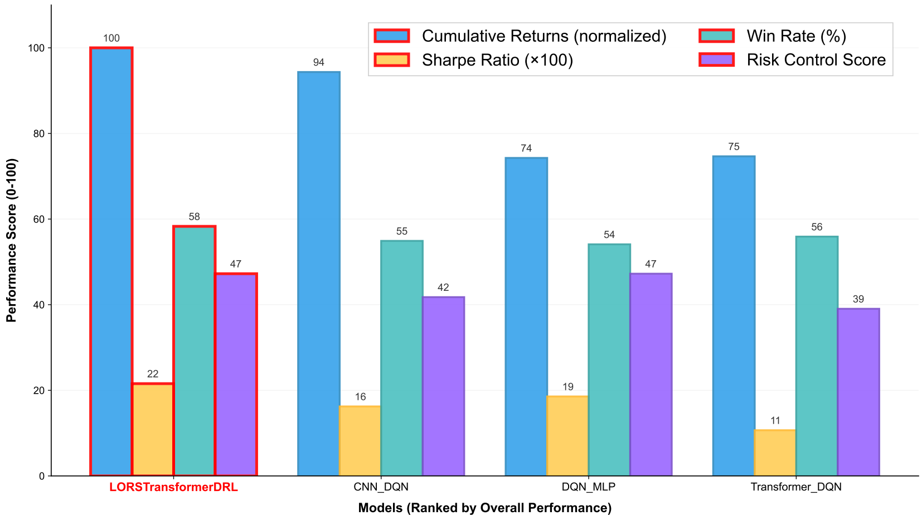
Multi-Metric Comparison (Figure 2)

Slide 25
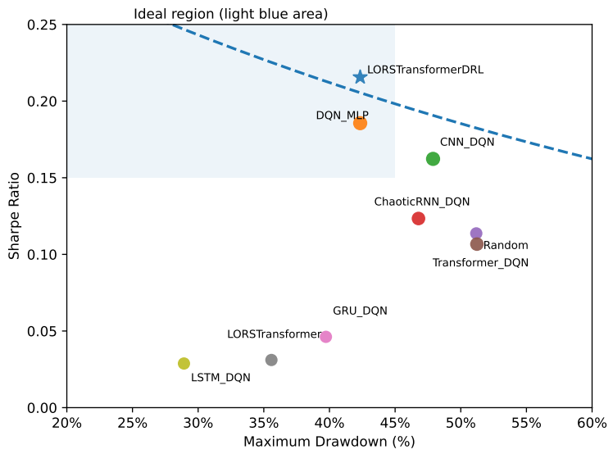
Risk-Return Trade-off (Figure 3)

Slide 26
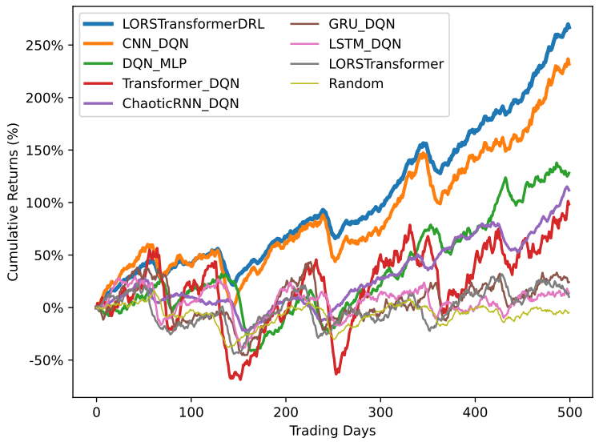
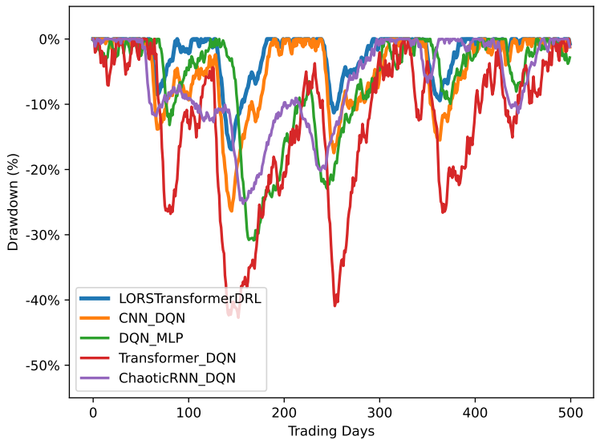
Performance Dynamics (Figure 4)
4a: Cumulative Return Trajectories
4b: Drawdown Trajectories

Slide 27
Ablation Study
Component Contributions
Key Takeaways
Ours vs no-LORS
ΔSharpe: +0.109
Transformer_DQN baseline
✓
LORS contributes most to Sharpe improvement
Ours vs no-Retrograde
ΔSharpe: +0.093
✓
Retrograde signaling improves risk control
ChaoticRNN_DQN baseline
Ours vs no-DRL
ΔSharpe: +0.185
✓
End-to-end DRL is necessary
LORSTransformer baseline

Slide 28
Limitations
⚠️
Single Asset Evaluation
⚠️
Statistical Validation
Only tested on DJI. Multi-asset portfolio not explored.
Single-seed results. Confidence intervals pending.
⚠️
Extreme Market Conditions
⚠️
Model Complexity
Flash crashes not fully tested. Need more stress testing.
Many parameters. LORS adds computational overhead.

Slide 29
Future Work
→
Multi-Asset Portfolio
→
Statistical Robustness
Multiple stocks, ETFs, and portfolio optimization.
Multi-seed experiments and confidence intervals.
→
Adaptive LORS Parameters
→
Real-Time Deployment
Learnable bifurcation parameters for market regimes.
Latency optimization and live trading integration.
→
Model Interpretability
LORS activation analysis and attention visualization.

Slide 30
Conclusion
💡
⚙️
📈
Novel LORS Integration
End-to-End Framework
Comprehensive Evaluation
First to embed Lee Oscillator Retrograde Signal into Transformer architecture.
Direct trading decision optimization without prediction step.
Rigorous anti-leakage protocol with 8 baseline comparisons.
Main Results
214.9%
0.216
100%
Cumulative Return
Sharpe Ratio (6.9×)
Outperforms Baselines

Slide 31
Thank You for Your Listenning
Pengyue MA 2230026119
Zihang ZENG 2230026204
Ziqian LU 2230026112
Beijing Normal-Hong Kong Baptist University

Slide 32
Reference
[1] R. S. T. Lee, “Chaotic type-2 transient-fuzzy deep neuro_x0002_oscillatory network (CT2TFDNN) for worldwide financial pre_x0002_diction,” IEEE Transactions on Fuzzy Systems, vol. 28, no. 4, pp. 731–745, 2020.
[2] M. J. Page et al., “The PRISMA 2020 statement: An updated guideline for reporting systematic reviews,” BMJ, vol. 372, p.n71, 2021.
[3] Z. Shi, Y. Hu, G. Mo, and J. Wu, “Attention-based CNN-LSTM and XGBoost hybrid model for stock prediction,” 2023. [Online]. Available: https://arxiv.org/abs/2204.02623
[4] C. Wang, J. Ren, H. Liang, J. Gong, and B. Wang, “Conducting stock market index prediction via the localized spatial–temporal convolutional network,” Computers and Electrical Engineering, vol. 108, p. 108687, 2023. [Online]. Available: https://www.sci-encedirect.com/science/article/pii/S0045790623001118
[5] A. A. Ariyo, A. O. Adewumi, and C. K. Ayo, “Stock price prediction using the ARIMA model,” in 2014 UKSim-AMSS
16th International Conference on Computer Modelling and Simulation, 2014, pp. 106–112.
[6] A. Daryl, Winata, S. Kumara, and D. Suhartono, “Predicting stock market prices using time series SARIMA,” in 2021 1st
International Conference on Computer Science and Artificial Intelligence (ICCSAI), vol. 1, 2021, pp. 92–99.
[7] P. Tang, C. Tang, and K. Wang, “Stock movement prediction: A multi-input LSTM approach,” Journal of Forecasting, vol. 43,
no. 5, pp. 1199–1211, 2024. [Online]. Available: https://onlineli-brary.wiley.com/doi/abs/10.1002/for.3071

Slide 33
Reference
[8] T. Li, Z. Liu, Y. Shen, X. Wang, H. Chen, and S. Huang, “Mas_x0002_ter: Market-guided stock transformer for stock price forecast_x0002_ing,” Proceedings of the AAAI Conference on Artificial Intelli_x0002_gence, vol. 38, no. 1, pp. 162–170, Mar. 2024. [Online]. Available: https://ojs.aaai.org/index.php/AAAI/article/view/27767
[9] V. Mnih et al., “Human-level control through deep reinforce_x0002_ment learning,” Nature, vol. 518, no. 7540, pp. 529–533, Feb.
2015. [Online]. Available: https://doi.org/10.1038/nature14236
[10] K. Cho, B. van Merrienboer, C. Gulcehre, D. Bah_x0002_danau, F. Bougares, H. Schwenk, and Y. Bengio, “Learn_x0002_ing phrase representations using RNN encoder-decoder for statistical machine translation,” 2014. [Online]. Available: https://arxiv.org/abs/1406.1078
[11] G. L. Gil, P. Duhamel-Sebline, and A. McCarren, “An evalua_x0002_tion of deep learning models for stock market trend prediction,”
2024. [Online]. Available: https://arxiv.org/abs/2408.12408
[12] P. Singh, M. Jha, and H. Patel, “Wavelet-enhanced deep learning ensemble for accurate stock market forecasting: A case
study of Nifty 50 index,” IEEE Access, pp. 1–1, 2025.
[13] A. Vaswani et al., “Attention is all you need,” in Advances in Neural Information Processing Systems, vol. 30. Curran Associates, Inc., 2017. [Online]. Available: https://proceedings.neurips.cc/paper_files/pa_x0002_per/2017/file/3f5ee243547dee91fbd053c1c4a845aa-Paper.pdf

Slide 34
Reference
[14] W. F. Sharpe, “The Sharpe ratio,” in The Journal of Portfolio Management, Fall 1994, pp. 169–178. Prince_x0002_ton University Press, Princeton, 1998. [Online]. Available: https://doi.org/10.1515/9781400829408-022
[15] D. M. Q. Nelson, A. C. M. Pereira, and R. A. de Oliveira, “Stock market’s price movement prediction with LSTM neural
networks,” in 2017 International Joint Conference on Neural Networks (IJCNN), 2017, pp. 1419–1426.
[16] Y. Lecun, L. Bottou, Y. Bengio, and P. Haffner, “Gradient_x0002_based learning applied to document recognition,” Proceedings
of the IEEE, vol. 86, no. 11, pp. 2278–2324, 1998.
[17] R. D. Riley, J. P. T. Higgins, and J. J. Deeks, “Interpretation of random effects meta-analyses,” BMJ, vol. 342, 2011. [Online]. Available: https://www.bmj.com/content/342/bmj.d549

