Slide 1
Python Programming Practice!
Intro to Python

Slide 2
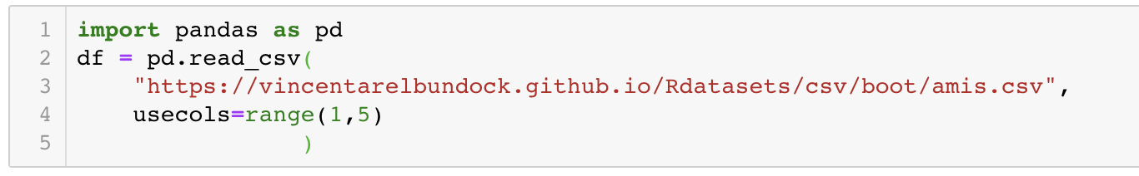
Data Analysis Datafile
2
Go to the ‘Speeding Case Study’ of the Jupyter Notebook
Import pandas and load the dataset
You can also download the csv to your computer, locally. https://vincentarelbundock.github.io/Rdatasets/datasets.html
We are using the amis dataset, fifth on that page

Slide 3
Data Analysis Overview
5
The data used here show measured car speeds with 3 other labels:
pair - There are 14 pairs of data collected
warning - For each pair, two sections of road were measured:
Where a warning sign was placed for part of the experiment
Whether there was a similar stretch of road in another part of town where no sign was erected during the experiment (control)
period -There are 3 time periods in the data for each pair:
Before the warning sign was placed on road section 1
Just after the sign was placed on road section 1
Some time after the sign was erected (so the sign is no longer "new")

Slide 4
Data Analysis
5
We want to study how the average speed changes in one section of road after the sign was erected, so we need to:
Read the data
Loop over the rows of data
Select data only from the group of interest (just pair 7)
Compute the answer

Slide 5
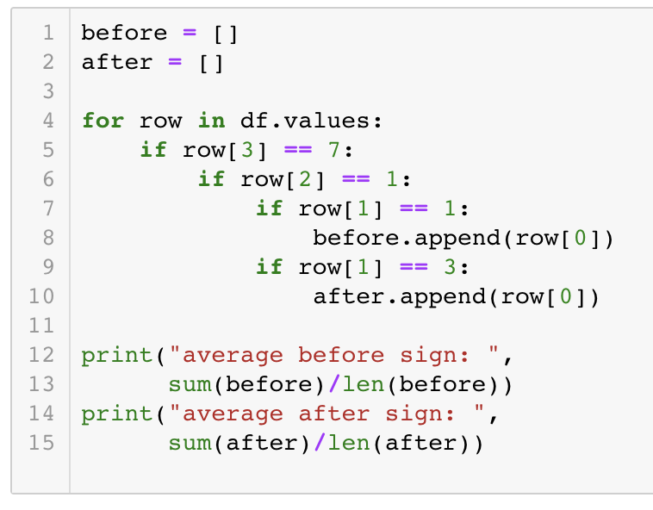
Data Analysis Recap
3
Create lists to store data of interest
For loop over all the data
Nested if statements to filter just the:
Pair
Warning
Period
we are look for
Save data to appropriate list
Print average of list after loop

Slide 6
Data Analysis Script
5
Change the Notebook name to speeding_example
Note no spaces!
File > Download As > Python (.py)
Click Keep if Browser warns file may be dangerous
Open new Terminal (or Anaconda Prompt) window
Change to Downloads folder in Terminal
type: cd Downloads and press enter
Run the python script
Type: python speeding_example.py and press enter
Note only the printed output lines appear in the terminal!

