Slide 1
+

Slide 2

5
+

Slide 3
+

Slide 4
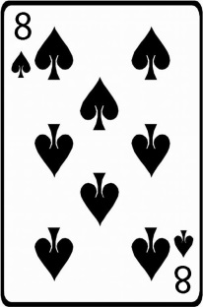
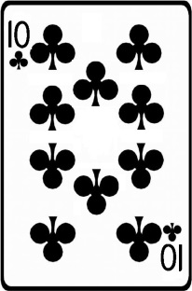

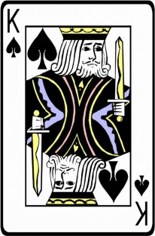
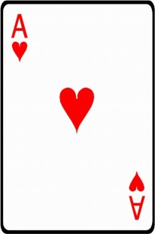

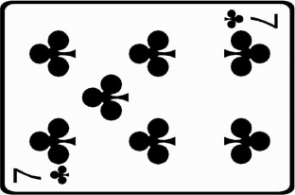
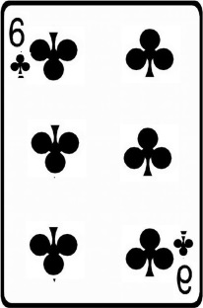
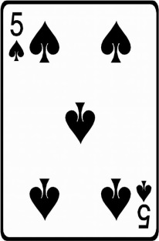
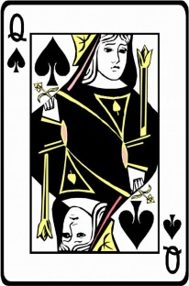
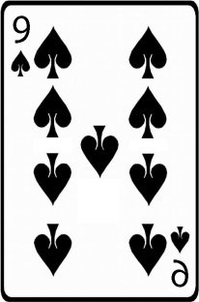
You Win!
+5
+

Slide 5
+

Slide 6
25
+

Slide 7
+

Slide 8
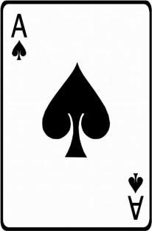

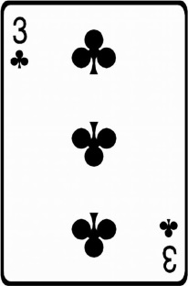
You Win!
+25
+

Slide 9
+

Slide 10
5
+

Slide 11
+

Slide 12

You Lose!
-5
+

Slide 13
+

Slide 14
25
+

Slide 15
+

Slide 16

You Lose!
-25
+

Slide 17
+

