Slide 1
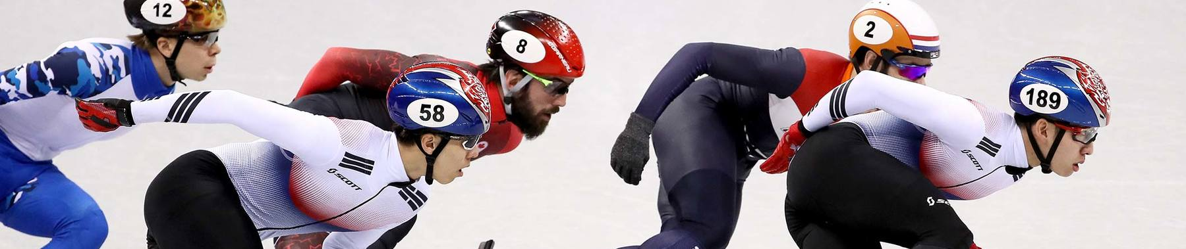
120 Years of Olympic History: Athletes and Results
Shijie Cheng

Slide 2
Intro
Motivation
Objective
Spanning over a century, the Olympic Games have witnessed the triumphs and challenges of generations, making Olympic history a rich data that mirrors global cultural and social developments.
Utilizing two comprehensive datasets from Kaggle, I plan to examine the development history of the Olympics, focusing on:
1. Medal distribution
2. Athlete demographics
3. National performances (China vs. US)
Data Source
https://www.kaggle.com/datasets/heesoo37/120-years-of-olympic-history-athletes-and-results/data
athlete_events.csv: Contains records of individual athletes' performances across different Olympic Games, including details like the athlete's name, sex, age, team, NOC code, the game year, sport, event, and medals won.
noc_regions.csv: Provides a mapping between the NOC codes and the corresponding countries or regions, facilitating an understanding of the athletes' national affiliations.

Slide 3
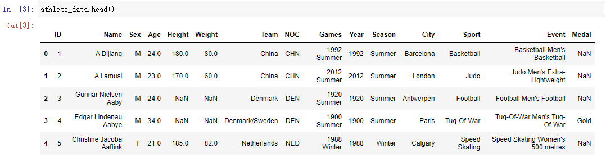
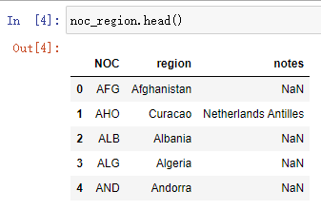
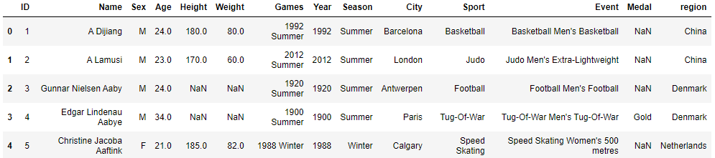
Extraction, Transform, and Load (ETL)
athlete_events.csv
noc_regions.csv
1. Merge these two datasets
Final DataFrame
2. Removed some redundant columns
1. "Team", "NOC", and "region" all mean the country of players
2. The "notes" column is irrelevant to the topic of my project.

Slide 4
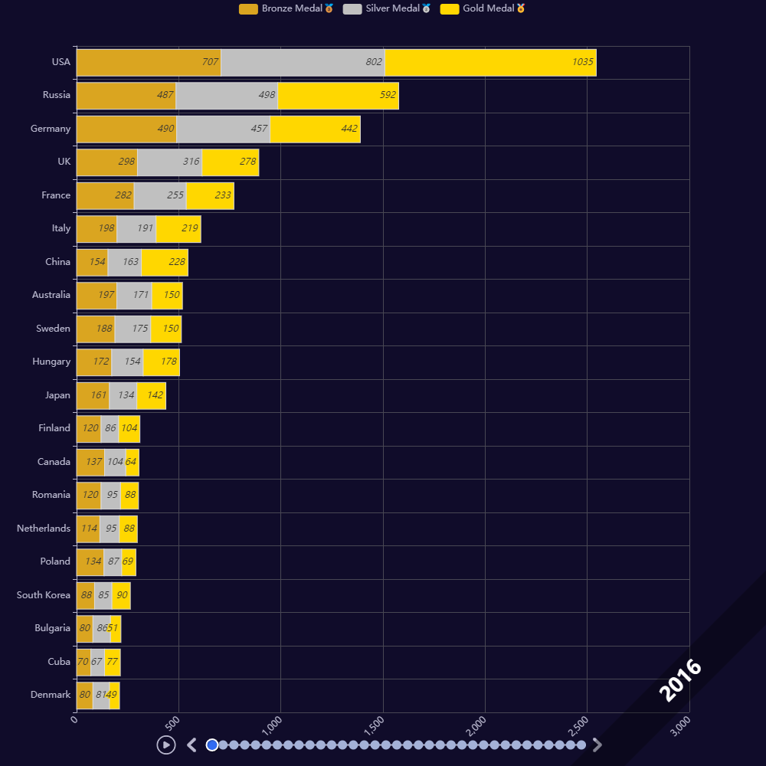
Exploratory Data Analysis (EDA)
Medal distribution
As of the 2016 Summer Olympics, the United States took first place by a wide margin, winning 2,544 medals and 1035 gold medals, which are both nearly twice as many as the second-place Russia.
China, a well-known sports powerhouse, is only in the seventh place, behind the United Kingdom, France and Italy. (The reason for this will be found in the later section China vs. US)
Conclusion:
In 120 years of Olympic history, the United States has dominated the gold and medal standings by a breakneck margin.

Slide 5
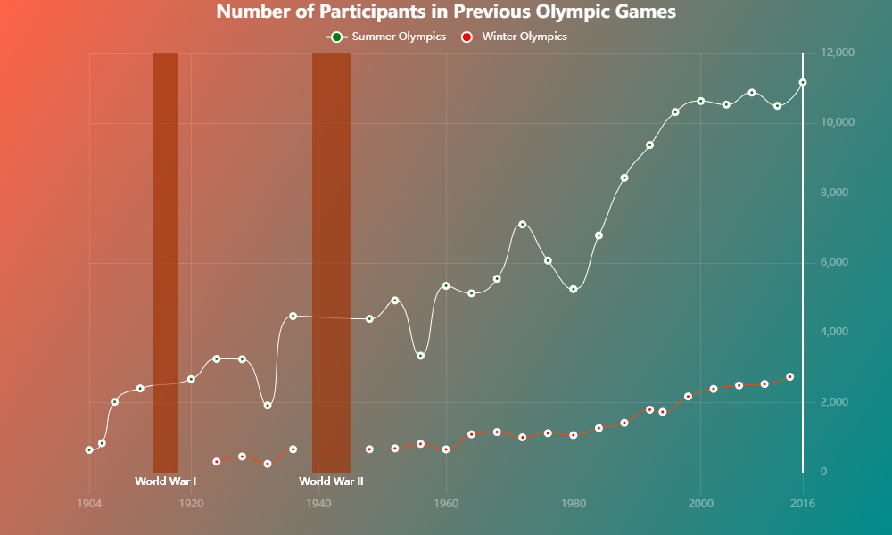
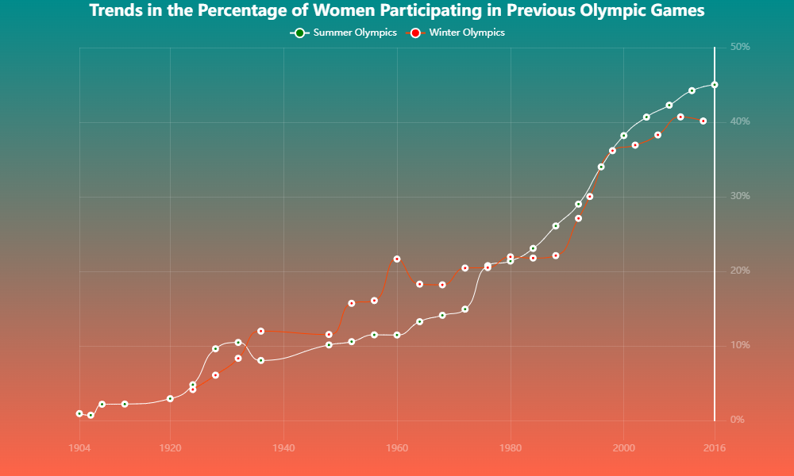
Athlete Demographics
Numbers of Athletes
Trends of Women Participating
The number of participants in each Summer Olympics is 4-8 times higher than in the Winter Olympics.
In the beginning, the Olympics was basically a “man‘s sport” with only single digit female athletes.
The overall number of participants is trending upwards.
However, in recent Olympics, the number of male and female participants has basically equalized.

Slide 6
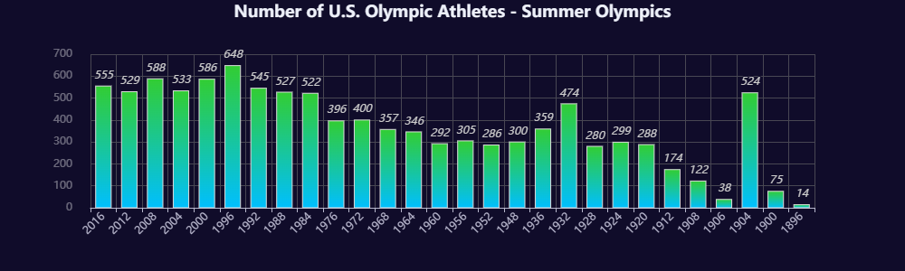
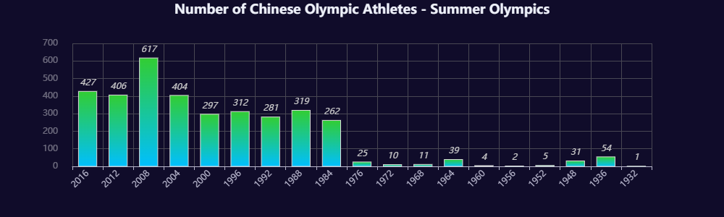
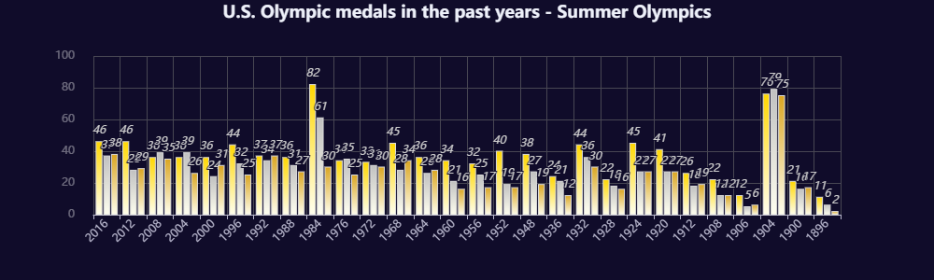
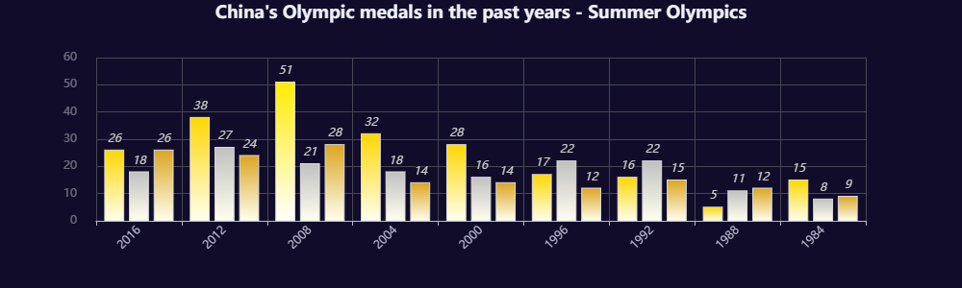
National performances (China vs. US)
US
China
United States has maintained a relatively high and stable number of participants and medals throughout its 120-year Olympic history.
China only started to win medals and have a relatively high and stable number of participants until 1984.

Slide 7
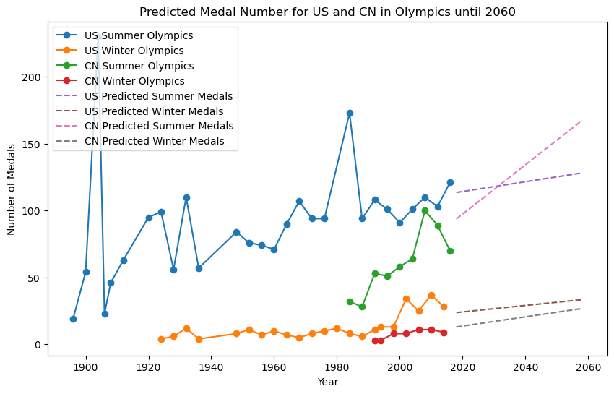
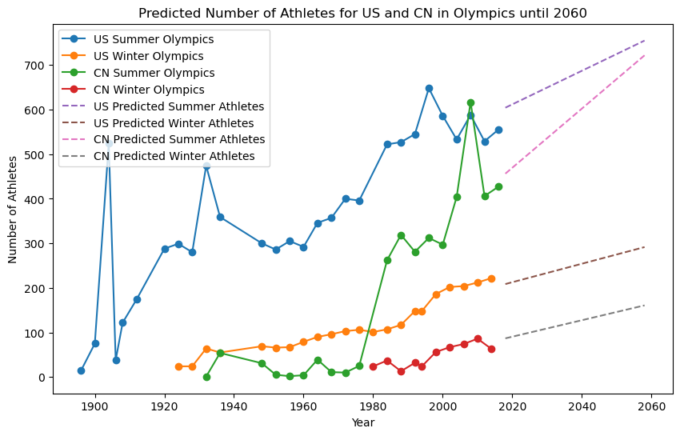
Model Prediction (China vs. US)
Medal Number Prediction
Athletes Number Prediction
Although United States is ahead of China so far in terms of both number of medals and participants, in the future China seems to have a tendency to overtake the US in both parts.

