Slide 1
System Design for Online/LastSeen (In Chat Server)

Slide 2
Use Case – Display Client A’s status on Client B
To implement this we need to store client A’s last activity time stamp and send it to Client B when requested
Client A’s activity can be tracked when he perform following operations
Open Application
Send message to any contact
Reading messages
When Client B request from Client A’s status, get the status from chat server and display Online/LastSeen.
Lets See System design in next slide

Slide 3
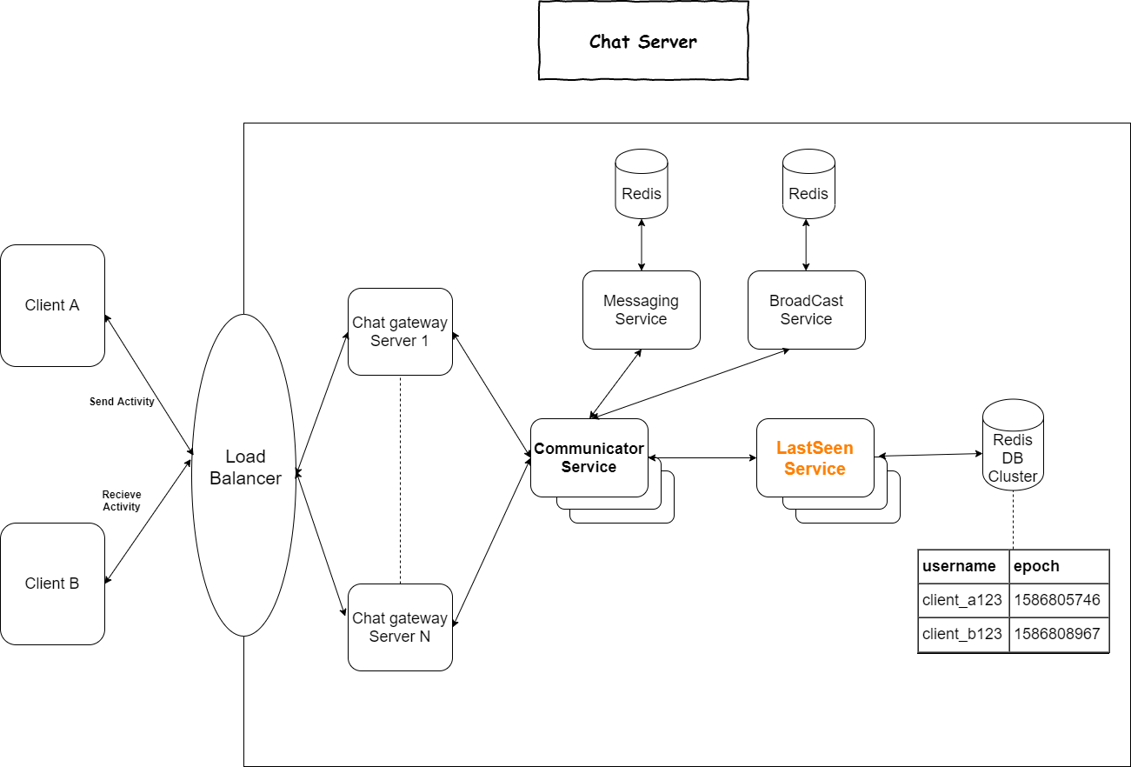

Slide 4
The System is design into following components
Client – Which can send and receive the message
Load Balancer – Client communicate to Load balancer which then communicate to Chat Server
Chat Server: Responsible for holding TCP Connection till the time client is connected
Communicator Service : This is a micro service. It is responsible for sending request to correct internal service e.g Messaging Service, BroadCast Service or LastSeen Service
Messaging Service : This is a micro service. It is responsible for doing peer to peer and group messaging
BroadCast Service : This is a micro service. It is responsible for doing broadcast Messaging.
LastSeen Service : This is a micro service. It is responsible for storing user’s last active time stamp. It uses Redis cluster to store values.
Communicator service identifies the activity and send request to LastSeen service which update user’s time stamp.
When someone requested it will send last active time stamp, based on this client can take decision to show Online/LastSeen
In the next slide will see the flow from Client A to Client B

Slide 5
Application Flow :
Client A perform the activity (open app, send message, read message) for this activity connection will be established with Chat server.
Chat server creates the TCP connection and route the request to communicator service
Communication service can then take logic decision to pass request to different services
If Client A send message to his contact, communicator service take design by reading request payload and send the parallel request to Messaging Service and LastSeen service
LastSeen Service update the user last activity timestamp in Redis cluster
Client B open app and open chat window for Client A, it will request for LastSeen timestamp, based on received timestamp Client B display Online/LastSeen

Slide 6
Technology Stack
Client – Any device
Load Balance – AWS Application Load balancer
Chat Server – Spring Boot micro service (With WebSocket endpoint)
Communicator – Spring Boot micro service (With Routing login)
LastSeen Service - Spring Boot micro service (Interacting with Redis Cluster)
Database – AWS ElatiCache with Redis
Operating System – AWS Linux
Container – Docker
Deployment Manager - Kubernates

