Slide 1
Mechanics of Bitcoin and Wallet
Risman Adnan Mattotorang, Ph.D
Telkom University

Slide 2
What You Learnt Last Week
The Core Components of Bitcoin (and Blockchain)
Hash Function
Merkle Tree
Digital Signature
Public Key as Identity
Simple Cryptocurrency

Slide 3
What You Will Learn Today
The Mechanics of Bitcoin Transactions
Overview of Consensus Layer
Bitcoin’s Blockchain
Bitcoin’s Transactions
Bitcoin’s Script
Managing Crypto Assets (Wallet)

Slide 4
Overview of Consensus Layer

Slide 5
Bitcoin Consensus Layer
Bitcoin P2P Network
End Users
signed Tx
sk_{A}
sk_{B}
sk_{C}
Typically, miners are connected to eight other peers (anyone can join)

Slide 6
Bitcoin Consensus Layer
mempool
Miners broadcast received Tx to the P2P network
Every miner:
Validates received Tx and
stores them in its mempool
(unconfirmed Tx)
note: miners see all Tx before they are posted on chain
Bitcoin P2P network
Notes:
Minters may decide to front run a Tx, if it is profitable.

Slide 7
Bitcoin Consensus Layer
Blockchain
I am the leader
Every 10 minutes:
Each miner creates a candidate block from Tx in its mempool
A “random” miner is selected (how: next week), and broadcasts its block to P2P network
All miners validate new block
Bitcoin P2P network
Notes:
Tx in new block are removed from the mempool.

Slide 8
Bitcoin Consensus Layer
Blockchain
6.25 BTC
Selected miner is paid 6.25 BTC in coinbase Tx (first Tx in the block)
Only way new BTC is created
Block reward halves every four years
⇒ max 21M BTC (currently 18.75M BTC)
Note: miner chooses order of Tx in block
Notes:
Miners want to be selected as often as possible: can join multiple times to increase their chances. Need to prevent that.

Slide 9
Bitcoin Consensus Layer
Very informal properties of Bitcoin consensus layer:
Persistence:
To remove a block, need to convince 51% of mining power *
Liveness:
To block a Tx from being posted, need to convince 51% of mining power **
(some sub 50% censorship attacks, such as feather forks)

Slide 10
Bitcoin’s Blockchain

Slide 11
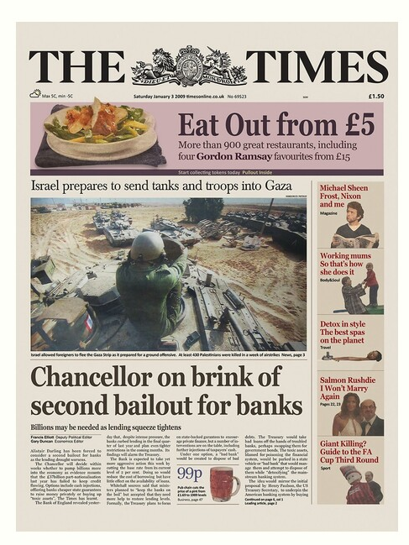
Bitcoin’s Blockchain: A sequence of block headers, 80 bytes each
Genesis block
BH₃
BH₁
BH₂
version (4 bytes)
prev (32 bytes)
time (4 bytes)
bits (4 bytes)
nonce (4 bytes)
Tx root (32 bytes)
prev
Tx root
prev
Tx root
H
H
H
…
80 bytes
coinbase Tx
coinbase Tx

Slide 12
Bitcoin’s blockchain: A sequence of block headers, 80 bytes each
Time: time miner assembled the block. Self reported. (block rejected if too far in past or future)
Bits: proof of work difficulty
Nonce: proof of work solution
Merkle Tree: payer can give a short proof that Tx is in the block
New block every ≈10 minutes.
for choosing a leader

Slide 13
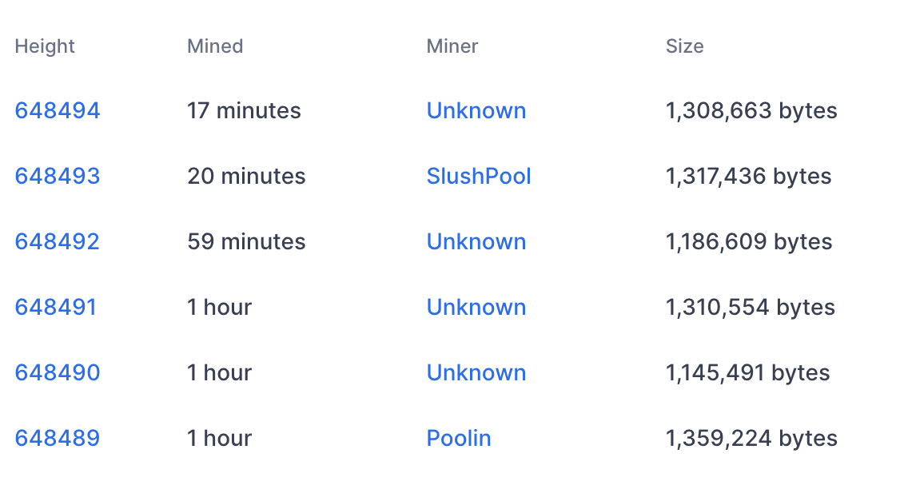
An example (Sep. 2020)
Tx data
#Tx
1855
2826
1128
2774
2075
2622

Slide 14
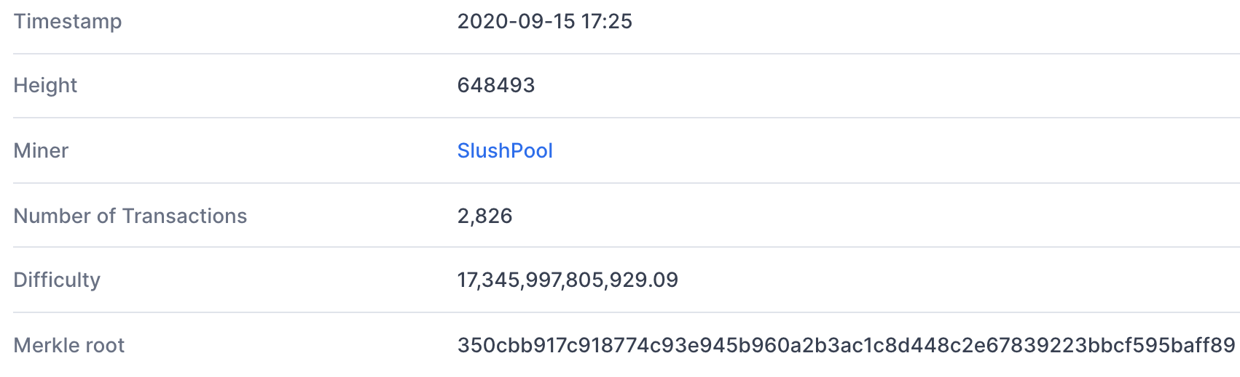
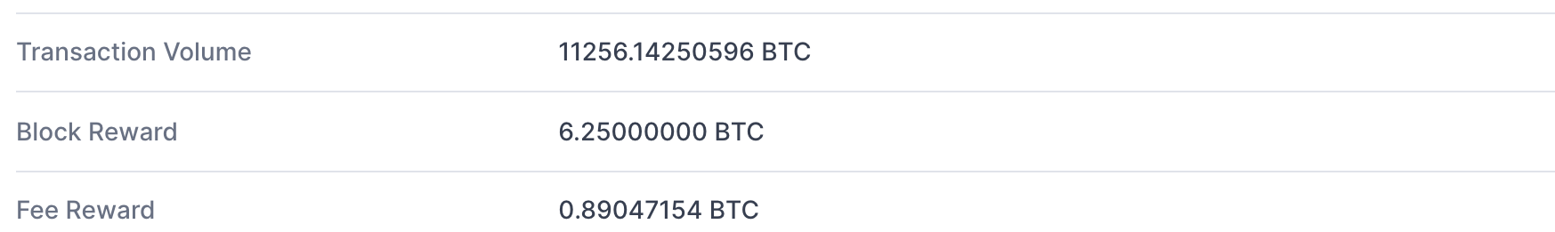
Block 648493
(from coinbase Tx)
(D)
(adjusts every two weeks)
(Tx fees given to miner in coinbase Tx)

Slide 15
Bitcoin’s Transactions

Slide 16
Tx sequence
View the blockchain as a sequence of Tx (append-only)
…
coinbase Tx
Tx cannot be erased: mistaken Tx ⇒ locked or lost of funds
Notes:
Unlike a canceled check: no such thing as canceling a Tx.

Slide 17
Tx structure (non-coinbase)
input[0]
input[1]
input[2]
output[0]
output[1]
witnesses (part of input)
locktime
TxID
out-index
ScriptSig
seq
32 byte hash
Input:
Inputs
4 byte index
program
TxID = H(Tx)
ignore
Outputs
(excluding witnesses)
Output:
value
ScriptPK
8 bytes
(segwit)
program
(4 bytes)
#BTC = value/10⁸
Earliest block # that can include Tx
Notes:
10⁻⁸ BTC = 1 Satoshi ~ 0.01 cent
TxID are unique – two Tx cannot have the same TxID, because inputs are unique. The only exception is the coinbase Tx, which has no inputs, so that two coinbase Tx can have the same TxID. To solve that, every coinbase Tx includes the block height in its ScriptPk (BIP 34).

Slide 18
Example
null locktime
Tx1:
input
2
ScriptPK
5
ScriptPK
0
(funding Tx)
value
value
UTXO₁
UTXO₂
UTXO: unspent Tx output
Tx2:
TxID
1
ScriptSig
output
output
0
(spending Tx)
identifies a UTXO
UTXO₃
UTXO₄
Notes:
ScriptPK specifies who or how can spend.

Slide 19
Example
☓
null locktime
Tx1:
input
2
ScriptPK
5
ScriptPK
0
(funding Tx)
UTXO₁
UTXO₂
UTXO: unspent Tx output
Tx2:
TxID
1
ScriptSig
output
output
0
(spending Tx)
identifies a UTXO
UTXO₃
UTXO₄

Slide 20
Validating Tx2
program from funding Tx: under what conditions
can UTXO be spent
Miners check (for each input):
The program ScriptSig | ScriptPK returns true
TxID | index is in the current UTXO set
sum input values ≥ sum output values
After Tx2 is posted, miners remove UTXO₂ from UTXO set
Notes:
Spent UTXOs can be forgotten. They are no longer needed for block validation.

Slide 21
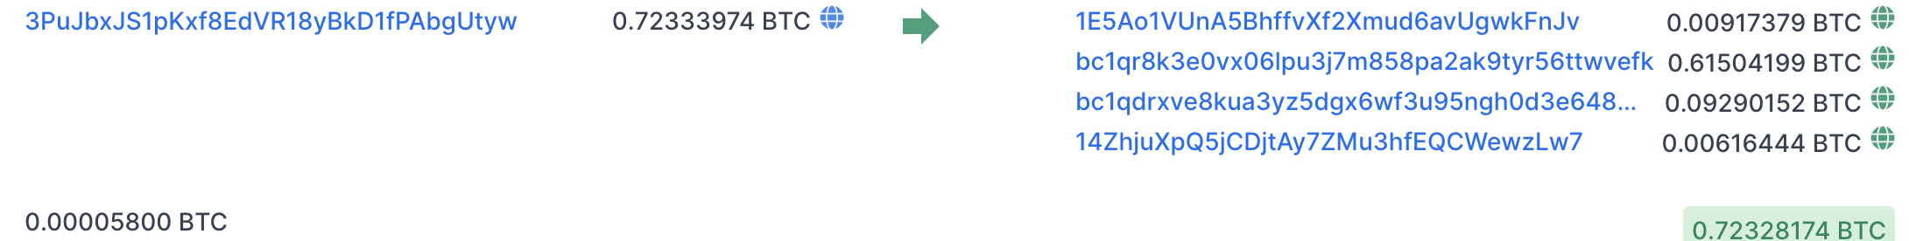
An example (block 648493) [2826 Tx]
Tx0
6.25 + Tx fees =
input
(input UTXO value)
Tx1
outputs
(Tx fee)
Tx2
(Tx fee)
sum of fees in block added to coinbase Tx
Notes:
Fees: Tx1 0.00005 BTC ≈ .5$,
Fees: Tx2 0.002 BTC ≈ 20$.
Low Tx fee in Tx means Tx will remain unconfirmed (sit in mempool).
To frontrun a Tx: submit a Tx with a higher Tx fee.

Slide 22
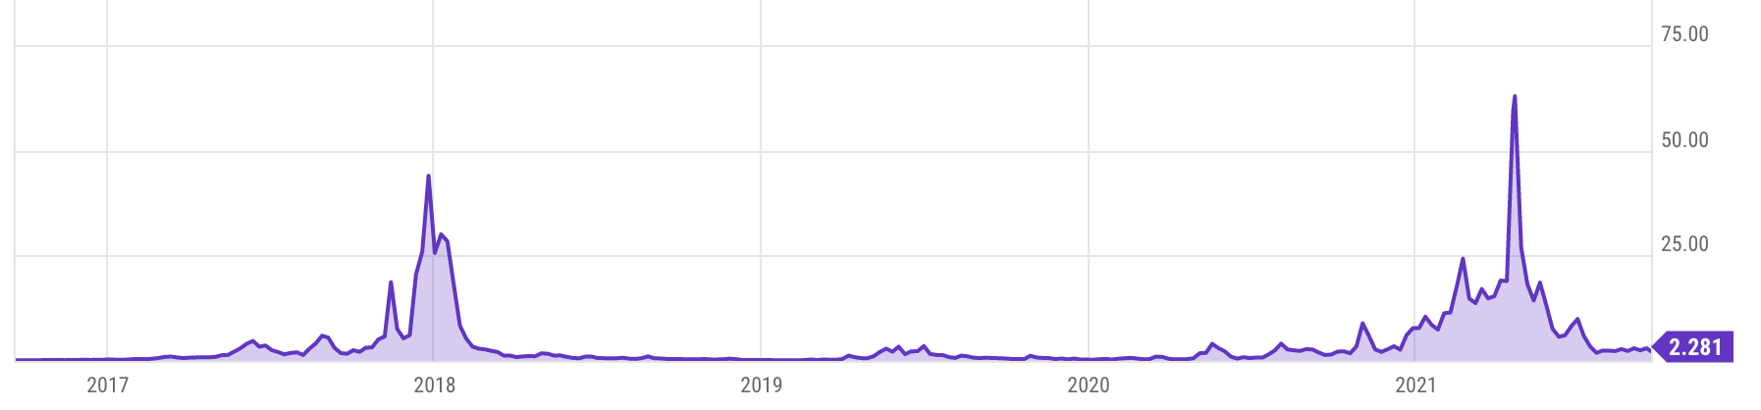
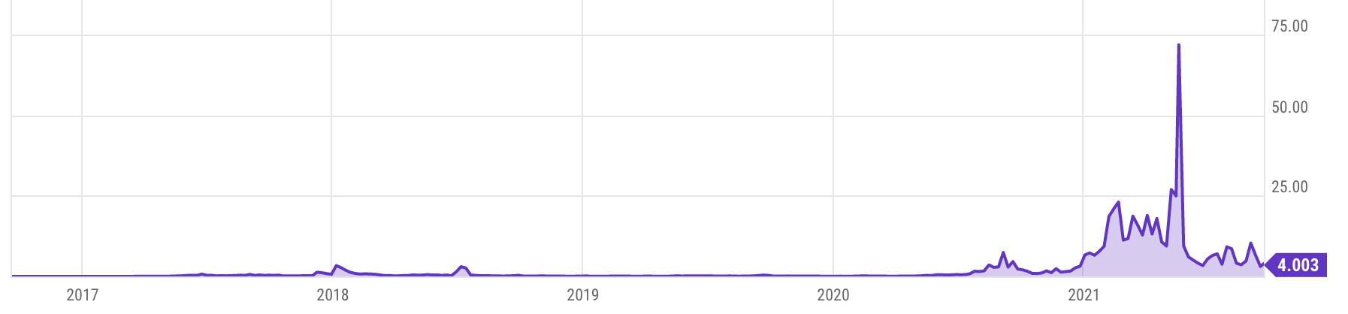
Tx fees
Bitcoin average Tx fees in USD
Ethereum average Tx fees in USD
Notes:
Fee depends on network congestion, price of BTC.

Slide 23
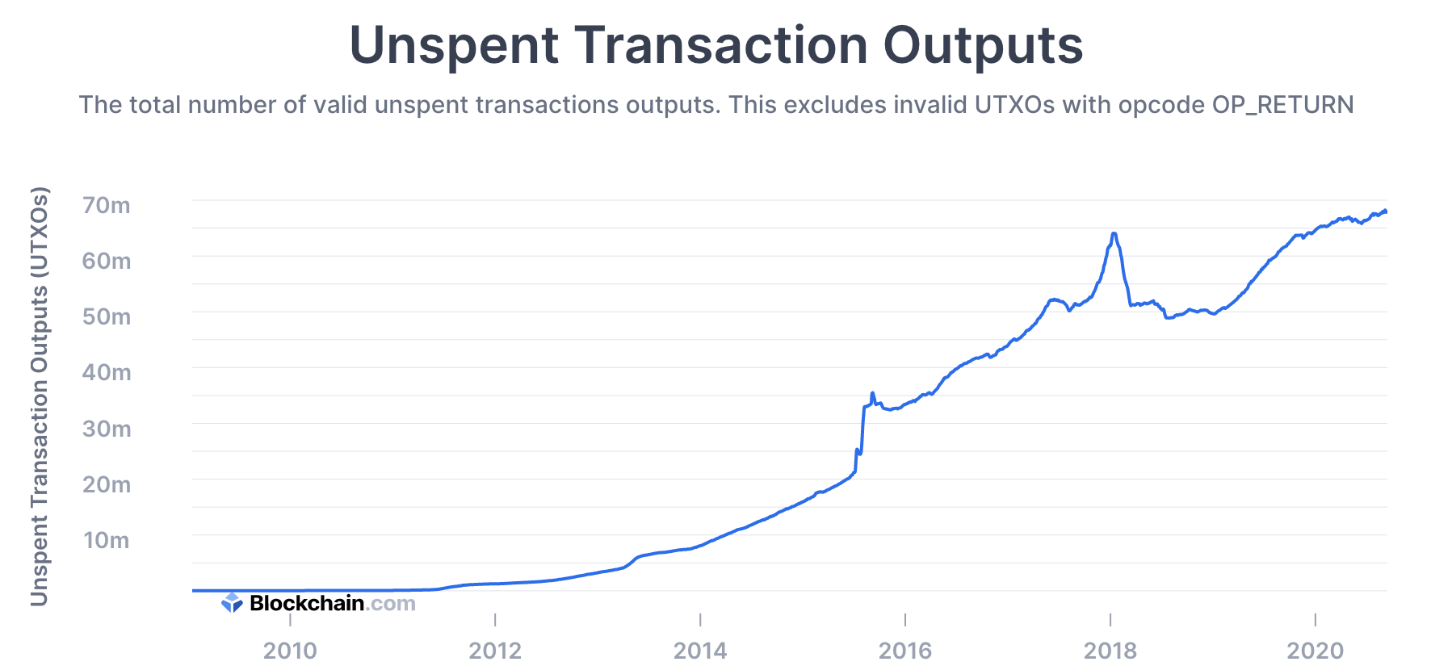
All value in Bitcoin is held in UTXOs
Sep. 2021: miners need to store ≈76M UTXOs in memory
Notes:
How many Bitcoins do I have: need to find all the UTXOs on chain that I can spend. Typically done by wallet software (next lecture).

Slide 24
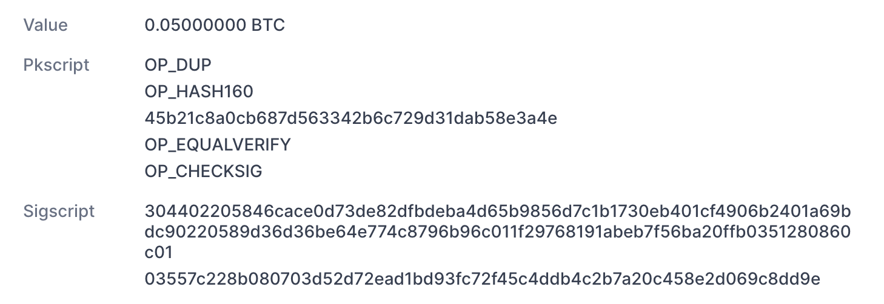
Focusing on Tx2: TxInp[0]
from UTXO
(Bitcoin script)
from TxInp[0]

Slide 25
Bitcoin’s Script

Slide 26
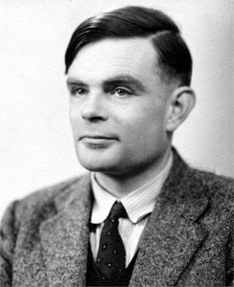

Bitcoin Scripting Language
Design goals
Built for Bitcoin (inspired by Forth)
Simple, compact
Support for cryptography
Stack-based
Limits on time/memory
No looping
I am not impressed
image via Jessie St. Amand

Slide 27
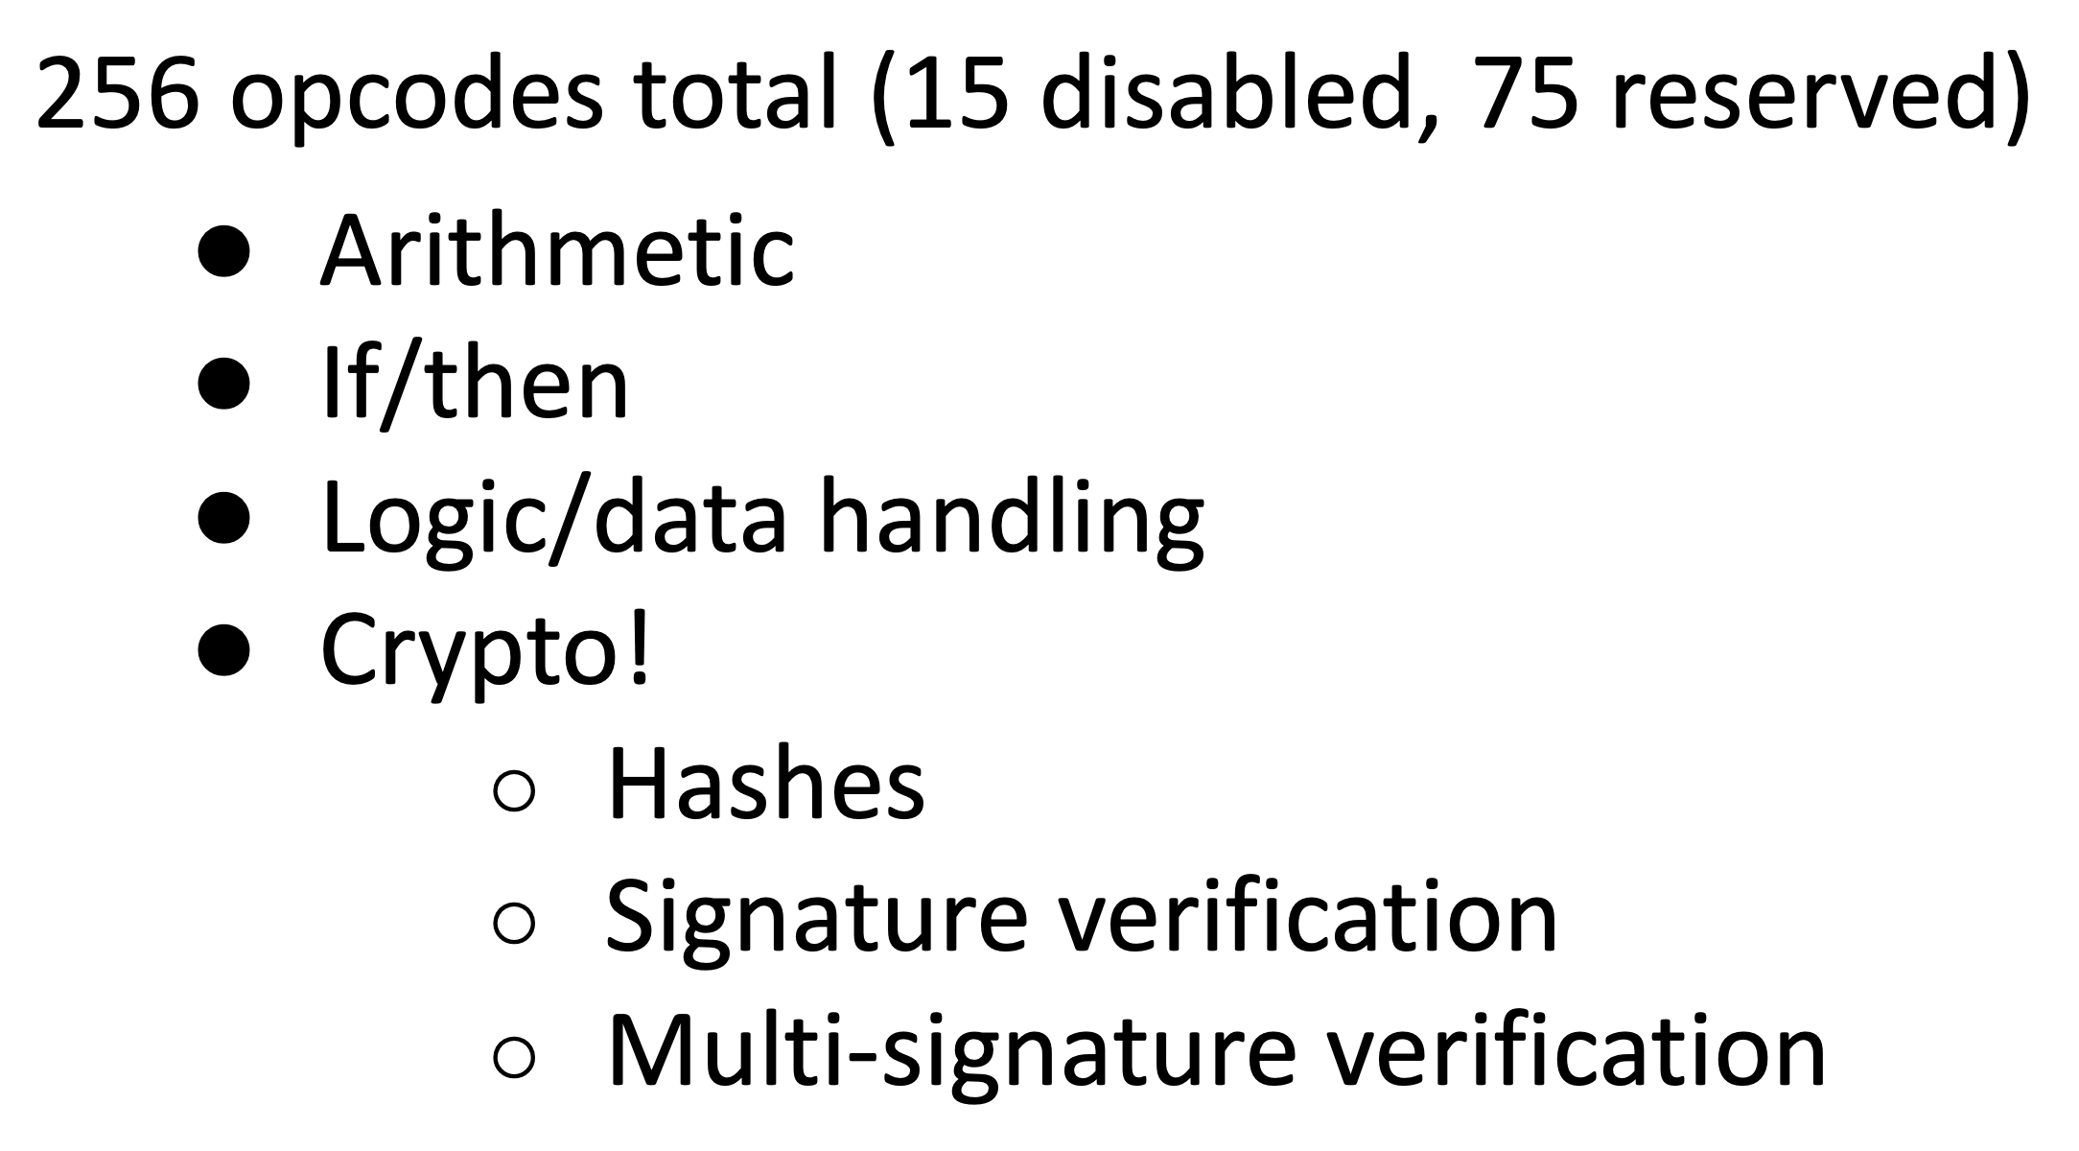
Bitcoin Script Execution Example
✓
<pubKeyHash?>
<pubKey>
<pubKeyHash>
<pubKey>
<sig>
true
<sig> <pubKey> OP_DUP OP_HASH160 <pubKeyHash?> OP_EQUALVERIFY OP_CHECKSIG

Slide 28
Bitcoin Script
A stack machine. Not Turing Complete: no loops.
Quick survey of op codes:
1. OP_TRUE (OP_1), OP_2, …, OP_16: push value onto stack
2. OP_DUP: push top of stack onto stack
81
82
96
118

Slide 29
Bitcoin Script
Control:
OP_IF <statements> OP_ELSE <statements> OP_ENDIF
OP_VERIFY: abort fail if top = false
OP_RETURN: abort and fail
what is this for? ScriptPK = [OP_RETURN, <data>]
OP_EQVERIFY: pop, pop, abort fail if not equal
99
105
106
136

Slide 30
Bitcoin Script
4. Arithmetic:
OP_ADD, OP_SUB, OP_AND, …: pop two items, add, push
5. Crypto:
OP_SHA256: pop, hash, push
OP_CHECKSIG: pop sig, pop pk, verify sig. on Tx, push 0 or 1
Time: OP_CheckLockTimeVerify (CLTV): fail if value at the top of stack > Tx locktime value.
usage: UTXO can specify min-time when it can be spent

Slide 31
Example: a common script
<sig> <pk> DUP HASH256 <pkhash> EQVERIFY CHECKSIG
stack: empty init
<sig> <pk> push values
<sig> <pk> <pk> DUP
<sig> <pk> <hash> HASH256
<sig> <pk> <hash> <pkhash> push value
<sig> <pk> EQVERIFY
1 CHECKSIG
⇒ successful termination
verify(pk, Tx, sig)

Slide 32
Transaction types: (1) P2PKH
pay to public key hash
Alice want to pay Bob 5 BTC:
step 1: Bob generates sig key pair (pk_{B}, sk_{B}) ⇽ Gen()
step 2: Bob computes his Bitcoin address as addr_{B} ⇽ H(pk_{B})
step 3: Bob sends addr_{B} to Alice
step 4: Alice posts Tx:
UTXO_{B} for Bob
UTXO_{A} for Alice (change)
Point to Alice’s UTXO
input
7 BTC
5
ScriptPK_{B}
2
ScriptPK_{A}
0
ScriptPK_{B}:
DUP HASH256 <addr_{B}> EQVERIFY CHECKSIG

Slide 33
Transaction Types: (1) P2PKH
pay to public key hash
“Input” contains ScriptSig that authorizes spending Alice’s UTXO
example: ScriptSig contains Alice’s signature on Tx
⟹ miners cannot change ScriptPK_{B} (will invalidate Alice’s signature)
UTXO_{B} for Bob
UTXO_{A} for Alice (change)
Point to Alice’s UTXO
input
7 BTC
5
ScriptPK_{B}
2
ScriptPK_{A}
0
ScriptPK_{B}:
DUP HASH256 <addr_{B}> EQVERIFY CHECKSIG

Slide 34
Transaction Types: (1) P2PKH
Later, when Bob wants to spend his UTXO: create a Tx_{spend}
Tx_{spend}:
TxID
0
ScriptSig_{B}
output
output
0
points to UTXO_{B}
<sig> <pk_{B}>
(authorizes spending UTXO_{B})
<sig> = Sign(sk_{B}, Tx) where Tx = (Tx_{spend} excluding all ScriptSigs) (SIGHASH_ALL)
Miners validate that ScriptSig_{B} | ScriptPK_{B} returns true
Notes:
Bob’s <sig> ensures that miners cannot change the Tx outputs.

Slide 35
P2PKH: Comments
Alice specifies recipient’s pk in UTXO_{B}
Recipient’s pk is not revealed until UTXO is spent
(some security against attacks on pk)
Miner cannot change <Addr_{B}> and steal funds:
invalidates Alice’s signature that created UTXO_{B}

Slide 36
Segregated Witness
ECDSA malleability:
Given (m, sig) anyone can create (m, sig’) with sig ≠ sig’
⇒ miner can change sig in Tx and change TxID = SHA256(Tx)
⇒ Tx issuer cannot tell what TxID is, until Tx is posted
⇒ leads to problems and attacks
Segregated witness: signature is moved to witness field in Tx
TxID = Hash(Tx without witnesses)
Notes:
Mt. Gox attack

Slide 37
Transaction Types: (2) P2SH: pay to script hash
(pre SegWit in 2017)
Let’s payer specify a redeem script (instead of just pkhash)
Usage: payee publishes hash(redeem script) ⟵ Bitcoint addr.
payer sends funds to that address
ScriptPK in UTXO: HASH160 <H(redeem script)> EQUAL
ScriptSig to spend: <sig₁> <sig₂> … <sig_{n}> <redeem script>
payer can specify complex conditions for when UTXO can be spent

Slide 38
P2SH
Miner verifies:
<ScriptSig> ScriptPK = true ⟵ payee gave correct script
(2) ScriptSig = true ⟵ script is satisfied

Slide 39
Example P2SH: Multisig
Goal: spending a UTXO requires t-out-of-n signatures
Redeem script for 2-out-of-3: (set by payer)
<2> <PK₁> <PK₂> <PK₃> <3> CHECKMULTISIG
hash gives P2SH address
ScriptSig to spend: (by payee) <0> <sig1> <sig3> <redeem script>
Notes:
Note: redeem script becomes public when spending Tx. Several tricks make it possible to keep redeem script secret, unless there is a dispute (Taproot)

Slide 40
Abstractly …
Multisig address: addr = H(PK₁, PK₂, PK₃, 2-of-3)
Tx1:
input
5
addr
2
ScriptPK_{A}
0
(funding Tx)
7 BTC
UTXO_{B} for Bob
UTXO_{A} for Alice (change)
Tx2:
input: UTXO, sig₁, sig₃, PK₁, PK₂, PK₃, 2-of-3
output
0
(spending Tx)

Slide 41
Example Bitcoin scripts

Slide 42
Protecting Assets with a Co-signatory
Alice stores her funds in UTXOs for addr = 2-of-2(PK_{A}, PK_{S})
PK_{A}
spending Tx
PK_{S}
Alice
custody
server
is this Alice
yep, it’s me
post Tx with <sig_{A}> <sig_{S}>
<sig_{S}> on Tx
⇒ theft of Alice’s SK_{A} does not compromise BTC
Notes:
Alice’s authentication: out of band (cell phone, pwd, etc.)

Slide 43

Escrow Service
Alice wants to buy a backpack for 0.1₿ from merchant Bob
Goal: Alice only pays after backpack arrives, but can’t not pay
addr = 2-of-3(PK_{A}, PK_{B}, PK_{J})
post payment of 0.11₿ to addr
(UTXO_{A})
want backpack for 0.1₿
Alice
Bob
Judge
once see Tx on chain
mail backpack
PK_{A}
PK_{B}
PK_{J}
backpack arrives
send <sig_{A}> on Tx: UTXO_{A}⇾ (PK_{B}:0.1, PK_{A}:0.01)
redeem using <sig_{A}> <sig_{B}>
on Tx
Notes:
redeem: 2-of-3 is satisfied.

Slide 44
Escrow Service: A Dispute
Backpack never arrives: (Bob at fault)
Alice gets her funds back with help of Judge and a Tx:
Tx: ( UTXO_{A} ⇾ PK_{A} , sig_{A}, sig_{Judge} ) [2-out-of-3]
Alice never sends sig_{A}: (Alice at fault)
Bob gets paid with help of Judge as a Tx:
Tx: ( UTXO_{A} ⇾ PK_{B} , sig_{B}, sig_{Judge} ) [2-out-of-3]
(3) Both are at fault: Judge publishes <sig_{Judge}> on Tx:
Tx: ( UTXO_{A} ⇾ PK_{A}: 0.05, PK_{B}: 0.05, PK_{J}: 0.01 )
Now either Alice or Bob can execute this Tx.

Slide 45
Cross Chain Atomic Swap
Alice has 5 BTC, Bob has 2 LTC (LiteCoin). They want to swap.
Want a sequence of Tx on the Bitcoin and Litecoin chains s.t.:
either success: Alice has 2 LTC and Bob has 5 BTX,
or failure: no funds move.
Swap cannot get stuck halfway.
Goal: design a sequence of Tx to do this.
solution: programming proj #1 ex 4.

Slide 46
Managing Crypto Assets: Wallets

Slide 47
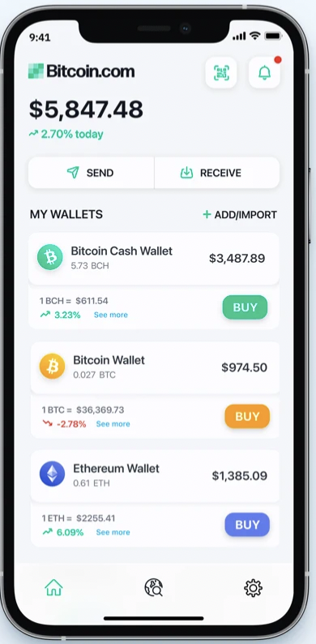
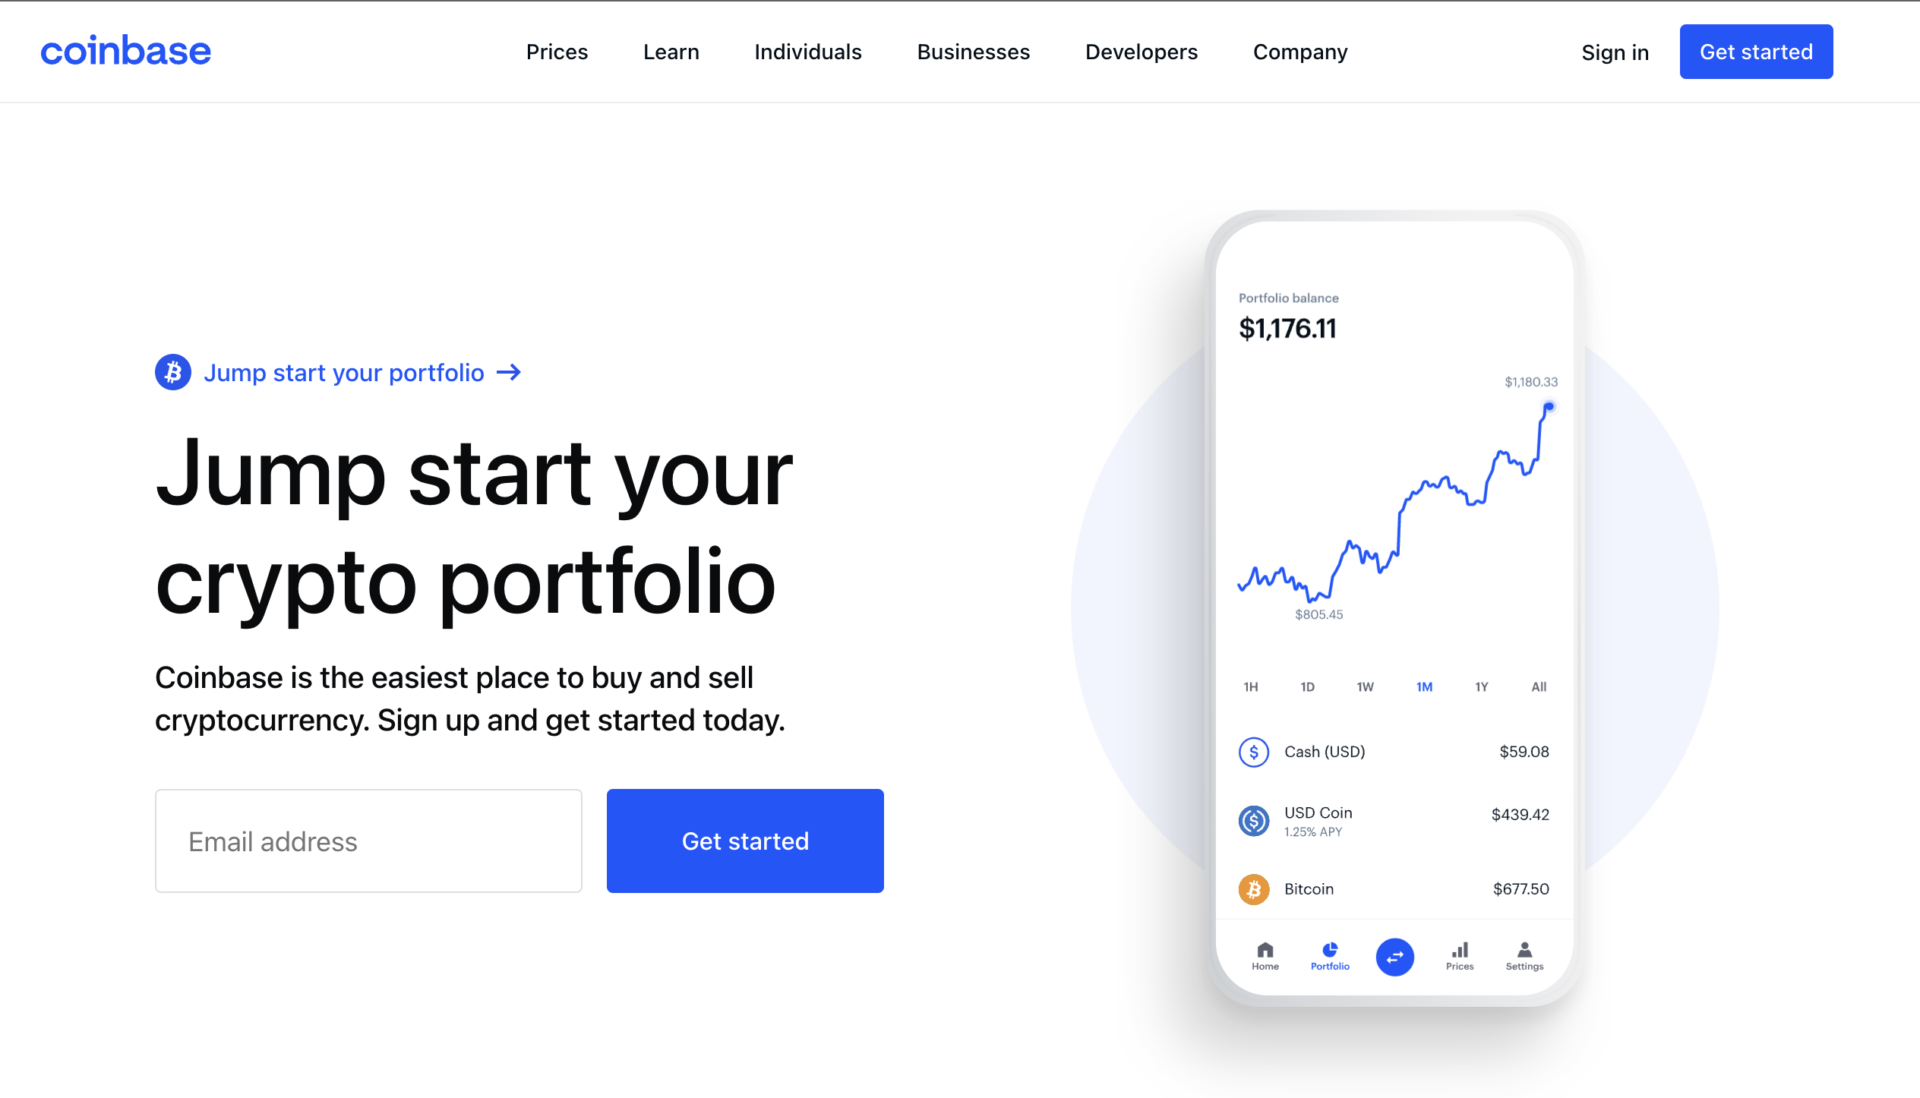
Managing secret keys
Users can have many PK/SK:
one per Bitcoin address, Ethereum address, …
Wallets:
Generates PK/SK, and stores SK,
Post and verify Tx,
Show balances
Notes:
How much Bitcoin do I own?

Slide 48
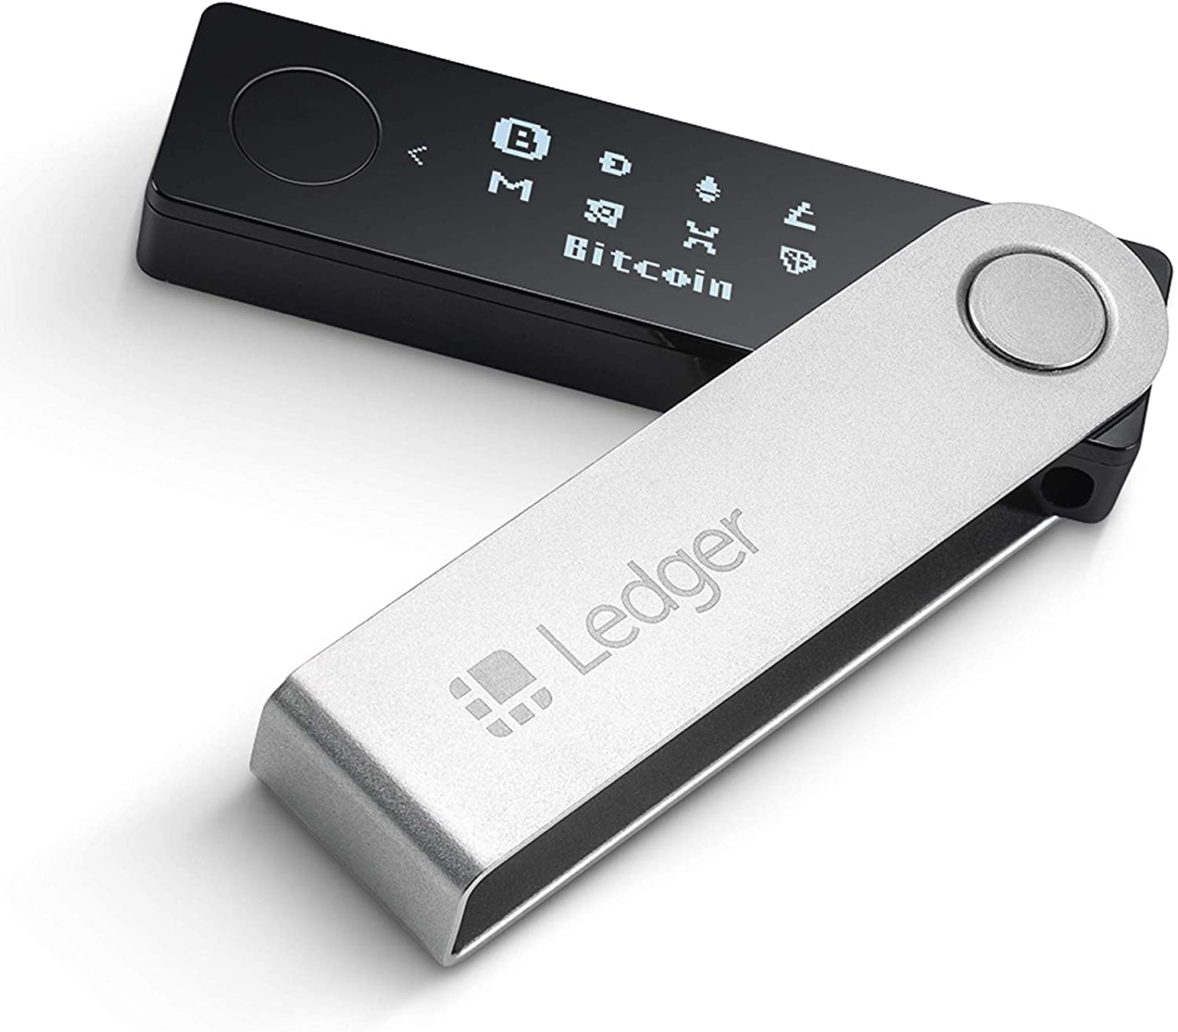
Managing lots of secret keys
Types of wallets:
cloud (e.g., Coinbase): cloud holds secret keys … like a bank.
laptop/phone: Electrum, MetaMask, …
hardware: Trezor, Ledger, …
paper: print all sk on paper
brain: memorize sk (bad idea)
Hybrid: non-custodial cloud wallet (using threshold signatures)
client stores secret keys
Not your keys, not your coins …
but lose key ⇒ lose funds
Notes:
Threshold signatures in section.

Slide 49
Simplified Payment Verification (SPV)
How does a client wallet display Alice’s current balances?
Laptop/phone wallet needs to verify an incoming payment
Goal: do so w/o downloading entire blockchain (366 GB)
SPV: (1) download all block headers (56 MB)
(2) Tx download:
wallet ⇾ server: list of my wallet addrs (Bloom filter)
server ⇾ wallet: Tx involving addresses + Merkle proof to block header.
Tx root
block header

Slide 50
Simplified Payment Verification (SPV)
Problems:
(1) Security: are BH the ones on the blockchain? Can server omit Tx?
Electrum: download block headers from ten random servers, optionally, also from a trusted full node.
List of servers: electrum.org/#community
(2) Privacy: remote server can test if an addr belongs to wallet
We will see better light client designs later in the course (e.g. Celo)

Slide 51
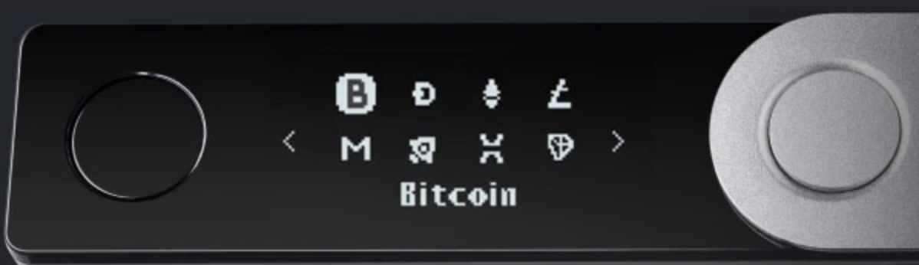
Hardware Wallet: Ledger, Trezor, …
End user can have lots of secret keys. How to store them ???
Hardware wallet (e.g., Ledger Nano X)
- connects to laptop or phone wallet using Bluetooth or USB
manages many secret keys
Bolos OS: each coin type is an app on top of OS
PIN to unlock HW (up to 48 digits)
screen and buttons to verify and confirm Tx

Slide 52
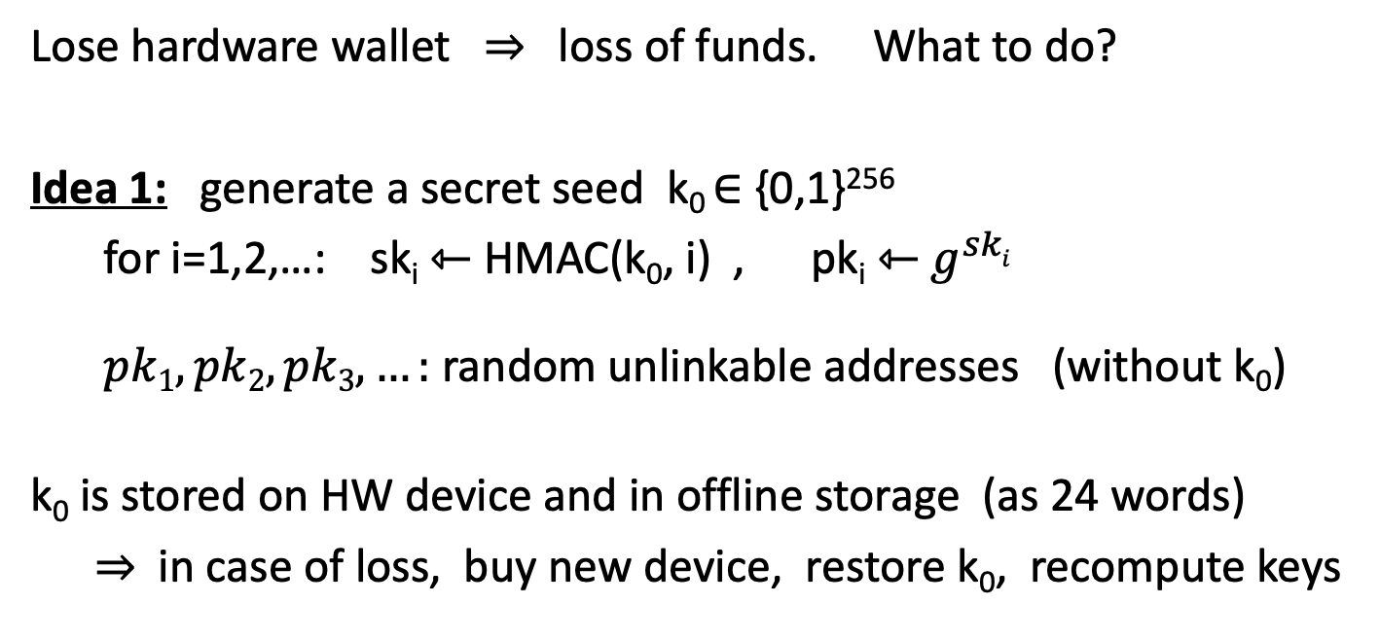
Hardware Wallet: Backup
Lose hardware wallet ⇒ loss of funds. What to do?
Idea 1: generate a secret seed k₀ ∈ {0,1}²⁵⁶
for i=1,2,…: sk_{i} ⇽ HMAC(k₀, i) , pk_{i} ⇽ $g^{ski}$
$pk1, pk2, pk3, …:$ random unlinkable addresses (without k₀)
k₀ is stored on HW device and in offline storage (as 24 words)
⇒ in case of loss, buy new device, restore k₀, recompute keys
ECDSA public key

Slide 53
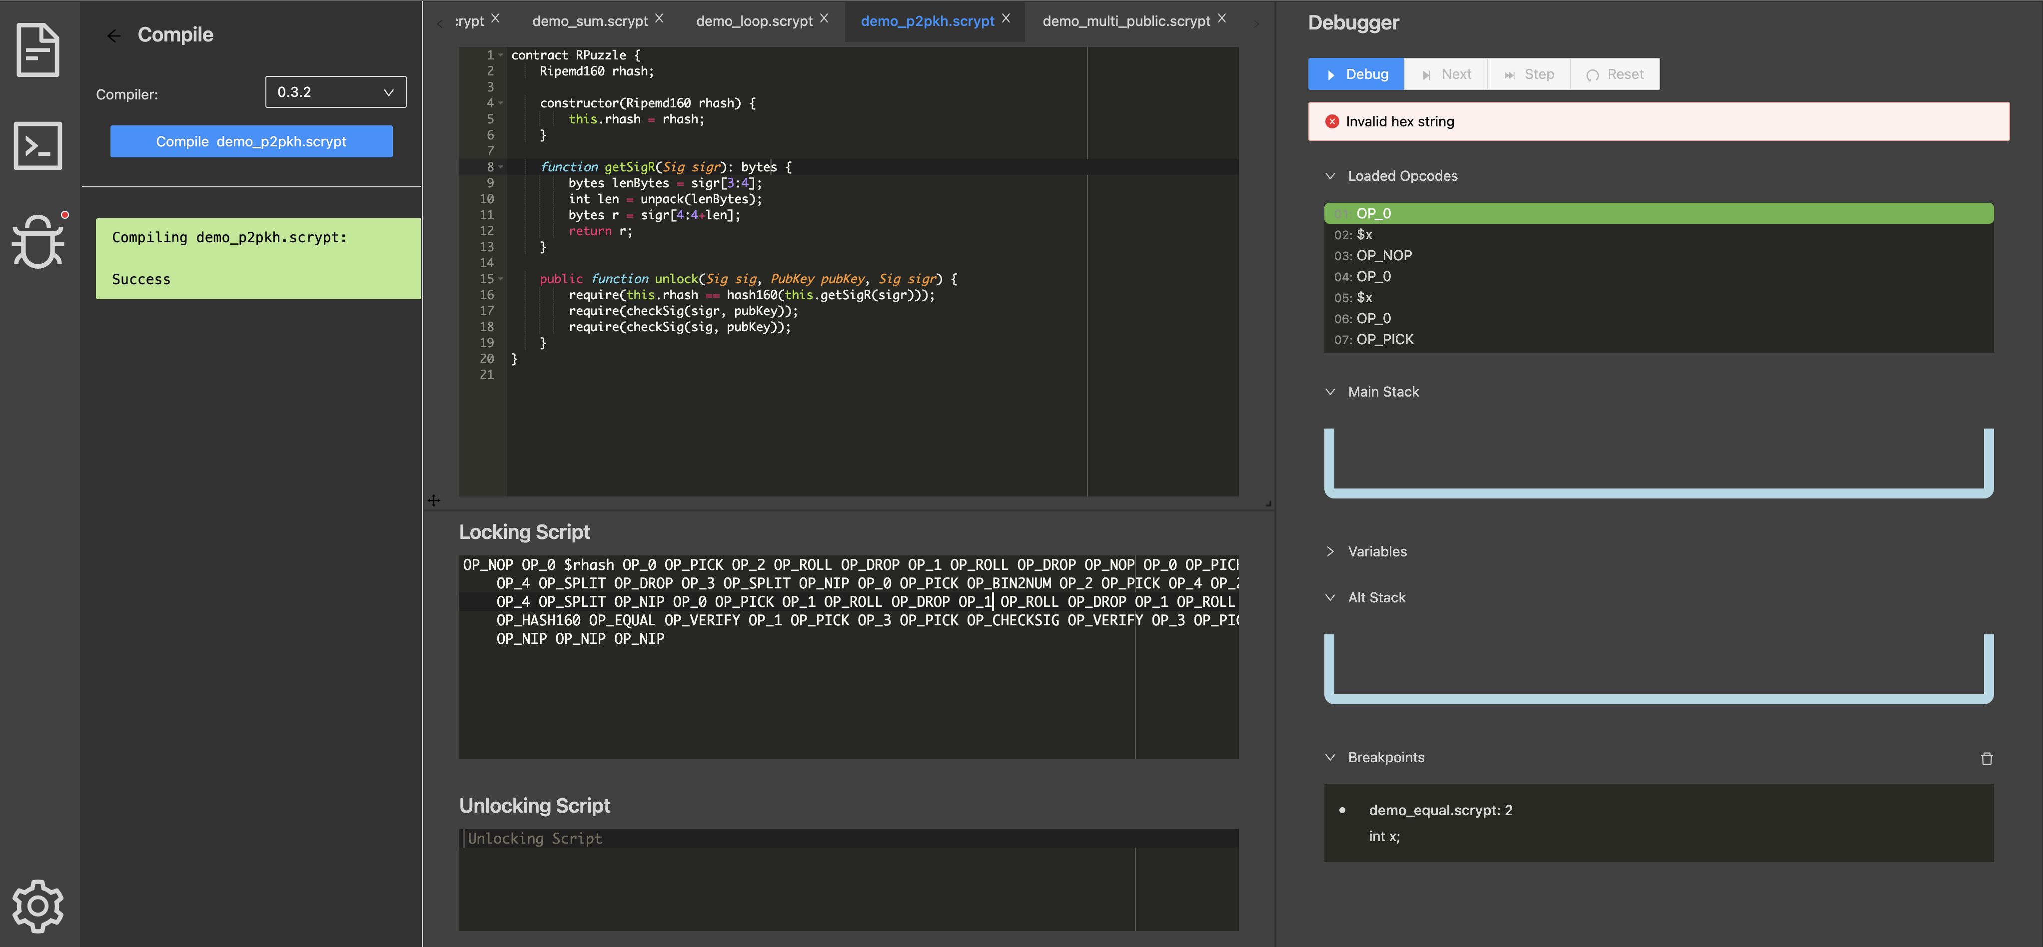
W3 Home Work
Read the Documentation of Bitcoin Script
Learn How to Use Script Studio to Compile and Translate PPKH Scripts!

Slide 54
END OF LECTURE
Next Lecture: Blockchain Consensus

