Slide 1
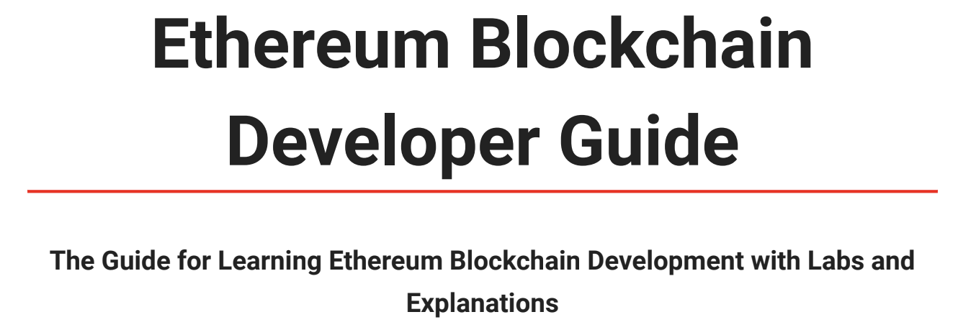
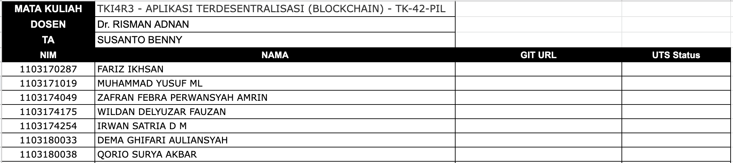
UTS – Blockhain Telkom University
Theme: Hands on Lab with Ethereum Developer Guide
Task: Reproduce the LABs in the Guide
Read the Developer Guide End to End
Reproduce LAB 1: Deposit/Withdraw Ether
Reproduce LAB 2 : Shared Wallet
Reproduce LAB 3: Supply Chain
UTS Submission Guideline:
Make Github account & update on GDocs
Create UTS folder in your Git
Reproduce LAB 1, 2 and 3
Put Contract Codes in UTS Folder
Make Technical Documentation
Update UTS Status (100%, 50%, Done)
URL for GDocs Submission below:
https://docs.google.com/spreadsheets/d/1WlFzJ8koedHpJbXBW99LH6NVgRRdl9o-l5FnROf7u4Q/edit?usp=sharing
Download PDF here
1
6

