Slide 1
LESSON 16
Hardhat Upgrades
Garry Abel Diaraja H - 1103190147

Slide 2
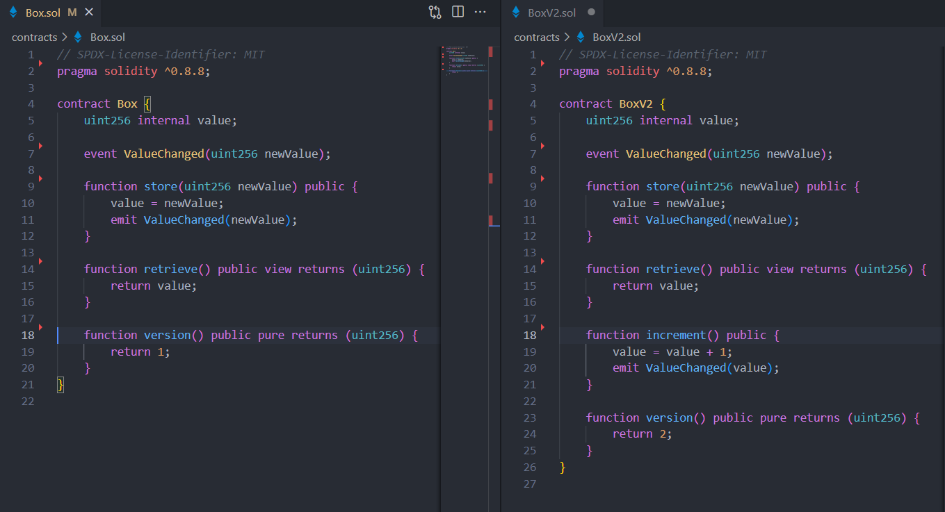
Contracts

Slide 3
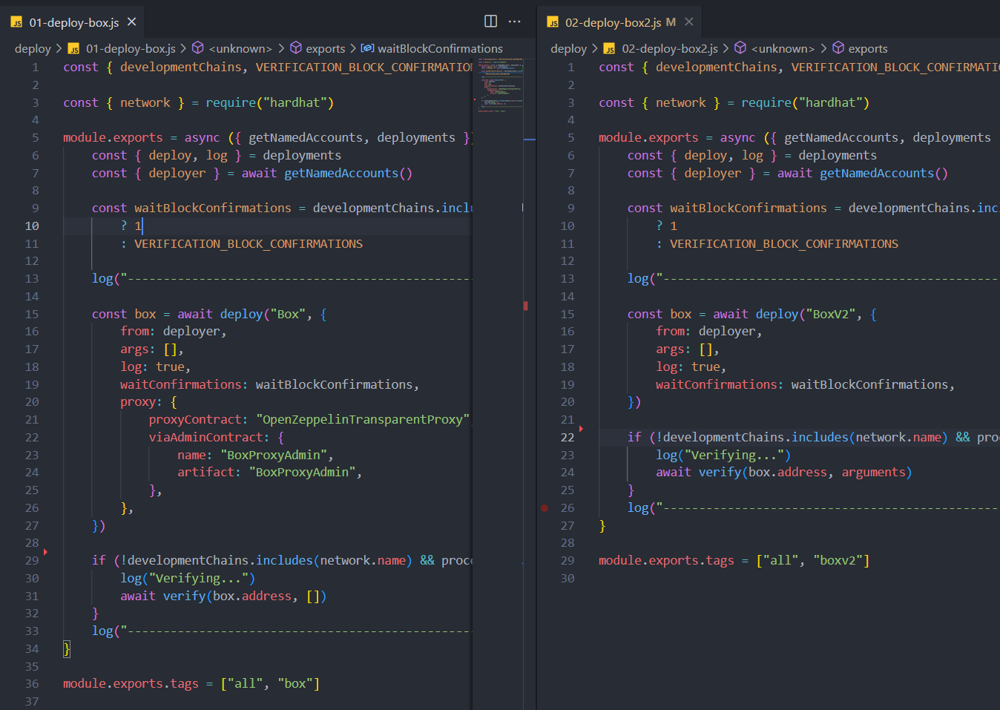
Deploy

Slide 4
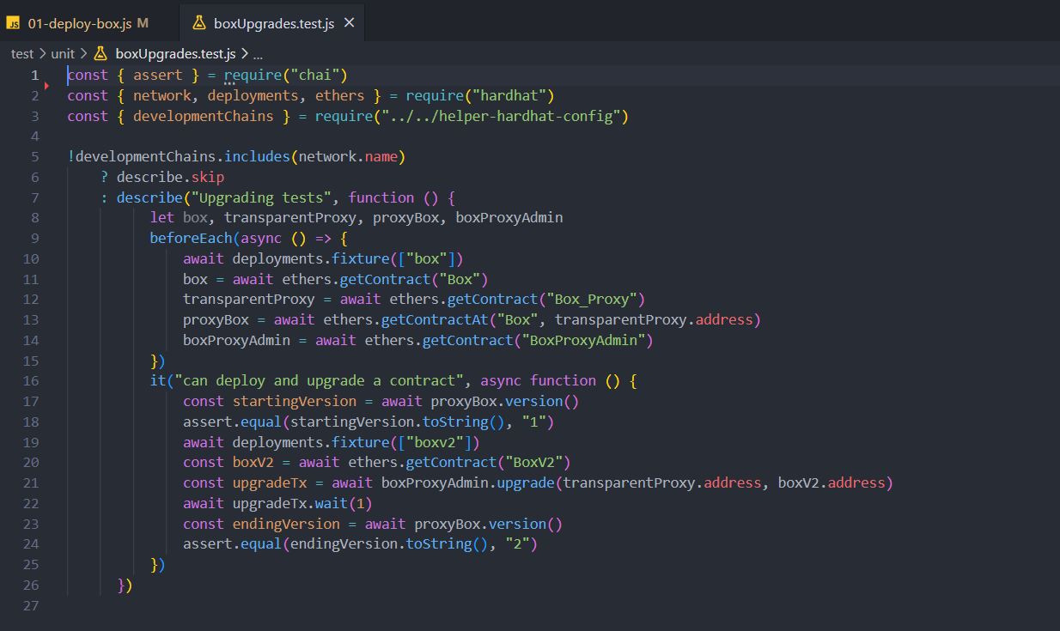
Testing

Slide 5
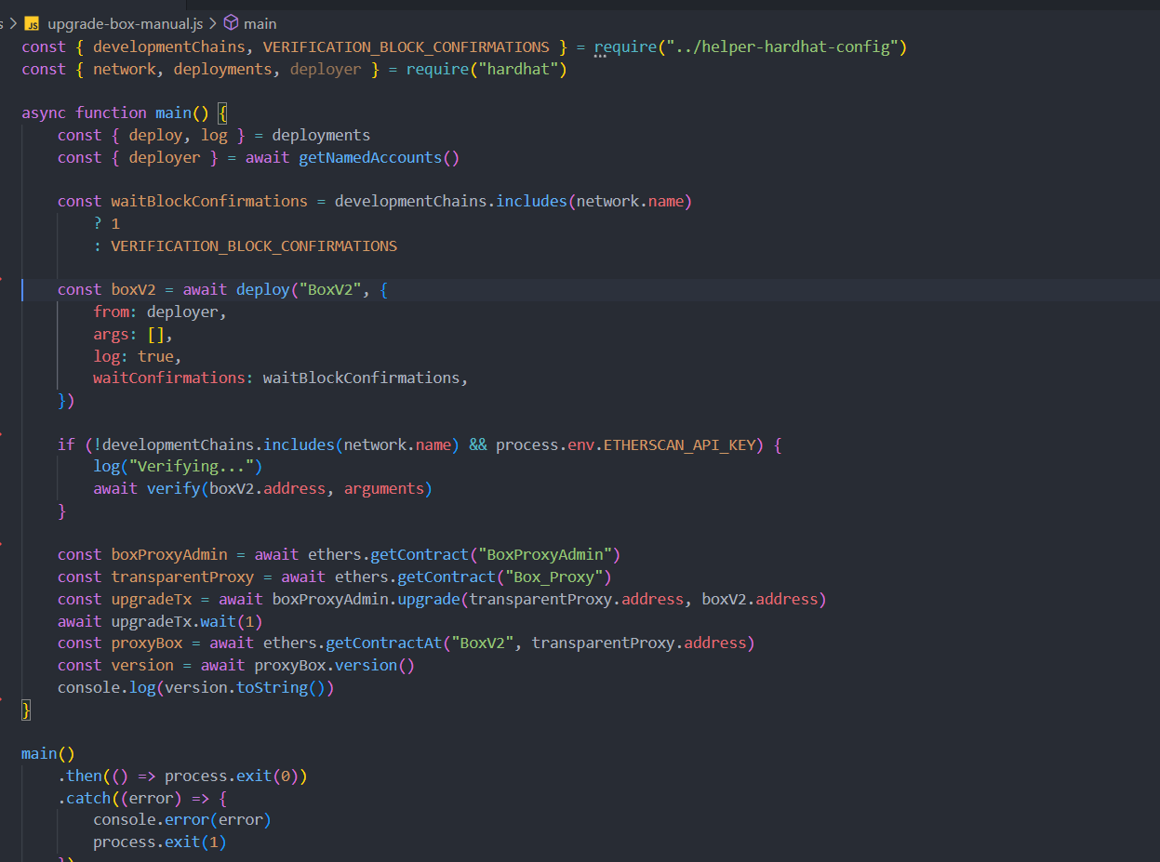
Scripts

