Slide 1
Voorraadbeheer
Hardwaresetup

Slide 2
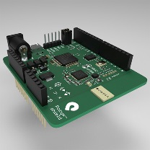
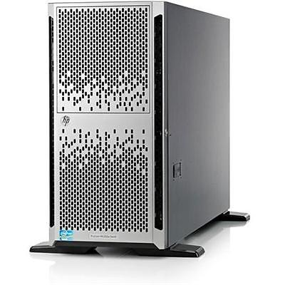
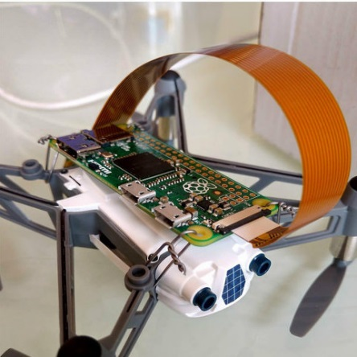

Systeem componenten
Location Anchors
Drone + controller
Server + wifi AP
UWB
UWB
Routebeschrijving
UWB
Afstandsbepaling

Slide 3
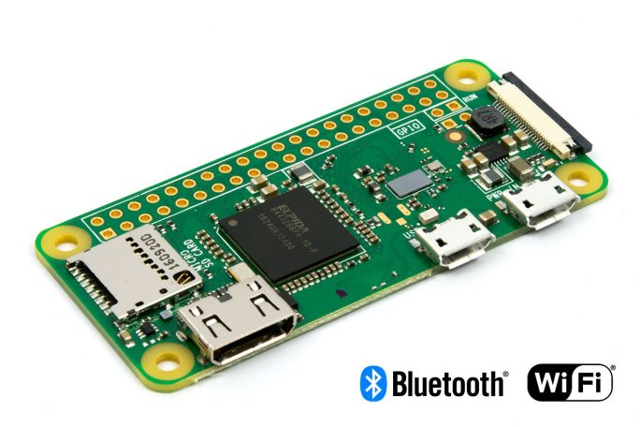
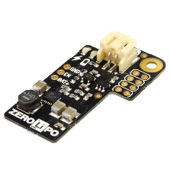
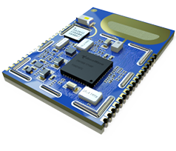
Dronecontroller: detail
Controller
Power
LiPo SHIM/Zero Lipo
Raspberry PI Zero W
+
I2C/TWI
LIPO Battery
Decawave DWM1001

Slide 4
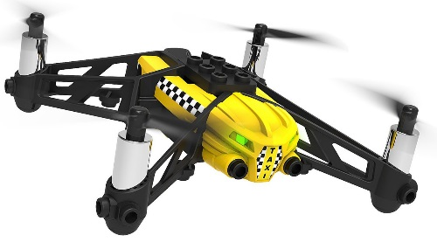


Dronecontroller: detail
Drone
Controller
/
Power
LiPo SHIM/Zero Lipo
Raspberry PI Zero W
+
I2C/TWI
LIPO Battery
Decawave DWM1001

Slide 5

Dronecontroller: detail
Drone
Controller
/
Power
LiPo SHIM/Zero Lipo
Location Anchors
Raspberry PI Zero W
+
I2C/TWI
LIPO Battery
UWB
UWB
UWB
Decawave DWM1001

Slide 6

Dronecontroller: detail
Drone
Controller
Wifi mesh
Wifi
/
Server + wifi AP
Power
LiPo SHIM/Zero Lipo
Location Anchors
Raspberry PI Zero W
+
I2C/TWI
LIPO Battery
UWB
UWB
UWB
Decawave DWM1001

