Slide 1
Start with: Most columns + one-hot-encoded amenities
Ridge Regression + k-fold cross validation + PCA testing

Slide 2
Data Cleaning
Start with: listings_detailed_final_final_final.csv
All amenities are one-hot-encoded
Shape is (8898, 293)
Remove lat-, lon_neighbourhood
Add one-hot-encoded neighbourhood groups
Fill missing values with reasonable estimates based on other data
Don't drop all rows with missing values as to not lose too much data
Drop all rows with missing prices
Create csv's, each with different price outliers excluded

Slide 3
Modelling outliers
Test performance of ridge regression when leaving out more and more price outliers (from both training and testing)
Difference between 8th and 9th most expensive listing is
9000->3400, ie extreme outliers at the top
Good compromise is removing upper 1% price outliers
RMSE = 45
Same Modell on data only without extreme outliers: RMSE roughly 89
By removing upper 1%, RMSE goes from around 110 to 45 and still works on 99% of the real data

Slide 4
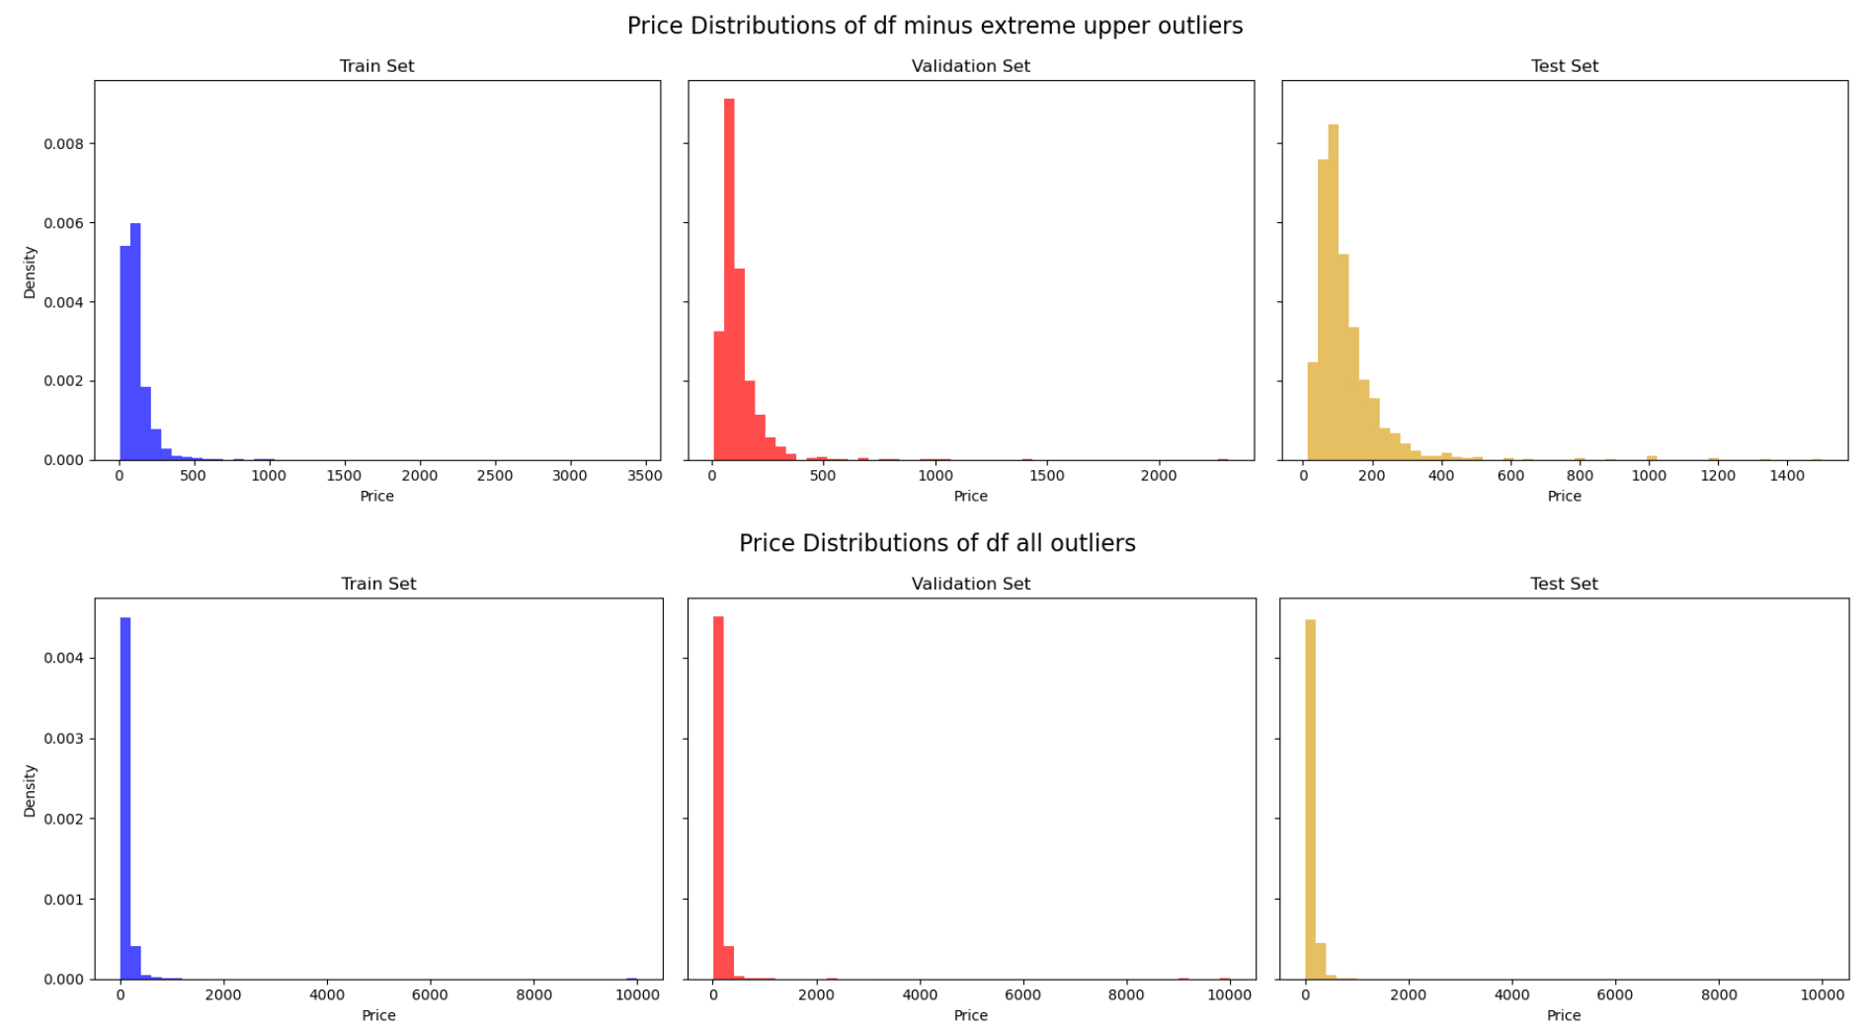

Slide 5
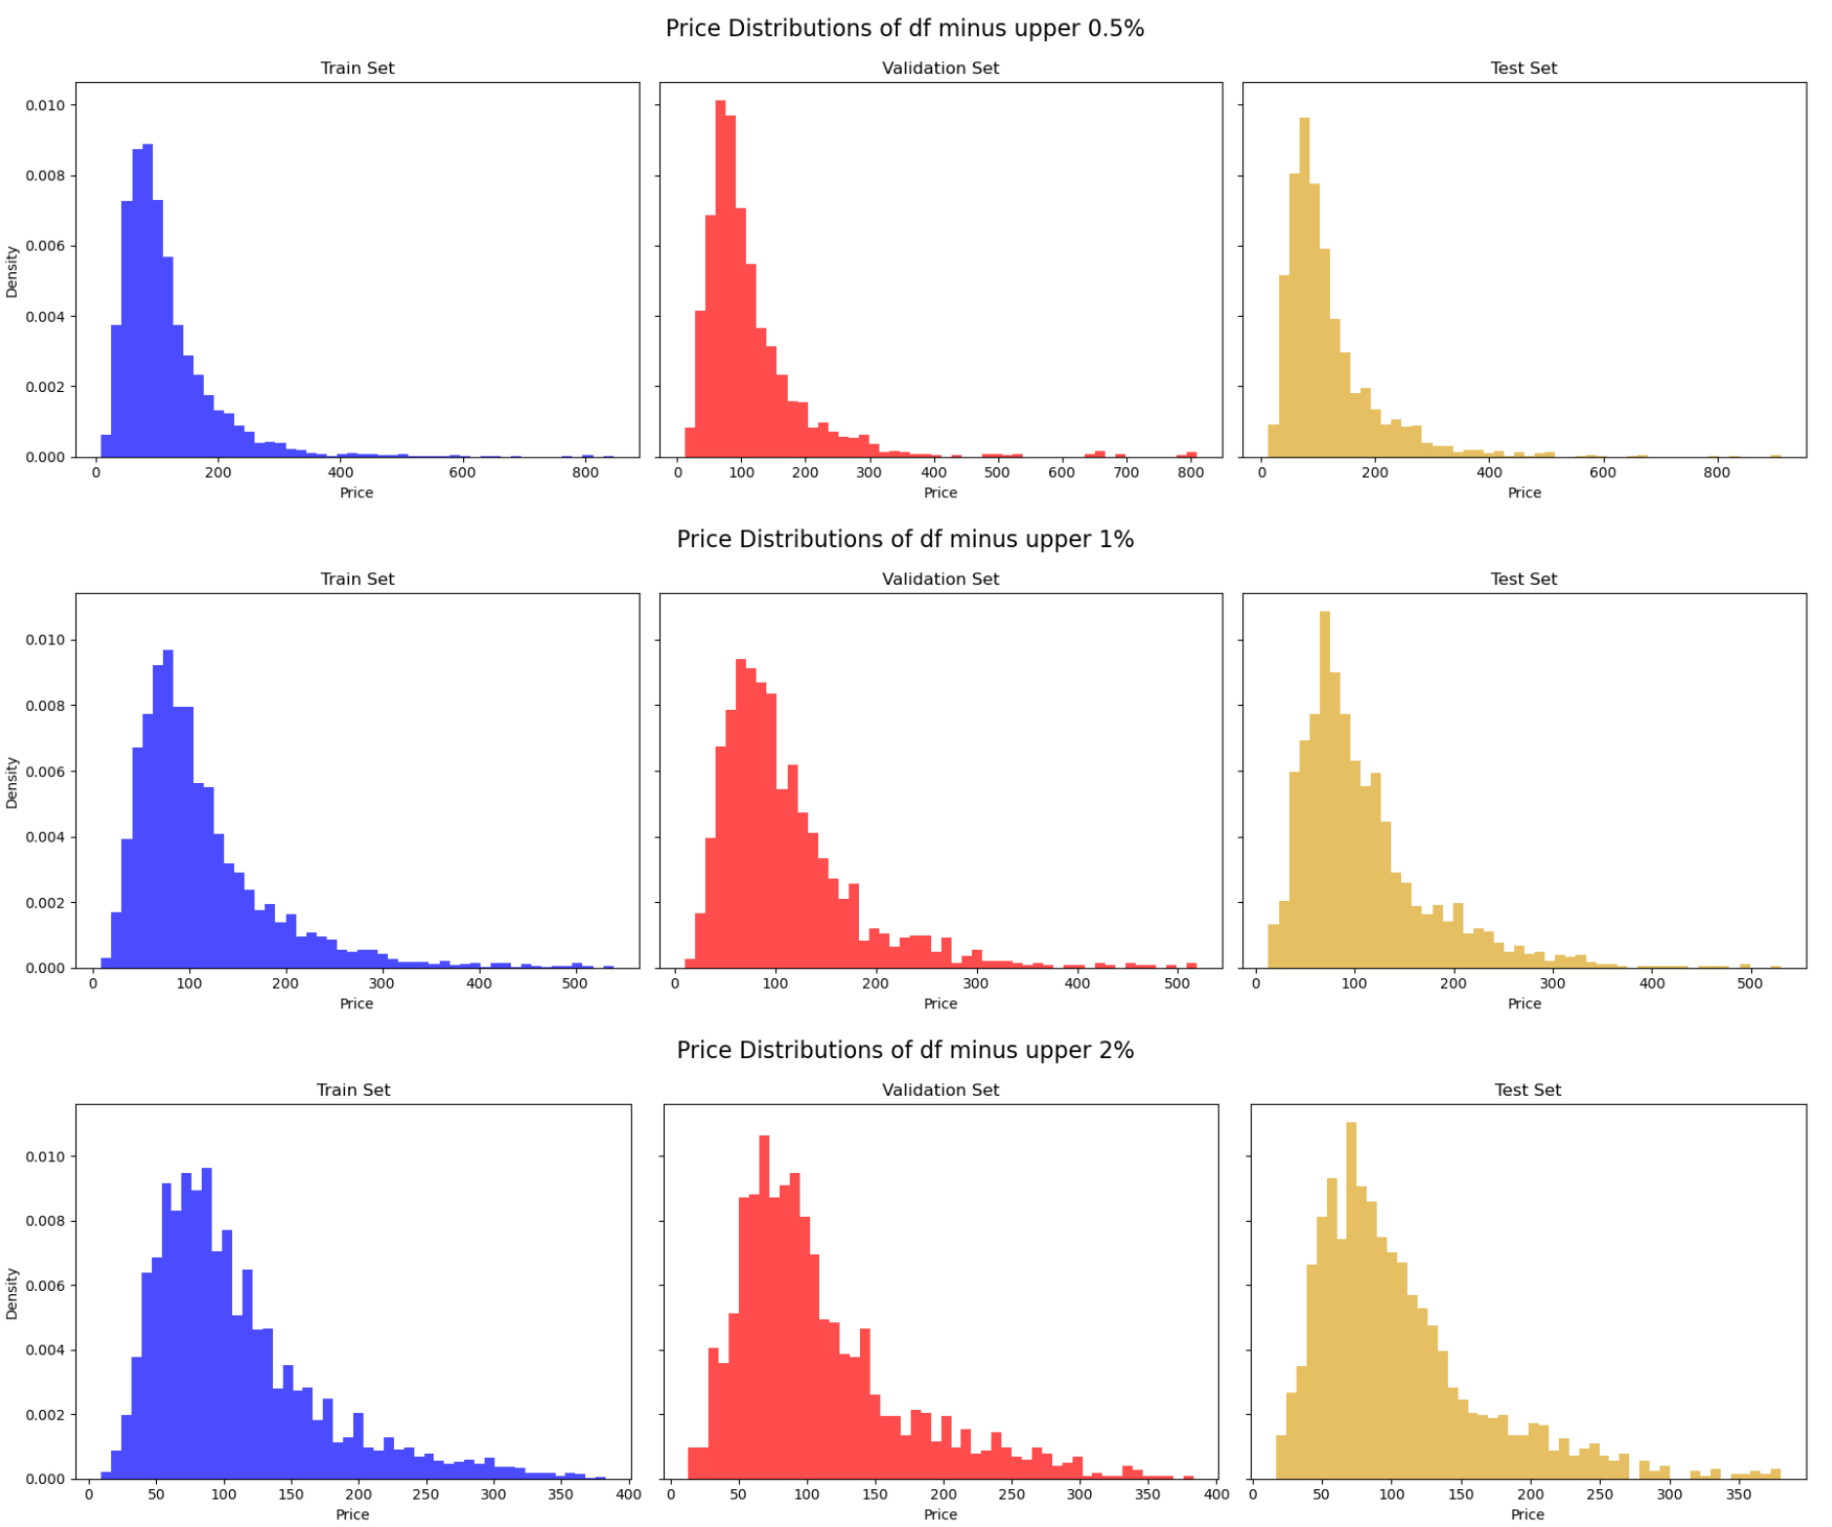

Slide 6
Modelling columns
Id and latitude, longitude columns do not significantly affect the MSE for the ridge regression modell, since id should be more or less random and lat, Lon effect is likely not linear -> remove them
In comparison, removing the amenities does affect the MSE visibly
Modell performs only slightly worse (about 5% more MSE) on training data than on validation. -> slight, but acceptable amount of underfitting via hyperparameters on the training data for better performance on general data

Slide 7
Modelling k-fold cross validation
Use dataset without upper 1% of prices and without lat, lon, id columns
Ideal alpha ridge parameters from 5-fold and 10-fold ridge regression perform almost the same as "single fold" on test set, ie. RMSE of 45
Same for the dataset with specific ids excluded (RMSE 65 originally -> 65.5)
Result for df without upper 1%:
RMSE: 45, Mean Absolute Error: 32, MRE: 36%

Slide 8
PCA
Start again without upper 1% and without lat, lon, id -> 299 features
PCA
240 principal components to retain 99% of var
271 PCs dim to retain 100% of var
Modell with only 240 dimensions still has RMSE of about 46, only slightly worse than modell with full dimensions

Slide 9
