Slide 1
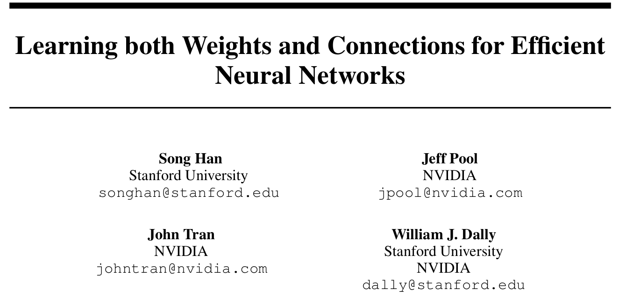
Source: [1]

Slide 2


About the researcher
Song Han
  PhD degree from Standford University
  research focus on energy-efficient deep learning
  Joins MIT EECS as assistant professor in summer 2018
Source: [2]
Prof. Bill Dally
  Supervisor, Standford University
Source: [3]

Slide 3
Goal
Reduce storage and computation of neural networks
without loss of accuracy !!!
Why?

Slide 4

It should run on my smartphone
Source: [4]

Slide 5
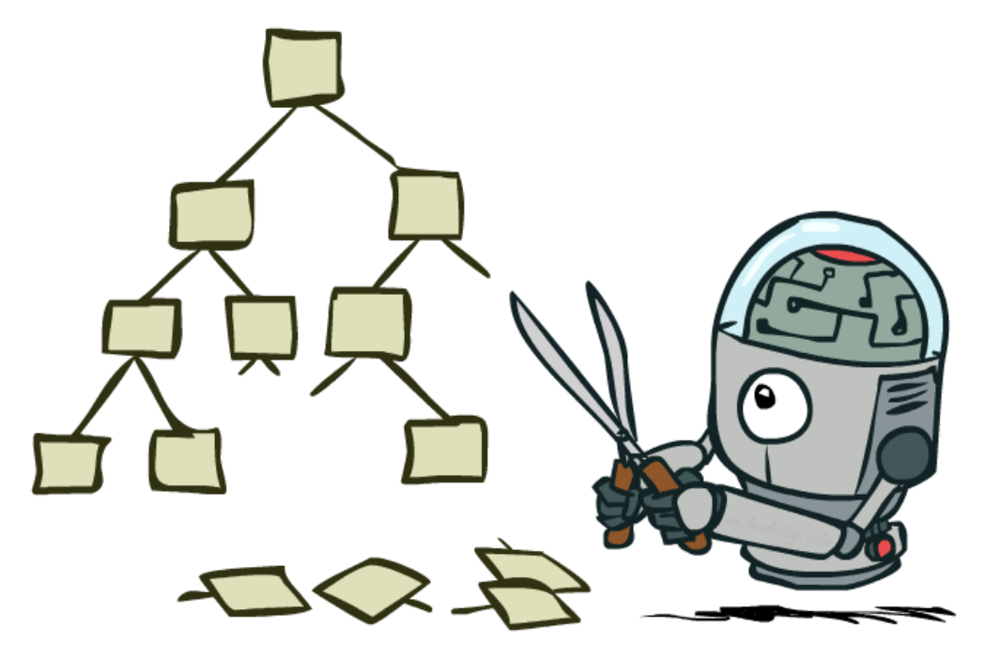
Key Technique: Pruning Weights
Source: [5]

Slide 6
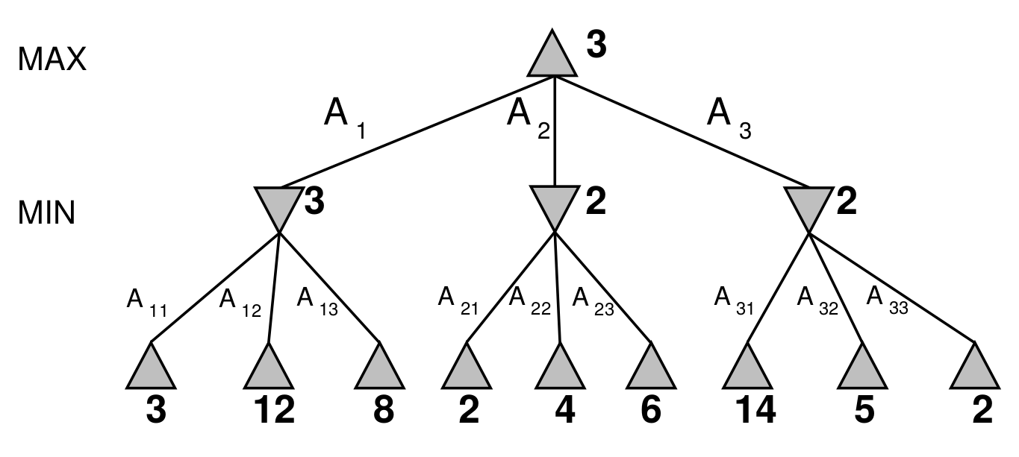
Example Min-Max Pruning
Source: [5]

Slide 7
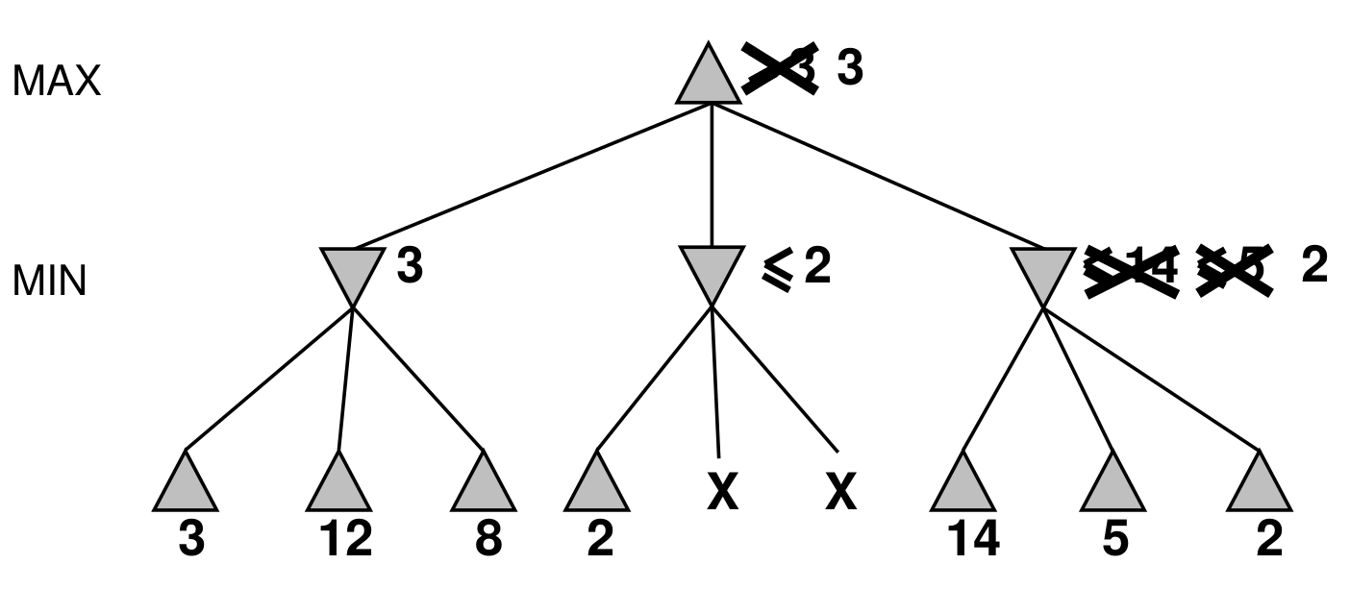
Example Min-Max Pruning
Source: [5]

Slide 8
References
[1]: Song Han, Jeff Pool, John Tran, William J. Dally. Learning both Weights and Connections for Efficient Neural Networks
[2]: https://stanford.edu/~songhan/
[3]: http://cva.stanford.edu/billd_webpage_new.html
[4]: https://www.pinterest.at/pin/319544536042026993/
[5]: http://ai.berkeley.edu
[?]: Nitish Srivastava, Geoffrey Hinton, Alex Krizhevsky, Ilya Sutskever, and Ruslan Salakhutdinov. Dropout: A simple way to prevent neural networks from overfitting.

