Slide 1
Sound Classification of YouTube videos with Recurrent Neural Networks
Bachelor Thesis
by
Christian Walter

Slide 2




Agenda
Introduction
Recurrent Neural Networks
Google Audioset
Experiments
Examples
Conclusion
Source: [1 - 4]

Slide 3
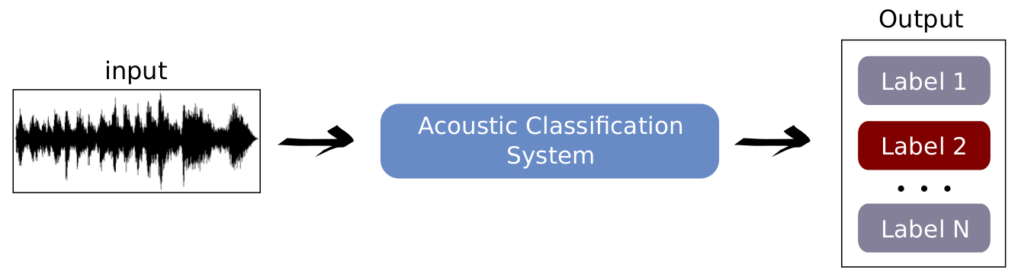
Introduction
Sound Classification Basics:
  Input: Data with extracted Sound features
  Classification System
  Output: classes or labels
Neural Network

Slide 4
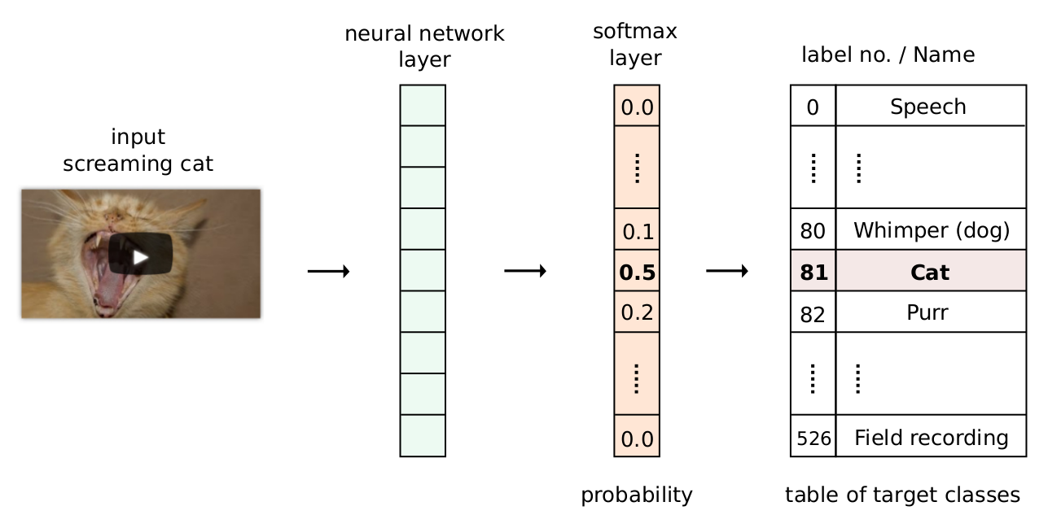
Classification System
Examle of a Sound classification:
Neural Network layer
Softmax layer (optional) for probability distribution
Label map

Slide 5
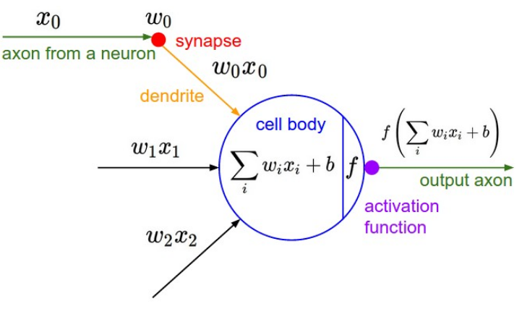
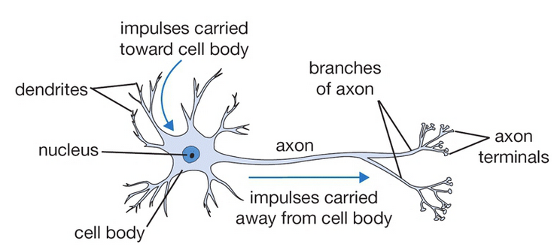
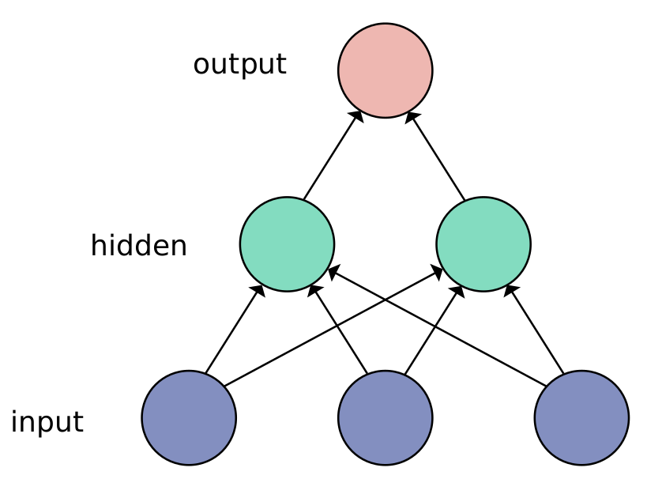
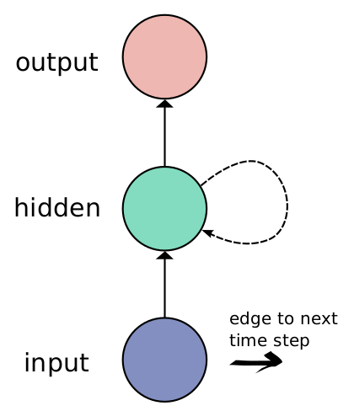
Neural Networks
Biological Neural Net
Mathematical model
Source: [5]
Feed-forward
Recurrent

Slide 6
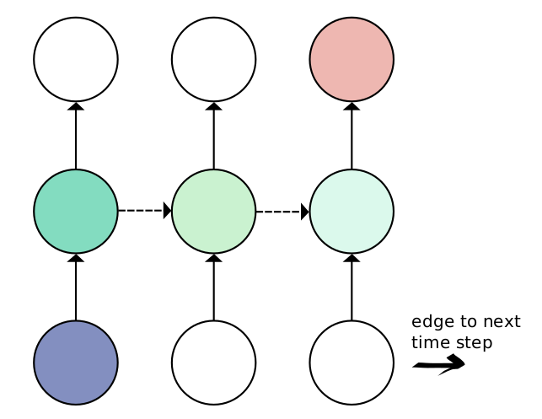
Recurrent Neural Networks (RNN)
RNNs are able to remember past content
Good choice for sequential data
Example: used for chat-bots
Presented as unfold over time
Known problems are the vanishing or exploding gradients [6]

Slide 7
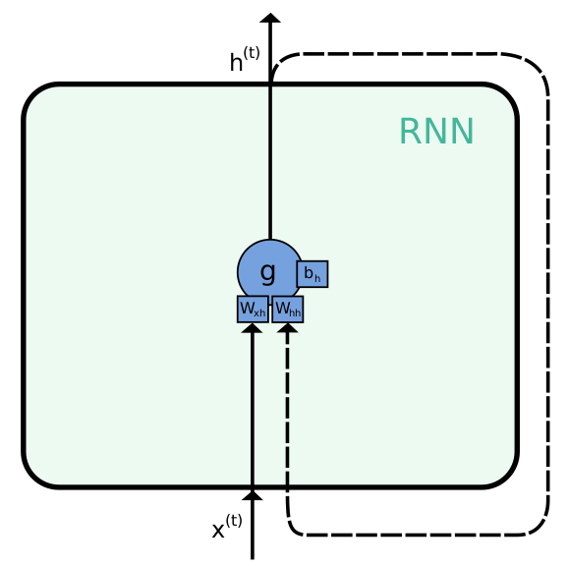

Basic Recurrent Unit
Simplest design of a recurrent unit
Problem of vanishing gradients
Usually LSTMs or GRUs are used
Hidden state:

Slide 8
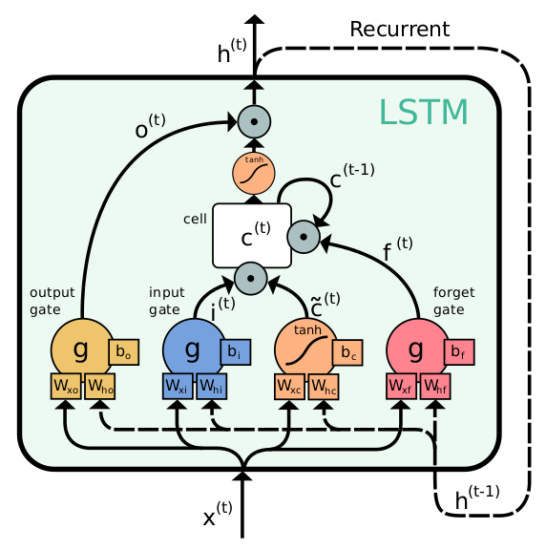
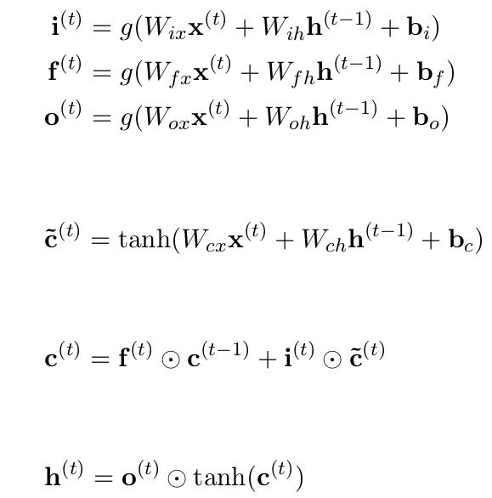
Long Short-Term Memory Unit (LSTM)
Solve the vanishing gradient problem through gates
Gates:
Cell
state:
Hidden state:

Slide 9
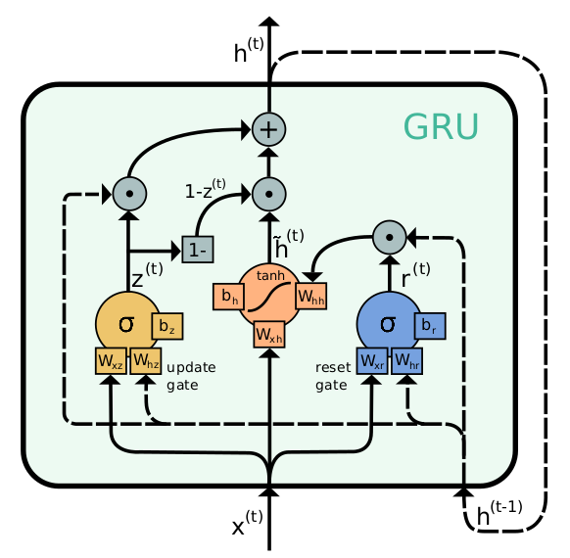
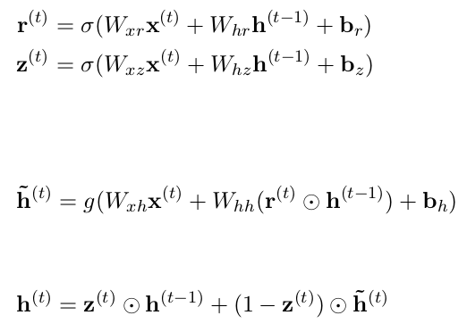
Gated Recurrent Unit (GRU)
Simpler Approach to the LSTM
2 gates
No cell state required
Gates:
Hidden state:

Slide 10
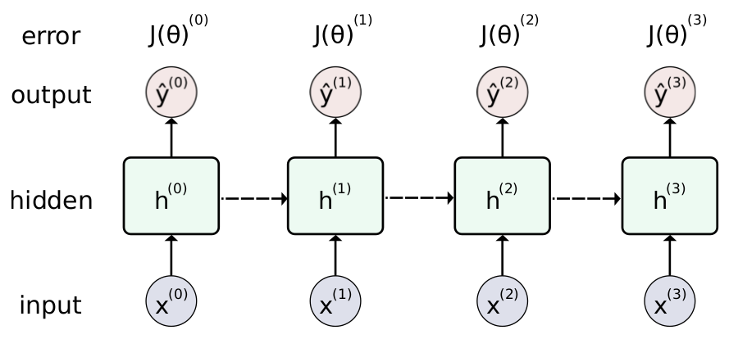

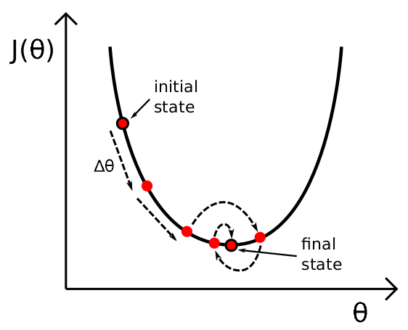


Training RNNs
Backpropagation Through Time (BPTT):
Unfold Network over time
Calculate the gradients in respect to each parameter and sum them over time
Update set of parameters according to gradient descend

Slide 11
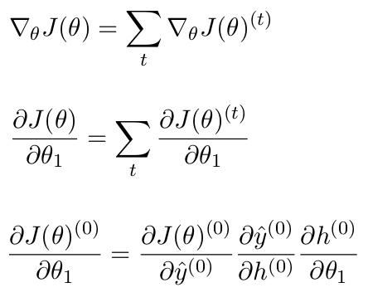
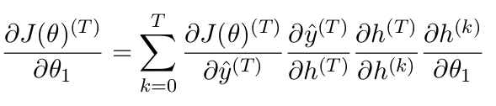
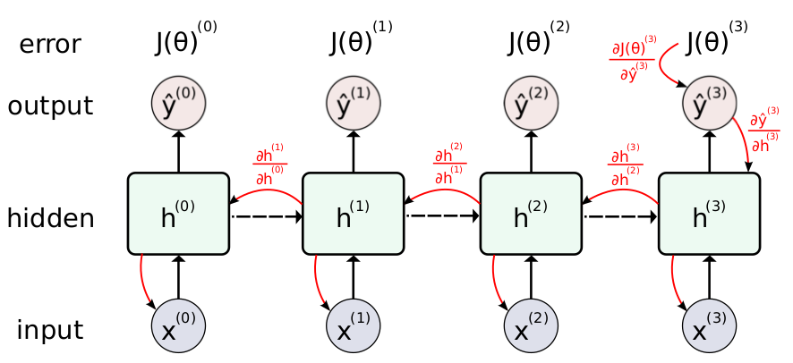
Example of BPTT

Slide 12
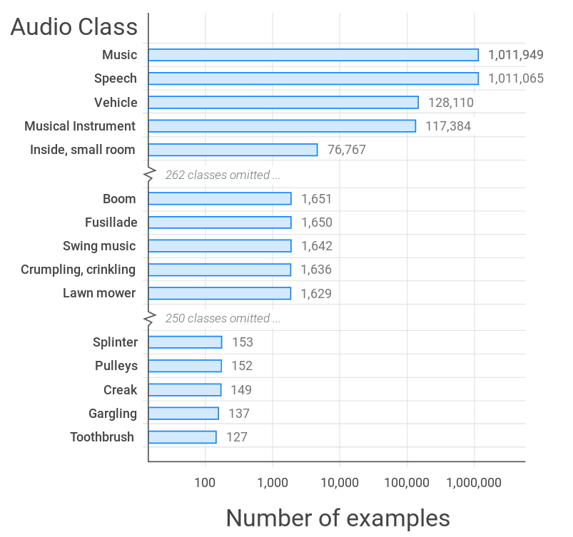
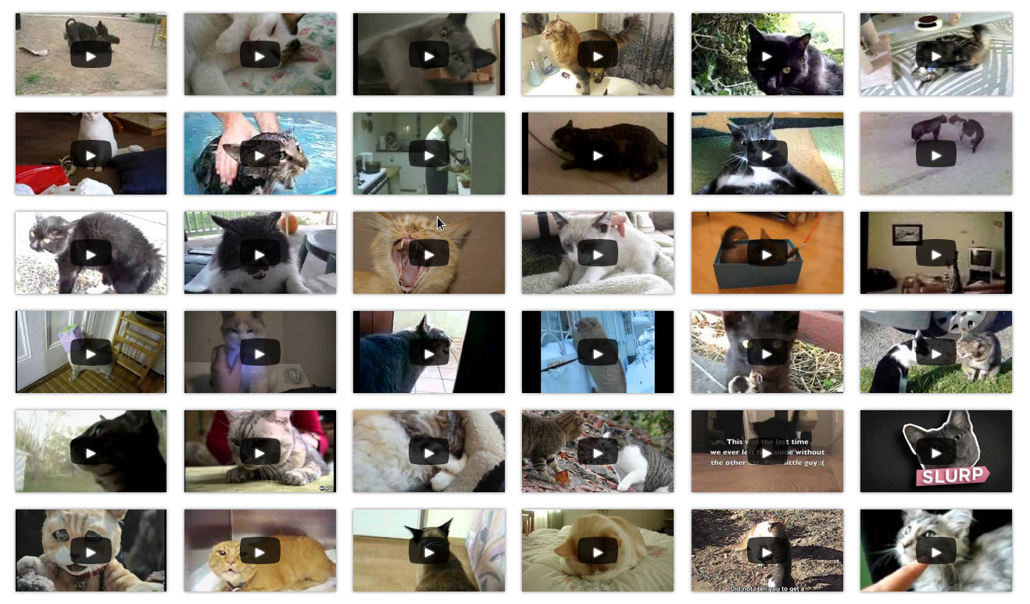
Google Audioset
2M 10-sec. Sound clips of YouTube videos
Human labeled
527 classes
300 frames per video
128 features per frame

Slide 13
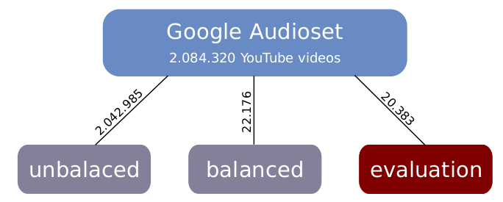
Google Audioset
The Dataset is splitted into 3 sets:
  Unbalanced: examples per class are unbalanced
  Balanced: at least 59 examples per class
  Evaluation: at least 59 examples per class

Slide 14
Experiments
Training and evaluating 2 models:
  Logistic-model
  LSTM-model
Google Audioset
    Balanced dataset training with 100 epochs
    Unbalanced dataset training with 3 epochs
    Evaluation dataset used for comparison
Training Parameters:
Stochastic Gradient Descend
Mini-Batch size: 64 examples
Adam Optimizer

Slide 15
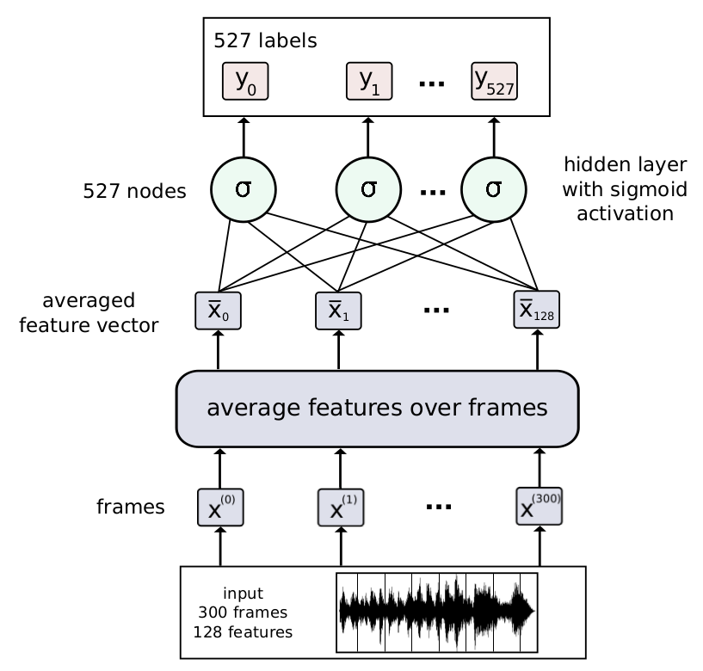
Logistic model
Feed-forward fc layer
Features are averaged over all frames
Simple and fast
Low training time
Very good results

Slide 16
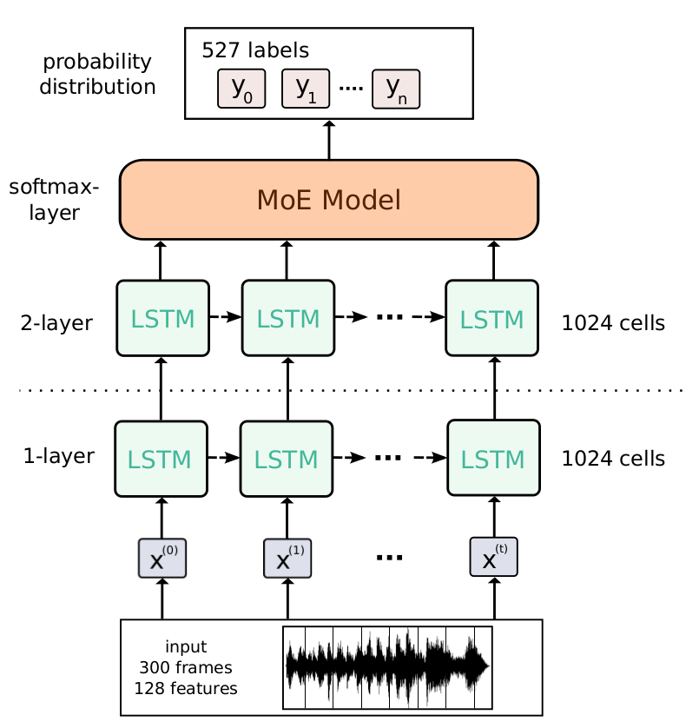
LSTM model

Slide 17
Evaluation Metrics

Slide 18
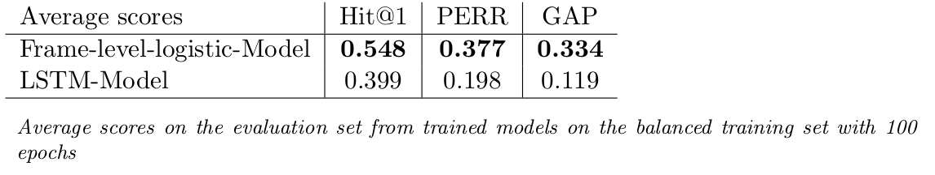
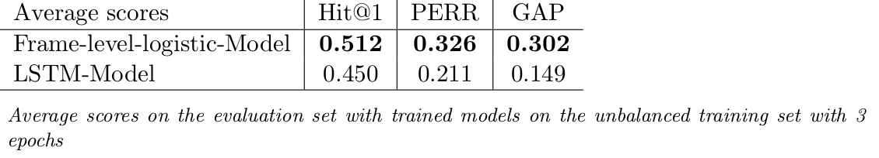
Results

Slide 19
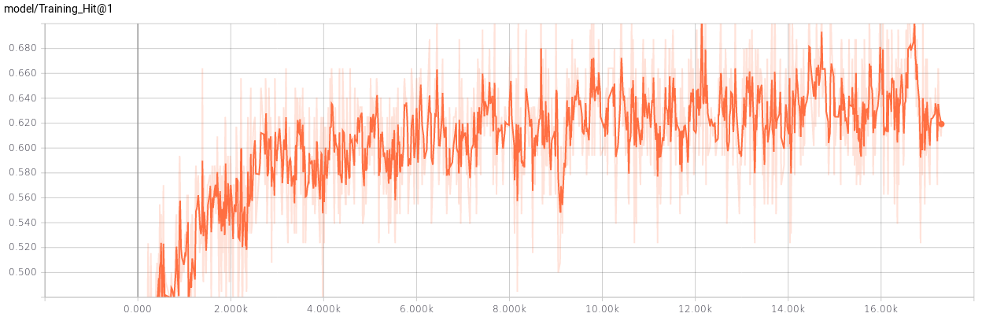
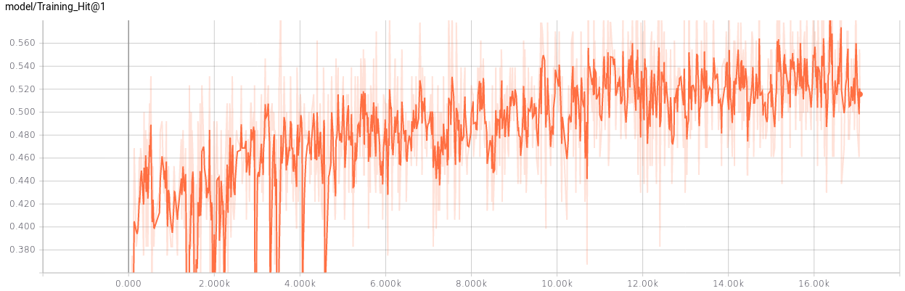
Training score on ballanced dataset
Logistic-model
LSTM-model

Slide 20

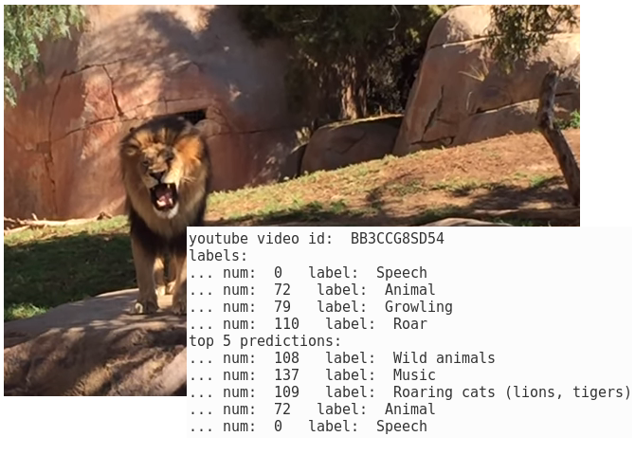
Examples
Trained with unbalanced training set for 3 epochs

Slide 21
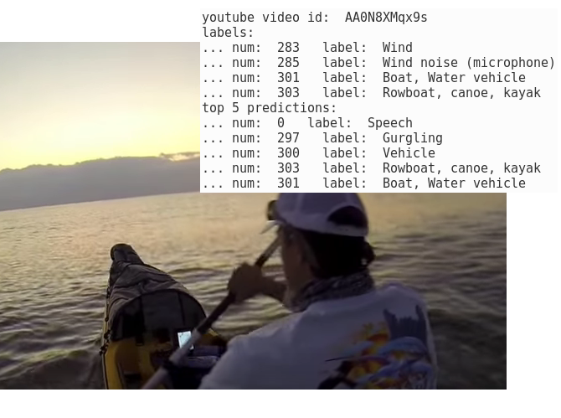
Examples

Slide 22
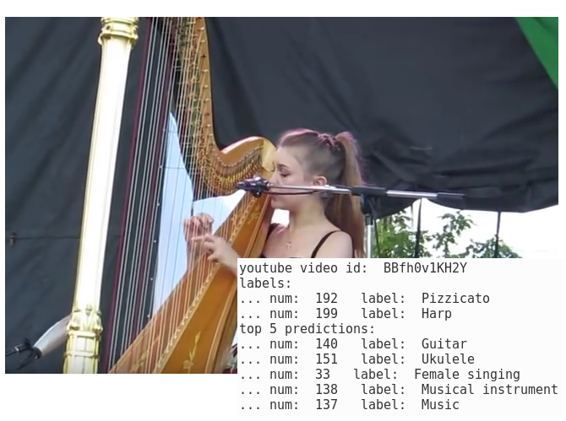
Examples

Slide 23
Conclusion

Slide 24
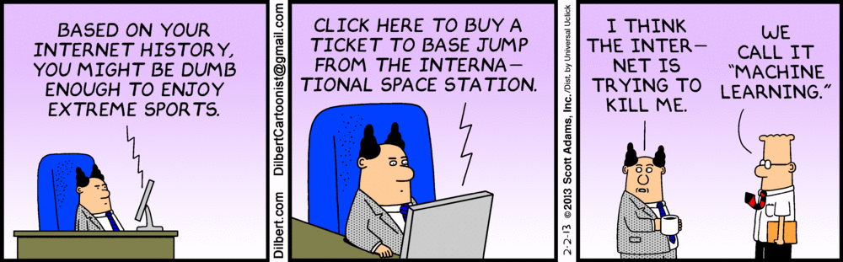
Questions?
Source: [20]

Slide 25
References
[1]: https://research.google.com/audioset/
[2]: https://upload.wikimedia.org/wikipedia/commons/a/a4/TensorFlowLogo.png
[3]: https://www.raspberrypi.org/documentation/usage/python/
[4]: https://research.google.com/youtube8m/
[5]: http://cs231n.github.io/neural-networks-1/
[6]: Y. Bengio, P. Simard, and P. Frasconi, “Learning long-term dependencies with gradient descent is difficult,”
[20]: https://www.analyticsvidhya.com/blog/2015/12/hilarious-jokes-videos-statistics-data-science/

