Slide 1
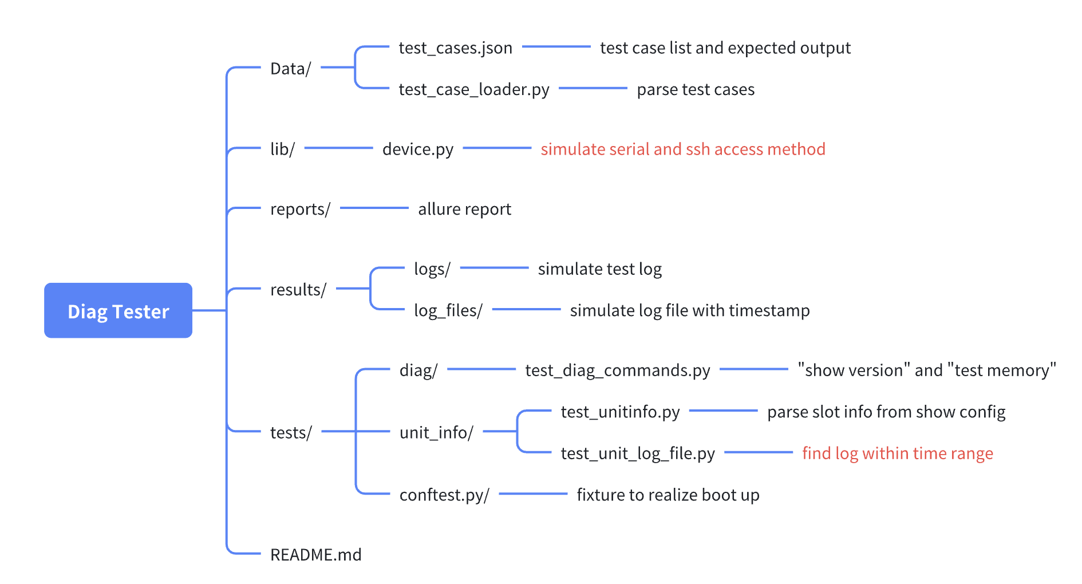
Pytest Diag Test simulation Platform.
Code Structure:
Code repo:
git clone https://github.com/garthdawn/diag_tester.git

Slide 2
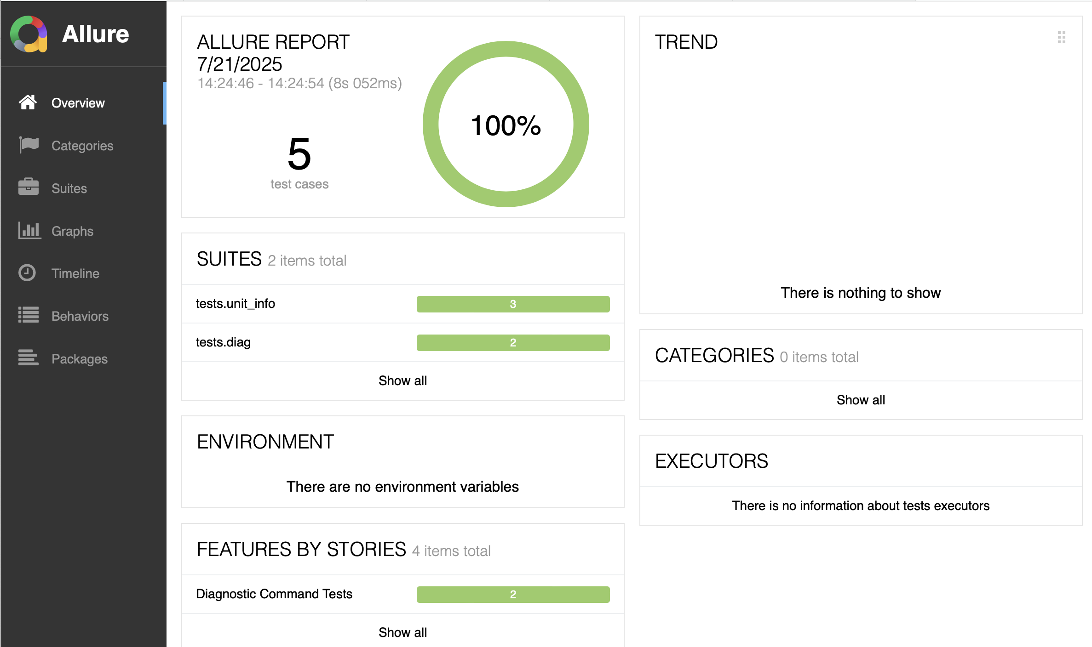
Allure Report : Overview

Slide 3
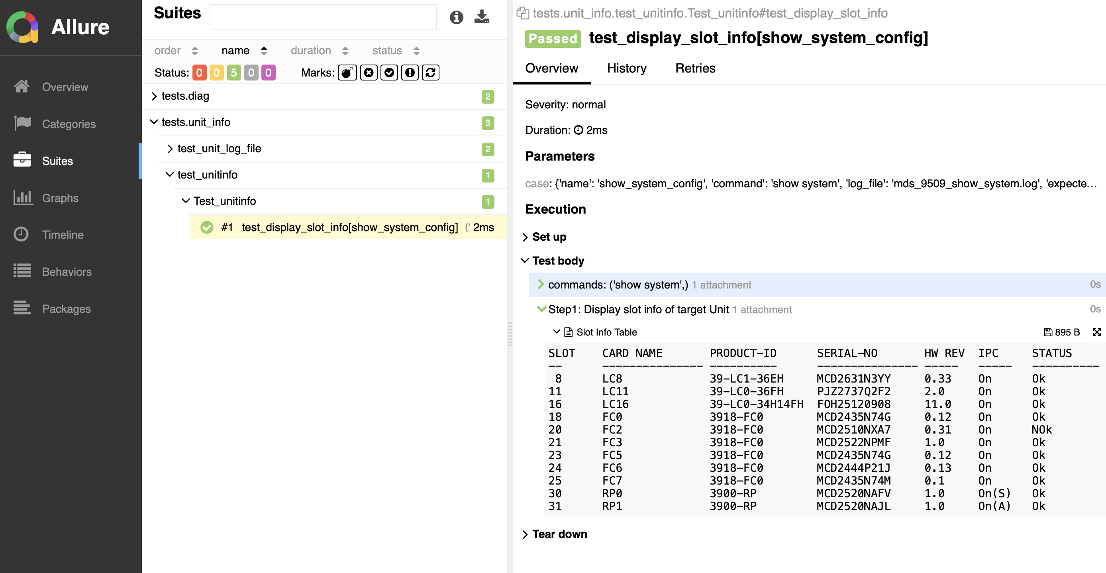
Allure Report : test_display_slot_info

Slide 4
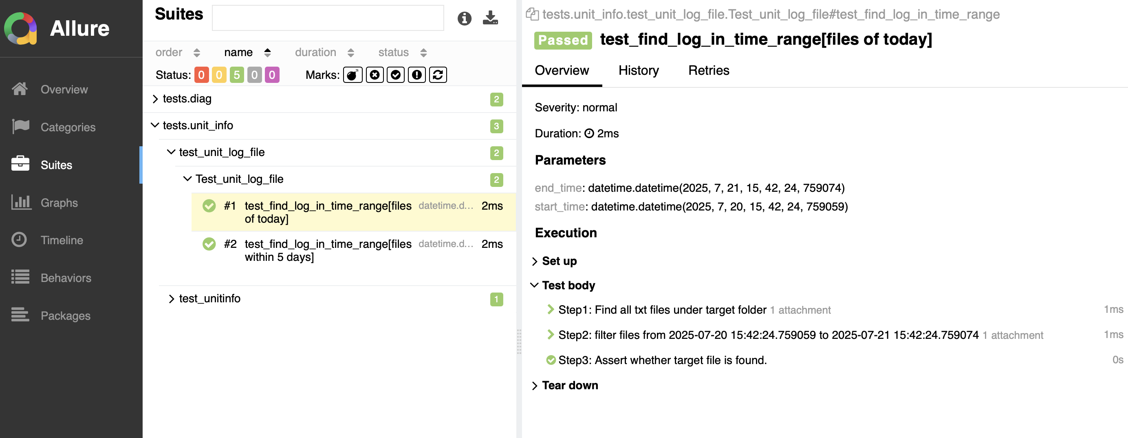
Allure Report : test_find_log_in_time_range

Slide 5
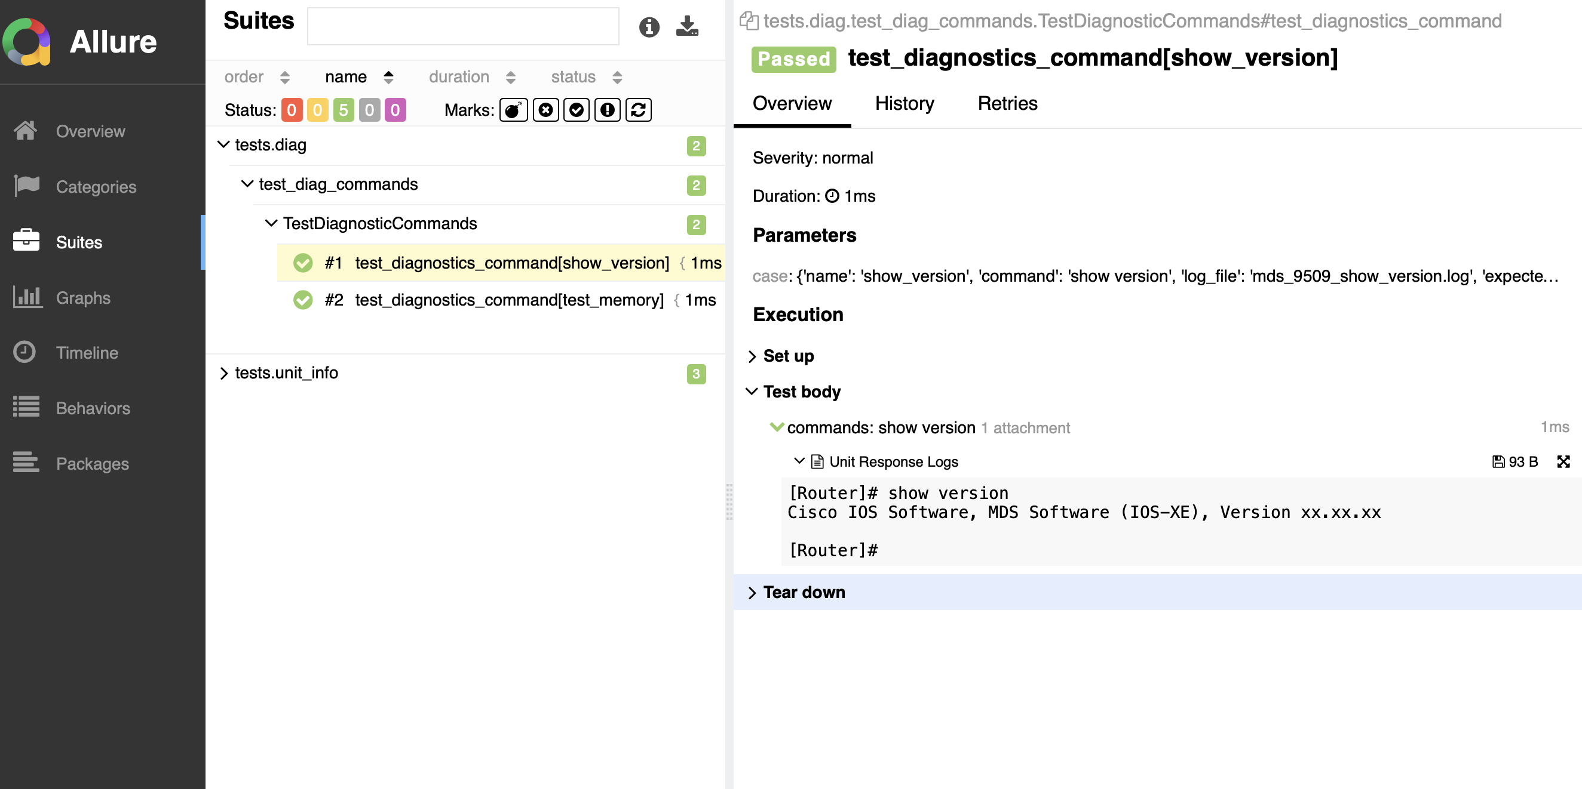
Allure Report : test_diagnostic_show_version

Slide 6
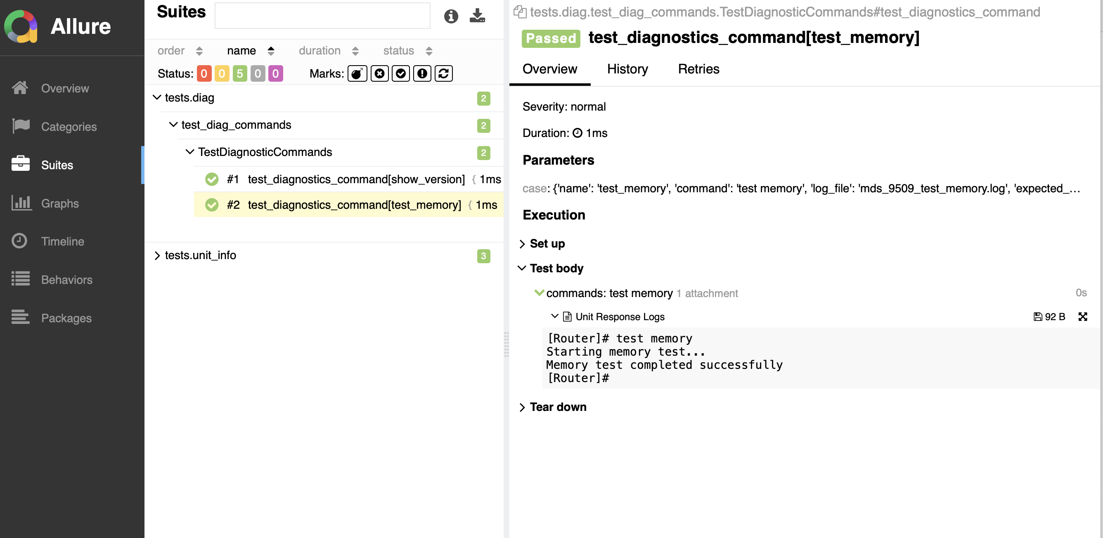
Allure Report : test_diagnostic_show_memory

