Slide 1
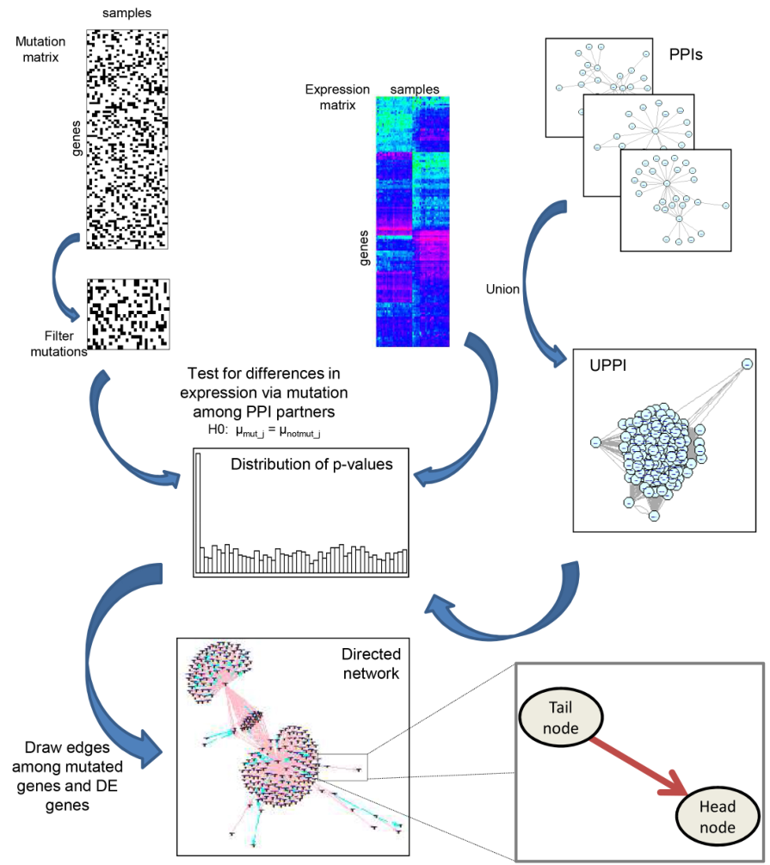
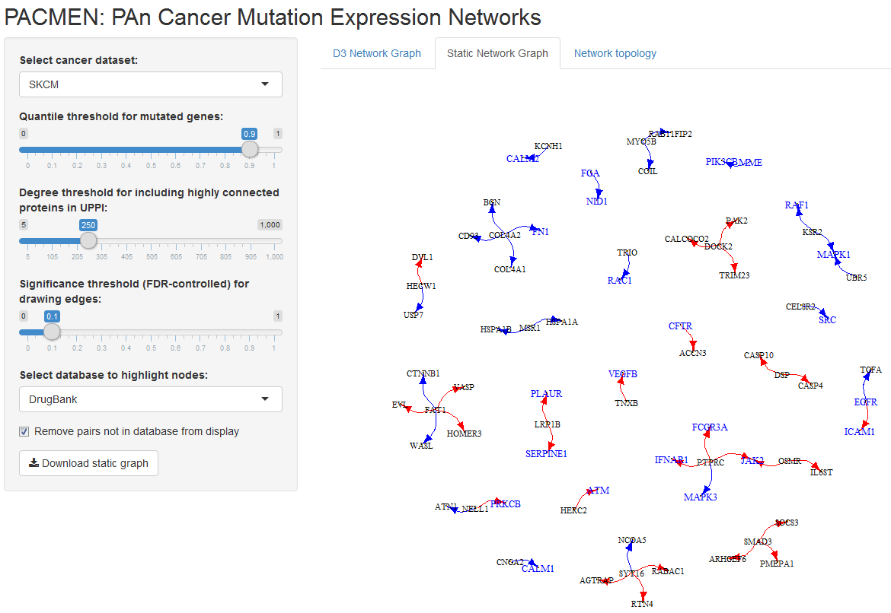
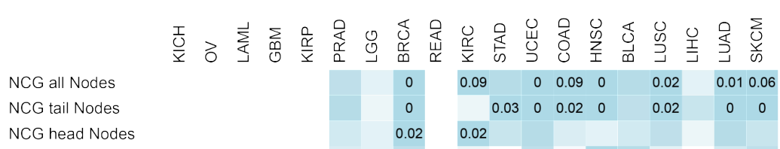
Characterizing mutation-expression networks in multiple cancers Shila Ghazanfar and Jean Yee Hwa Yang
Network construction
4,443 tumours analysed over 19 cancers from TCGA
R Shiny app to explore results among different parameters
Available to download at
www.maths.usyd.edu.au/u/sheilag/pacmen.zip
Overlap with known cancer genes

