Slide 1

Apple Stock Forecast
Predicting Apple Stock Price (AAPL) Using Financial, Economic and Sentiment indicators.
Objective: Help investors, traders, and analysts make buy/sell decisions
By : Group - 1

Slide 2
Business Objective
Predict Apple’s next 30-day stock price using data from financial, economic, and sentiment indicators.
Enable investors and traders to:
  Monitor stock trends
  Identify buy/sell opportunities
  Scope: Daily prediction within trading hours (Mon–Fri, 4 AM–8 PM ET)

Slide 3
Dataset Overview
Variable | Type | Description | Real-World Impact
stock_price | Target | Apple’s stock price over time | Measure of Apple’s performance
nasdaq_index | Feature | NASDAQ Composite Index | Market correlation
sp500_index | Feature | S&P 500 Index | Macro-market benchmark
inflation_rate | Feature | % price increase | Impacts costs & demand
unemployment_rate | Feature | % jobless | Affects consumer spending
interest_rate | Feature | Federal Funds Rate | Affects borrowing & expansion
market_sentiment | Feature | Score (–1 to +1) | Reflects investor mood

Slide 4
Data Preparation & Cleaning
Removed weekends (Saturday, Sunday) – U.S. markets closed.
Time filter: 4:00 AM – 8:00 PM ET (pre-market + regular + after-hours).
Handled blanks/missing values:
  Forward fill (for time series gaps)
  Mean/median imputation (for continuous variables)
  Interpolation (for inflation, rates)
  Outlier treatment: Using IQR Method

Slide 5
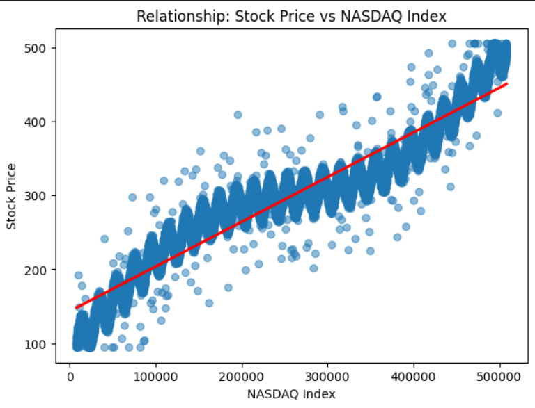
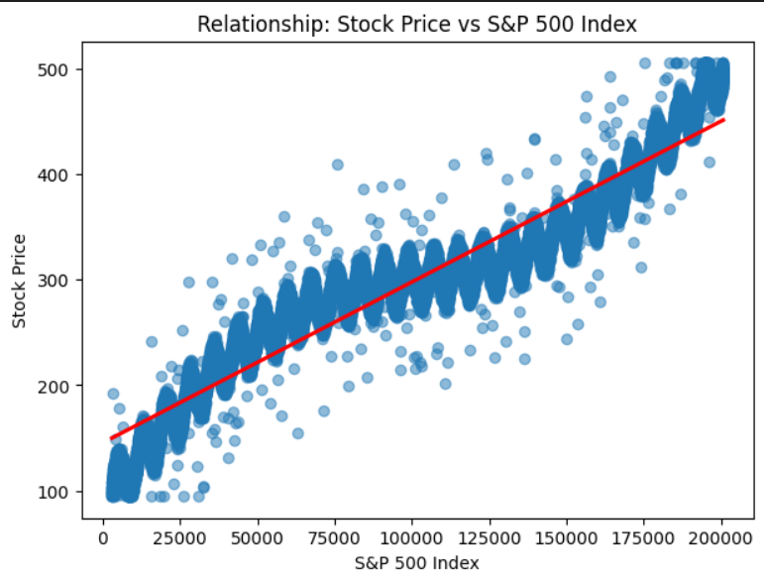
Exploratory Data Analysis (EDA)
Scatter plot: Stock Price vs NASDAQ Index
Scatter plot: Stock Price vs S&P 500 Index

Slide 6
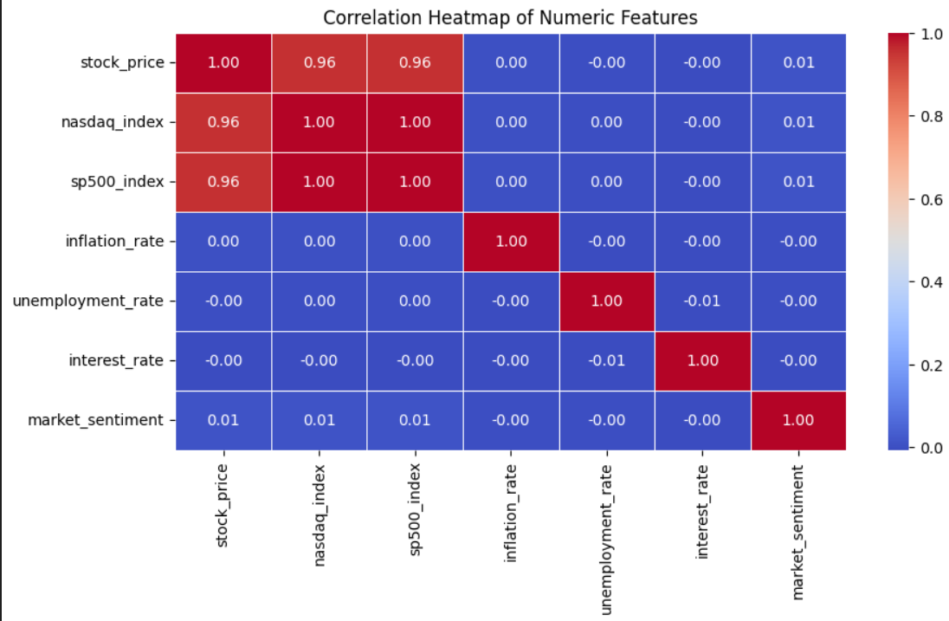
Exploratory Data Analysis (EDA)
📈 Correlation heatmap (highlight strong relationships)
Insights:
Apple’s stock is highly correlated with NASDAQ & S&P 500.

Slide 7
Model Selection
Content :
  We explored multiple forecasting approaches:
    ARIMA / SARIMA (statistical time-series models)
    Machine Learning (Random Forest, XGBoost)
    Deep Learning (LSTM)
    Hybrid Models (SARIMA + LSTM)
    Final selection: SARIMA + Hybrid LSTM
      SARIMA stands for Seasonal AutoRegressive Integrated Moving Average.
      It’s an extension of ARIMA that handles both trend and seasonality in time-series data.

Slide 8
Hybrid SARIMA + LSTM Model
Title: Hybrid SARIMA + LSTM Approach
  Sarima Capture the linear seasonal structure.
  The Final Sarima order (1,0,1) and seasonal order (0,0,0,5)
  Final forecast = SARIMA forecast + LSTM residual prediction.
  Advantages:
    Combines interpretability (SARIMA) with accuracy (LSTM)
    Reduces forecasting error
    Handles both macro (trend) and micro (volatility) components

Slide 9
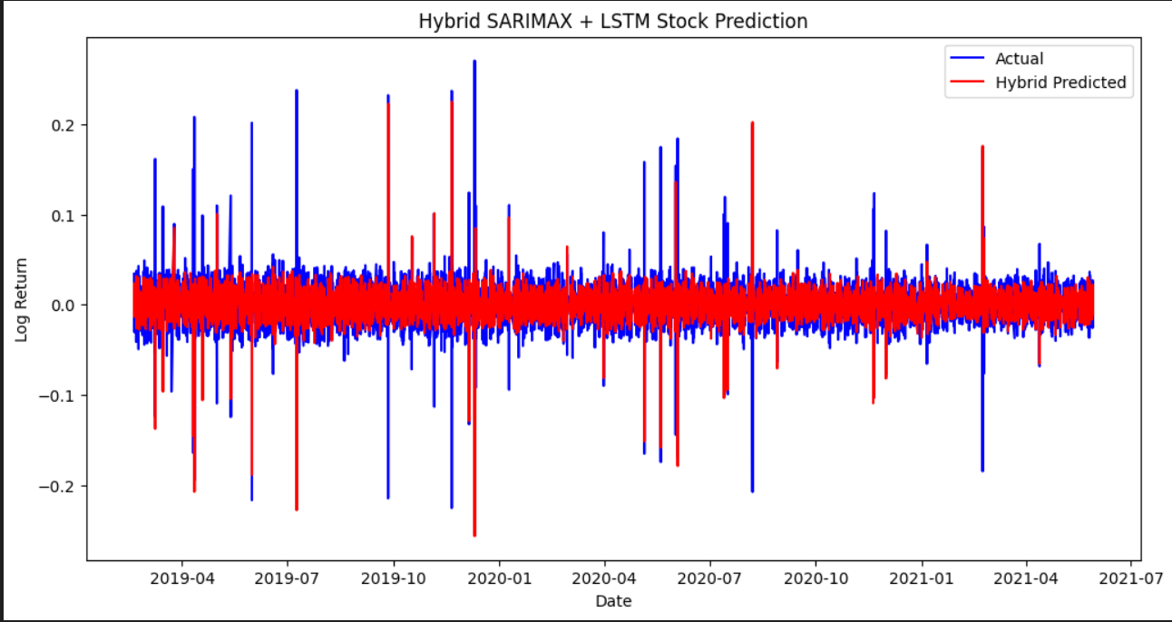
Hybrid SARIMA + LSTM Model
  Comparison chart: Actual vs. SARIMA vs. Hybrid prediction.
  Training loss curve (epoch vs. loss)
Key Insight:
The Hybrid model achieved the lowest RMSE [0.014], outperforming standalone SARIMA or LSTM models.

Slide 10
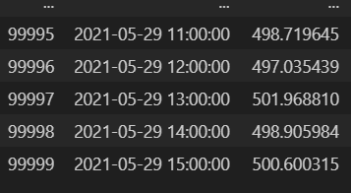
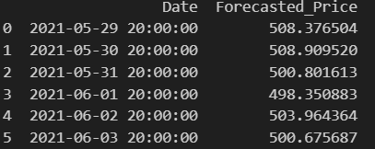
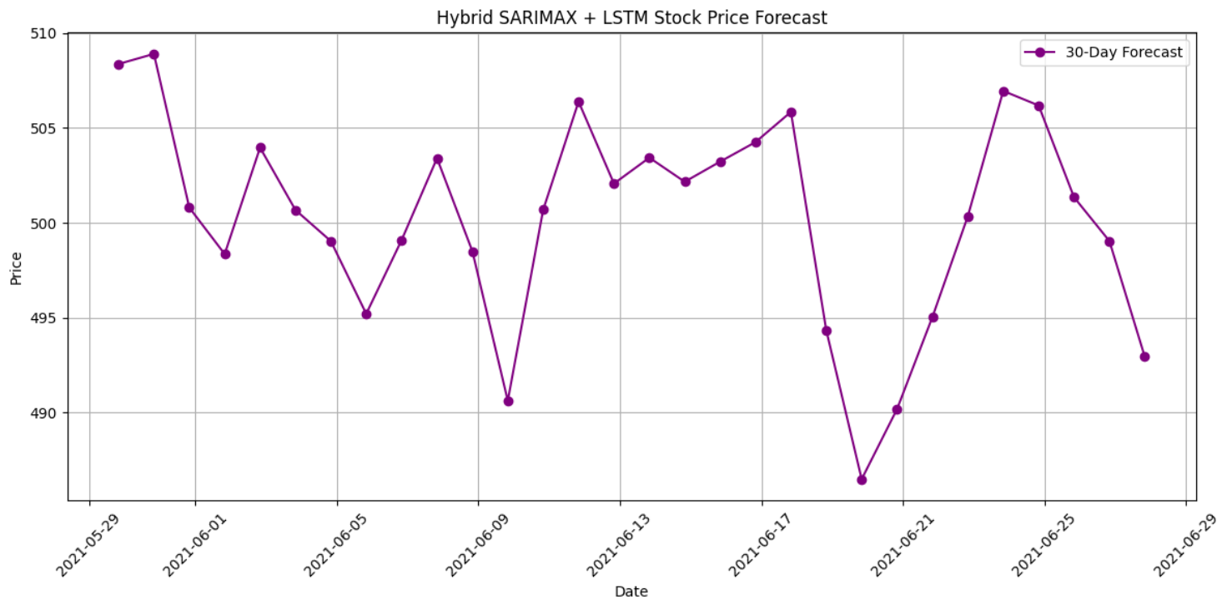
Hybrid SARIMA + LSTM Model Next 30 Days Forecast
Before Forecast Dataset Display Few Last line
After Forecast Dataset Display Few First line
Historical Data → SARIMA → Residuals → LSTM → Final Forecast

Slide 11
Deployment of Hybrid Forecast Model using Streamlit
  Allow real-time prediction and visualization of Apple (AAPL) stock prices.
  Simple interface accessible via any browser.
  Content
    Framework: Streamlit
    Backend: SARIMA + LSTM model (trained offline, loaded using .pkl or .h5)
    Frontend features:
      “Predict” button → displays next 30-day forecast
      Charts: Actual vs Predicted, Residual trends, Confidence intervals

Slide 12
Streamlit Application Workflow
  User Input: Choose start date & number of days (30 days).
  Data Fetching: App retrieves recent Apple, NASDAQ, S&P 500 data.
  Preprocessing: Cleans, scales, and prepares inputs.
  Model Prediction:
    SARIMA → trend component
    LSTM → residual component
    Combine → final forecast
    Output Display: Charts & Forecast dataset appear in dashboard.

Slide 13
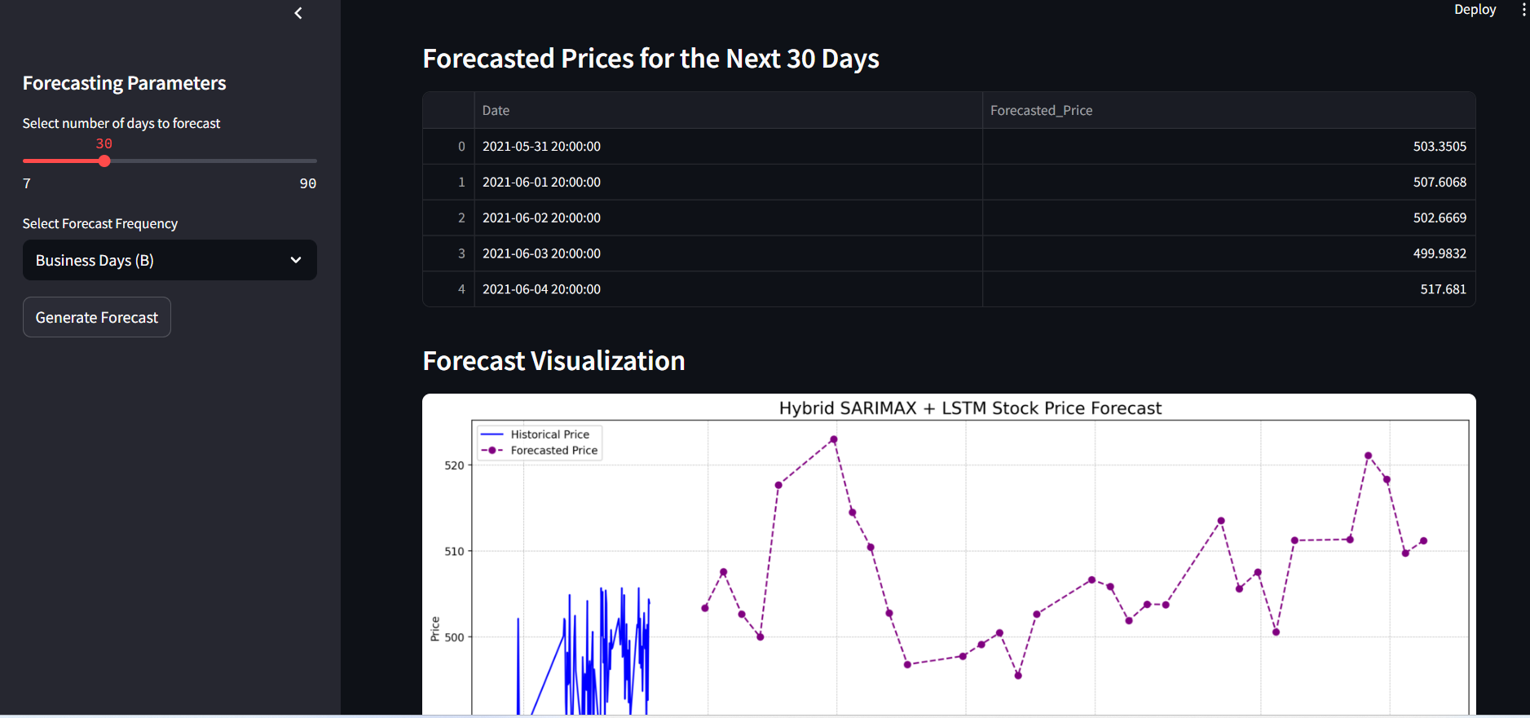
Dashboard
Conclusion:
The hybrid SARIMA + LSTM model provided the most accurate 30-day forecast for Apple stock prices.

