Slide 1
demo_for_ccgb Weekly Update
20220829
Jon Mah
Garud and Lohmueller Labs

Slide 2
Summary
MIDAS
Figure 2
Sanity checks on B. intestinihominis
Pi
Likelihood surface

Slide 3
MIDAS
339/339 species_profile.txt + species union text files
Merge species step:
count_reads.txt
coverage.txt
readme.txt
relative_abundance.txt
species_prevalence.txt
Merge genes step:
100 species from genes step

Slide 4
MIDAS (cont’d)
These (12) hosts don’t have any species with coverage >= 3
SRS020402
SRS023591
SRS049283
SRS055118
SRS063858
SRS077187
SRS077386
SRS077999
SRS1041161
SRS1055080
SRS1055036
SRS1491337
These don’t have genes or snps output

Slide 5
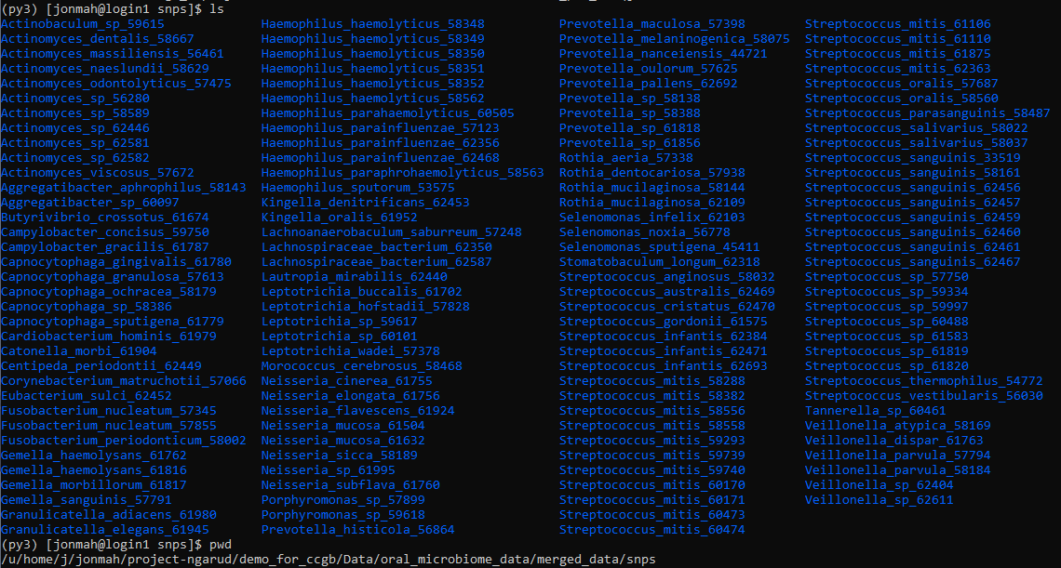
MIDAS merge snps
There is output from the merge snps step, in each species directory:
readme.txt
snps_alt_allele.txt
snps_depths.txt
snps_info.txt
snps_log.txt
snps_ref_freq.txt
snps_summary.txt

Slide 6
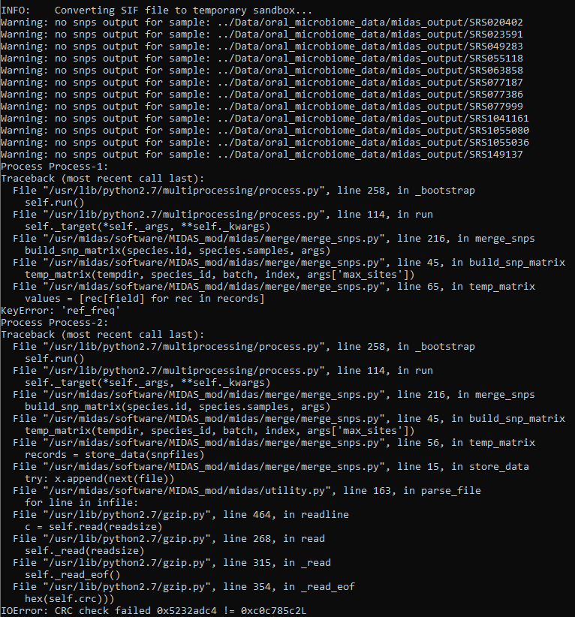
MIDAS merge snps
Job is running
I was/am getting an error message thrown and am still troubleshooting it
Tried singularity exec approach + new approach + local MIDAS installation (py2), error is still thrown
Digging through code still to try and figure out

Slide 7
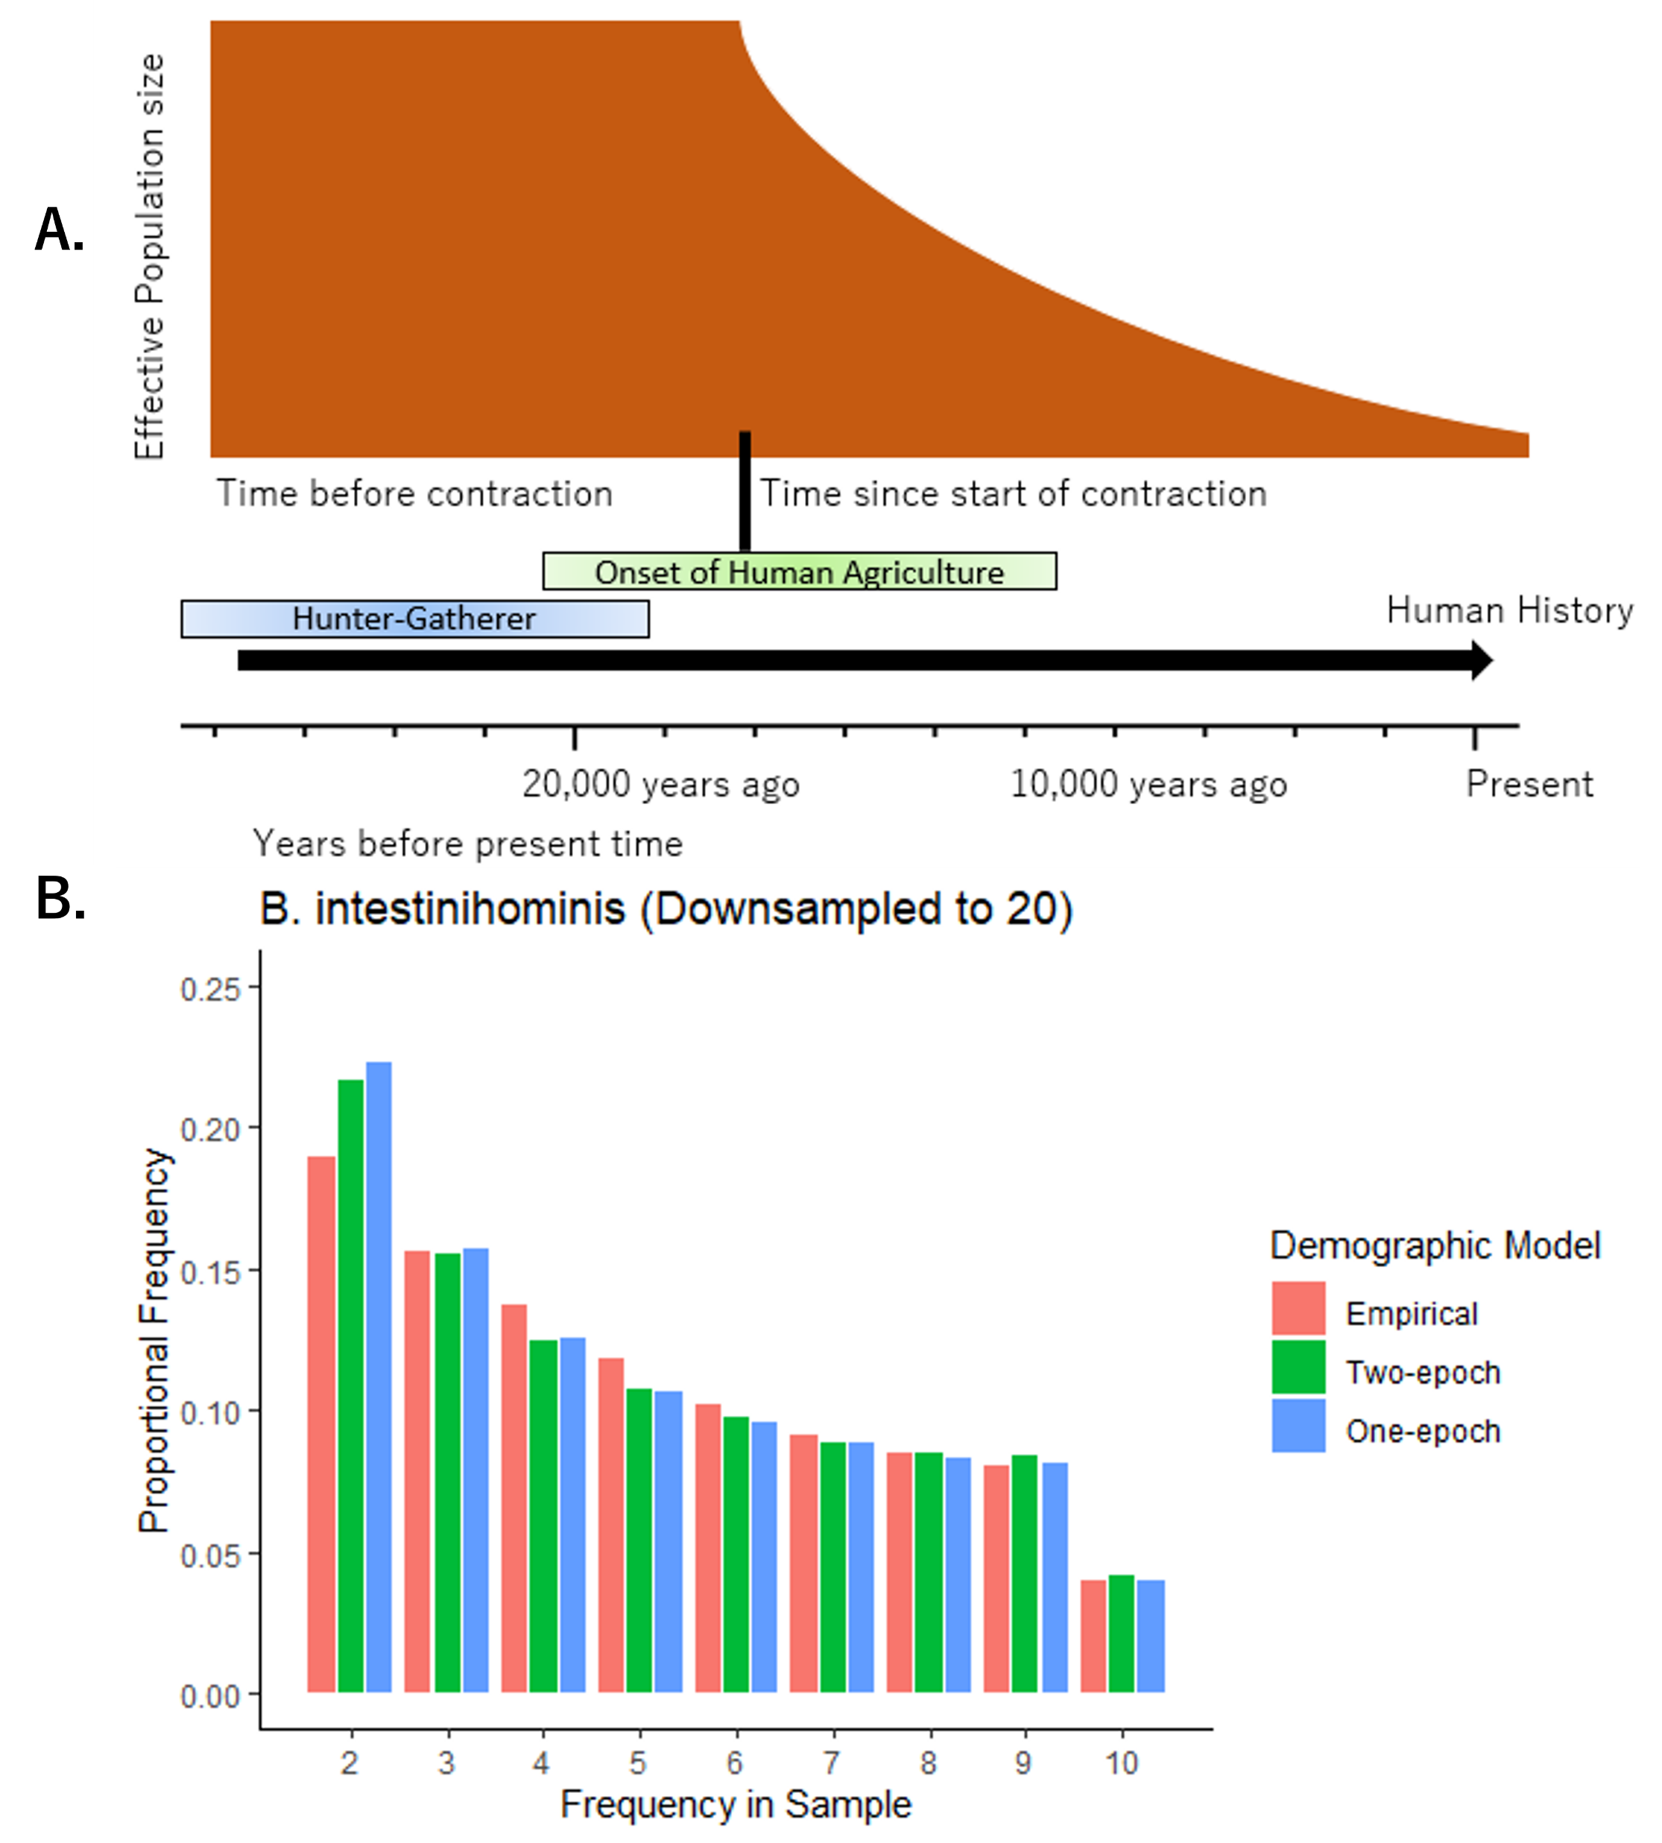
Figure 2

Slide 8
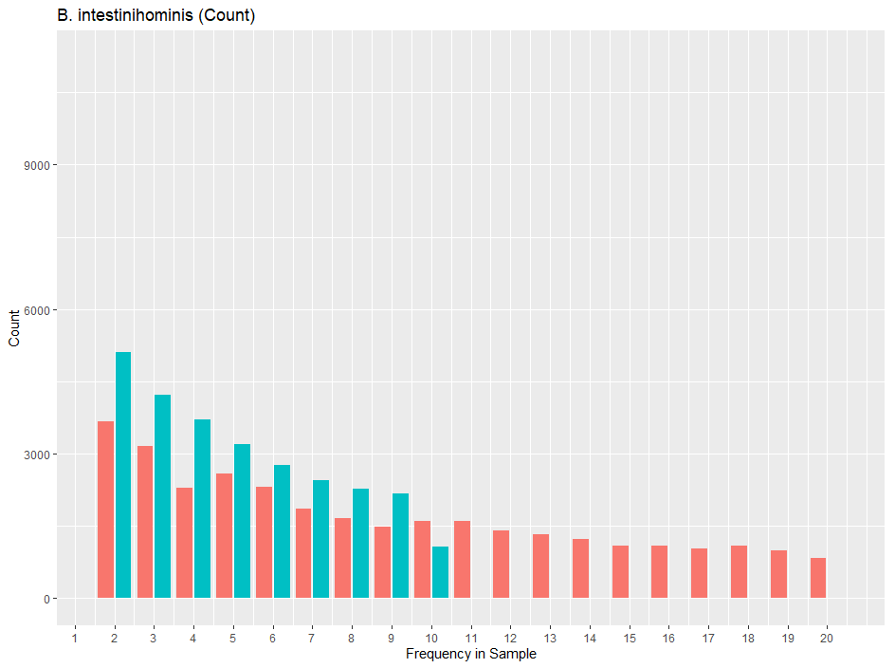
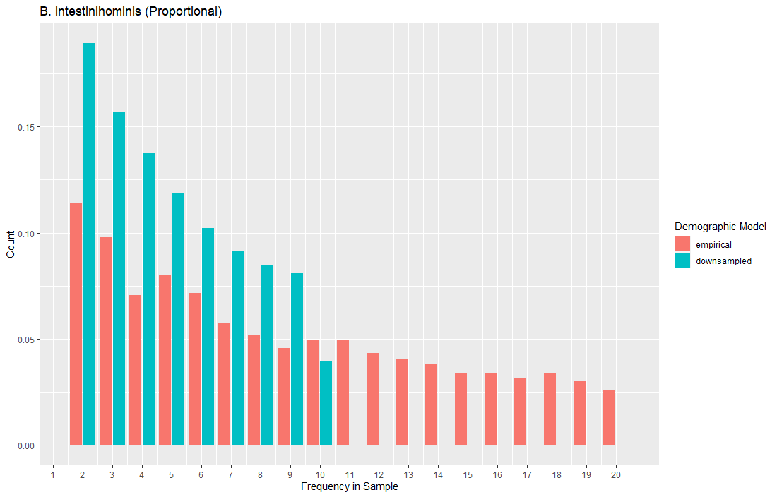
Sanity Check figures

Slide 9
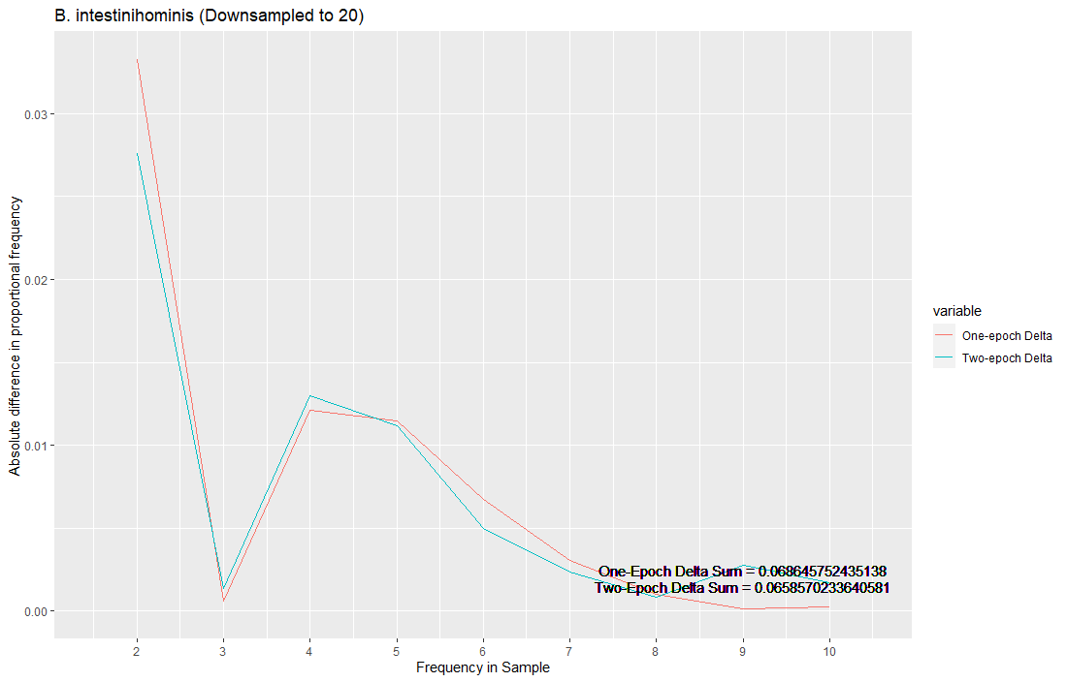
Sanity Check figures

Slide 10
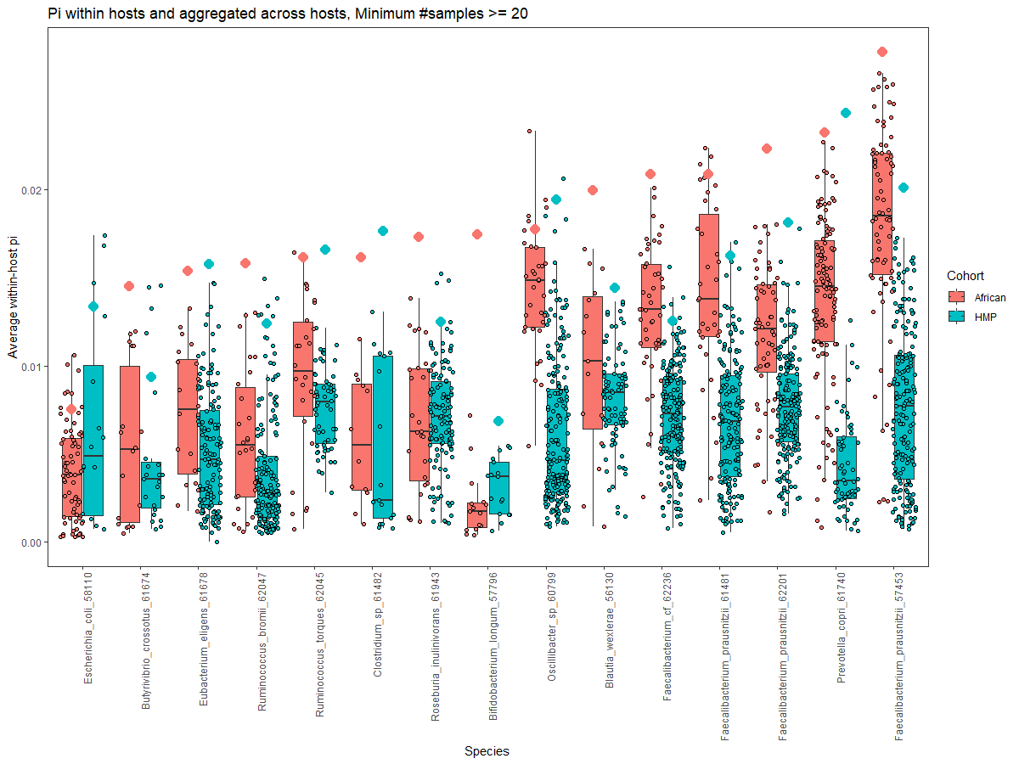
Pi
IID
Organized in ascending order of across-host pi for the African cohort of each species
Show any species present in at least 5 hosts for both
Non-parametric t-test for hypothesis that African pi is greater than HMP pi

Slide 11
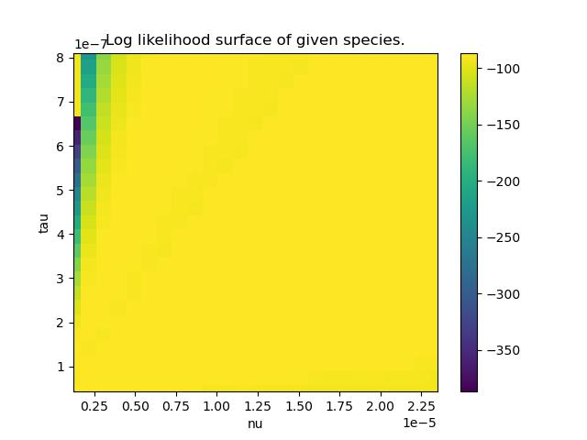



B. thetaiotaomicron
Better color scheme
Logscale on the gradient
More dramatic color shift
Highlight MLE site

Slide 12
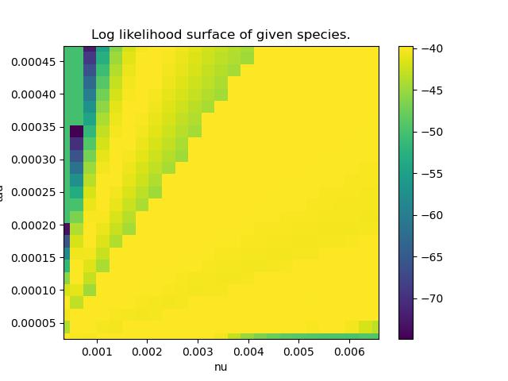
B. xylanisolvens

Slide 13
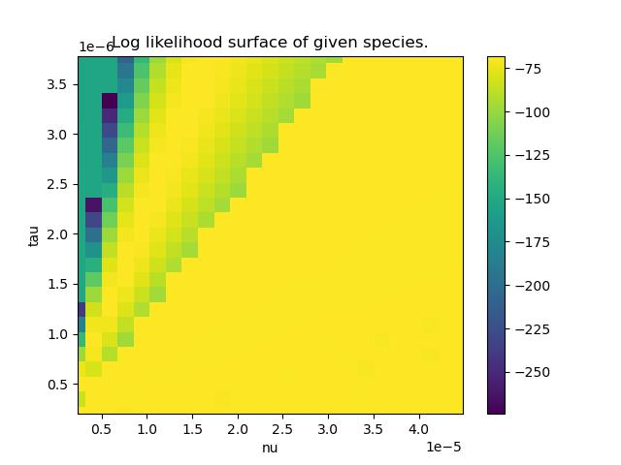
B. intestinihominis

Slide 14
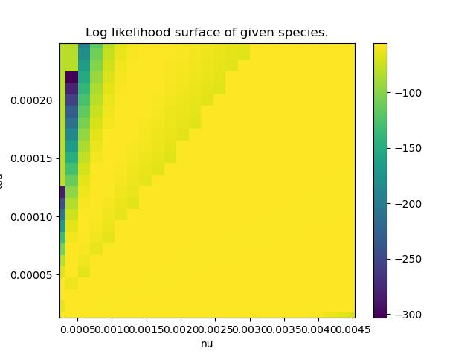
P. distasonis

Slide 15
TODO 20220829
SFSs for supplement + main text (B. intestinihominis)
Merge snps step with a smaller directory of two files
Pi plot, species with >= 5 hosts in both cohorts instead of original list
Wilcoxon rank sum test

