Slide 1
demo_for_ccgb Weekly Update
20220624
Jon Mah
Garud and Lohmueller Labs

Slide 2
Summary of Update
Downsampling SFS (sample size 25) + Dadi preliminary results
Patric works now
Overleaf WIP: https://www.overleaf.com/project/618d1cb43026d96396b379ca

Slide 3
Key Issue
Investigate models of selection that results in SFS that suggests a “false” contraction of N_e
Balancing selection → excess of rare and intermediate freq
Hard sweeps → should results in inferred expansion, however;
Soft sweeps → could result in inferred contraction?
Slim sims to interrogate
Loss of fluctuating selection – Joanna Masel
Human demography → bottleneck

Slide 4
Downsampling pipeline
Load core genes → gene present in >= 90% of samples
Pre-compute substitution rate for species
Identify largest clade for clade control
Parse SNPs with MIDAS
Exclude nonsynonymous SNPs
Compute allele count for synonymous variants in each gene from core genes
Compute synonymous SFS

Slide 5
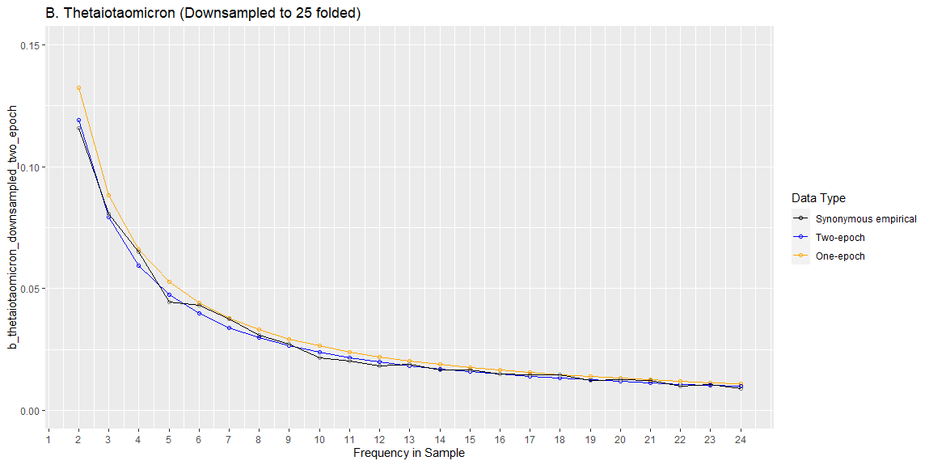
Preliminary Results (B. Thetaiotaomicron)
Other ways to show SFS:
Delta
Logscale on Y-axis
Maybe bin common variants together, e.g., everything greater than 10 (also shrinks plot)
 | One Epoch | Two Epoch
LL | -72.7526626915 | -67.7389287184
Nu | N/A | 4.38198542e-02
T in years | N/A | 2.5432E+04

Slide 6
Preliminary Results (B. Thetaiotaomicron)
One epoch overestimates rare variants
Two epoch is closer to empirical data, still suggests contraction
Time range is a little higher than estimated from non-downsampled data
Contraction is less severe here in terms of Nu params

Slide 7
//TODO
How many hosts are quasiphaseable for each species to determine appropriate number for downsampling
Check largest_clade_samples on line 508 of `compute_downsampled_sfs.py`
Check if refs and alts are correctly computed
Long term:
Confidence Intervals
Some sort of bootstrapping approach
Oral data (consult Daisy + Brian)

