Slide 1
demo_for_ccgb Rotation Update
20210217
Jon Mah
Garud Lab

Slide 2
Logistics
Hope you had a nice holiday weekend!

Slide 3
Project Aim
Science Goal: Infer the demographic history of common commensal gut bacteria
Training Goal: Learn popgen tools / tech for microbiome
Personal Goal: Have fun ☺!

Slide 4
Gameplan
Initially focus on B. vulgatus
Create syn / ns SFSs
Compare to expectation of SFS
Given clade data (e.g., continent of origin), create PCA plot
Run Dadi to determine best fit demographic model
Start with Omar Conejo’s model(s)
Perhaps find link to human demography?
Apply to other species
Apply to other data sets (include African data, Peruvian data)

Slide 5
Progress
Fixed bug and re-implemented pipeline
TLDR part of the pipeline is in python2, and part of it is in python3 which messes with some data structures, particularly when used for string manipulation
Resulted in some technically not-allowed SFS’s, i.e., data in masked sites.
I believe that sparsity of data, e.g., in P. copri, is not due to this bug.
Inference performance has either improved or stayed the same in terms of log-likelihood, but computational performance has worsened, e.g., computational time.
Inference for different models is now parallelized so that it runs in a reasonable timeframe.
Initial params and boundaries were changed.
Reran Dadi + computed expected sfs on non-bugged sfs’s.
Some results still pending.
Still working on some of the fancier PCA stuff, e.g., probabilistic PCA to deal with missing data.

Slide 6
Implementation details (for following slides)
Input synonymous SFS’s: output from `plot_within_clade_sfs.py`.
High prevalence species:
B. vulgatus, B. ovatus, A. putredinis, B. uniformis, E. rectale.
Four demographic models
exponential growth, two-epoch, bottleneck + growth, three-epoch
For each input species
For each model:
Take 15 initial guesses for parameter space (parameters differ by model)
For each initial guess:
Iterate through gradient ascent to find maximum likelihood for <= 50 steps
Compute model params and log likelihood
Output log likelihood and model params of best initial guess + iterations

Slide 7
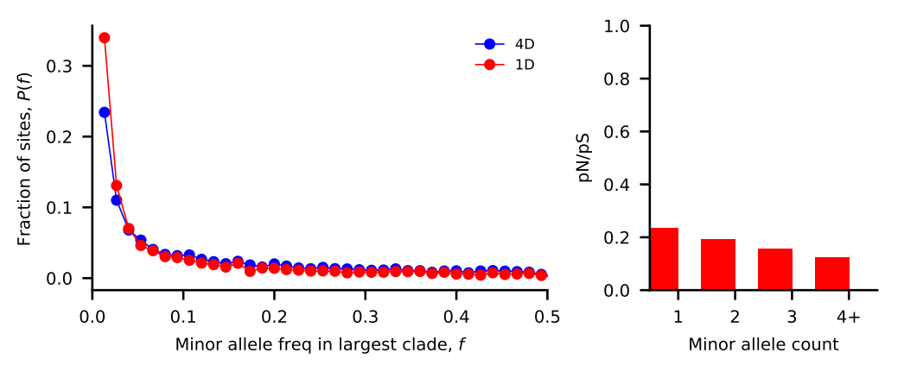
Bacteroides vulgatus
Nu_a: contemporary population relative to ancestral population before first epoch
Nu_b: contemporary population relative to ancestral population before second epoch
T_1: Duration of first epoch (units of 2 * N_a)
T_2: Duration of second epoch (units of 2 * N_a)
Model | Exponential growth | Two-epoch | Bottleneck + growth | Three-epoch
Log Likelihood | -120.722757756 | -121.994069176 | -120.726052275 | -121.995339345
Nu_a | 1.62764391 | 1.49516307 | 1.07053664 | 2.64925027
Nu_b | N/A | N/A | 1.63127485 | 1.49440752
T_12 | 1.09100781 | 0.44708506 | 0.98098777 | 0.00631432
T_23 | N/A | N/A | N/A | 0.43254745

Slide 8
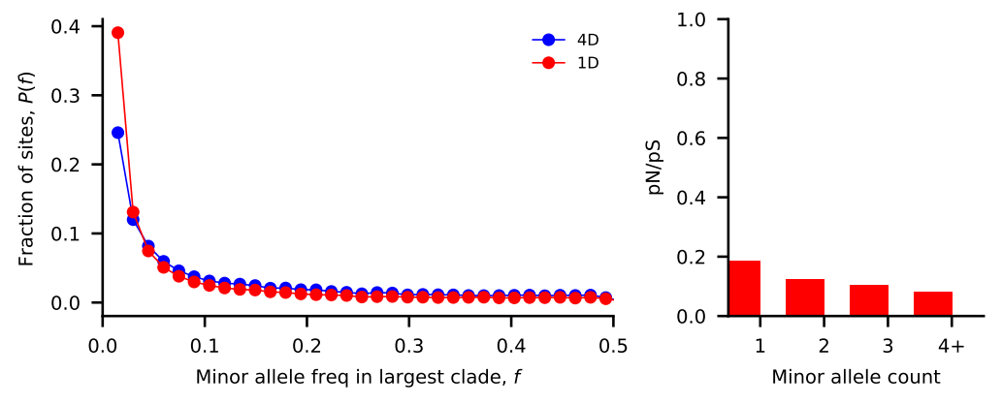
Bacteroides ovatus
Nu_a: contemporary population relative to ancestral population before first epoch
Nu_b: contemporary population relative to ancestral population before second epoch
T_1: Duration of first epoch (units of 2 * N_a)
T_2: Duration of second epoch (units of 2 * N_a)
Model | Exponential growth | Two-epoch | Bottleneck + growth | Three-epoch
Log Likelihood | -145.678269157 | -142.249802587 | -141.923362261 | -141.148031575
Nu_a | 2.02416132 | 12.62499552 | 2.24845827 | 3.24358033
Nu_b | N/A | N/A | 1.79912316 | 1.73262388
T_12 | 3.17342171 | 18.01177973 | 1.23976291 | 0.40179331
T_23 | N/A | N/A | N/A | 0.54790132

Slide 9
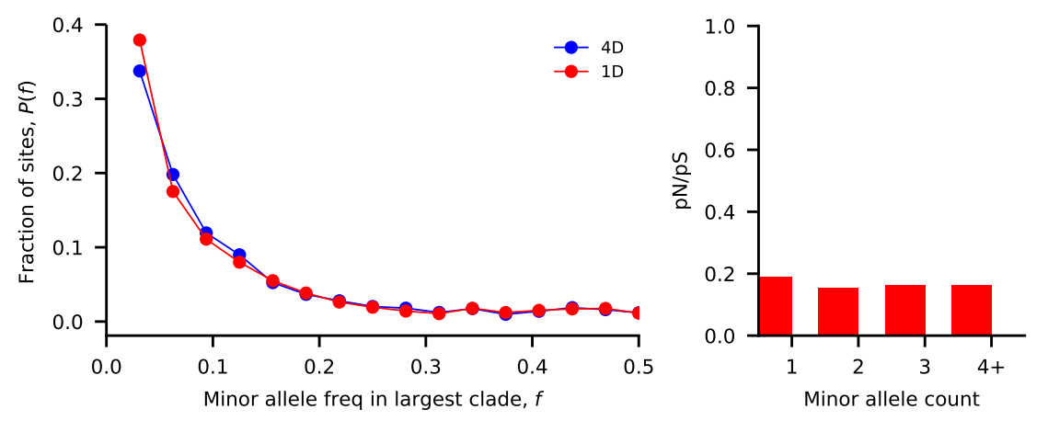
Alistipes putredinis
Nu_a: contemporary population relative to ancestral population before first epoch
Nu_b: contemporary population relative to ancestral population before second epoch
T_1: Duration of first epoch (units of 2 * N_a)
T_2: Duration of second epoch (units of 2 * N_a)
Model | Exponential growth | Two-epoch | Bottleneck + growth | Three-epoch
Log Likelihood | -239.595010976 | -283.836375864 | --156.298283062 | --239.803514655
Nu_a | 11.61457391 | 12.85982032 | 59.81554768 | 10.31769069
Nu_b | N/A | N/A | 3.57118932 | 12.07534007
T_12 | 4.39995892 | 5.26353859 | 1.59972168 | 0.90845072
T_23 | N/A | N/A | N/A | 3.75907656

Slide 10
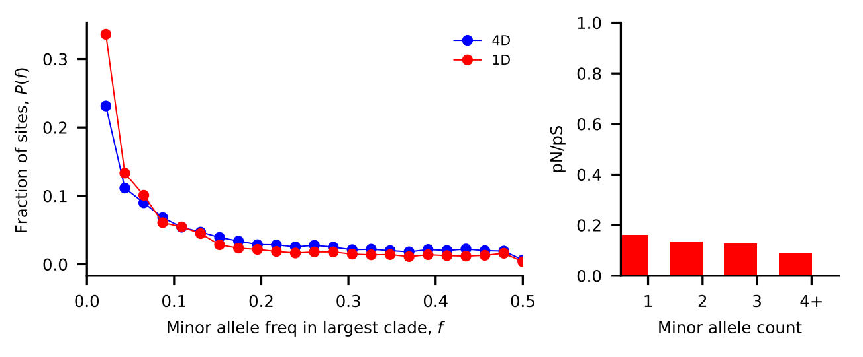
Bacteroides uniformis
Nu_a: contemporary population relative to ancestral population before first epoch
Nu_b: contemporary population relative to ancestral population before second epoch
T_1: Duration of first epoch (units of 2 * N_a)
T_2: Duration of second epoch (units of 2 * N_a)
Model | Exponential growth | Two-epoch | Bottleneck + growth | Three-epoch
Log Likelihood | -217.295138336 | -219.788922069 | -217.323496551 | -219.821925537
Nu_a | 6.69551901 | 2.80634262 | 1.39324194 | 0.13057176
Nu_b | N/A | N/A | 2.3096104 | 0.64729155
T_12 | 17.29658449 | 2.15350674 | 1.68463977 | 0.29392339
T_23 | N/A | N/A | N/A | 0.50844704

Slide 11
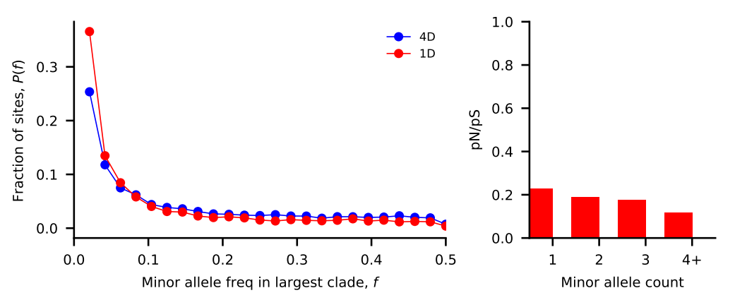
Eubacterium rectale
Nu_a: contemporary population relative to ancestral population before first epoch
Nu_b: contemporary population relative to ancestral population before second epoch
T_1: Duration of first epoch (units of 2 * N_a)
T_2: Duration of second epoch (units of 2 * N_a)
Model | Exponential growth | Two-epoch | Bottleneck + growth | Three-epoch
Log Likelihood | -205.765950246 | -195.375739908 | -195.963644837 | -195.048421331
Nu_a | 7.31029292 | 2.1856705 | 1.98581751 | 5.67294569
Nu_b | N/A | N/A | 1.98256884 | 9.43310158
T_12 | 25.36171078 | 1.56531566 | 1.22253381 | 5.84565073
T_23 | N/A | N/A | N/A | 7.36221575

Slide 12
Implementation details (for following slides)
Input synonymous SFS’s: output from `plot_within_clade_sfs.py`.
High recombination / mutation species:
P. copri, A. shahii, O. splanchnicus, Coprococcus species
Four demographic models
exponential growth, two-epoch, bottleneck + growth, three-epoch
For each input species
For each model:
Take 15 initial guesses for parameter space (parameters differ by model)
For each initial guess:
Iterate through gradient ascent to find maximum likelihood for <= 50 steps
Compute model params and log likelihood
Output log likelihood and model params of best initial guess + iterations

Slide 13
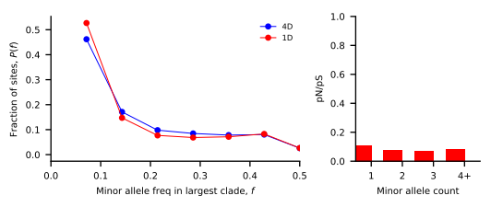
Prevotella copri
Nu_a: contemporary population relative to ancestral population before first epoch
Nu_b: contemporary population relative to ancestral population before second epoch
T_1: Duration of first epoch (units of 2 * N_a)
T_2: Duration of second epoch (units of 2 * N_a)
Model | Exponential growth | Two-epoch | Bottleneck + growth | Three-epoch
Log Likelihood | -134.75824907 | -136.939167057 | -134.758223864 | -133.877889826
Nu_a | 5.52070018 | 3.96928341 | 1.00120516 | 1.69793265
Nu_b | N/A | N/A | 5.52035461 | 4.91266537
T_12 | 0.65275521 | 0.3955718 | 0.65317188 | 0.46533747
T_23 | N/A | N/A | N/A | 0.27208794

Slide 14
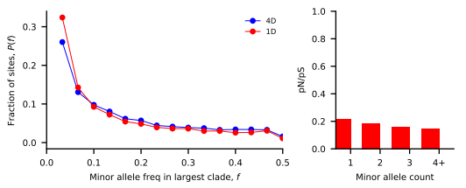
Odoribacter splanchnicus
Nu_a: contemporary population relative to ancestral population before first epoch
Nu_b: contemporary population relative to ancestral population before second epoch
T_1: Duration of first epoch (units of 2 * N_a)
T_2: Duration of second epoch (units of 2 * N_a)
Model | Exponential growth | Two-epoch | Bottleneck + growth | Three-epoch
Log Likelihood | -79.5072733364 | -78.4987541152 | -72.4113238931 | -71.7398615765
Nu_a | 1.25970836 | 1.27668903 | 2.72055134 | 2.87225645
Nu_b | N/A | N/A | 1.16513409 | 1.22885559
T_12 | 3.48244616 | 1.50769258 | 0.89676622 | 0.49102279
T_23 | N/A | N/A | N/A | 0.33065142

Slide 15
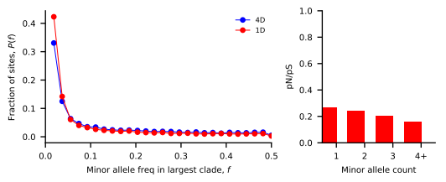
Alistipes shahii
Nu_a: contemporary population relative to ancestral population before first epoch
Nu_b: contemporary population relative to ancestral population before second epoch
T_1: Duration of first epoch (units of 2 * N_a)
T_2: Duration of second epoch (units of 2 * N_a)
Model | Exponential growth | Two-epoch | Bottleneck + growth | Three-epoch
Log Likelihood | -147.46475957 | -145.123391468 | -142.935960178
Nu_a | 5.13299045 | 3.80385035 | 0.46397566
Nu_b | N/A | N/A | 4.41839408
T_12 | 0.09838097 | 0.07048171 | 0.17523284
T_23 | N/A | N/A | N/A

Slide 16
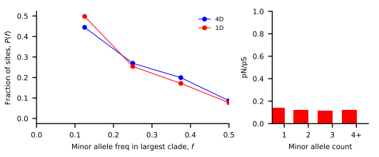
Coprococcus species
Nu_a: contemporary population relative to ancestral population before first epoch
Nu_b: contemporary population relative to ancestral population before second epoch
T_1: Duration of first epoch (units of 2 * N_a)
T_2: Duration of second epoch (units of 2 * N_a)
Model | Exponential growth | Two-epoch | Bottleneck + growth | Three-epoch
Log Likelihood | -41.8555238016 | -36.8580257978 | -32.4812368669 | -25.7139166244
Nu_a | 3.54675343 | 25.94229854 | 5.72218052 | 24.06635808
Nu_b | N/A | N/A | 1.95484218 | 4.63164974
T_12 | 4.63322821 | 28.36962305 | 1.15575146 | 4.14974652
T_23 | N/A | N/A | N/A | 1.32298356

Slide 17
//TODO

Slide 18
Standing questions
Investigate edge length distribution
Compare commensal bacteria to human demography
Compare commensal bacteria to pathogens

